Slide 1
Jolly Grammar
5a-17

Slide 2
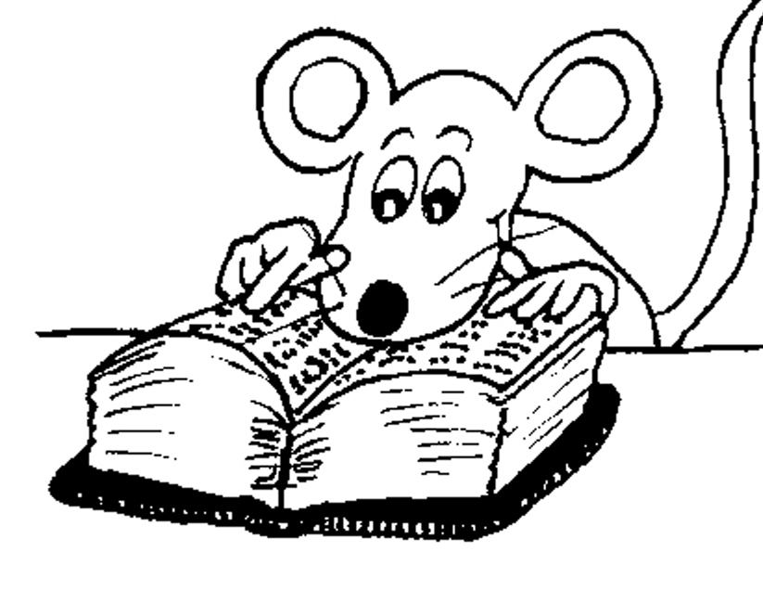
Let’s Revise
Adverbs.

Slide 3
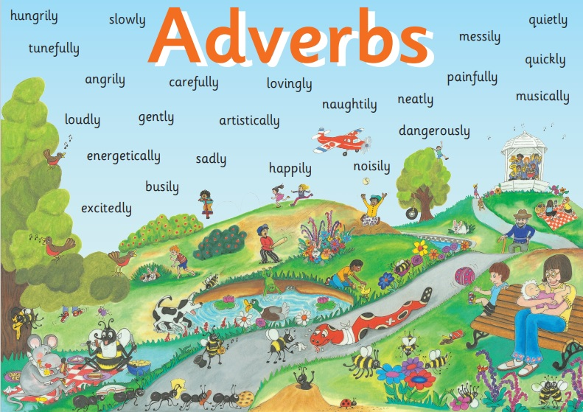

Slide 4
✔ Adverbs of Manner
The children were eating their snacks happily.
✔Adverbs of Degree and Place
The dog ran indoors.
● Adverbs of Time and Frequency
I am exercising now.
● Adverbs Describing Other Adverbs
The actor was speaking really clearly.
● Adverbs Describing Adjectives
The chairs were uncomfortably hard.

Slide 5
✔ Adverbs of Manner
The children were eating their snacks happily.
✔Adverbs of Degree and Place
The dog ran indoors.
● Adverbs of Time and Frequency
I am exercising now.
● Adverbs Describing Other Adverbs
The actor was speaking really clearly.
● Adverbs Describing Adjectives
The chairs were uncomfortably hard.

Slide 6
✔ Adverbs of Manner
The children were eating their snacks happily.
✔Adverbs of Degree and Place
The dog ran indoors.
● Adverbs of Time and Frequency
I am exercising now.
● Adverbs Describing Other Adverbs
The actor was speaking really clearly.
● Adverbs Describing Adjectives
The chairs were uncomfortably hard.

Slide 7
Activity Page
Spelling: <tious>

Slide 8
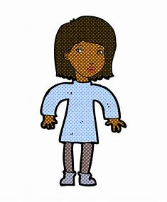
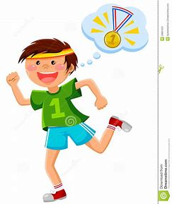
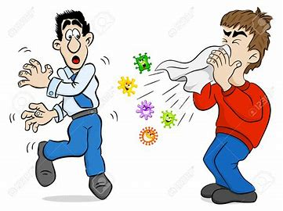
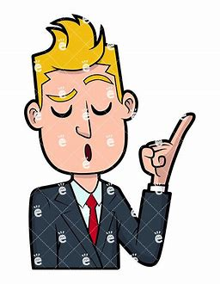
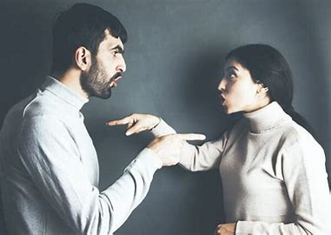
ambitious cautious incautious
infectious bumptious contentious

Slide 9
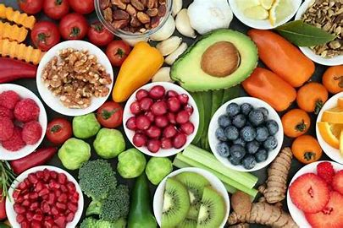
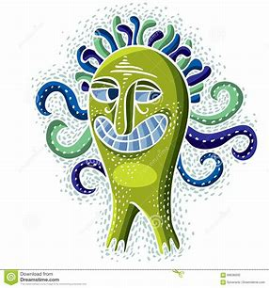
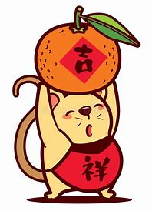
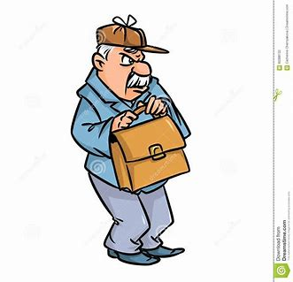
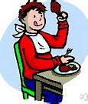
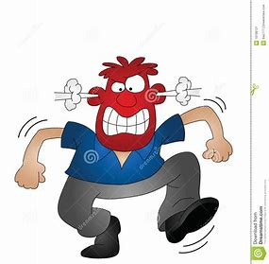
nutritious fictitious propitious
fractious surreptitious scrumptious

Slide 10
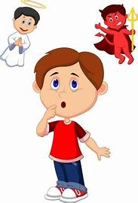
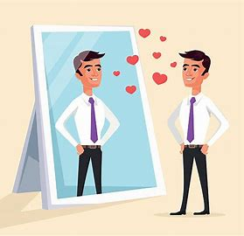
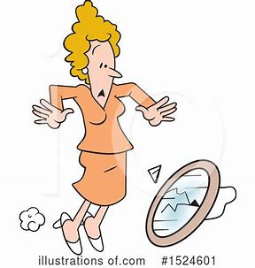
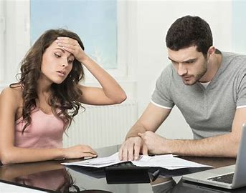
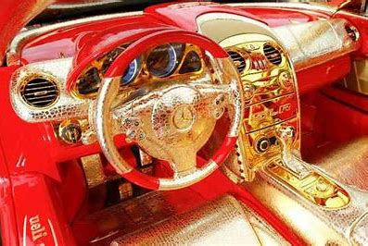
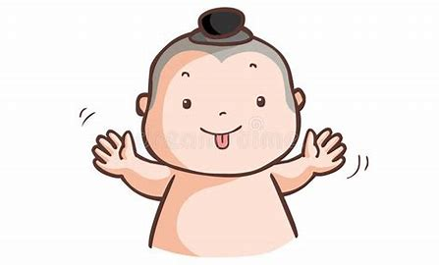
conscientious pretentious superstitious
vexatious ostentatious facetious

Slide 12
Parsing & Sentence Walls

Slide 13
The cricket umpire had unfortunately made contentious decision.
Subject
umpire
The cricket
Verb
had made
(transitive)
unfortunately
Object
decision
contentious

Slide 14
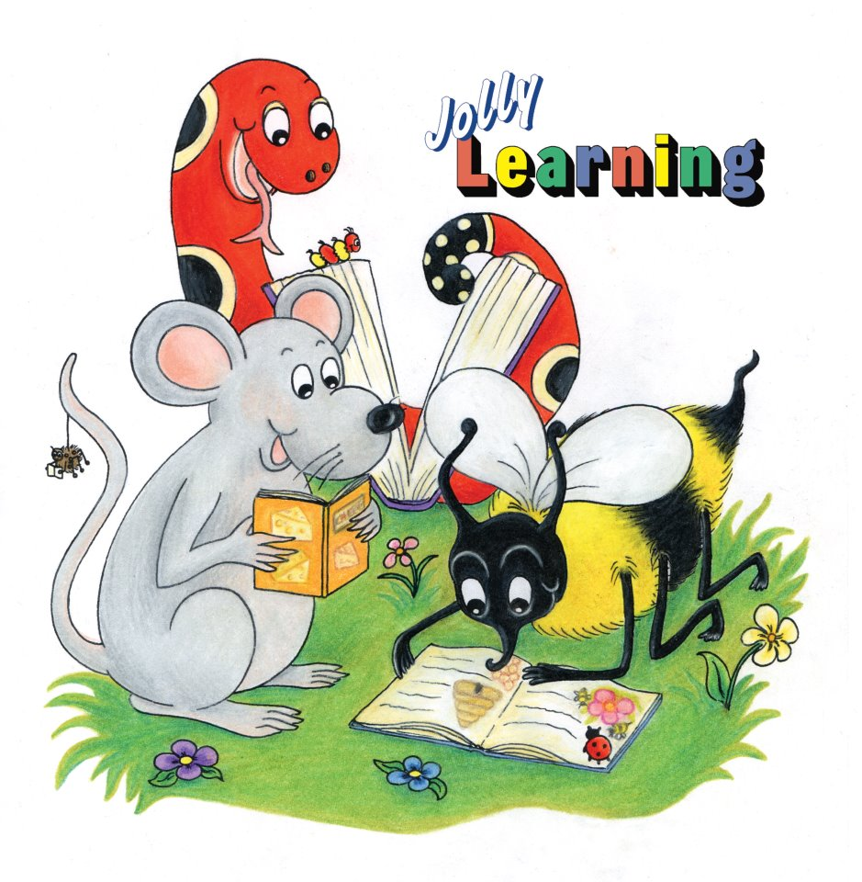
Dictation

Slide 15
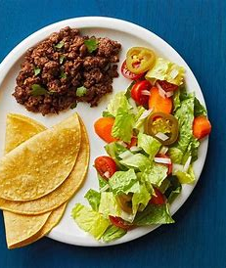

Slide 16
We enjoyed a nutritious and delicious meal.

Slide 17
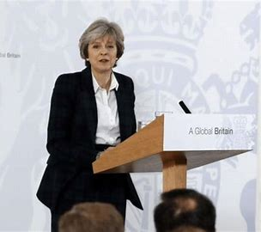

Slide 18
She was a ferociously ambitious politician.

Slide 19
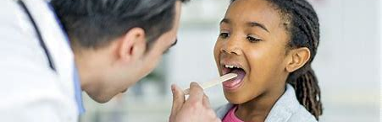

Slide 20
“The illness is infectious but not dangerous,” said the nurse.

Slide 21
See you
next time!

