Slide 1
Jolly Grammar
5b-16

Slide 2
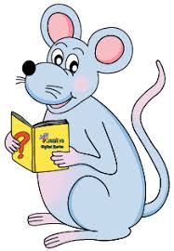
Spelling Test 26

Slide 3
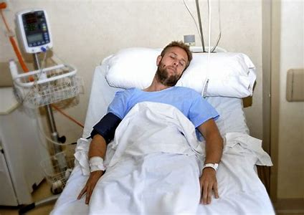
serious

Slide 4
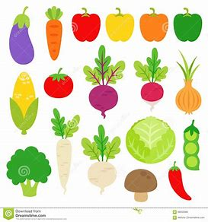
serious
various

Slide 5
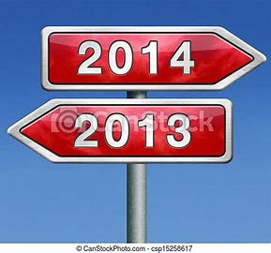
serious
various
previous

Slide 6
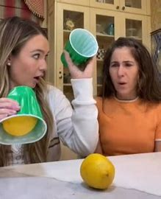
serious
various
previous
obvious

Slide 7
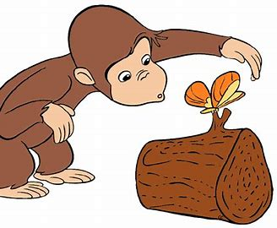
serious
various
previous
obvious
curious

Slide 8
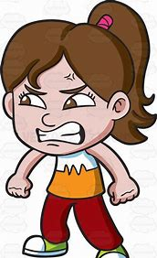
serious
various
previous
obvious
curious
furious

Slide 9
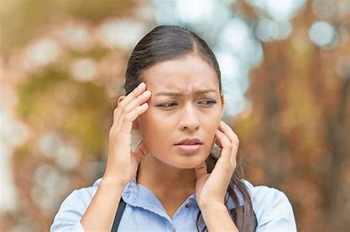
serious
various
previous
obvious
curious
furious
anxious

Slide 10
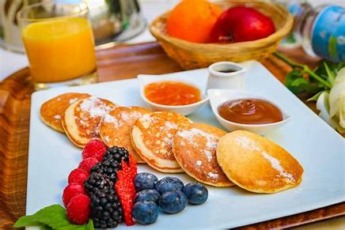
serious
various
previous
obvious
curious
furious
anxious
delicious

Slide 11
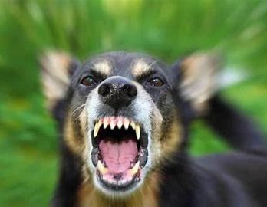
serious
various
previous
obvious
curious
furious
anxious
delicious
ferocious

Slide 12
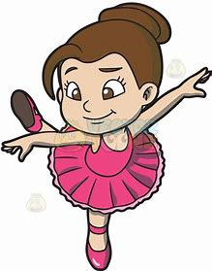
serious
various
previous
obvious
curious
furious
anxious
delicious
ferocious
10. gracious

Slide 13
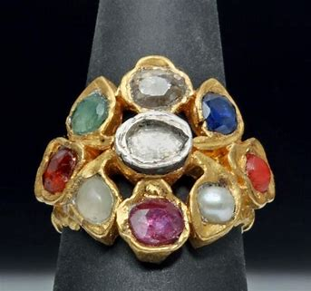
serious
various
previous
obvious
curious
furious
anxious
delicious
ferocious
10. gracious
11. precious

Slide 14
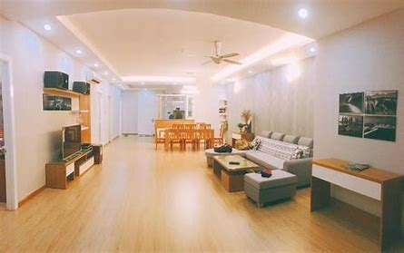
serious
various
previous
obvious
curious
furious
anxious
delicious
ferocious
10. gracious
11. precious
12. spacious

Slide 15
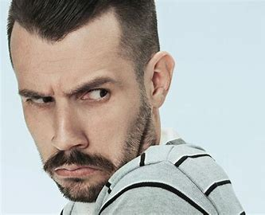
serious
various
previous
obvious
curious
furious
anxious
delicious
ferocious
10. gracious
11. precious
12. spacious
13. dubious

Slide 16
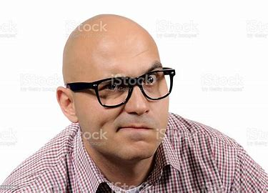
serious
various
previous
obvious
curious
furious
anxious
delicious
ferocious
10. gracious
11. precious
12. spacious
13. dubious
14. suspicious

Slide 17
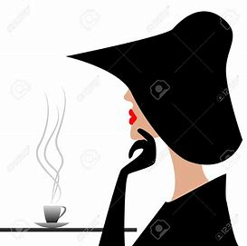
serious
various
previous
obvious
curious
furious
anxious
delicious
ferocious
10. gracious
11. precious
12. spacious
13. dubious
14. suspicious
15. mysterious

Slide 18
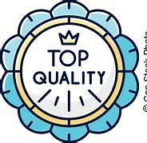
serious
various
previous
obvious
curious
furious
anxious
delicious
ferocious
10. gracious
11. precious
12. spacious
13. dubious
14. suspicious
15. mysterious
16. prestigious

Slide 19
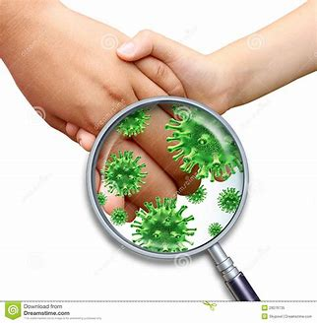
serious
various
previous
obvious
curious
furious
anxious
delicious
ferocious
10. gracious
11. precious
12. spacious
13. dubious
14. suspicious
15. mysterious
16. prestigious
17. contagious

Slide 20
serious
various
previous
obvious
curious
furious
anxious
delicious
ferocious
10. gracious
11. precious
12. spacious
13. dubious
14. suspicious
15. mysterious
16. prestigious
17. contagious
18. vicious

Slide 21
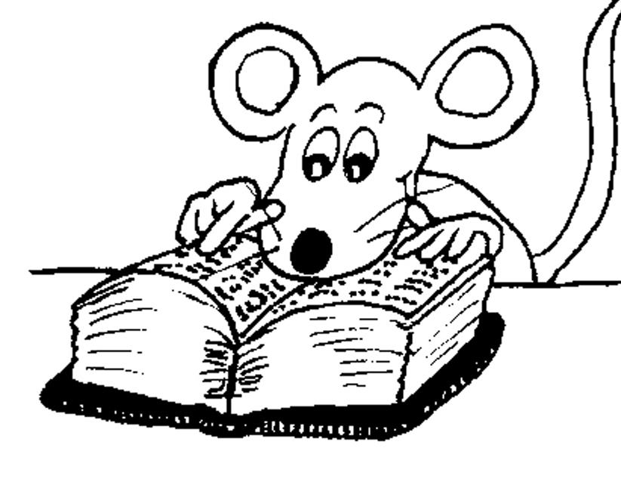
Let’s Revise
Adverbs.

Slide 22
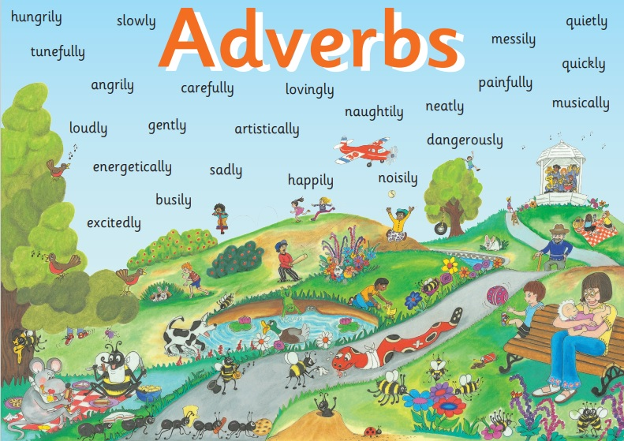

Slide 23
● Adverbs of Manner
The children were eating their snacks happily.
● Adverbs of Degree and Place
The dog ran indoors.
● Adverbs of Time and Frequency
I am exercising now.
● Adverbs Describing Other Adverbs
The actor was speaking really clearly.
● Adverbs Describing Adjectives
The chairs were uncomfortably hard.

Slide 24
● Adverbs of Degree and Place
She had almost finished her book.
I went abroad.

Slide 25
Activity Page
Adverbs of Degree and Place

Slide 26
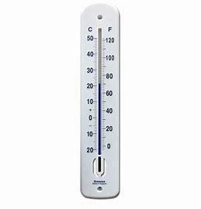
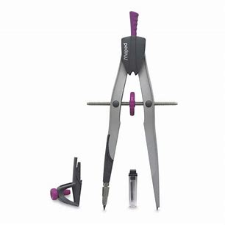
Adverbs of degree tell us more about how much, or to what extent, something is done. In the sentences below, underline the verbs in red and adverbs in orange. Then write each adverb on the line underneath.

Slide 27
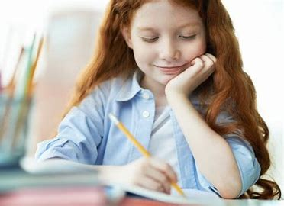
She has almost finished her homework.

Slide 28
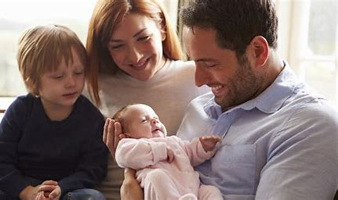
They love their children deeply.

Slide 29
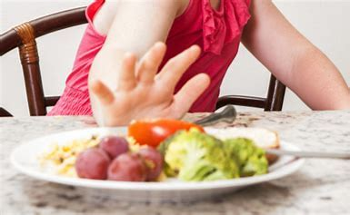
We have hardly eaten anything.

Slide 30
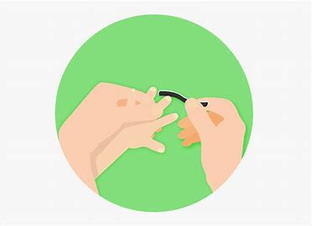
The boy nearly cut his finger.

Slide 31
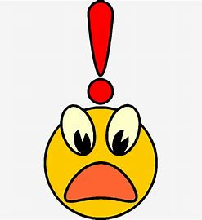
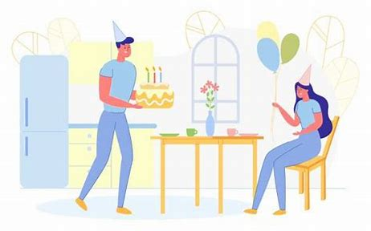
He completely forgot his wife’s birthday.

Slide 32
Adverbs of place tell us more about where something is done. In the sentences below, underline the verbs and adverbs in appropriate colors, and write each adverb on the line underneath.

Slide 33
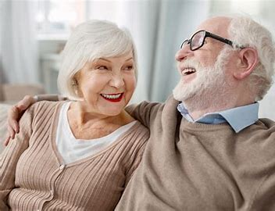
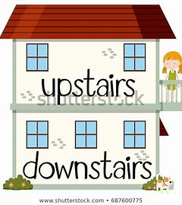
The elderly couple live downstairs.

Slide 34
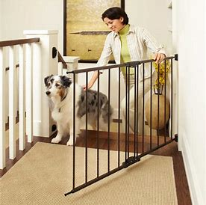
The dog ran indoors.

Slide 35
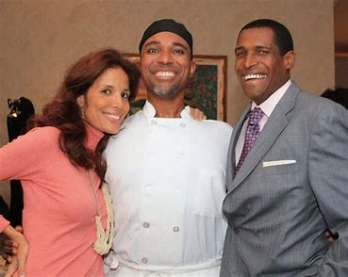
Our friends were standing nearby.

Slide 36
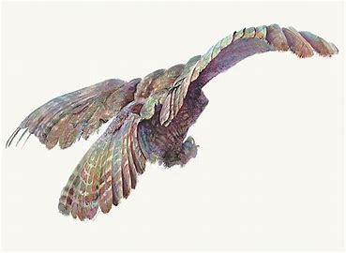
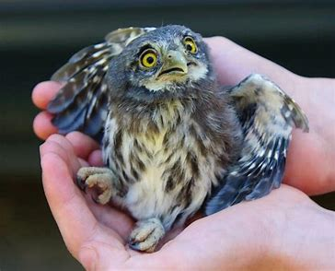
The startled bird flew away.

Slide 37
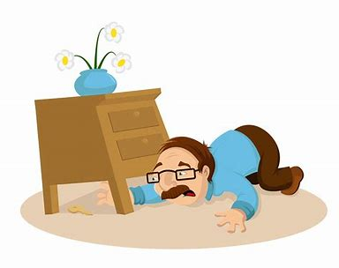
I looked everywhere for my car keys.

Slide 38
See you
next time!

