Slide 1
Jolly Grammar
5b-15

Slide 2
Let’s Revise
Adverbs.

Slide 3
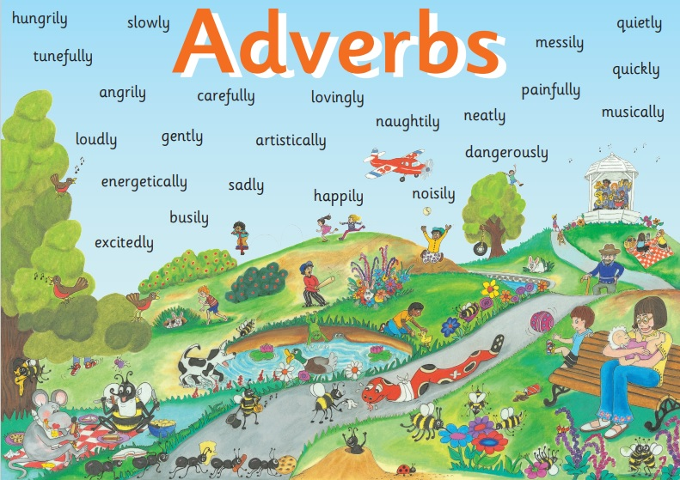

Slide 4
Activity Page
Spelling: <-ious>

Slide 5
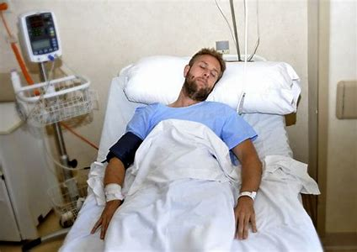
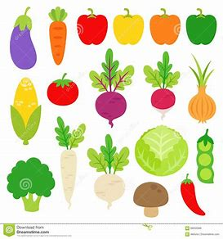
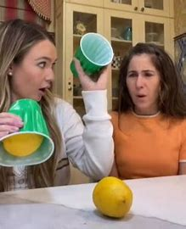
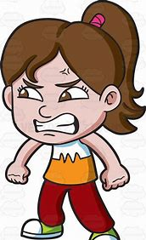
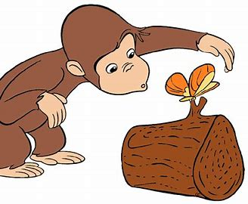
serious various previous
obvious curious furious

Slide 6
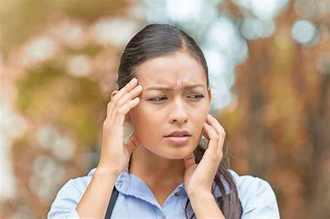
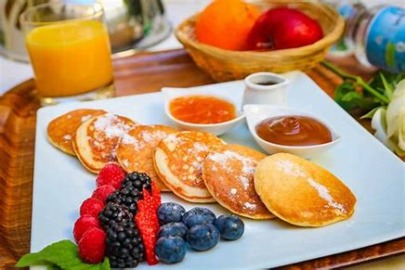
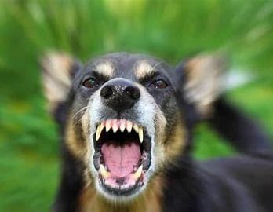
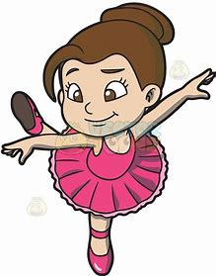
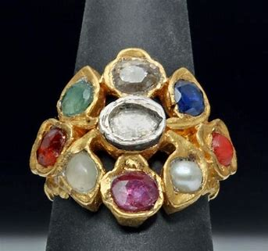
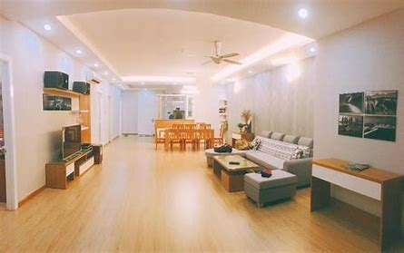
anxious delicious ferocious
gracious precious spacious

Slide 7
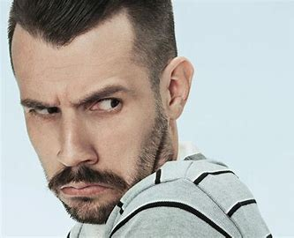
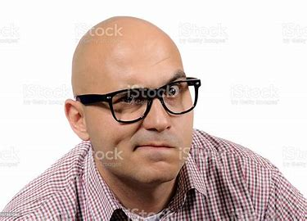
dubious suspicious mysterious
prestigious contagious vicious

Slide 10
Activity Page
Which words complete the sentences?

Slide 11
Activity Page
Which adjectives match these descriptions?

Slide 12
nervous
spacious
furious
poisonous
vigorous
dangerous
various
anxious
mysterious
disastrous
curious
hazardous
jealous
suspicious

Slide 13
Parsing & Sentence Walls

Slide 14
The fabulous chandelier has disappeared
(in suspicious circumstances).
Subject
chandelier
The fabulous
Verb
has disappeared
(in transitive)
in suspicious circumstances
Object

Slide 15
Dictation

Slide 16
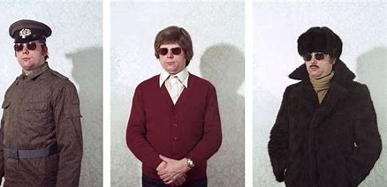

Slide 17
“There are various disguises I can use,” said the spy.

Slide 19
They were curious about the mysterious stranger.

Slide 20
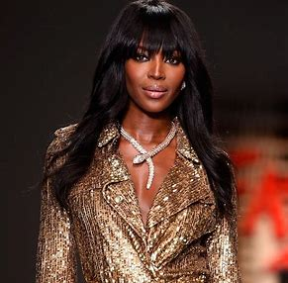

Slide 21
The supermodel wore a necklace of precious jewels.

Slide 22
See you
next time!

