Slide 1
Jolly Grammar
5b-14

Slide 2
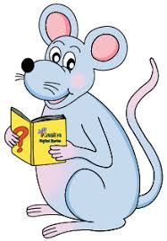
Spelling Test 25

Slide 3
famous

Slide 4
famous
nervous

Slide 5
famous
nervous
enormous

Slide 6
famous
nervous
enormous
numerous

Slide 7
famous
nervous
enormous
numerous
generous

Slide 8
famous
nervous
enormous
numerous
generous
vigorous

Slide 9
famous
nervous
enormous
numerous
generous
vigorous
dangerous

Slide 10
famous
nervous
enormous
numerous
generous
vigorous
dangerous
continuous

Slide 11
famous
nervous
enormous
numerous
generous
vigorous
dangerous
continuous
ridiculous

Slide 12
famous
nervous
enormous
numerous
generous
vigorous
dangerous
continuous
ridiculous
10. poisonous

Slide 13
famous
nervous
enormous
numerous
generous
vigorous
dangerous
continuous
ridiculous
10. poisonous
11. jealous

Slide 14
famous
nervous
enormous
numerous
generous
vigorous
dangerous
continuous
ridiculous
10. poisonous
11. jealous
12. fabulous

Slide 15
famous
nervous
enormous
numerous
generous
vigorous
dangerous
continuous
ridiculous
10. poisonous
11. jealous
12. fabulous
13. outrageous

Slide 16
famous
nervous
enormous
numerous
generous
vigorous
dangerous
continuous
ridiculous
10. poisonous
11. jealous
12. fabulous
13. outrageous
14. hazardous

Slide 17
famous
nervous
enormous
numerous
generous
vigorous
dangerous
continuous
ridiculous
10. poisonous
11. jealous
12. fabulous
13. outrageous
14. hazardous
15. disastrous

Slide 18
famous
nervous
enormous
numerous
generous
vigorous
dangerous
continuous
ridiculous
10. poisonous
11. jealous
12. fabulous
13. outrageous
14. hazardous
15. disastrous
16. spontaneous

Slide 19
famous
nervous
enormous
numerous
generous
vigorous
dangerous
continuous
ridiculous
10. poisonous
11. jealous
12. fabulous
13. outrageous
14. hazardous
15. disastrous
16. spontaneous
17. simultaneous

Slide 20
famous
nervous
enormous
numerous
generous
vigorous
dangerous
continuous
ridiculous
10. poisonous
11. jealous
12. fabulous
13. outrageous
14. hazardous
15. disastrous
16. spontaneous
17. simultaneous
18. anonymous

Slide 21
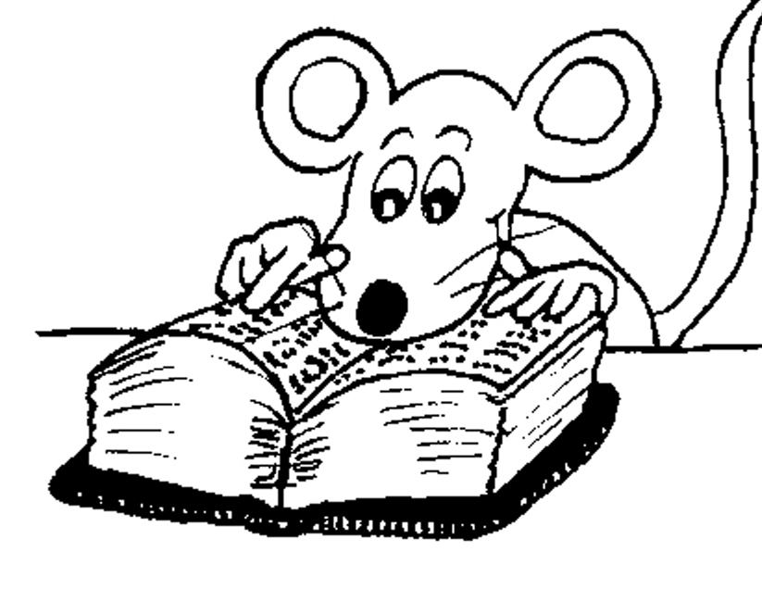
Let’s Revise
Adverbs.

Slide 22
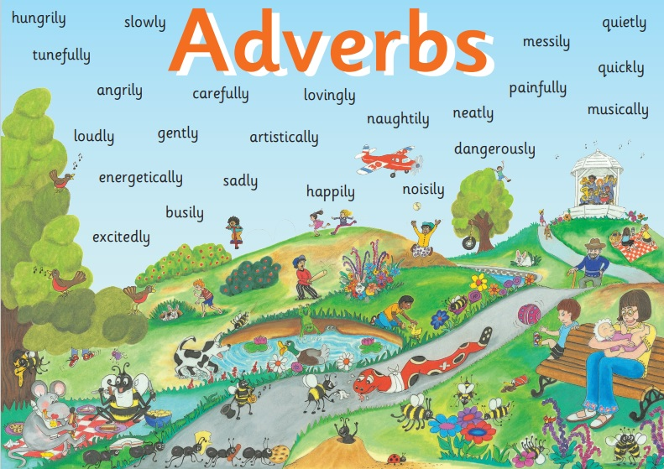

Slide 23
● Adverbs of Manner
The children were eating their snacks happily.

Slide 24
● Adverbs of Manner
The children were eating their snacks happily.
● Adverbs of Degree and Place
The dog ran indoors.

Slide 25
● Adverbs of Manner
The children were eating their snacks happily.
● Adverbs of Degree and Place
The dog ran indoors.
● Adverbs of Time and Frequency
I am exercising now.

Slide 26
● Adverbs of Manner
The children were eating their snacks happily.
● Adverbs of Degree and Place
The dog ran indoors.
● Adverbs of Time and Frequency
I am exercising now.
● Adverbs Describing Other Adverbs
The actor was speaking really clearly.

Slide 27
● Adverbs of Manner
The children were eating their snacks happily.
● Adverbs of Degree and Place
The dog ran indoors.
● Adverbs of Time and Frequency
I am exercising now.
● Adverbs Describing Other Adverbs
The actor was speaking really clearly.
● Adverbs Describing Adjectives
The chairs were uncomfortably hard.

Slide 28
Activity Page
Adverbs of Manner

Slide 29
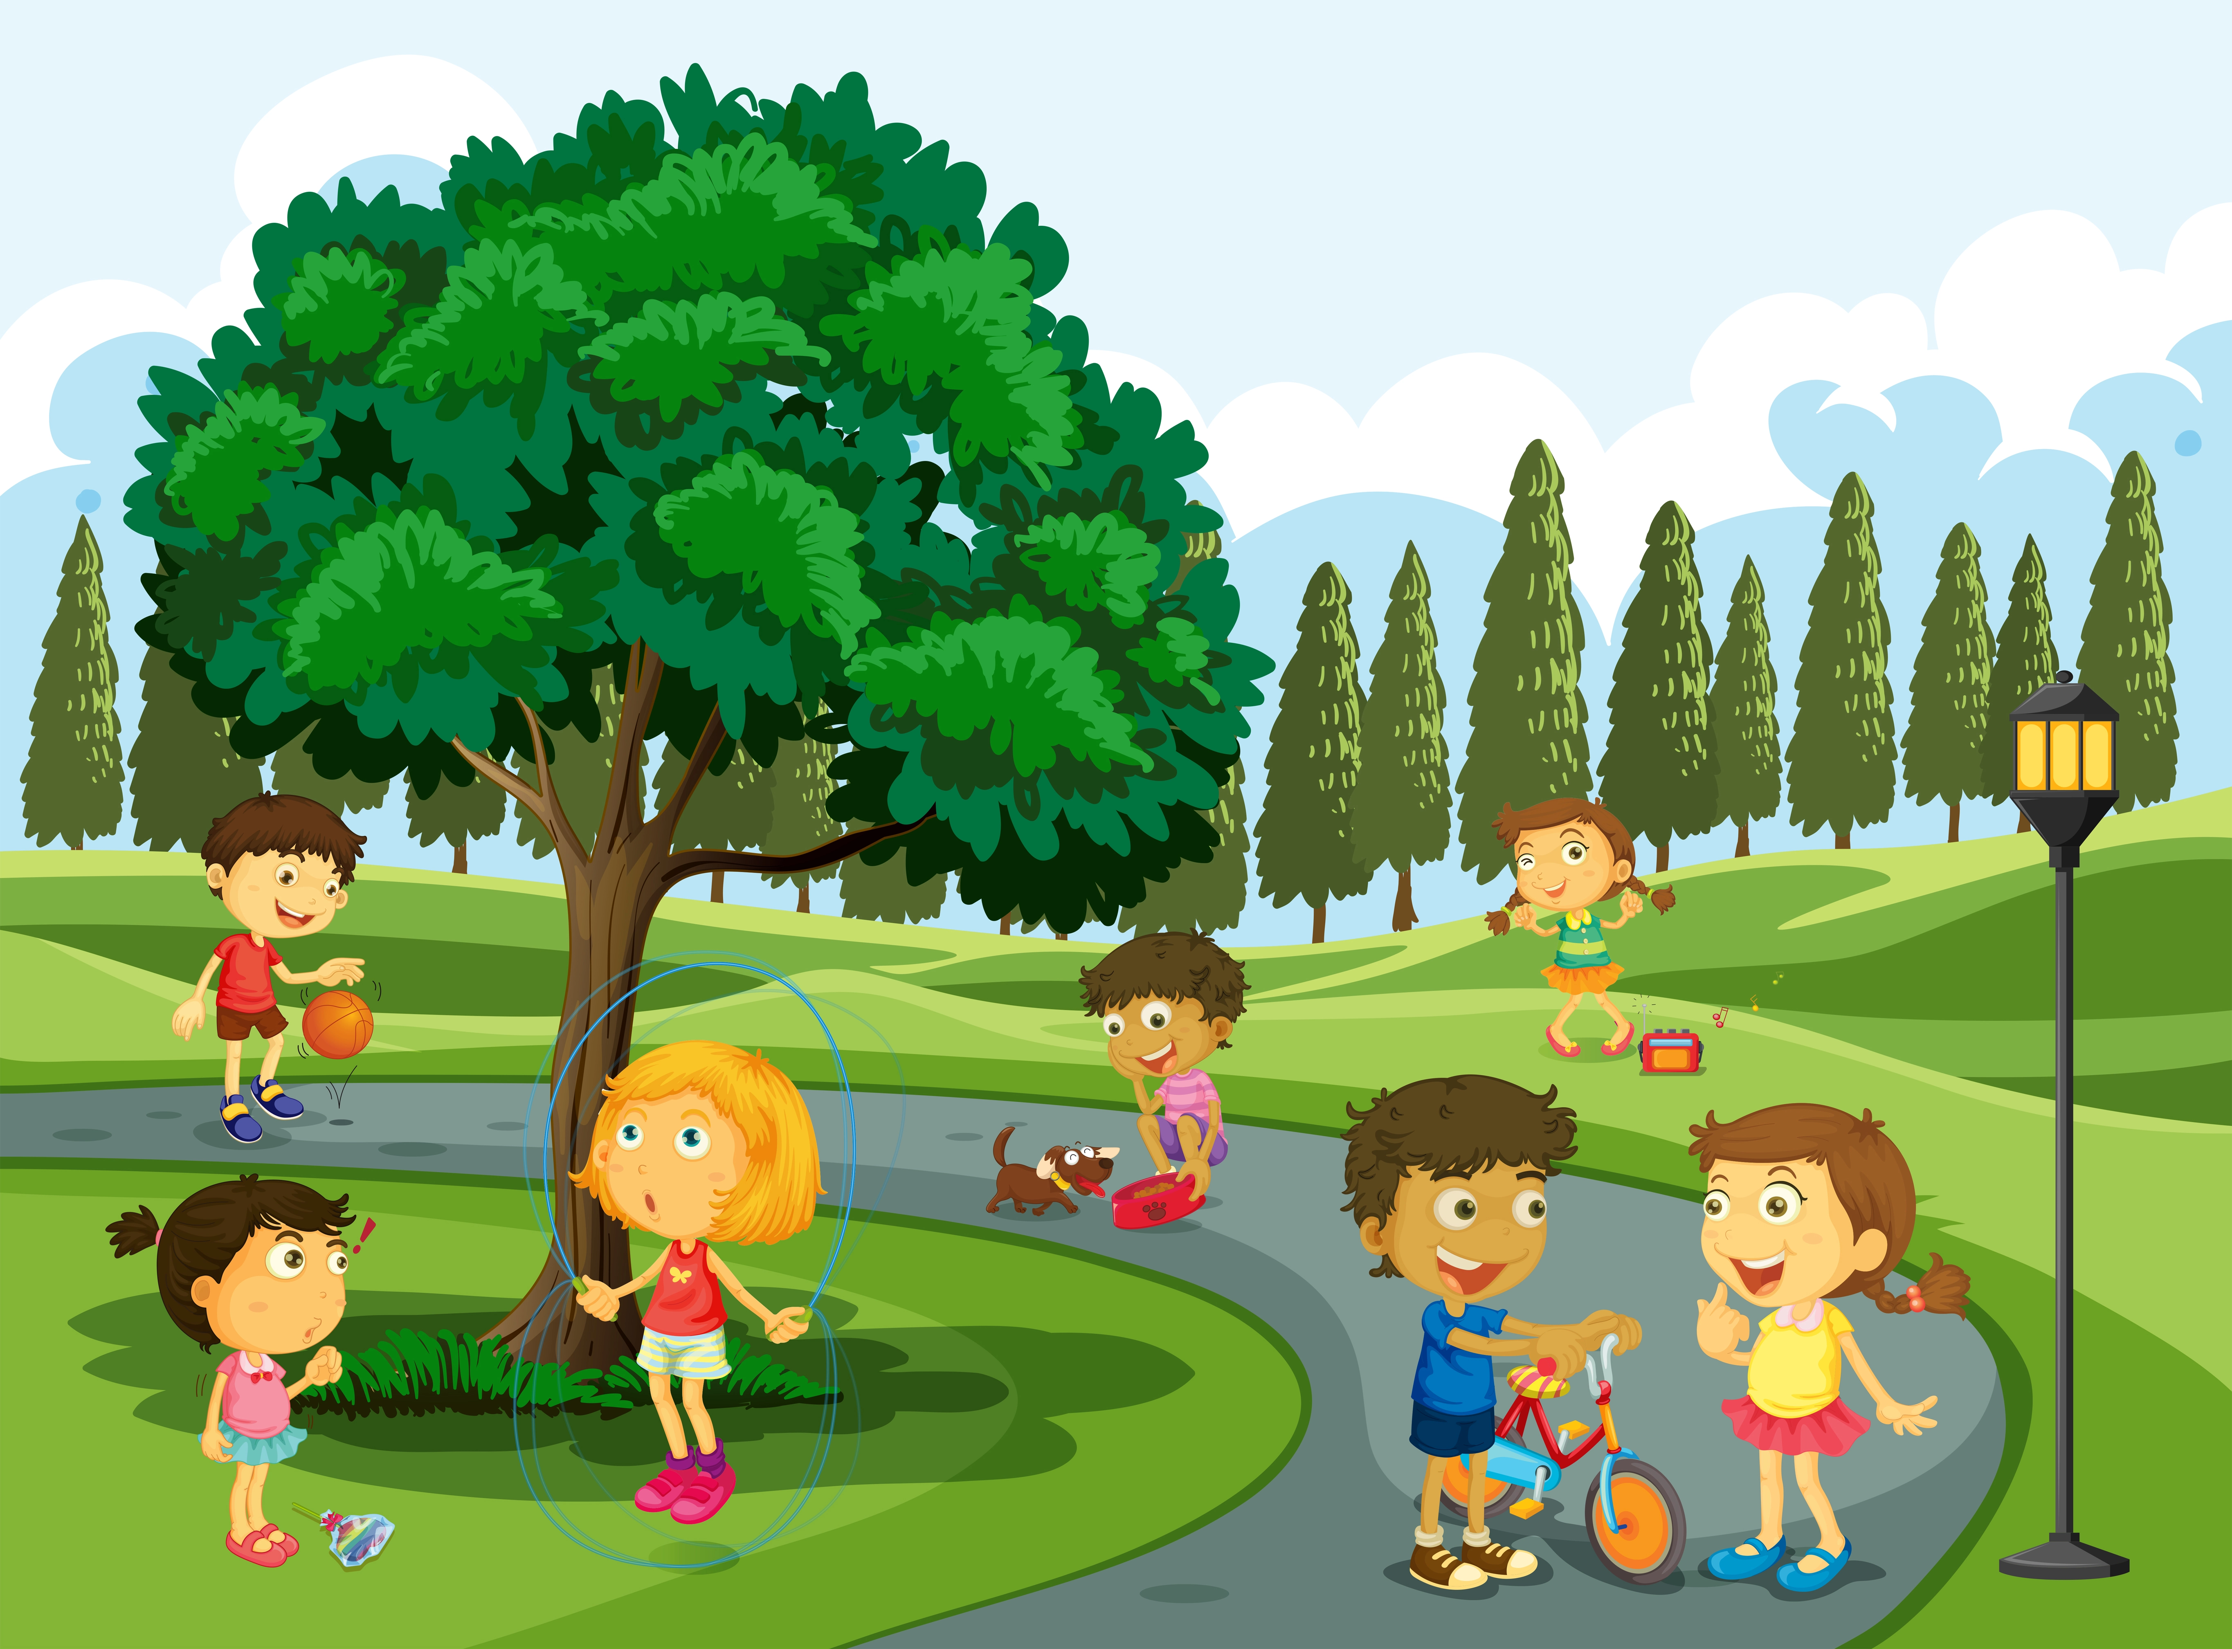
Adverbs of manner tell us more about how something is done. Complete the sentences below by adding one of the adverbs (any of them can be used), along with some more information to make it more interesting.

Slide 30
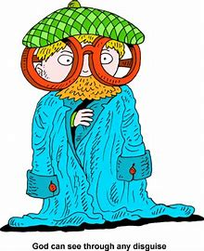
He had disguised himself badly
and hid behind the bush.

Slide 31
They asked where they can see the best view relentlessly.
politely
calmly

Slide 32
He was watching the airplane eagerly .

Slide 33
The fox crept silently .

Slide 34
I walked quickly .

Slide 35
The children were eating grubs happily .

Slide 36
See you
next time!

