Slide 1
Jolly Grammar
5b-13

Slide 2
Activity Page
The Order of Adjectives

Slide 3
The mixture.

Slide 4
The fresh, green, vegetable mixture.

Slide 5
His moustache.

Slide 6
His cool, big, yellow moustache.

Slide 7
A small, new, wooden chandelier.

Slide 8
A chandelier.

Slide 9
Gramma’s old, Australian, wooden furniture.

Slide 10
Gramma’s furniture.

Slide 11
The beautiful, big, squared, new chateau.

Slide 12
The chateau.

Slide 13
Her stylish, long signature.

Slide 14
Her signature.

Slide 15
A new, circled, purple machine.

Slide 16
A machine.

Slide 17
My small, new, golden prize.

Slide 18
My prize.

Slide 19
Activity Page
Spelling: <-ous>

Slide 20
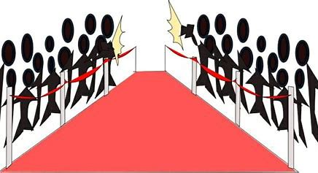
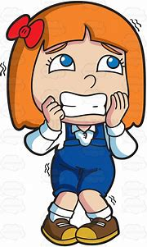
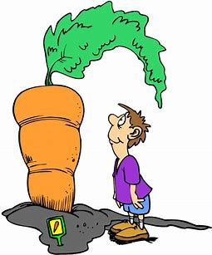
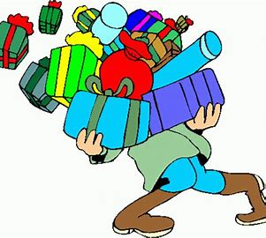
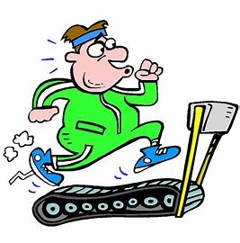
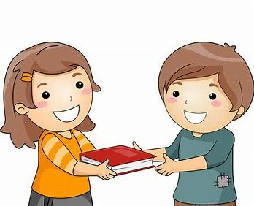
famous nervous enormous
numerous generous vigorous

Slide 21
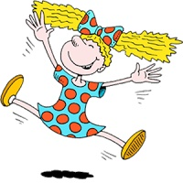
dangerous continuous ridiculous
poisonous jealous fabulous

Slide 22
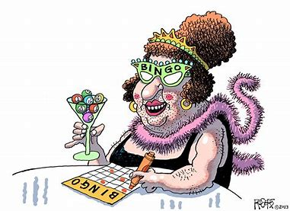
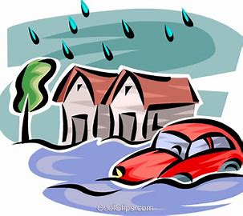
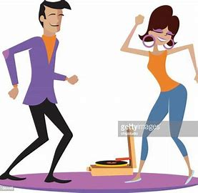
outrageous hazardous disastrous
spontaneous simultaneous anonymous

Slide 25
Activity Page
Write a sentence for each word

Slide 26
Parsing & Sentence Walls

Slide 27
The enormous turnip had grown
vigorously (over the summer).
Subject
turnip
The enormous
Verb
had grown
(intransitive)
vigorously
(over the summer)
Object

Slide 28
Dictation

Slide 29
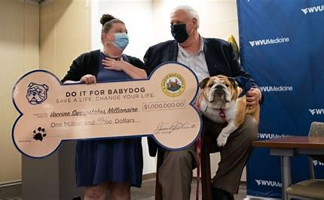

Slide 30
The multimillionaire gave a generous gift to the local hospital.

Slide 32
“Everything will be fine,” he reassured the nervous passenger.

Slide 33
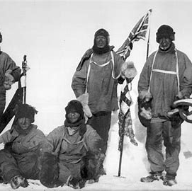

Slide 34
The explores made a hazardous journey in freezing temperatures.

Slide 35
See you
next time!

