Slide 1
Jolly Grammar
5b-12

Slide 2
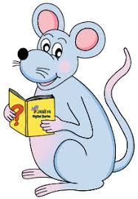
Spelling Test 24

Slide 3
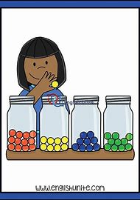
classify

Slide 4
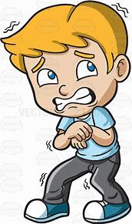
classify
terrify

Slide 5
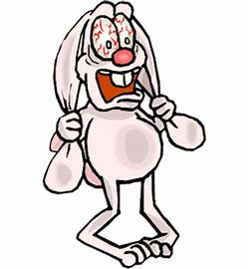
classify
terrify
horrify

Slide 6
classify
terrify
horrify
glorify

Slide 7
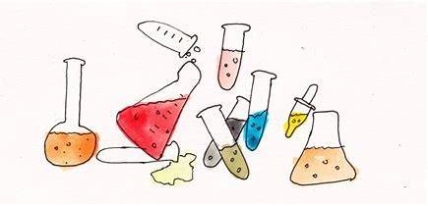
classify
terrify
horrify
glorify
solidify

Slide 8
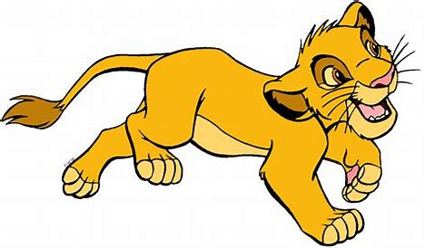
classify
terrify
horrify
glorify
solidify
personify

Slide 9
classify
terrify
horrify
glorify
solidify
personify
falsify

Slide 10
classify
terrify
horrify
glorify
solidify
personify
falsify
identify

Slide 11
classify
terrify
horrify
glorify
solidify
personify
falsify
identify
typify

Slide 12
classify
terrify
horrify
glorify
solidify
personify
falsify
identify
typify
10. simplify

Slide 13
classify
terrify
horrify
glorify
solidify
personify
falsify
identify
typify
10. simplify
11. signify

Slide 14
classify
terrify
horrify
glorify
solidify
personify
falsify
identify
typify
10. simplify
11. signify
12. magnify

Slide 15
classify
terrify
horrify
glorify
solidify
personify
falsify
identify
typify
10. simplify
11. signify
12. magnify
13. intensify

Slide 16
classify
terrify
horrify
glorify
solidify
personify
falsify
identify
typify
10. simplify
11. signify
12. magnify
13. intensify
14. mystify

Slide 17
classify
terrify
horrify
glorify
solidify
personify
falsify
identify
typify
10. simplify
11. signify
12. magnify
13. intensify
14. mystify
15. diversify

Slide 18
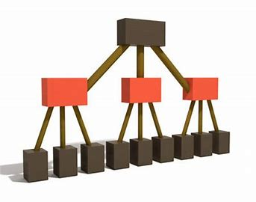
classify
terrify
horrify
glorify
solidify
personify
falsify
identify
typify
10. simplify
11. signify
12. magnify
13. intensify
14. mystify
15. diversify
16. specify

Slide 19
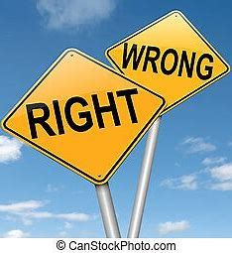
classify
terrify
horrify
glorify
solidify
personify
falsify
identify
typify
10. simplify
11. signify
12. magnify
13. intensify
14. mystify
15. diversify
16. specify
17. justify

Slide 20
classify
terrify
horrify
glorify
solidify
personify
falsify
identify
typify
10. simplify
11. signify
12. magnify
13. intensify
14. mystify
15. diversify
16. specify
17. justify
18. clarify

Slide 21
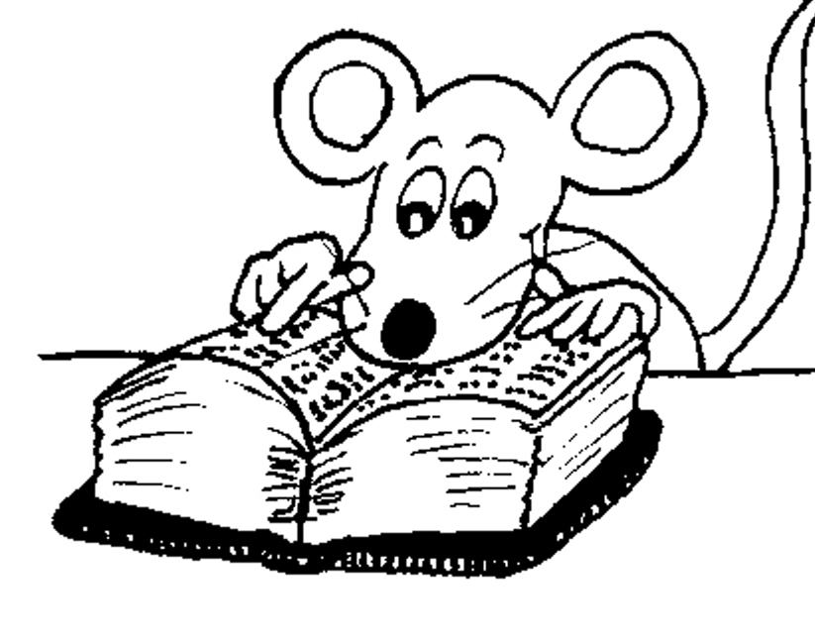
Let’s Revise
The Order of Adjectives.

Slide 22
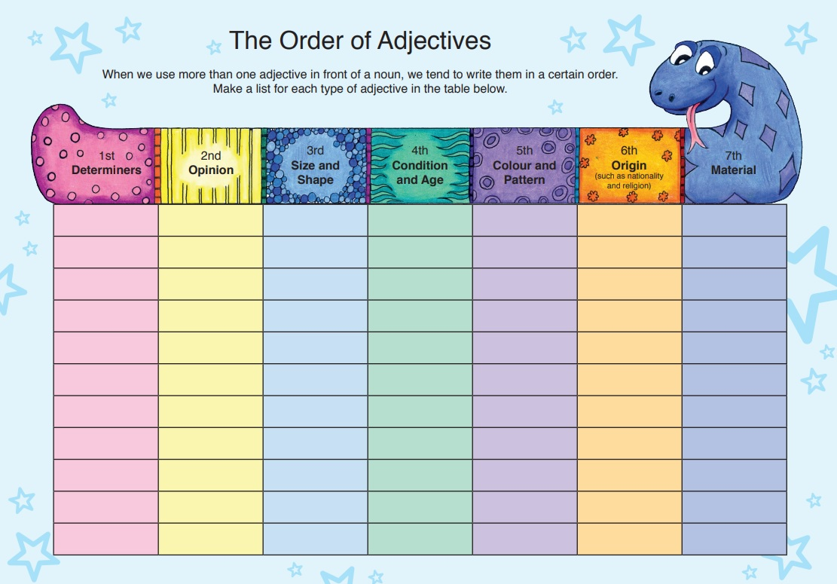

Slide 23
1st Determiners | 2nd Opinion | 3rd Size & Shape | 4th Condition & Age | 5th Colour and Pattern | 6th Origin | 7th Material
a | beautiful | big | old | red | Scottish | wooden
an | ugly | little | young | yellow | Chinese | silky
the | terrifying | heavy | new | blue | Indian | metallic
these | tasty | wide | antique | striped | Russian | furry
this | lovely | tall | clean | spotty | Japanese
some | interesting | deep | dirty | checked
one | boring | long | wet | flowery
those |  | enormous | dry
two |  | round

Slide 24
Activity Page
The order of Adjectives 2

Slide 25
Are these noun phrases correct? If not, rewrite them, putting the adjectives in a better order.

Slide 26
the English beautiful old mansion

Slide 27
the English beautiful old mansion
the beautiful old English mansion

Slide 28
some cardboard brown large dented boxes

Slide 29
some cardboard brown large dented boxes
some large dented brown cardboard boxes

Slide 30
his striped new silk handsome tie

Slide 31
his striped new silk handsome tie
his handsome new striped silk tie

Slide 32
three strange tall ancient stone megaliths

Slide 33
three strange tall ancient stone megaliths
three strange tall ancient stone megaliths

Slide 34
Think of some adjectives to describe each noun below and put them into a noun phrase. Remember to put the adjectives
in the correct order.

Slide 35
・parachute
the big new striped parachute

Slide 36
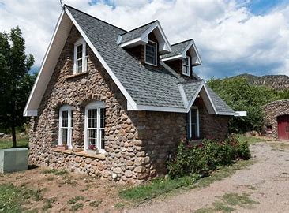
・cottage
my beautiful old stone cottage

Slide 37
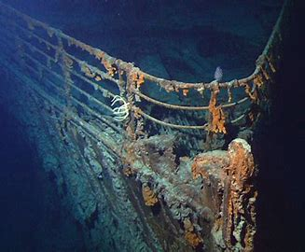
・wreckage
the big rusty old American wreckage

Slide 38
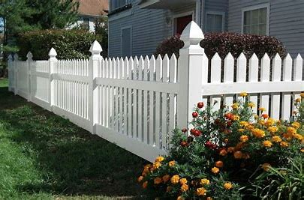
・fence
the beautiful new white fence

Slide 39
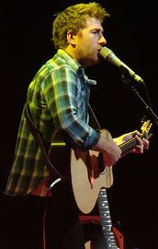
・musician
the famous dirty tall young American musician in green

Slide 40
See you
next time!

