Slide 1
Jolly Grammar
5b-11

Slide 2
Let’s review
spellings.

Slide 3
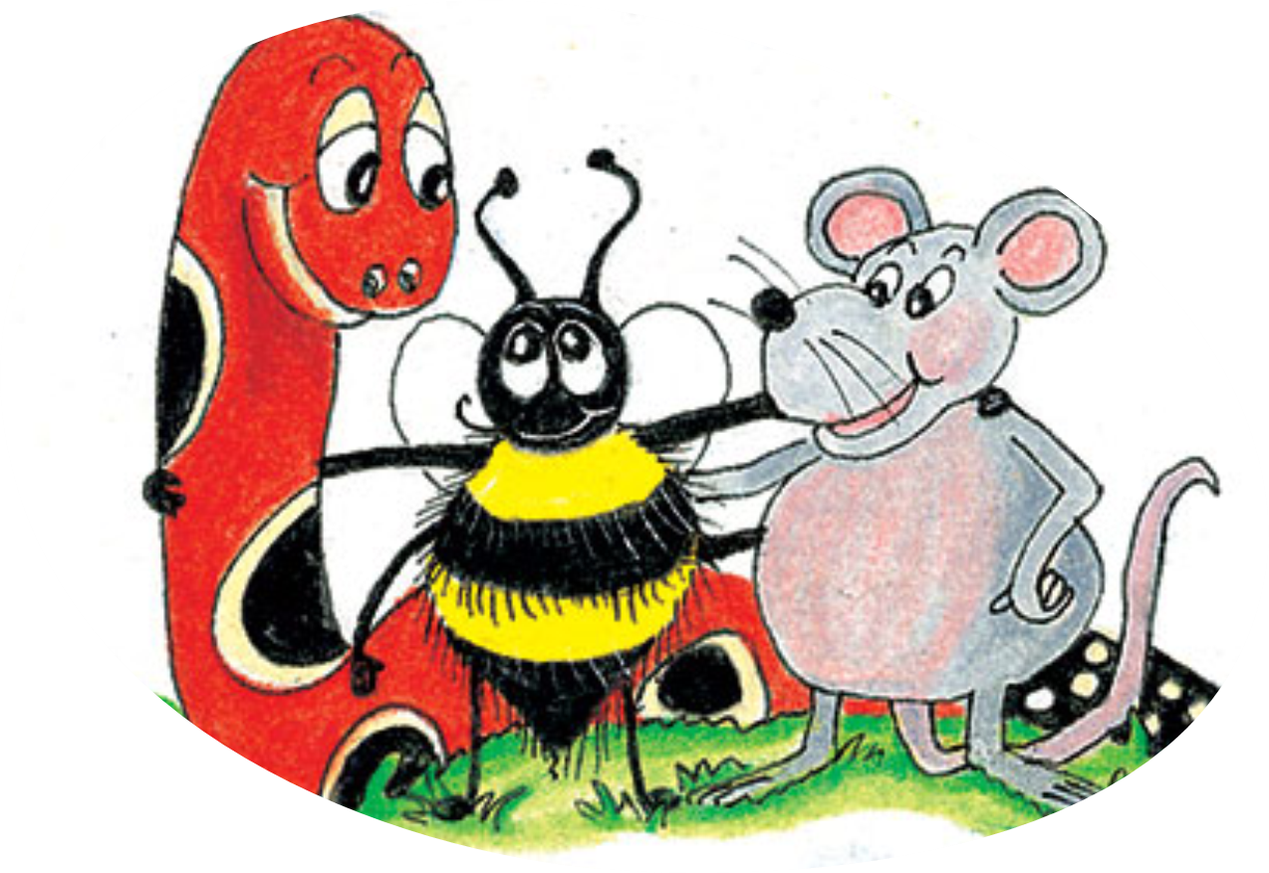
hibernate
horrify
capsize
vaccinate
simplify
surprise

Slide 4
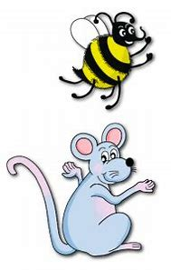
Spelling Point
<-ify>

Slide 6
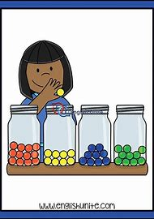
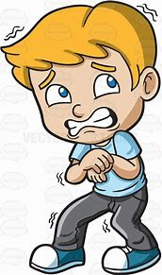
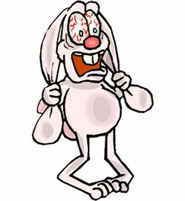
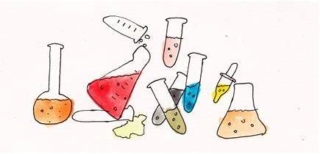
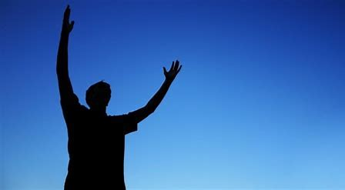
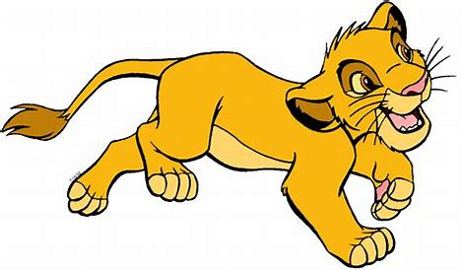
classify terrify horrify
glorify solidify personify

Slide 7
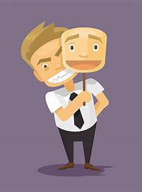
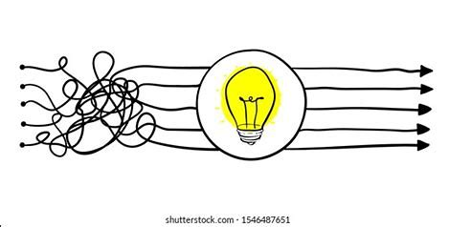
falsify identify typify
simplify signify magnify

Slide 8
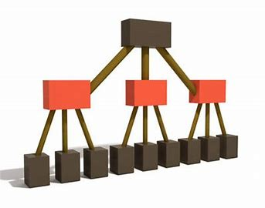
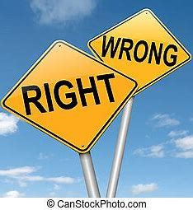
intensify mystify diversity
specify justify clarify

Slide 10
was qualifying
were qualifying
was qualifying
were qualifying
were qualifying
were qualifying
shall/will be qualifying
will be qualifying
will be qualifying
shall/will be qualifying
will be qualifying
will be qualifying
am qualifying
are qualifying
is qualifying
are qualifying
are qualifying
are qualifying

Slide 11
had qualified
had qualified
had qualified
had qualified
had qualified
had qualified
have qualified
have qualified
has qualified
have qualified
have qualified
have qualified
shall/will have qualified
will have qualified
will have qualified
shall/will have qualified
will have qualified
will have qualified

Slide 12
Nouns
person
sign
class
horror
type
glory
Verbs
terrify
clarify
justify
mystify
identify
magnify
Adjectives
simple
intense
false
solid
diverse
specific

Slide 14
Activity Page:
Spelling
<-ify>

Slide 15
Write the root nouns, adjectives, and verbs

Slide 16
Conjugation
‘qualify’

Slide 17
Parsing & Sentence Walls

Slide 18
The scary story terrified my brother and sister (at bedtime).
Subject
story
The scary
Verb
terrified
(transitive)
at bedtime
Object
brother/
sister
my

Slide 19
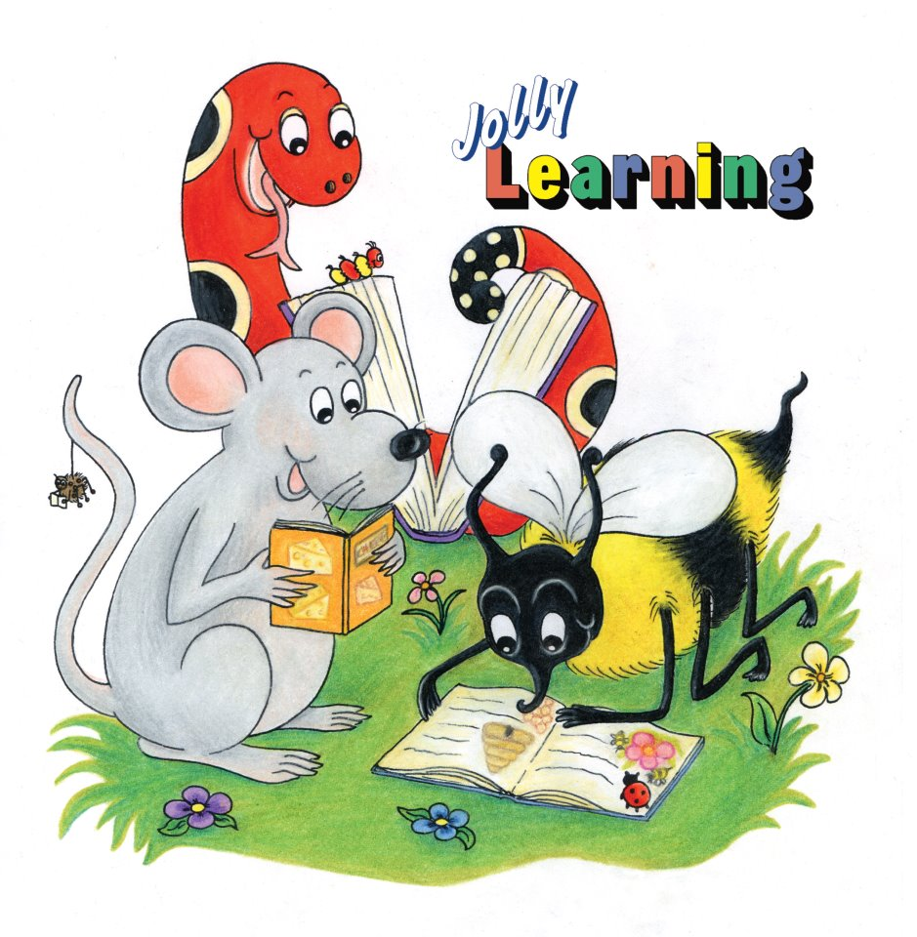
Dictation

Slide 20
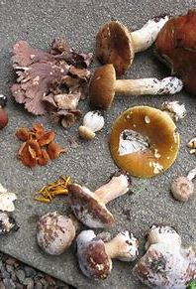

Slide 21
Please specify which mushrooms are edible.

Slide 23
Pam hopes to qualify as a beautician in the future.

Slide 24
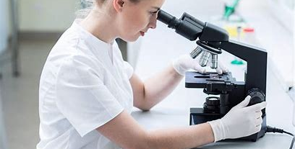
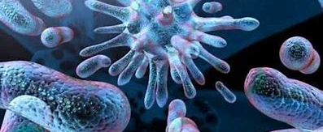

Slide 25
“We magnify microbes with a microscope,” explained the technician.

Slide 26
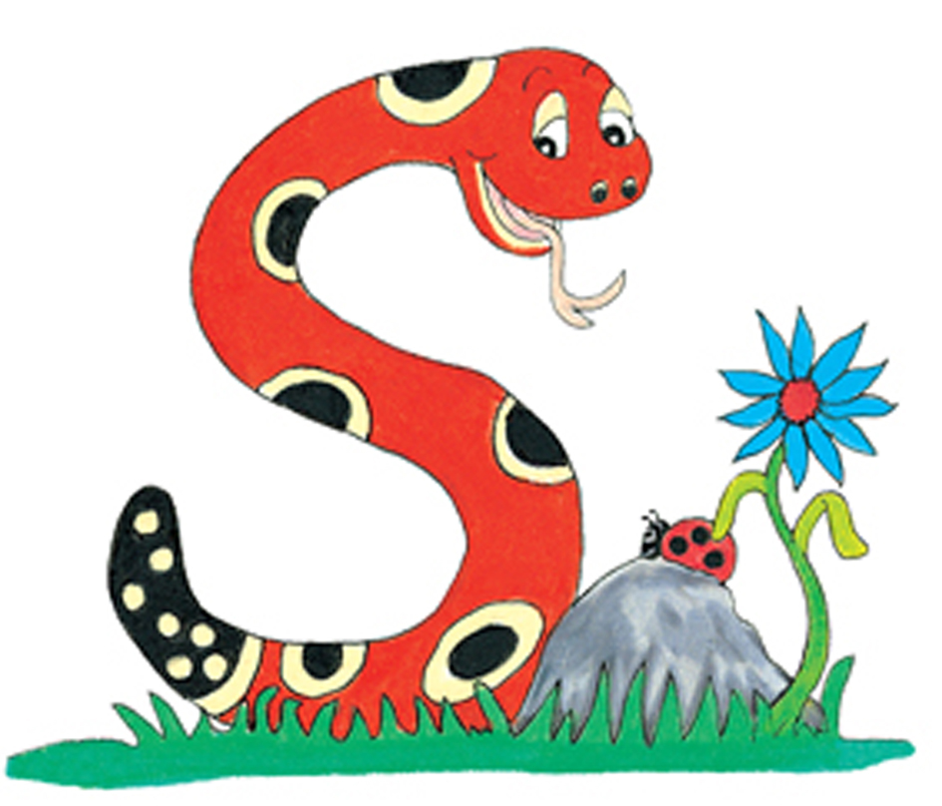
Thank you.
See you
next time!

