Slide 1
Jolly Grammar
5b-10

Slide 2
Spelling Test 23

Slide 3
prize

Slide 4
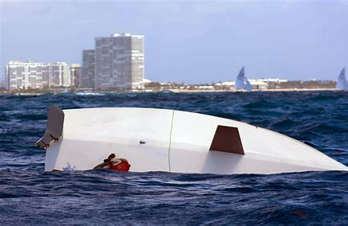
prize
capsize

Slide 5
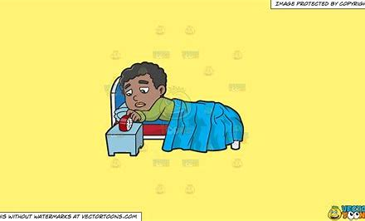
prize
capsize
arise

Slide 6
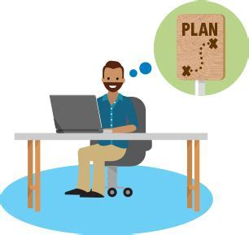
prize
capsize
arise
devise

Slide 7
prize
capsize
arise
devise
advise

Slide 8
prize
capsize
arise
devise
advise
revise

Slide 9
prize
capsize
arise
devise
advise
revise
advertise

Slide 10
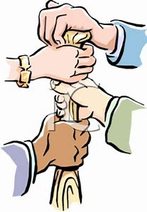
prize
capsize
arise
devise
advise
revise
advertise
comprise

Slide 11
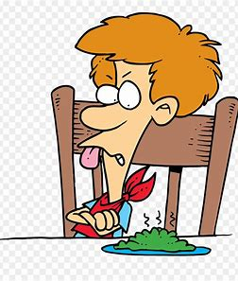
prize
capsize
arise
devise
advise
revise
advertise
comprise
despise

Slide 12
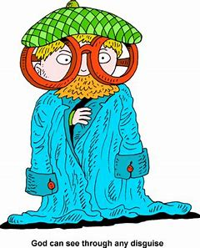
prize
capsize
arise
devise
advise
revise
advertise
comprise
despise
10. disguise

Slide 13
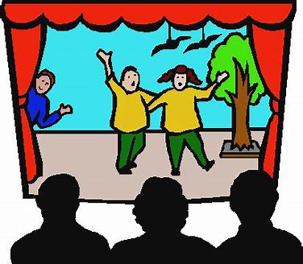
prize
capsize
arise
devise
advise
revise
advertise
comprise
despise
10. disguise
11. improvise

Slide 14
prize
capsize
arise
devise
advise
revise
advertise
comprise
despise
10. disguise
11. improvise
12. surmise

Slide 15
prize
capsize
arise
devise
advise
revise
advertise
comprise
despise
10. disguise
11. improvise
12. surmise
13. surprise

Slide 16
prize
capsize
arise
devise
advise
revise
advertise
comprise
despise
10. disguise
11. improvise
12. surmise
13. surprise
14. televise

Slide 17
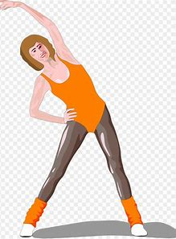
prize
capsize
arise
devise
advise
revise
advertise
comprise
despise
10. disguise
11. improvise
12. surmise
13. surprise
14. televise
15. exercise

Slide 18
prize
capsize
arise
devise
advise
revise
advertise
comprise
despise
10. disguise
11. improvise
12. surmise
13. surprise
14. televise
15. exercise
16. compromise

Slide 19
prize
capsize
arise
devise
advise
revise
advertise
comprise
despise
10. disguise
11. improvise
12. surmise
13. surprise
14. televise
15. exercise
16. compromise
17. enfranchise

Slide 20
prize
capsize
arise
devise
advise
revise
advertise
comprise
despise
10. disguise
11. improvise
12. surmise
13. surprise
14. televise
15. exercise
16. compromise
17. enfranchise
18. disenfranchise

Slide 21
Let’s Review
Adjectives.

Slide 22
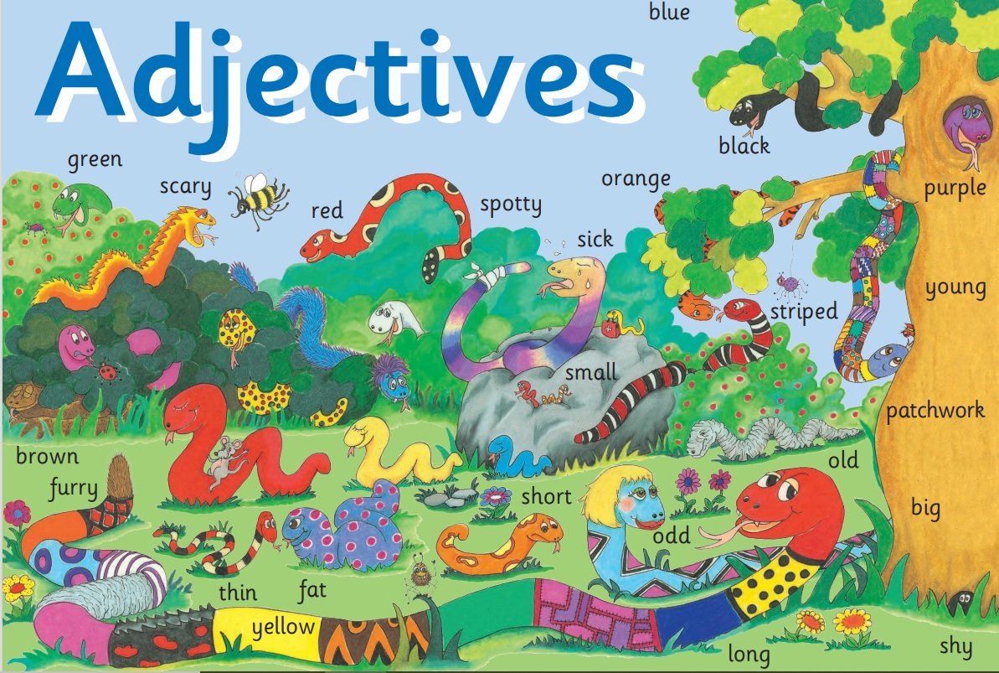

Slide 23
The car is blue.
She is happy.
I fed my cat.
We put up our umbrellas.
He is taller than his brother.

Slide 24
the little old Chinese lady

Slide 25
the little old Chinese lady
the Chinese old little lady

Slide 26
Activity Page
The order of
Adjectives (1)

Slide 27
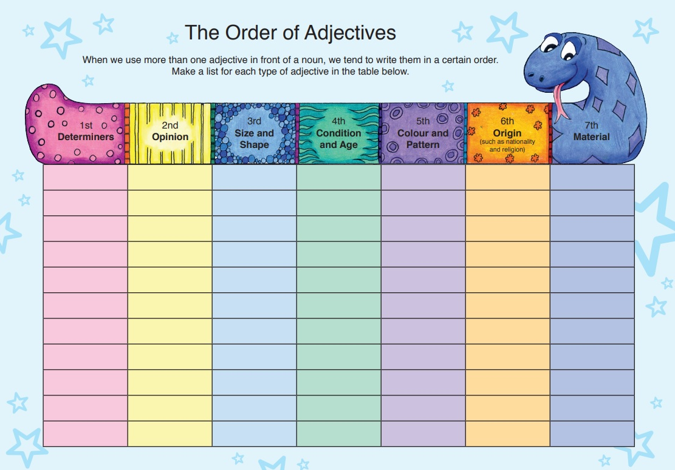

Slide 28
1st Determiners | 2nd Opinion | 3rd Size & Shape | 4th Condition & Age | 5th Colour and Pattern | 6th Origin | 7th Material
a

Slide 29
1st Determiners | 2nd Opinion | 3rd Size & Shape | 4th Condition & Age | 5th Colour and Pattern | 6th Origin | 7th Material
a
an
the
these
this
some
one
those
two

Slide 30
1st Determiners | 2nd Opinion | 3rd Size & Shape | 4th Condition & Age | 5th Colour and Pattern | 6th Origin | 7th Material
a | beautiful
an
the
these
this
some
one
those
two

Slide 31
1st Determiners | 2nd Opinion | 3rd Size & Shape | 4th Condition & Age | 5th Colour and Pattern | 6th Origin | 7th Material
a | beautiful
an | ugly
the | terrifying
these | tasty
this | lovely
some | interesting
one | boring
those | Pretty
two | fluffy

Slide 32
1st Determiners | 2nd Opinion | 3rd Size & Shape | 4th Condition & Age | 5th Colour and Pattern | 6th Origin | 7th Material
a | beautiful | big
an | ugly
the | terrifying
these | tasty
this | lovely
some | interesting
one | boring
those
two

Slide 33
1st Determiners | 2nd Opinion | 3rd Size & Shape | 4th Condition & Age | 5th Colour and Pattern | 6th Origin | 7th Material
a | beautiful | big
an | ugly | little
the | terrifying | heavy
these | tasty | wide
this | lovely | tall
some | interesting | deep
one | boring | long
those |  | enormous
two |  | round

Slide 34
1st Determiners | 2nd Opinion | 3rd Size & Shape | 4th Condition & Age | 5th Colour and Pattern | 6th Origin | 7th Material
a | beautiful | big | old
an | ugly | little | young
the | terrifying | heavy | new
these | tasty | wide | antique
this | lovely | tall | clean
some | interesting | deep | dirty
one | boring | long | wet
those |  | enormous | dry
two |  | round | opaque

Slide 35
1st Determiners | 2nd Opinion | 3rd Size & Shape | 4th Condition & Age | 5th Colour and Pattern | 6th Origin | 7th Material
a | beautiful | big | old | red
an | ugly | little | young
the | terrifying | heavy | new
these | tasty | wide | antique
this | lovely | tall | clean
some | interesting | deep | dirty
one | boring | long | wet
those |  | enormous | dry
two |  | round

Slide 36
1st Determiners | 2nd Opinion | 3rd Size & Shape | 4th Condition & Age | 5th Colour and Pattern | 6th Origin | 7th Material
a | beautiful | big | old | red
an | ugly | little | young | yellow
the | terrifying | heavy | new | blue
these | tasty | wide | antique | striped
this | lovely | tall | clean | spotty
some | interesting | deep | dirty | checked
one | boring | long | wet | flowery
those |  | enormous | dry | bordered
two |  | round

Slide 37
1st Determiners | 2nd Opinion | 3rd Size & Shape | 4th Condition & Age | 5th Colour and Pattern | 6th Origin | 7th Material
a | beautiful | big | old | red | Scottish
an | ugly | little | young | yellow
the | terrifying | heavy | new | blue
these | tasty | wide | antique | striped
this | lovely | tall | clean | spotty
some | interesting | deep | dirty | checked
one | boring | long | wet | flowery
those |  | enormous | dry
two |  | round

Slide 38
1st Determiners | 2nd Opinion | 3rd Size & Shape | 4th Condition & Age | 5th Colour and Pattern | 6th Origin | 7th Material
a | beautiful | big | old | red | Scottish
an | ugly | little | young | yellow | Chinese
the | terrifying | heavy | new | blue | Indian
these | tasty | wide | antique | striped | Russian
this | lovely | tall | clean | spotty | Japanese
some | interesting | deep | dirty | checked | Spanish
one | boring | long | wet | flowery | Korean
those |  | enormous | dry |  | American
two |  | round |  |  | Swiss

Slide 39
1st Determiners | 2nd Opinion | 3rd Size & Shape | 4th Condition & Age | 5th Colour and Pattern | 6th Origin | 7th Material
a | beautiful | big | old | red | Scottish | wooden
an | ugly | little | young | yellow | Chinese
the | terrifying | heavy | new | blue | Indian
these | tasty | wide | antique | striped | Russian
this | lovely | tall | clean | spotty | Japanese
some | interesting | deep | dirty | checked
one | boring | long | wet | flowery
those |  | enormous | dry
two |  | round

Slide 40
1st Determiners | 2nd Opinion | 3rd Size & Shape | 4th Condition & Age | 5th Colour and Pattern | 6th Origin | 7th Material
a | beautiful | big | old | red | Scottish | wooden
an | ugly | little | young | yellow | Chinese | silky
the | terrifying | heavy | new | blue | Indian | metallic
these | tasty | wide | antique | striped | Russian | furry
this | lovely | tall | clean | spotty | Japanese | wool
some | interesting | deep | dirty | checked
one | boring | long | wet | flowery
those |  | enormous | dry
two |  | round

Slide 41
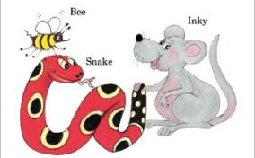
See you
next time!

