Slide 1
Jolly Grammar
5b-9

Slide 2
Let’s review
spellings.

Slide 3
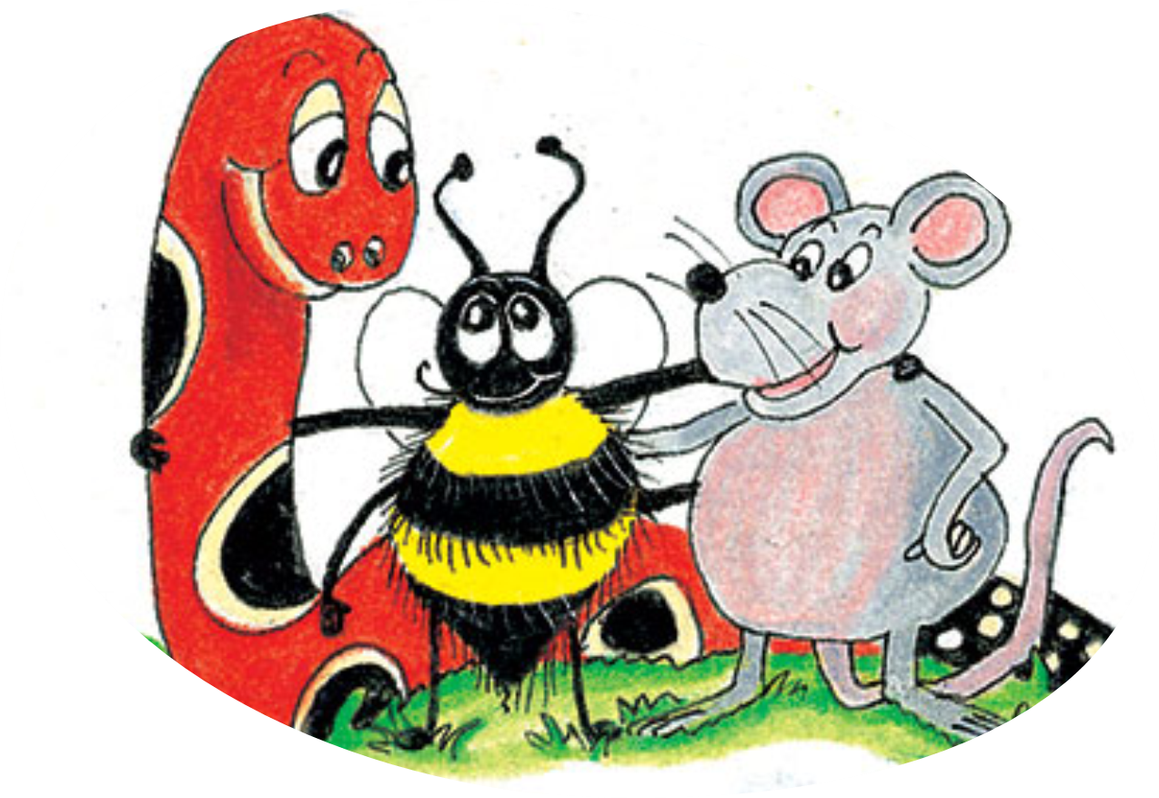
pollinate
decorate
terrify
identify
prize
disguise

Slide 4
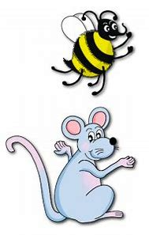
Spelling Point
<-ise><-ize>

Slide 6
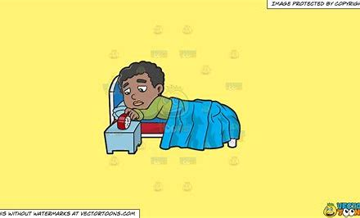
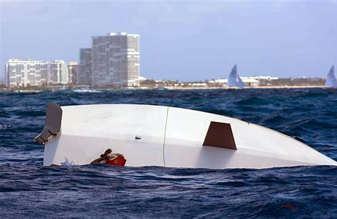
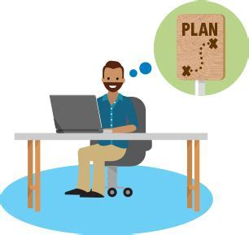
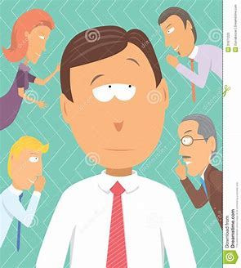
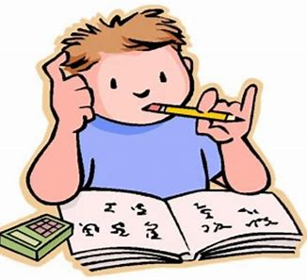
prize capsize arise
devise advise revise

Slide 7
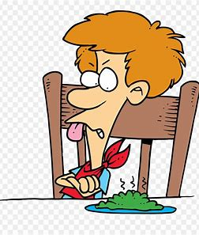
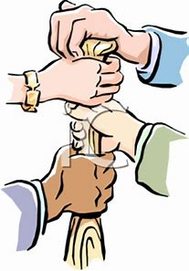
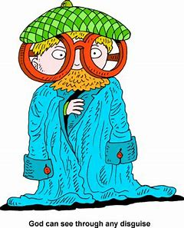
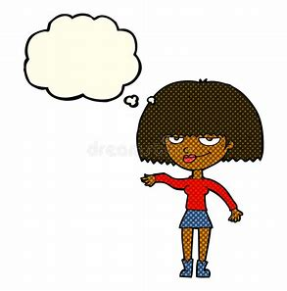
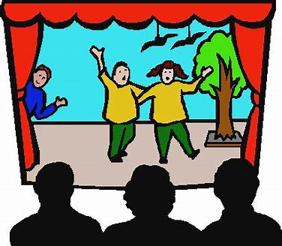
advertise comprise despise
disguise improvise surmise

Slide 8
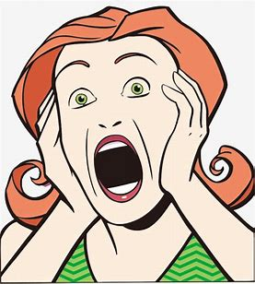
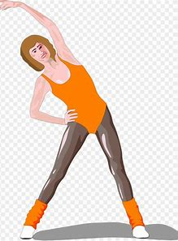
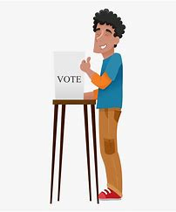
surprise televise exercise
compromise enfranchise disenfranchise

Slide 9
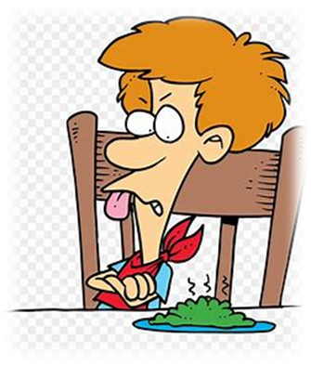

Slide 11
Activity Page:
Spelling
<-ise><ize>

Slide 12
Phrasal verbs and
prepositional phrases

Slide 13
To fall down means
to fall to the ground.
in the night

Slide 14
To put on means to wear something.
during the mission

Slide 15
To dress up means
to put on nice clothes.
for Tom’s surprise party

Slide 16
To work out is to exercise.
at the gym

Slide 17
To go back means to return.
after their trip

Slide 18
Parsing & Sentence Walls

Slide 19
The smaller cargo ship capsized
(after the collision).
Subject
ship
The smaller cargo
Verb
capsized
(intransitive)
after the collision
Object

Slide 20
Dictation

Slide 22
The doctor advised him to exercise more often.

Slide 23
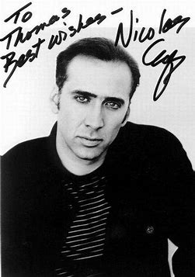
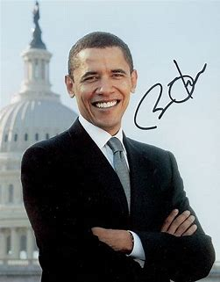

Slide 24
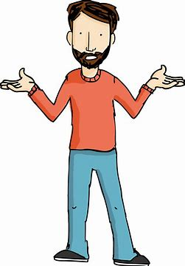
Ron prized his collection of famous autographs.

Slide 26
“I’m advertising for a new assistant,” said the magician.

Slide 27
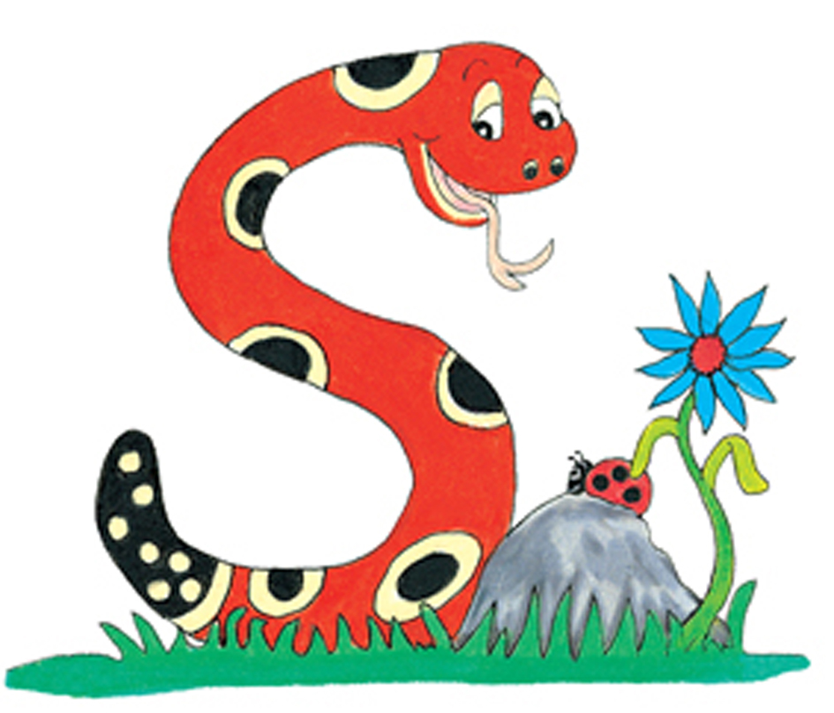
Thank you.
See you
next time!

