Slide 1
Jolly Grammar
5b-8

Slide 2
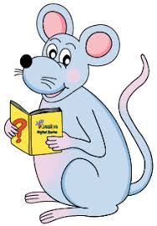
Spelling Test 22

Slide 3
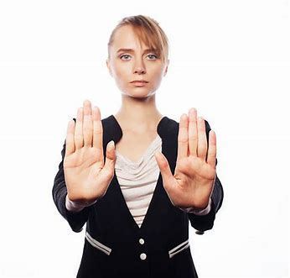
negate

Slide 4
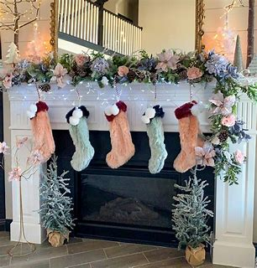
negate
decorate

Slide 5
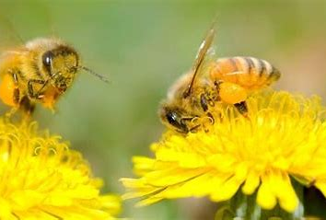
negate
decorate
pollinate

Slide 6
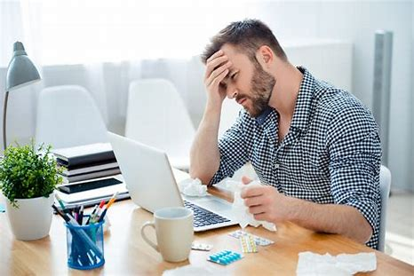
negate
decorate
pollinate
frustrate

Slide 7
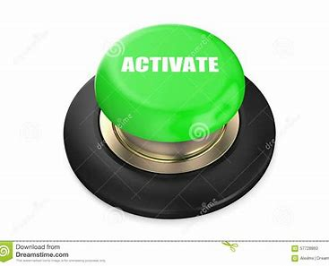
negate
decorate
pollinate
frustrate
activate

Slide 8
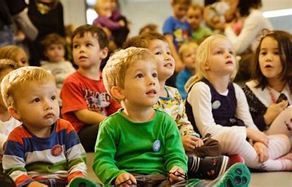
negate
decorate
pollinate
frustrate
activate
captivate

Slide 9
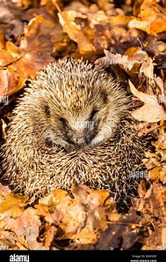
negate
decorate
pollinate
frustrate
activate
captivate
hibernate

Slide 10
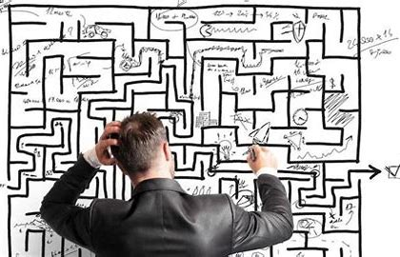
negate
decorate
pollinate
frustrate
activate
captivate
hibernate
complicate

Slide 11
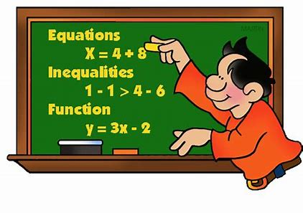
negate
decorate
pollinate
frustrate
activate
captivate
hibernate
complicate
formulate

Slide 12
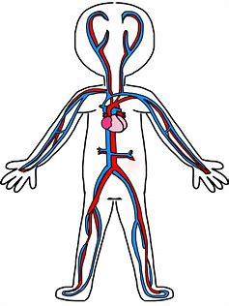
negate
decorate
pollinate
frustrate
activate
captivate
hibernate
complicate
formulate
10. circulate

Slide 13
negate
decorate
pollinate
frustrate
activate
captivate
hibernate
complicate
formulate
10. circulate
11. originate

Slide 14
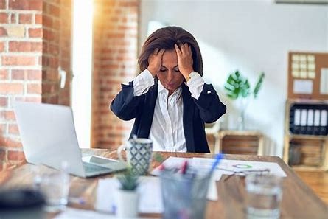
negate
decorate
pollinate
frustrate
activate
captivate
hibernate
complicate
formulate
10. circulate
11. originate
12. aggravate

Slide 15
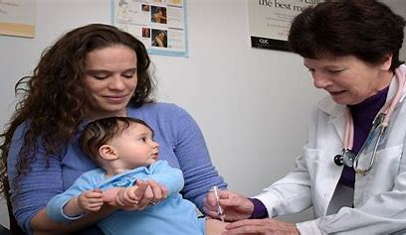
negate
decorate
pollinate
frustrate
activate
captivate
hibernate
complicate
formulate
10. circulate
11. originate
12. aggravate
13. vaccinate

Slide 16
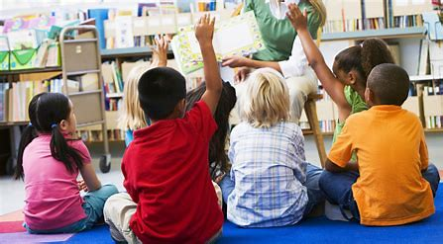
negate
decorate
pollinate
frustrate
activate
captivate
hibernate
complicate
formulate
10. circulate
11. originate
12. aggravate
13. vaccinate
14. participate

Slide 17
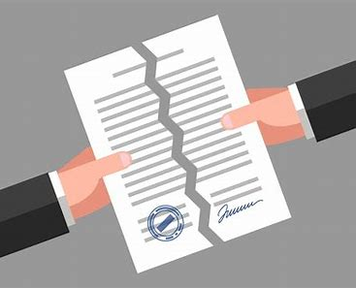
negate
decorate
pollinate
frustrate
activate
captivate
hibernate
complicate
formulate
10. circulate
11. originate
12. aggravate
13. vaccinate
14. participate
15. invalidate

Slide 18
negate
decorate
pollinate
frustrate
activate
captivate
hibernate
complicate
formulate
10. circulate
11. originate
12. aggravate
13. vaccinate
14. participate
15. invalidate
16. speculate

Slide 19
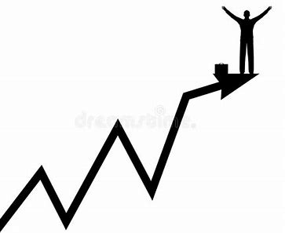
negate
decorate
pollinate
frustrate
activate
captivate
hibernate
complicate
formulate
10. circulate
11. originate
12. aggravate
13. vaccinate
14. participate
15. invalidate
16. speculate
17. culminate

Slide 20
negate
decorate
pollinate
frustrate
activate
captivate
hibernate
complicate
formulate
10. circulate
11. originate
12. aggravate
13. vaccinate
14. participate
15. invalidate
16. speculate
17. culminate
18. appreciate

Slide 21
Let’s Review
<-se><-ze>
Suffixes.

Slide 22
Activity Page
Nouns or Verbs?

Slide 23
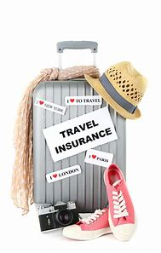
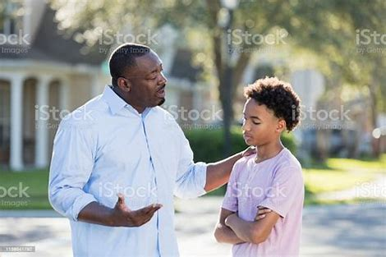
We strongly advise tourists to have travel insurance.
My dad gave me some sensible advice about the future .

Slide 24
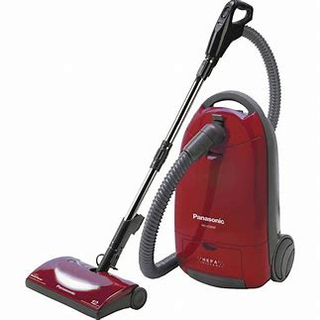
Electrical devices, such as vacuum cleaners and toasters are used in many homes.
How did he devise such a clever plan?

Slide 25
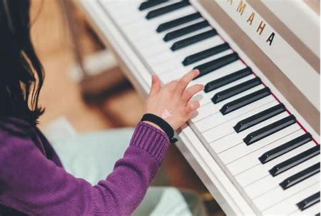
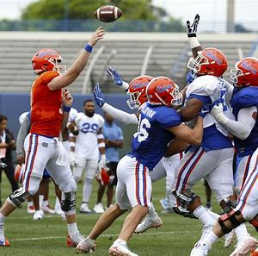
I must practise the piano every day after school.
The have football practice everyday Wednesday afternoon.

Slide 26
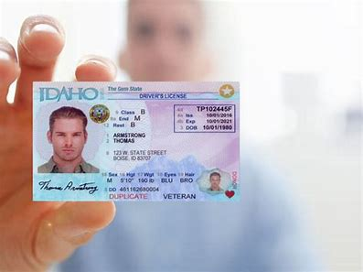
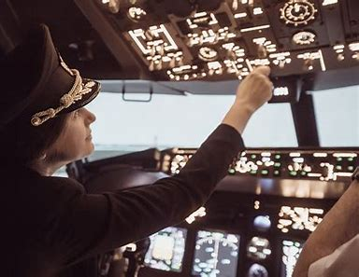
The driver showed his licence to the police officer.
Every year, they license many pilots to fly planes.

Slide 27
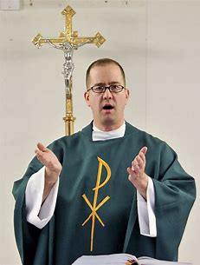
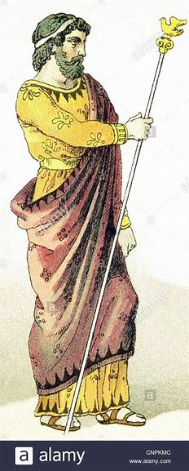
In ancient Greece, people believed that priests had the gift of prophecy.
The king asked them to prophesy who would win the battle.

Slide 28
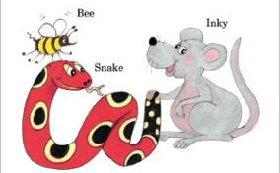
See you
next time!

