Slide 1
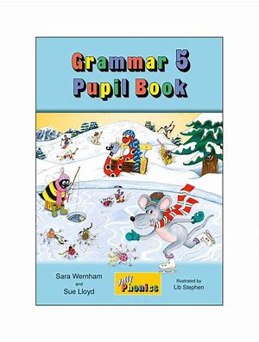
Jolly Grammar
5b-7

Slide 2
Let’s review
spellings.

Slide 3
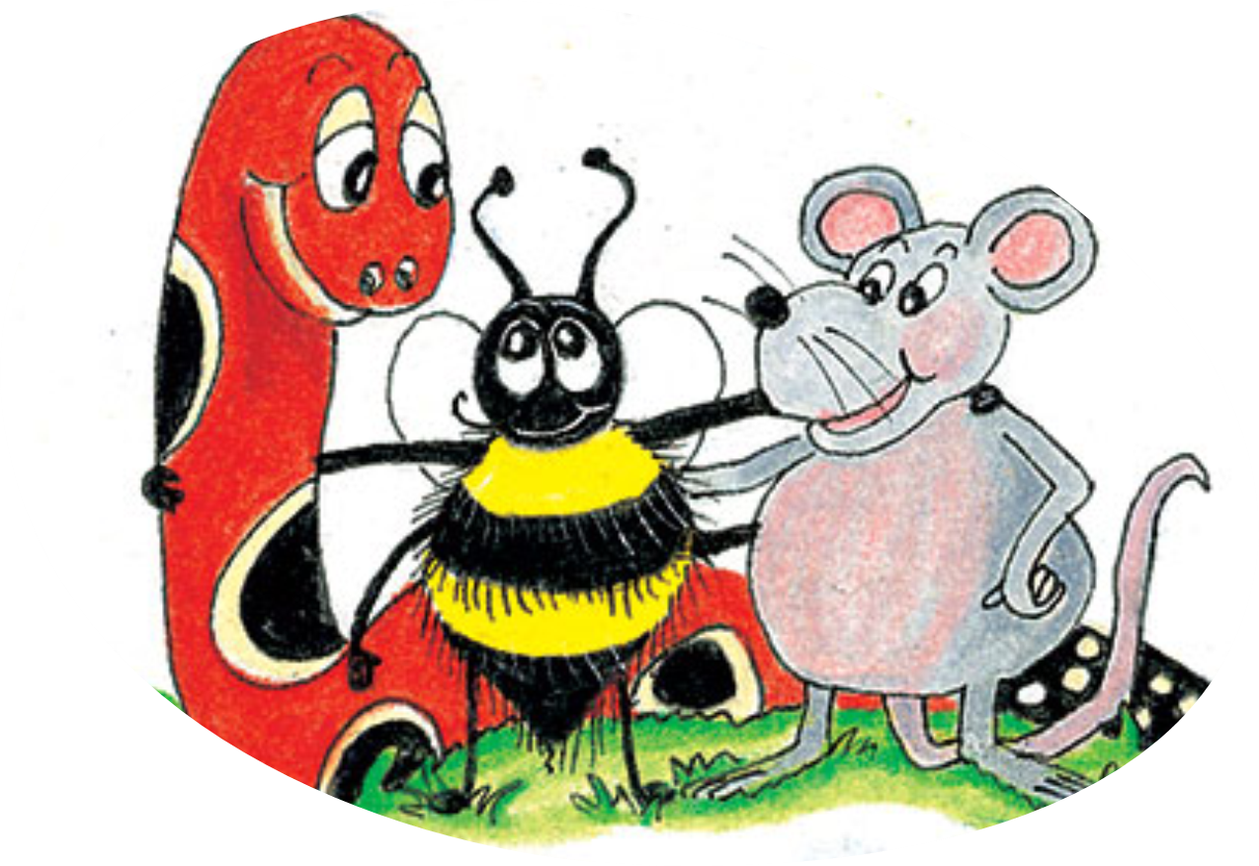
terrible
visible
horrible
comprehensible
reversible

Slide 4
terrible
visible
horrible
comprehensible
reversible
Word family

Slide 5
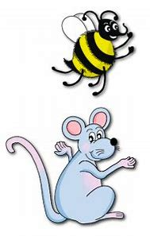
Spelling Point
<-ate>

Slide 6
frustrate
complicate
vaccinate

Slide 7
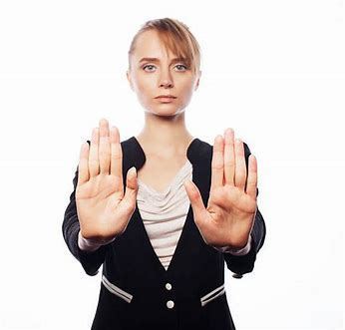
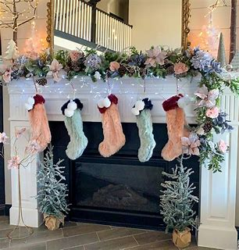
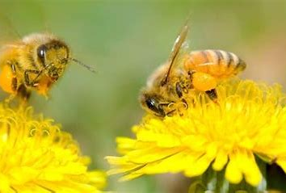
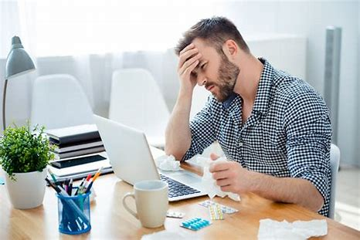
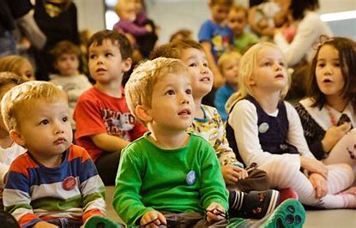
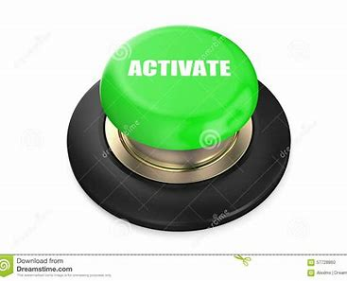
negate decorate pollinate
frustrate activate captivate

Slide 8
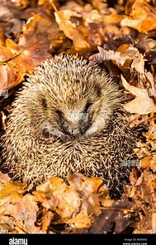
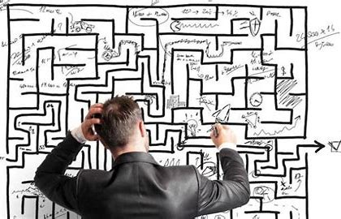
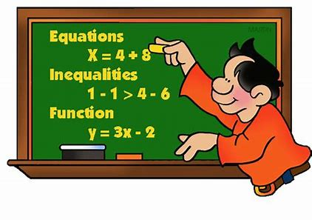
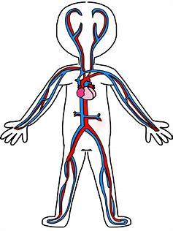
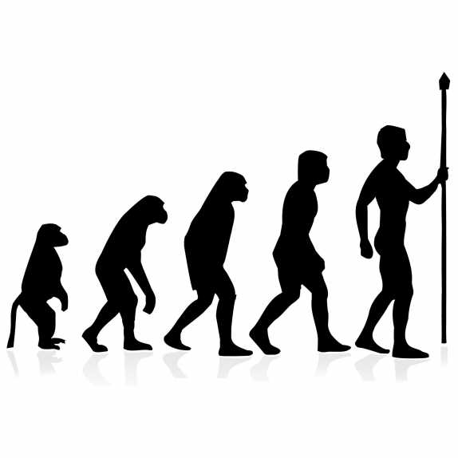
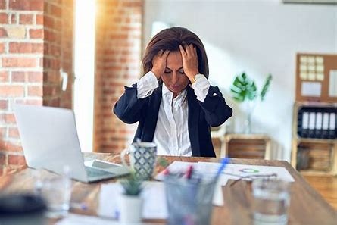
hibernate complicate formulate
circulate originate aggravate

Slide 9
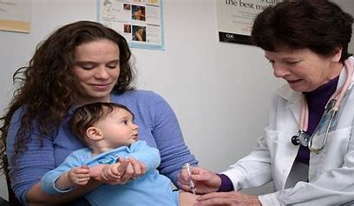
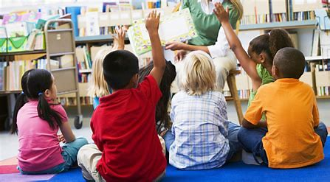
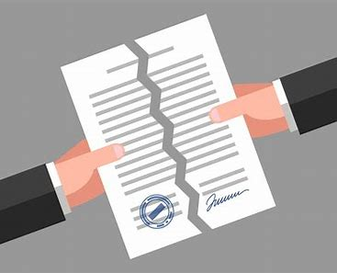
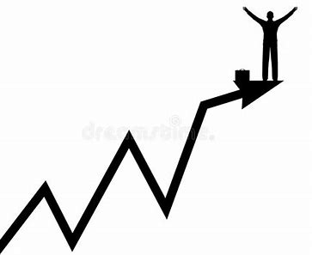
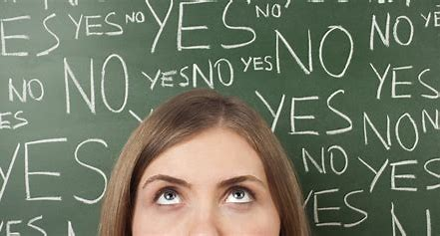
vaccinate participate invalidate
speculate culminate appreciate

Slide 11
Activity Page:
Spelling
<-ate>

Slide 12
How many other words can you make?

Slide 13
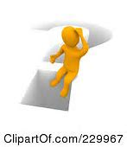
discombobulate
come
some
date
die
Ai
disco
bomb
ate
eat
bubble
is
disc
Bob
come
omelet

Slide 14
Parsing & Sentence Walls

Slide 15
Ben and Gemma have decorated their pictures (with stickers).
Subject
Ben/Gemma
Verb
have decorated
(transitive)
(with stickers)
Object
pictures
their

Slide 16
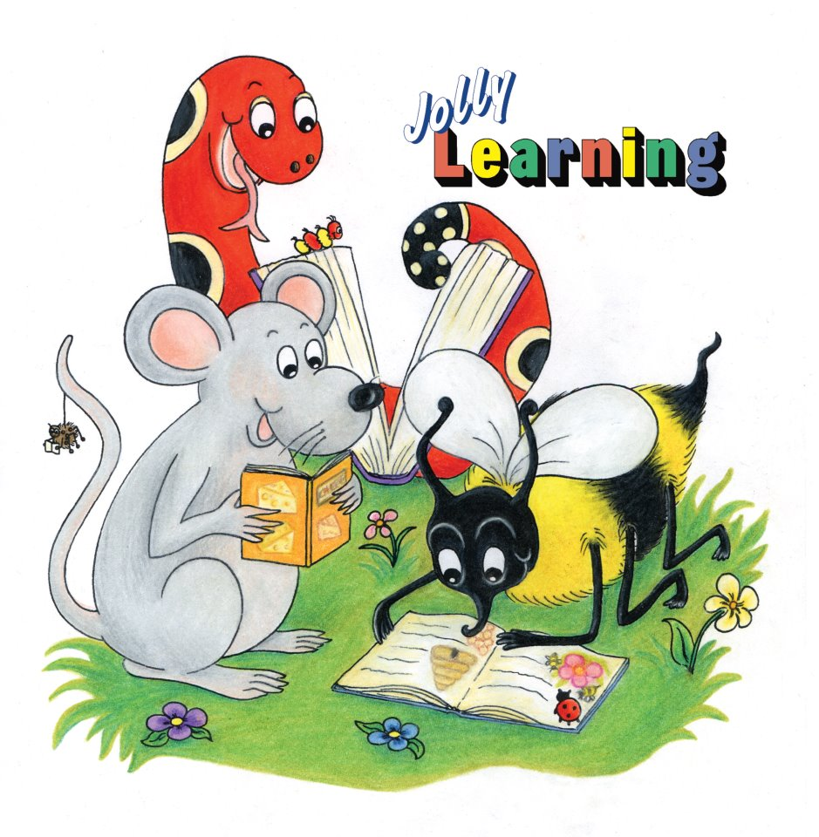
Dictation

Slide 17
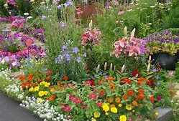

Slide 18
Honey bees pollinate the flowers in our cottage garden.

Slide 19
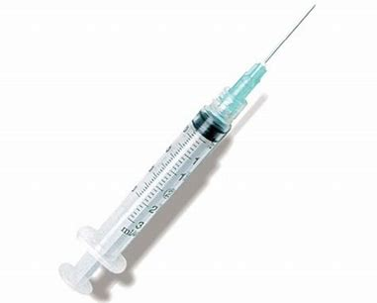

Slide 20
The paediatrician uses a syringe to vaccinate children.

Slide 21
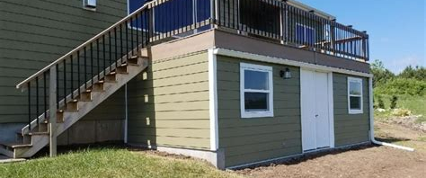

Slide 22
“The hedgehog is hibernating under the shed,” announced Dad.

Slide 23
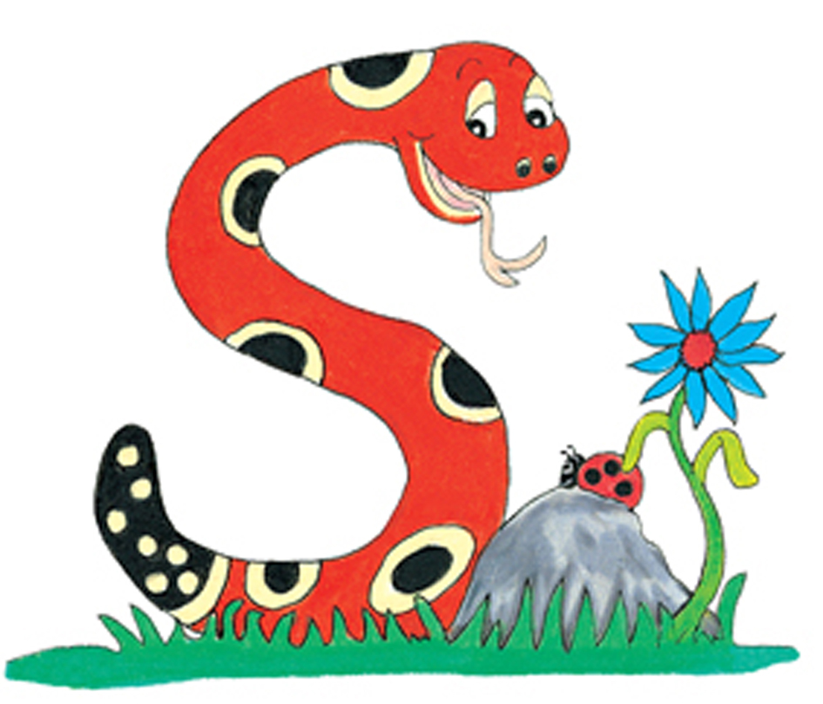
Thank you.
See you
next time!

