Slide 1
Jolly Grammar
5b-6

Slide 2
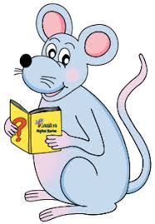
Spelling Test 21

Slide 3
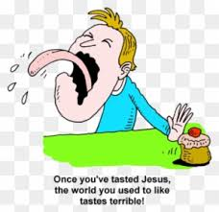
terrible

Slide 4
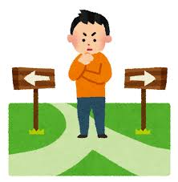
terrible
sensible

Slide 5
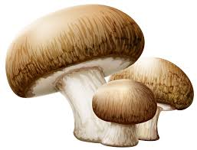
terrible
sensible
edible

Slide 6
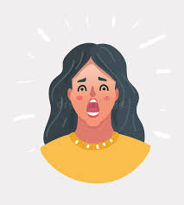
terrible
sensible
edible
horrible

Slide 7
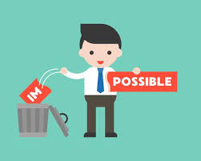
terrible
sensible
edible
horrible
possible

Slide 8
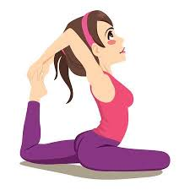
terrible
sensible
edible
horrible
possible
flexible

Slide 9
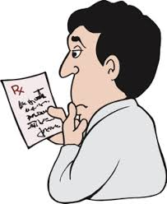
terrible
sensible
edible
horrible
possible
flexible
illegible

Slide 10
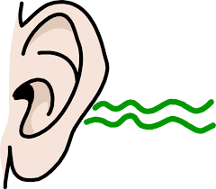
terrible
sensible
edible
horrible
possible
flexible
illegible
audible

Slide 11
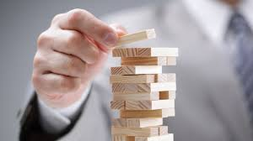
terrible
sensible
edible
horrible
possible
flexible
illegible
audible
tangible

Slide 12
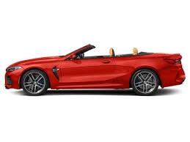
terrible
sensible
edible
horrible
possible
flexible
illegible
audible
tangible
10. convertible

Slide 13
terrible
sensible
edible
horrible
possible
flexible
illegible
audible
tangible
10. convertible
11. visible

Slide 14
terrible
sensible
edible
horrible
possible
flexible
illegible
audible
tangible
10. convertible
11. visible
12. incredible

Slide 15
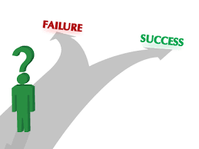
terrible
sensible
edible
horrible
possible
flexible
illegible
audible
tangible
10. convertible
11. visible
12. incredible
13. feasible

Slide 16
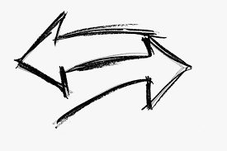
terrible
sensible
edible
horrible
possible
flexible
illegible
audible
tangible
10. convertible
11. visible
12. incredible
13. feasible
14. reversible

Slide 17
terrible
sensible
edible
horrible
possible
flexible
illegible
audible
tangible
10. convertible
11. visible
12. incredible
13. feasible
14. reversible
15. intelligible

Slide 18
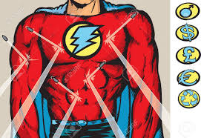
terrible
sensible
edible
horrible
possible
flexible
illegible
audible
tangible
10. convertible
11. visible
12. incredible
13. feasible
14. reversible
15. intelligible
16. indestructible

Slide 19
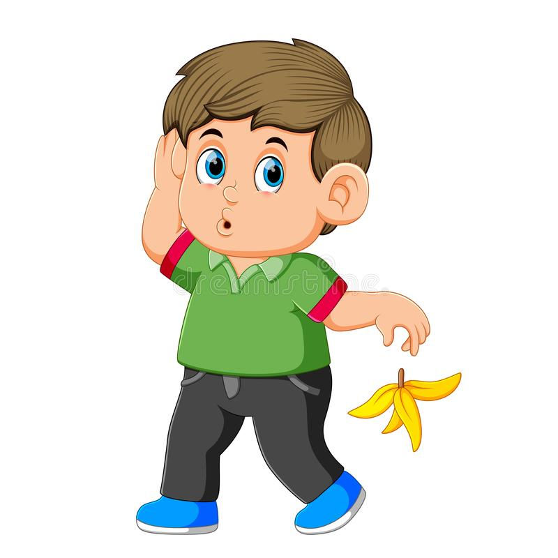
terrible
sensible
edible
horrible
possible
flexible
illegible
audible
tangible
10. convertible
11. visible
12. incredible
13. feasible
14. reversible
15. intelligible
16. indestructible
17. irresponsible

Slide 20
terrible
sensible
edible
horrible
possible
flexible
illegible
audible
tangible
10. convertible
11. visible
12. incredible
13. feasible
14. reversible
15. intelligible
16. indestructible
17. irresponsible
18. comprehensible

Slide 21
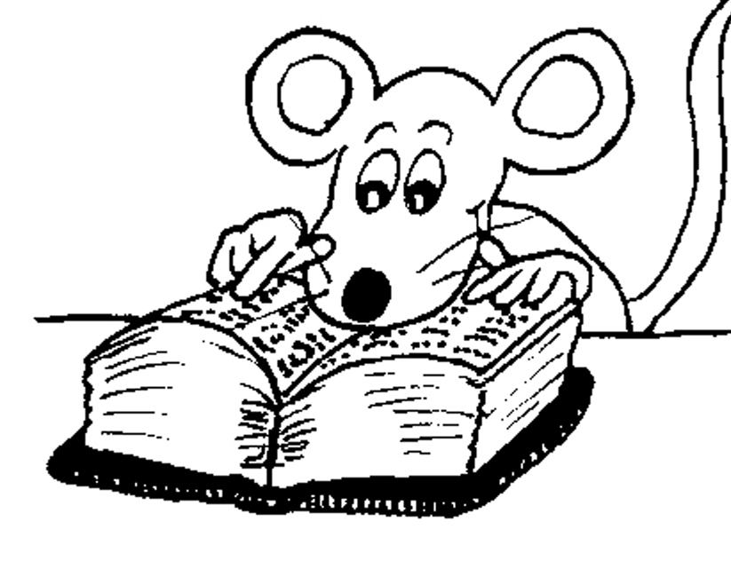
Let’s Review
Suffixes.

Slide 22
watched
had watched
watching
eaten
known
beds
sandwiches
diaries
late
later
latest
careful
careless
believe
believable
music
musician
grass
grassy
majestic
majestically

Slide 23
Activity Page
Making Nouns and Adjectives into Verbs

Slide 24
décor
vaccine
origin
invalid
simple
horror
solid
terror
apology
item
drama
computer
crystal

Slide 25
décor
vaccine
origin
invalid
decorate
simple
horror
solid
terror
apology
item
drama
computer
crystal

Slide 26
décor
vaccine
origin
invalid
decorate
vaccinate
simple
horror
solid
terror
apology
item
drama
computer
crystal

Slide 27
décor
vaccine
origin
invalid
decorate
vaccinate
originate
simple
horror
solid
terror
apology
item
drama
computer
crystal

Slide 28
décor
vaccine
origin
invalid
decorate
vaccinate
originate
invalidate
simple
horror
solid
terror
apology
item
drama
computer
crystal

Slide 29
décor
vaccine
origin
invalid
decorate
vaccinate
originate
invalidate
simple
horror
solid
terror
simplify
apology
item
drama
computer
crystal

Slide 30
décor
vaccine
origin
invalid
decorate
vaccinate
originate
invalidate
simple
horror
solid
terror
simplify
horrify
apology
item
drama
computer
crystal

Slide 31
décor
vaccine
origin
invalid
decorate
vaccinate
originate
invalidate
simple
horror
solid
terror
simplify
horrify
solidify
apology
item
drama
computer
crystal

Slide 32
décor
vaccine
origin
invalid
decorate
vaccinate
originate
invalidate
simple
horror
solid
terror
simplify
horrify
solidify
terrify
apology
item
drama
computer
crystal

Slide 33
décor
vaccine
origin
invalid
decorate
vaccinate
originate
invalidate
simple
horror
solid
terror
simplify
horrify
solidify
terrify
apology
item
drama
computer
crystal
apologize

Slide 34
décor
vaccine
origin
invalid
decorate
vaccinate
originate
invalidate
simple
horror
solid
terror
simplify
horrify
solidify
terrify
apology
item
drama
computer
crystal
apologize
itemize

Slide 35
décor
vaccine
origin
invalid
decorate
vaccinate
originate
invalidate
simple
horror
solid
terror
simplify
horrify
solidify
terrify
apology
item
drama
computer
crystal
apologize
itemize
dramatize

Slide 36
décor
vaccine
origin
invalid
decorate
vaccinate
originate
invalidate
simple
horror
solid
terror
simplify
horrify
solidify
terrify
apology
item
drama
computer
crystal
apologize
itemize
dramatize
computerize

Slide 37
décor
vaccine
origin
invalid
decorate
vaccinate
originate
invalidate
simple
horror
solid
terror
simplify
horrify
solidify
terrify
apology
item
drama
computer
crystal
apologize
itemize
dramatize
computerize
crystallize

Slide 38
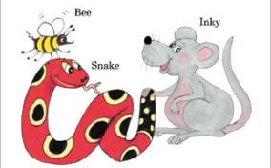
See you
next time!

