Slide 1
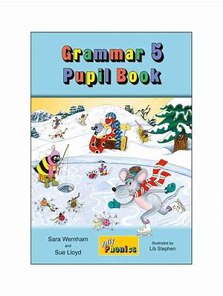
Jolly Grammar
5b-5

Slide 2
Let’s review
spellings.

Slide 3
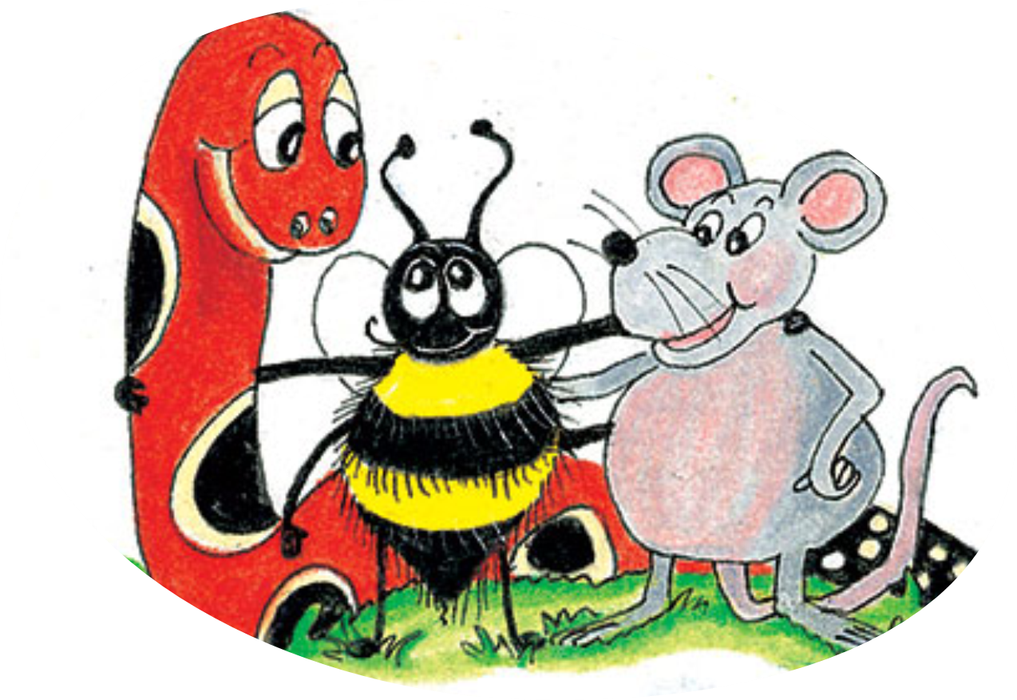
measure
pressure
insure
gesture
temperature
miniature

Slide 4
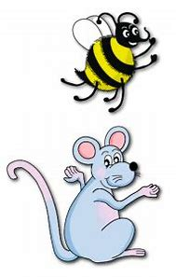
Spelling Point
<-ible>

Slide 5
breakable
lovable

Slide 6
breakable
lovable
↓
capable or worthy of being

Slide 7
breakable
lovable
↓
capable or worthy of being
visible

Slide 8
breakable
lovable
↓
capable or worthy of being
visible
→able to see

Slide 9
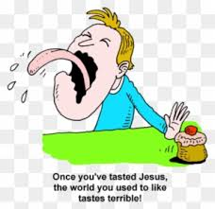
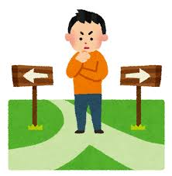
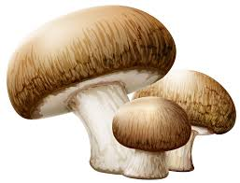
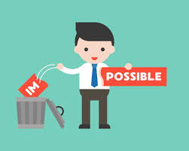
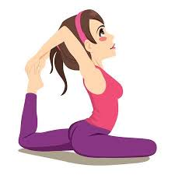
terrible sensible edible
horrible possible flexible

Slide 10
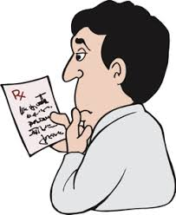
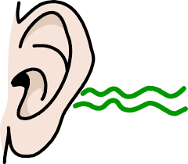
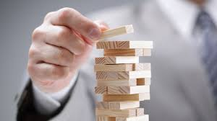
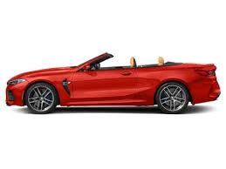
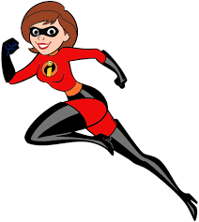
illegible audible tangible
convertible visible incredible

Slide 11
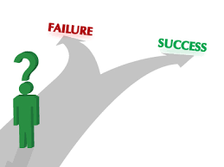
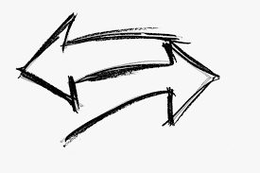
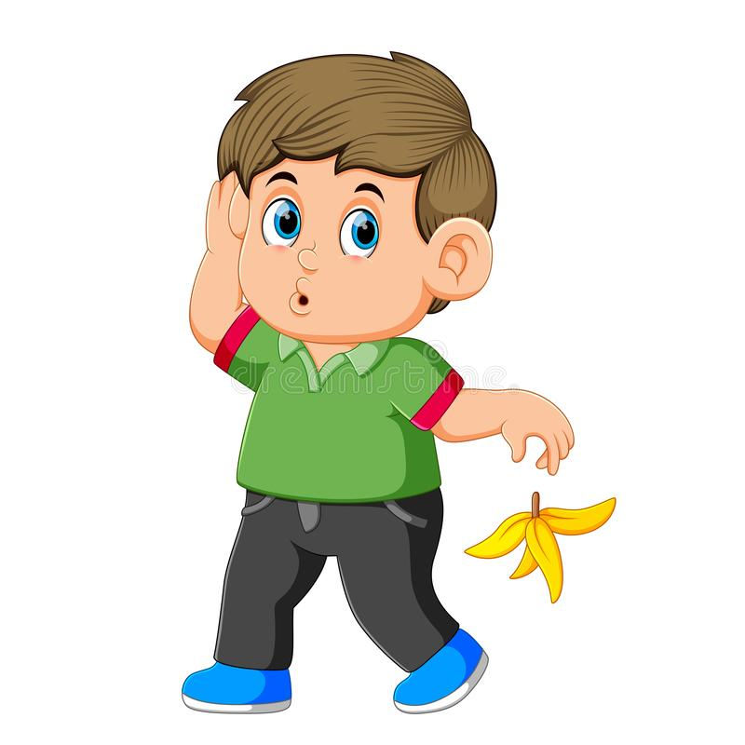
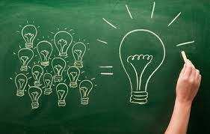
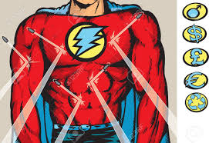
feasible reversible intelligible
indestructible irresponsible comprehensible

Slide 13
Activity Page:
Spelling
<-ible>

Slide 14
Write twelve noun phrases.

Slide 15
an expensive convertible car
audible books
a bag with terrible design
Superman is indestructible.
My handwriting is illegible.
a reversible jacket
a horrible person
I am not a flexible person.
My friend is a sensible man.
Eggplants are not edible.
I am an incredible boy.

Slide 16
Parsing & Sentence Walls

Slide 17
The inedible soup had a horrible taste and smell.
Subject
soup
The inedible
Verb
had
(transitive)
Object
taste/smell
a horrible

Slide 18
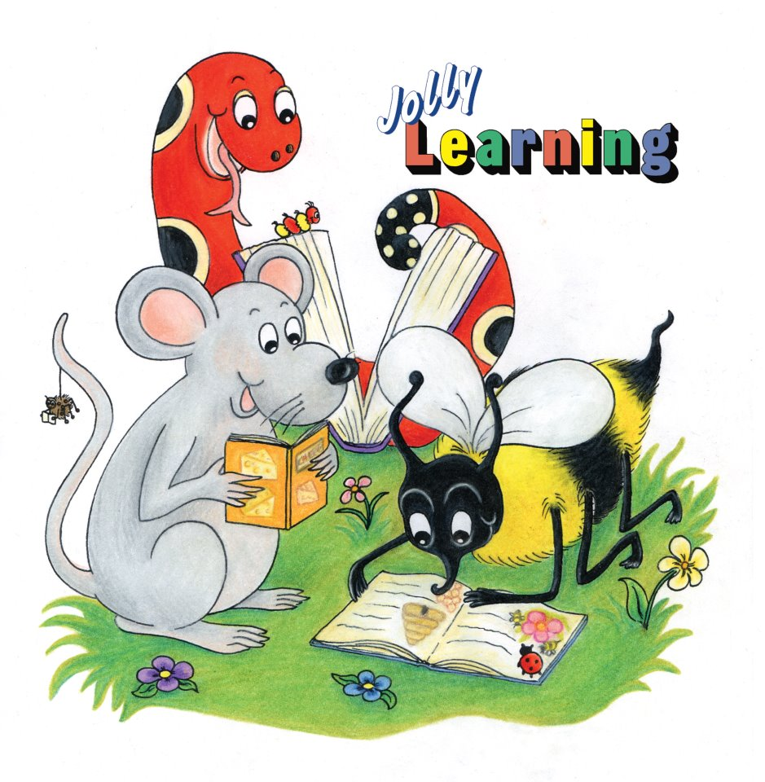
Dictation

Slide 19
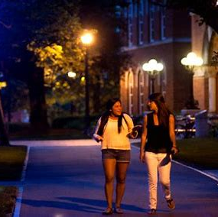

Slide 20
It is irresponsible to venture out alone at night.

Slide 21
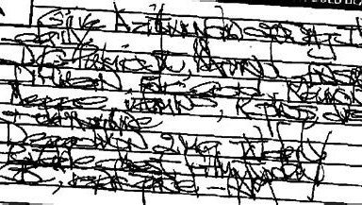
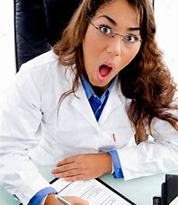

Slide 22
The physician’s handwriting is almost illegible.

Slide 23
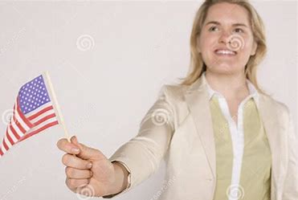
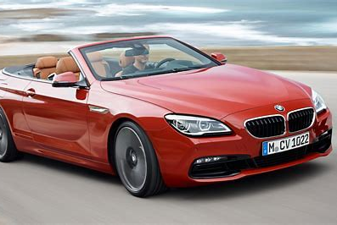

Slide 24
“This convertible is an incredible automobile!” exclaimed the American.

Slide 25
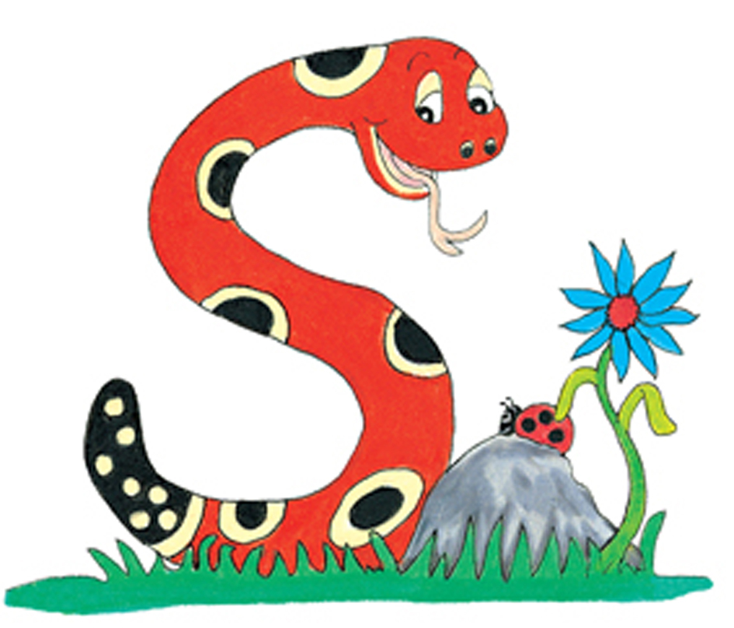
Thank you.
See you
next time!

