Slide 1
Jolly Grammar
5b-4

Slide 2
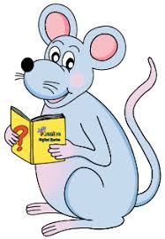
Spelling Test 20

Slide 3
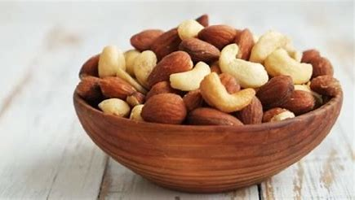
mixture

Slide 4
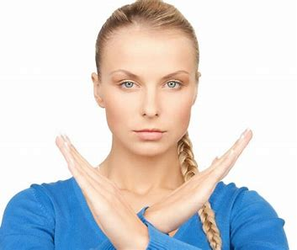
mixture
gesture

Slide 5
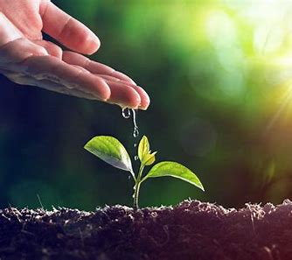
mixture
gesture
nurture

Slide 6
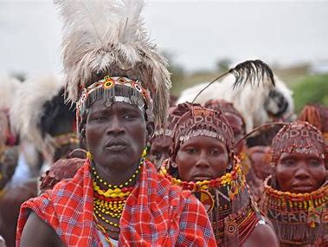
mixture
gesture
nurture
culture

Slide 7
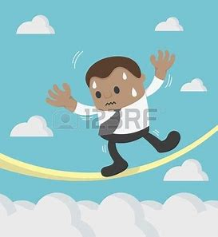
mixture
gesture
nurture
culture
venture

Slide 8
mixture
gesture
nurture
culture
venture
future

Slide 9
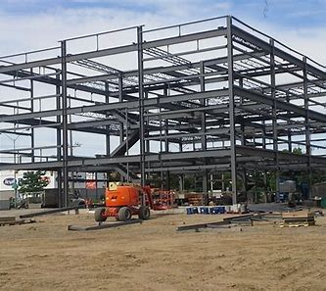
mixture
gesture
nurture
culture
venture
future
structure

Slide 10
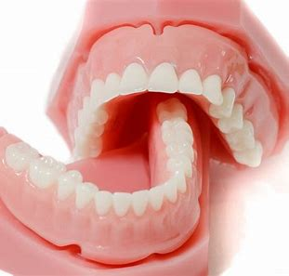
mixture
gesture
nurture
culture
venture
future
structure
dentures

Slide 11
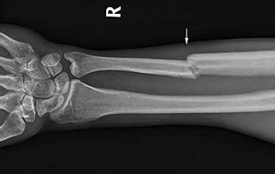
mixture
gesture
nurture
culture
venture
future
structure
dentures
fracture

Slide 12
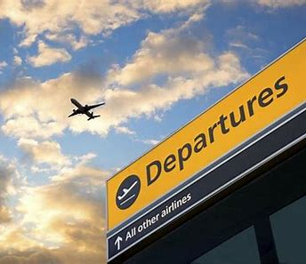
mixture
gesture
nurture
culture
venture
future
structure
dentures
fracture
10. departure

Slide 13
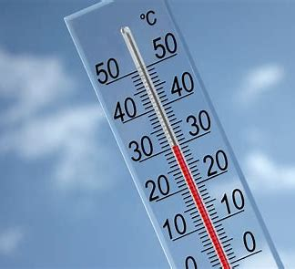
mixture
gesture
nurture
culture
venture
future
structure
dentures
fracture
10. departure
11. temperature

Slide 14
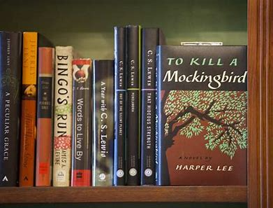
mixture
gesture
nurture
culture
venture
future
structure
dentures
fracture
10. departure
11. temperature
12. literature

Slide 15
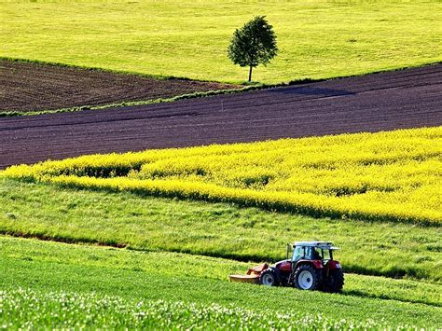
mixture
gesture
nurture
culture
venture
future
structure
dentures
fracture
10. departure
11. temperature
12. literature
13. agriculture

Slide 16
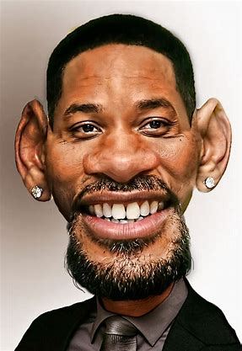
mixture
gesture
nurture
culture
venture
future
structure
dentures
fracture
10. departure
11. temperature
12. literature
13. agriculture
14. caricature

Slide 17
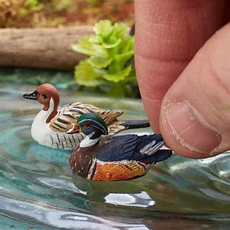
mixture
gesture
nurture
culture
venture
future
structure
dentures
fracture
10. departure
11. temperature
12. literature
13. agriculture
14. caricature
15. miniature

Slide 18
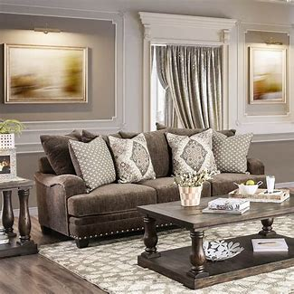
mixture
gesture
nurture
culture
venture
future
structure
dentures
fracture
10. departure
11. temperature
12. literature
13. agriculture
14. caricature
15. miniature
16. furniture

Slide 19
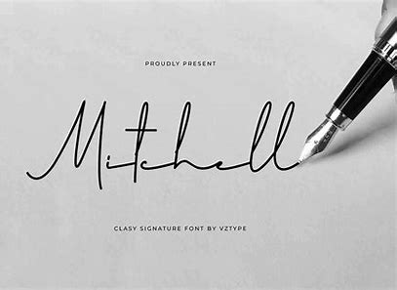
mixture
gesture
nurture
culture
venture
future
structure
dentures
fracture
10. departure
11. temperature
12. literature
13. agriculture
14. caricature
15. miniature
16. furniture
17. signature

Slide 20
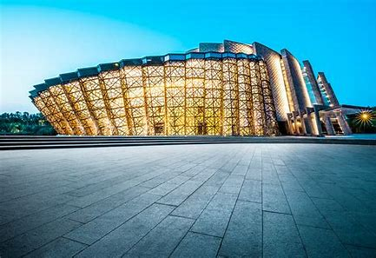
mixture
gesture
nurture
culture
venture
future
structure
dentures
fracture
10. departure
11. temperature
12. literature
13. agriculture
14. caricature
15. miniature
16. furniture
17. signature
18. architecture

Slide 21
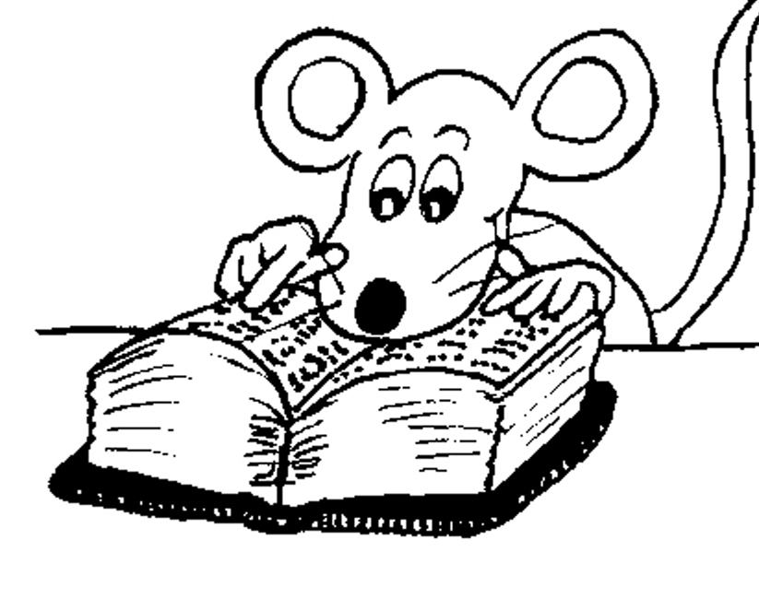
Let’s Review

Slide 22
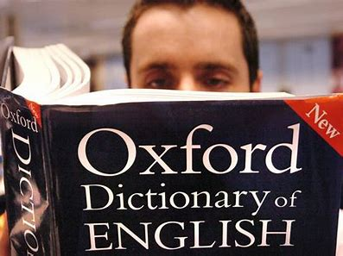
Tom looked up a word in the dictionary.

Slide 23
Tom looked up a word in the dictionary.
found

Slide 24
Tom looked up a word in the dictionary.
found
phrasal verb

Slide 25
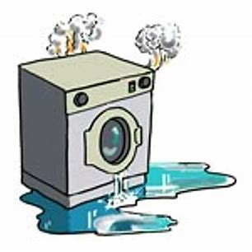
My washing machine broke down on Tuesday. → stopped working

Slide 26
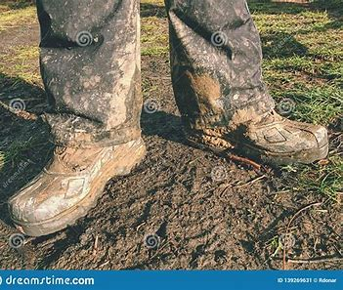
The farmer took off his muddy boots.
→ removed

Slide 27
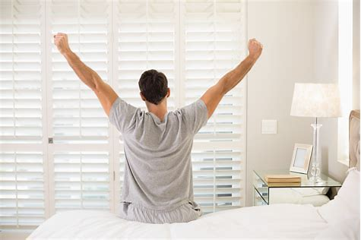
What time do you get up in the morning? → get out of bed

Slide 28
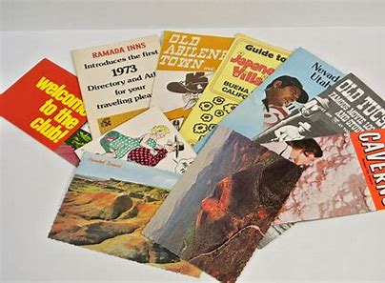
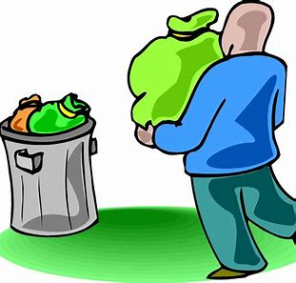
Did he throw away those old travel brochures? → get rid of

Slide 29
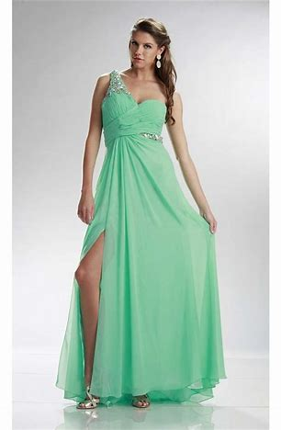
Anna tried on the green chiffon ballgown.
→ put on to see how it looks of fits

Slide 30
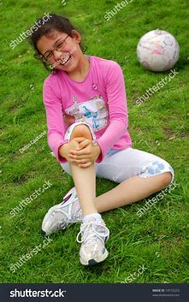
I fell over in the park and grazed my knee.
→ fell onto the ground

Slide 31
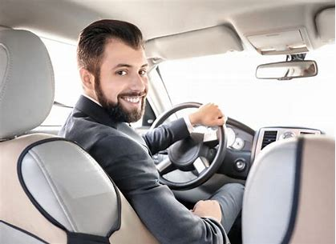
The chauffeur brings back the car every evening. → returns

Slide 32
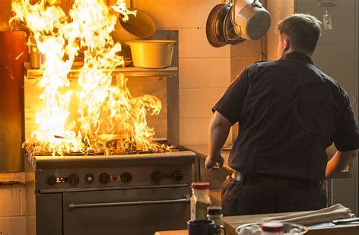
A fire broke out yesterday in the chef’s kitchen. → started suddenly

Slide 33
Activity Page
More Phrasal Verbs

Slide 34
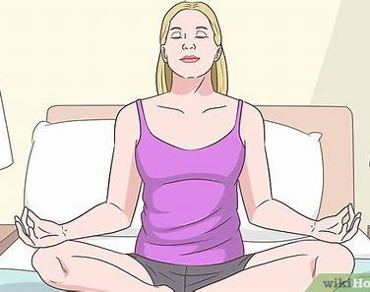
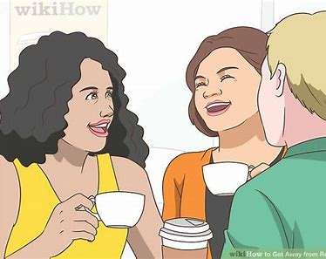
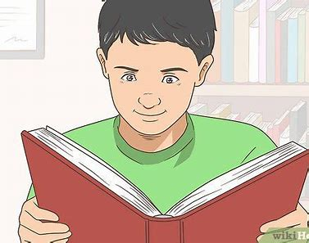
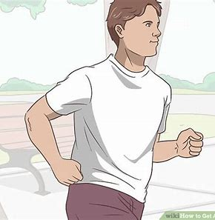
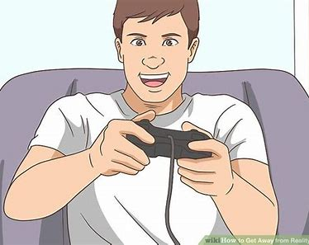
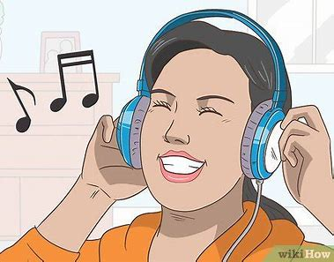
I want to get away from this world.

Slide 35
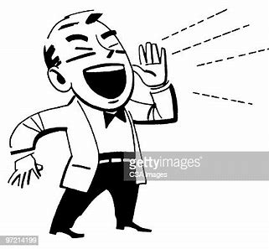
Please don’t call out to me.

Slide 36
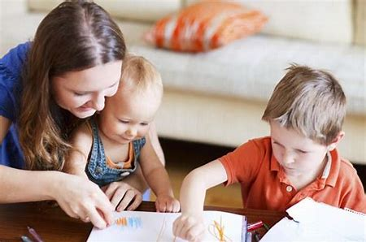
It is fun to look after children.

Slide 37
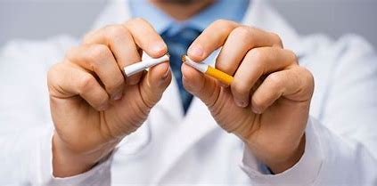
He gave up smoking.

Slide 38
Put the dictionary back on the shelf when you’re through.

Slide 39
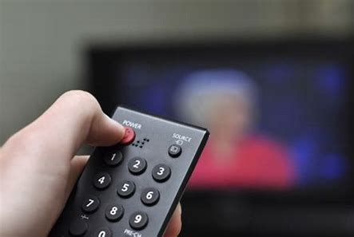
Please turn on the television.

Slide 40
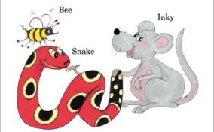
See you
next time!

