Slide 1
Jolly Grammar
5b-3

Slide 2
Let’s review
spellings.

Slide 3
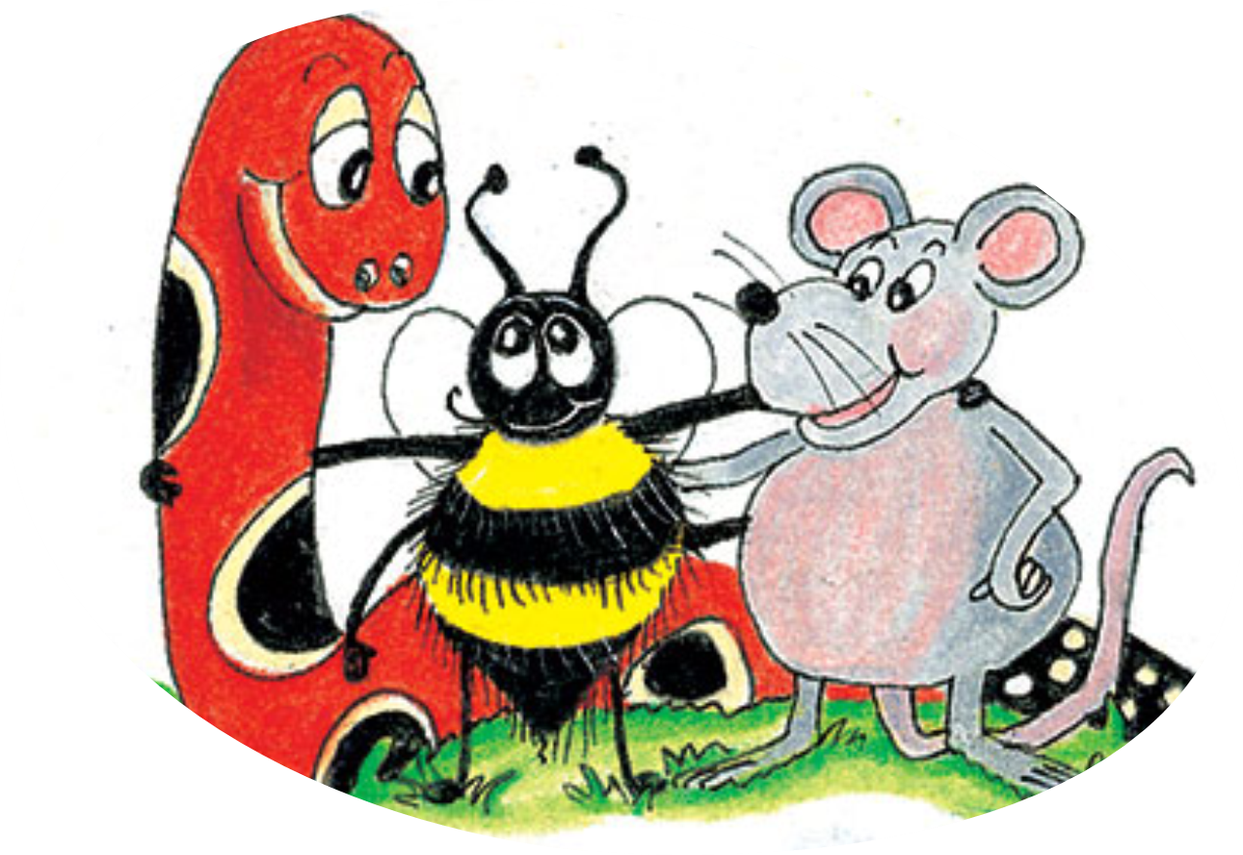
suggestion
dimension
discussion
electrician
celebration

Slide 4
Spelling Point
<ture>

Slide 5
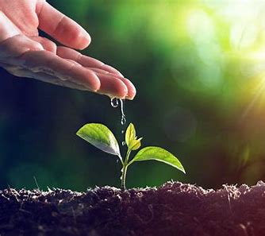
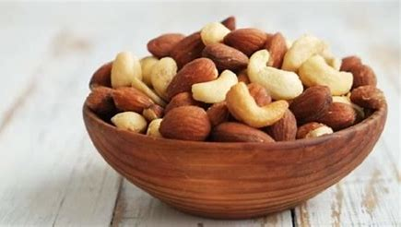
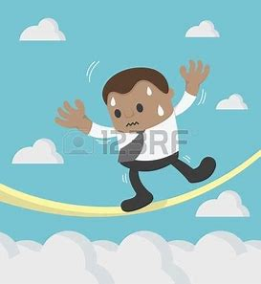
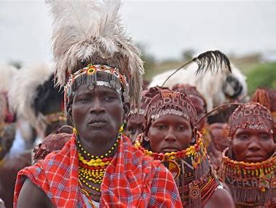
mixture gesture nurture
culture venture future

Slide 6
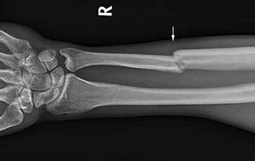
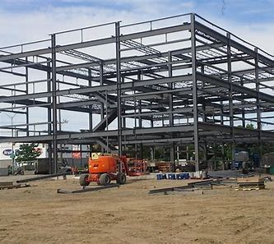
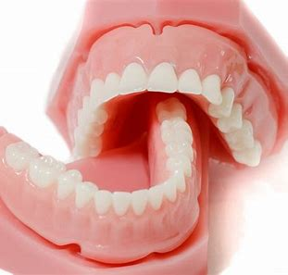
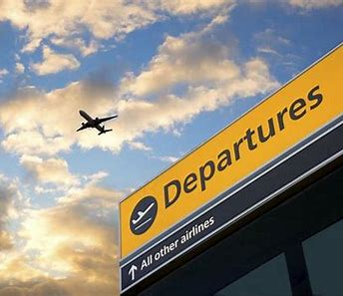
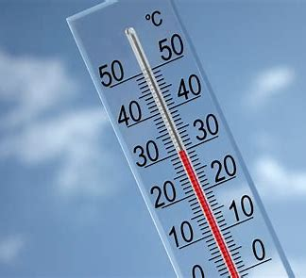
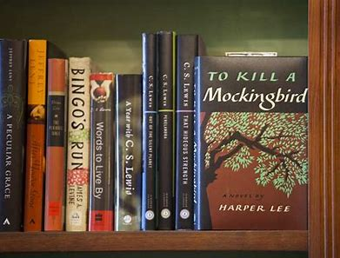
structure dentures fracture
departure temperature literature

Slide 7
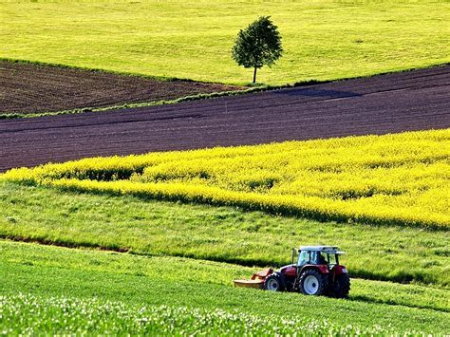
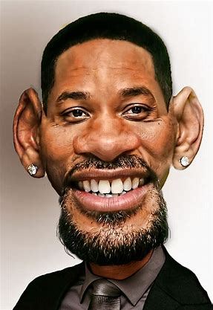
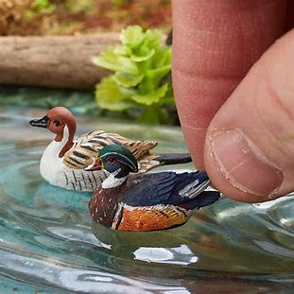
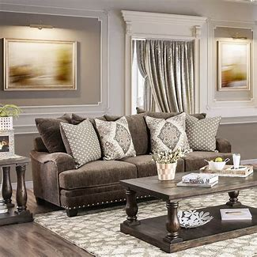
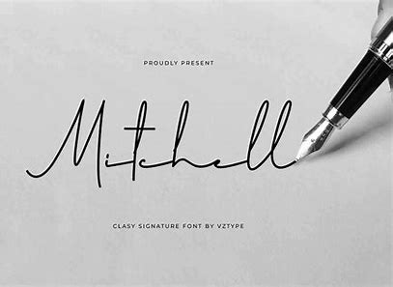
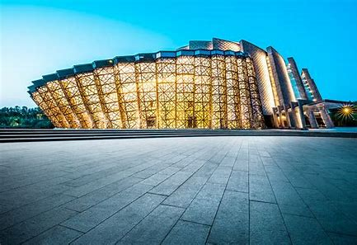
agriculture caricature miniature
furniture signature architecture

Slide 9
Activity Page:
Spelling
<ture>

Slide 10
Write the meaning.

Slide 11
Underline the verb in red, identify the subject & object. Then decide the verb is transitive or intransitive.

Slide 12
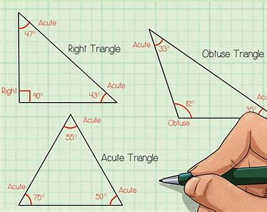
The class measured the triangles
accurately.

Slide 13
S
O
The class measured the triangles
accurately.
transitive

Slide 14
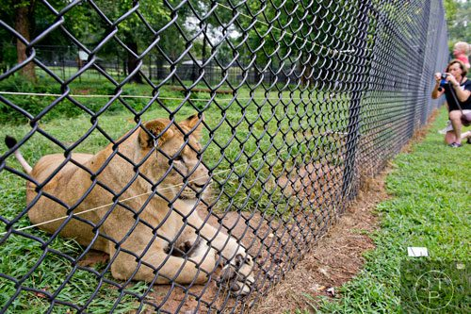
The lions lounged lazily in their
enclosure.

Slide 15
S
The lions lounged lazily in their
enclosure.
intransitive

Slide 16
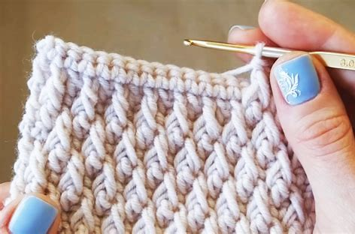
I will crochet more often in the future.

Slide 17
S
I will crochet more often in the future.
intransitive

Slide 18
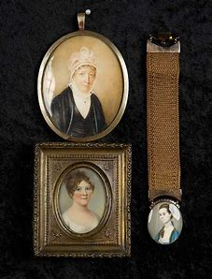
The gallery has some lovely miniature
portraits.

Slide 19
S
The gallery has some lovely miniature
portraits.
transitive
O

Slide 20
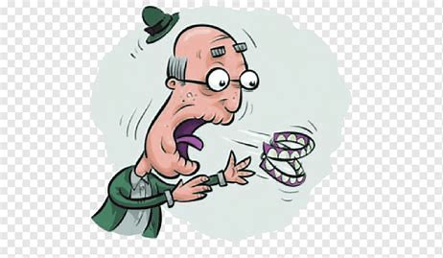
My grandpa needs new dentures.

Slide 21
S
O
My grandpa needs new dentures.
transitive

Slide 22
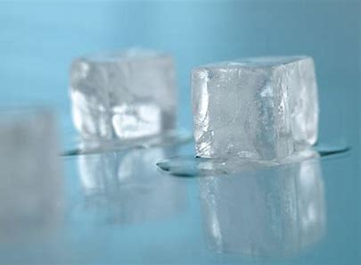
Ice will melt in hot temperatures.

Slide 23
S
Ice will melt in hot temperatures.
intransitive

Slide 24
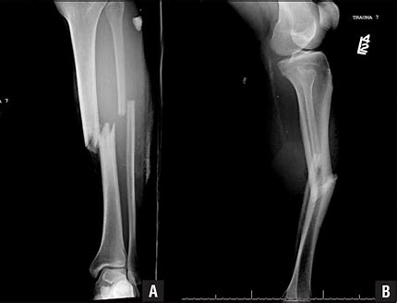
He had fractured his leg in several
places.

Slide 25
S
O
He had fractured his leg in several
places.
transitive

Slide 26
The courageous sailors ventured into
the storm.

Slide 27
S
The courageous sailors ventured into
the storm.
intransitive

Slide 28
Parsing & Sentence Walls

Slide 29
The baker will stir the cake mixture (for a long time).
Subject
baker
The
Verb
will stir
(transitive)
for a long time
Object
mixture
the cake

Slide 30
Dictation

Slide 31
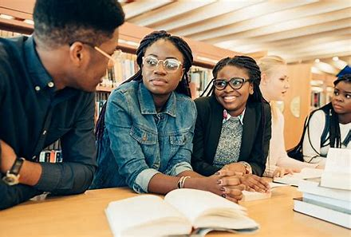

Slide 32
She studied Chinese culture and literature at college.

Slide 33
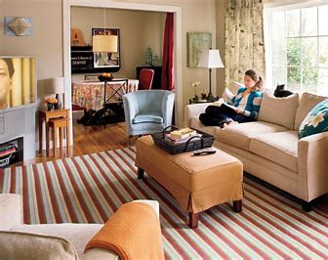

Slide 34
The room had a mixture of different styles of furniture.

Slide 35
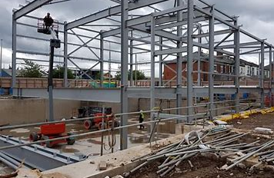
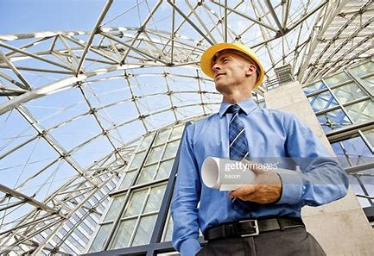

Slide 36
“The superstructure of the building is undamaged,” assured the architect.

Slide 37
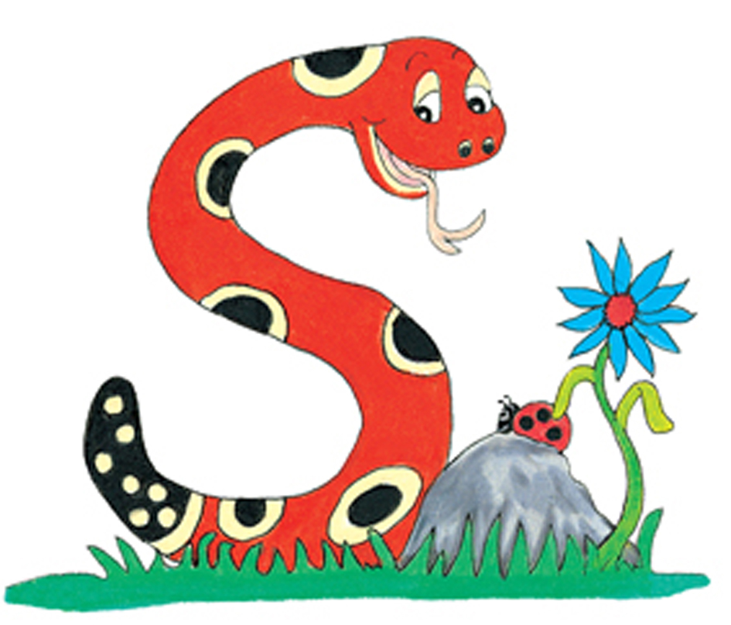
Thank you.
See you
next time!

