Slide 1
Jolly Grammar
5b-2

Slide 2
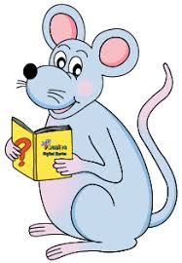
Spelling Test 19

Slide 3
sure

Slide 4
sure
unsure

Slide 5
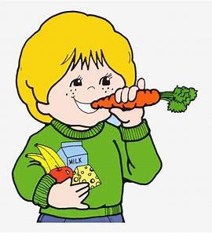
sure
unsure
ensure

Slide 6
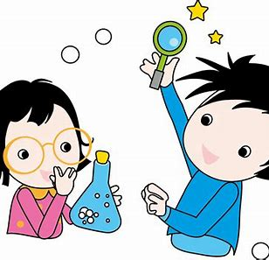
sure
unsure
ensure
assure

Slide 7
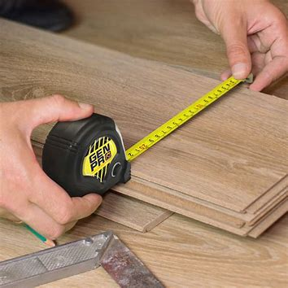
sure
unsure
ensure
assure
measure

Slide 8
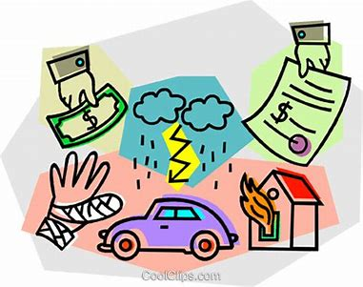
sure
unsure
ensure
assure
measure
insure

Slide 9
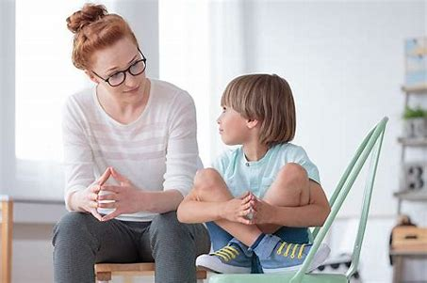
sure
unsure
ensure
assure
measure
insure
reassure

Slide 10
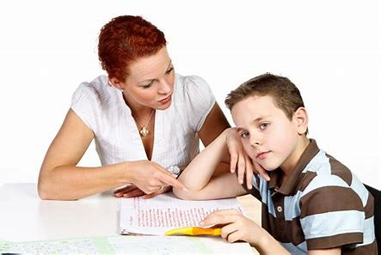
sure
unsure
ensure
assure
measure
insure
reassure
pressure

Slide 11
sure
unsure
ensure
assure
measure
insure
reassure
pressure
closure

Slide 12
sure
unsure
ensure
assure
measure
insure
reassure
pressure
closure
10. censure

Slide 13
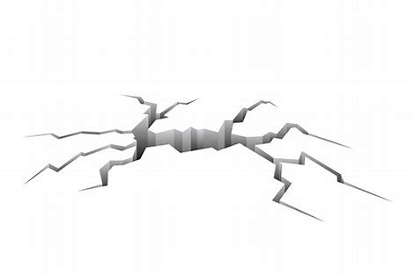
sure
unsure
ensure
assure
measure
insure
reassure
pressure
closure
10. censure
11. fissure

Slide 14
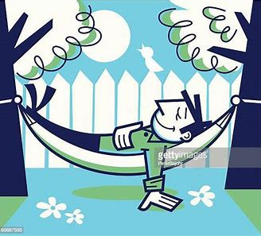
sure
unsure
ensure
assure
measure
insure
reassure
pressure
closure
10. censure
11. fissure
12. leisurely

Slide 15
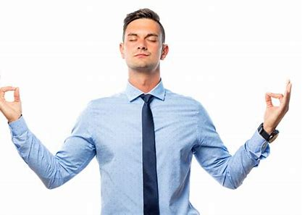
sure
unsure
ensure
assure
measure
insure
reassure
pressure
closure
10. censure
11. fissure
12. leisurely
13. composure

Slide 16
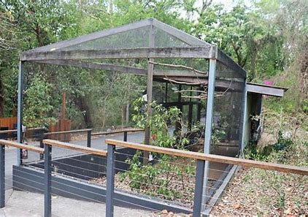
sure
unsure
ensure
assure
measure
insure
reassure
pressure
closure
10. censure
11. fissure
12. leisurely
13. composure
14. enclosure

Slide 17
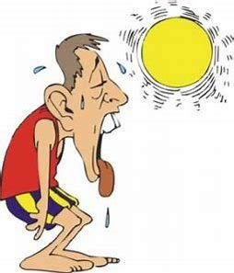
sure
unsure
ensure
assure
measure
insure
reassure
pressure
closure
10. censure
11. fissure
12. leisurely
13. composure
14. enclosure
15. overexposure

Slide 18
sure
unsure
ensure
assure
measure
insure
reassure
pressure
closure
10. censure
11. fissure
12. leisurely
13. composure
14. enclosure
15. overexposure
16. disclosure

Slide 19
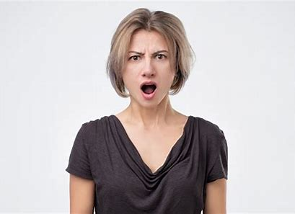
sure
unsure
ensure
assure
measure
insure
reassure
pressure
closure
10. censure
11. fissure
12. leisurely
13. composure
14. enclosure
15. overexposure
16. disclosure
17. displeasure

Slide 20
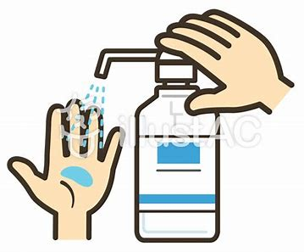
sure
unsure
ensure
assure
measure
insure
reassure
pressure
closure
10. censure
11. fissure
12. leisurely
13. composure
14. enclosure
15. overexposure
16. disclosure
17. displeasure
18. countermeasure

Slide 21
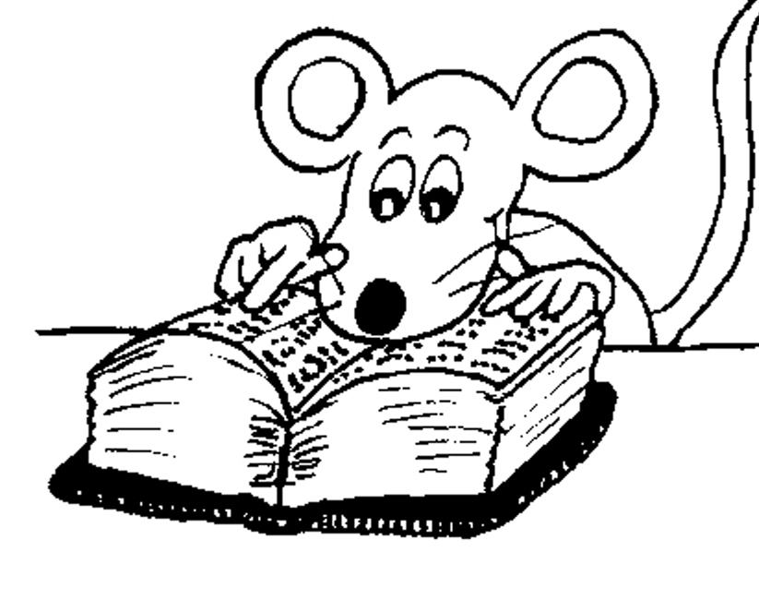
Let’s Review

Slide 22
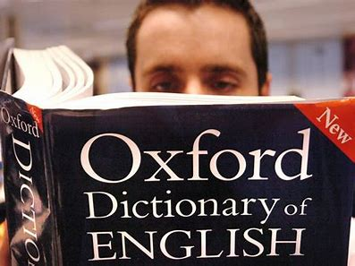
Tom looked up a word in the dictionary.

Slide 23
Tom looked up a word in the dictionary.

Slide 24
Tom looked up a word in the dictionary.
found

Slide 25
Tom looked up a word in the dictionary.
found
phrasal verb

Slide 26
Tom looked up a word in the dictionary.
found
phrasal verbs
blow up
break in
calm down
check in
fall apart

Slide 27
Tom looked up a word in the dictionary.
found
phrasal verbs
blow up
break in
calm down
check in
fall apart
get away
give in
grow out of
mix up
sleep over …

Slide 28
Activity Page
Phrasal Verbs

Slide 29
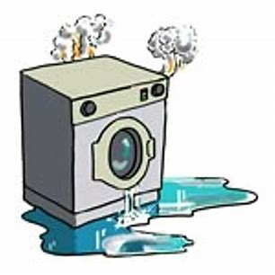
My washing machine broke down on Tuesday.

Slide 30
My washing machine broke down on Tuesday. → stopped working

Slide 31
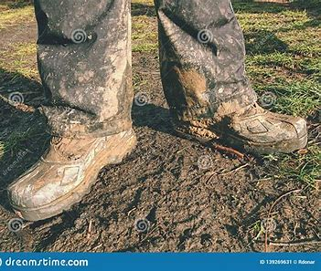
The farmer took off his muddy boots.

Slide 32
The farmer took off his muddy boots.
→ removed

Slide 33
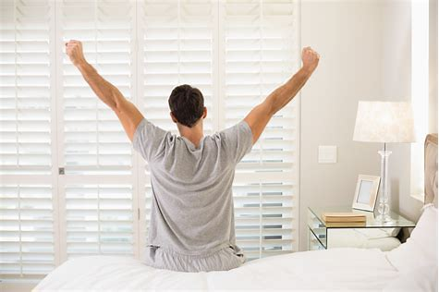
What time do you get up in the morning?

Slide 34
What time do you get up in the morning? → get out of bed

Slide 35
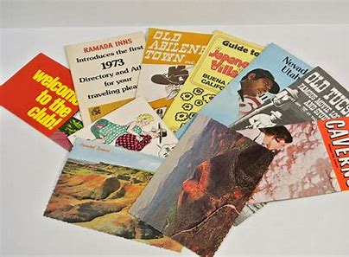
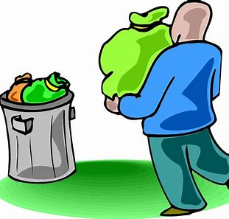
Did he throw away those old travel brochures?

Slide 36
Did he throw away those old travel brochures? → get rid of

Slide 37
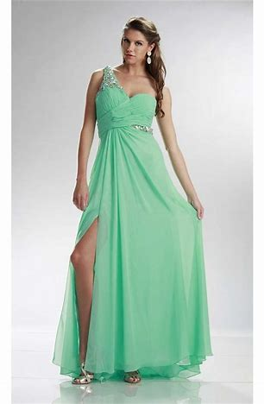
Anna tried on the green chiffon ballgown.

Slide 38
Anna tried on the green chiffon ballgown.
→ put on to see how it looks of fits

Slide 39
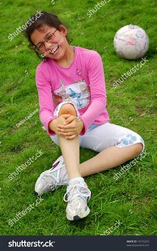
I fell over in the park and grazed my knee.

Slide 40
I fell over in the park and grazed my knee.
→ fell onto the ground

Slide 41
The chauffeur brings back the car every evening.

Slide 42
The chauffeur brings back the car every evening. → returns

Slide 43
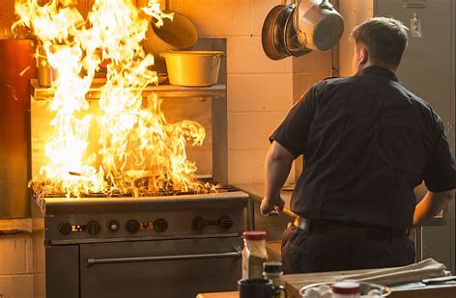
A fire broke out yesterday in the chef’s kitchen.

Slide 44
A fire broke out yesterday in the chef’s kitchen. → started suddenly

Slide 45
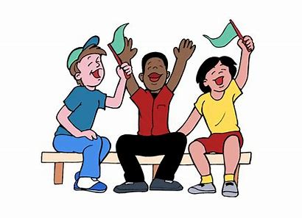
Cheer up!

Slide 46
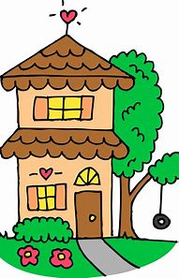
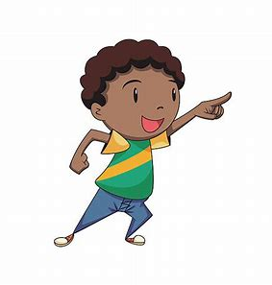
We found out where he lives.

Slide 47
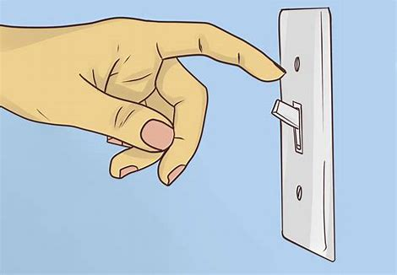
Don’t turn off the light.

Slide 48
If you come across an unfamiliar word,
look it up in your dictionary.

Slide 49
I look forward to my birthday
and Christmas.

Slide 50
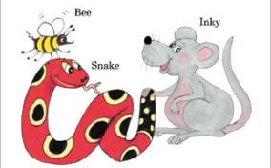
See you
next time!

