Slide 1
Jolly Grammar
5b-1

Slide 2
Let’s review
Prepositions and prepositional phrases.

Slide 3
Underline each preposition in green and add a noun phrase to it to make it a prepositional phrase.

Slide 4
by
with
down
over
after
opposite
the window
the friends
the stairs
the rabbit
school
you and me

Slide 5
up
near
into
until
beneath
behind
the room
his house
the box
the 3 o’clock
the table
the sofa

Slide 6
Let’s review
spellings.

Slide 7
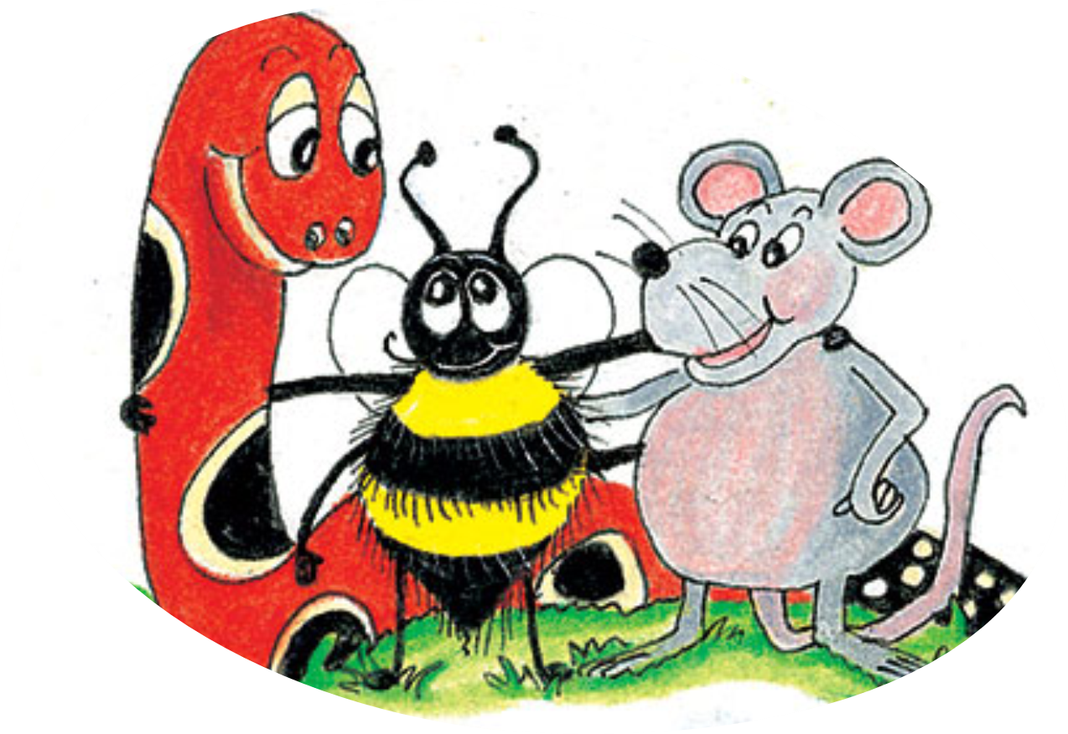
chef
parachute
machine
chevron
brochure
chauffeur

Slide 8
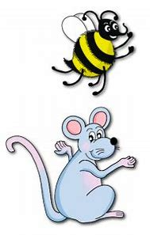
Spelling Point
<sure>

Slide 9
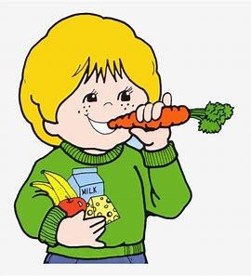
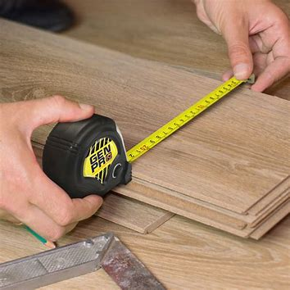
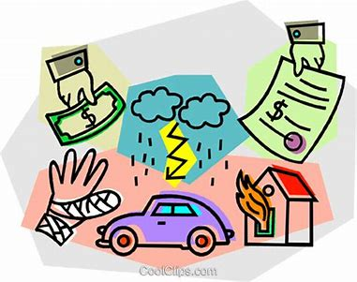
sure unsure ensure
assure measure insure

Slide 10
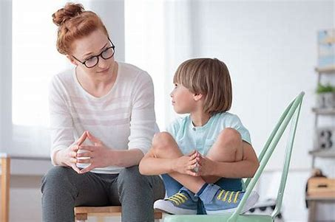
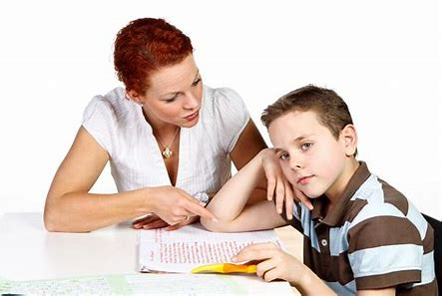
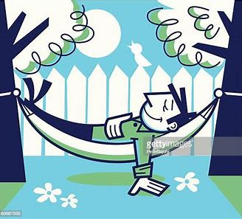
reassure pressure closure
censure fissure leisurely

Slide 11
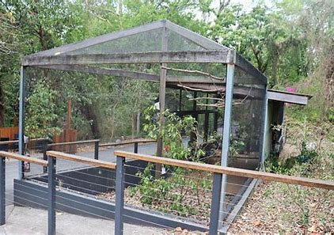
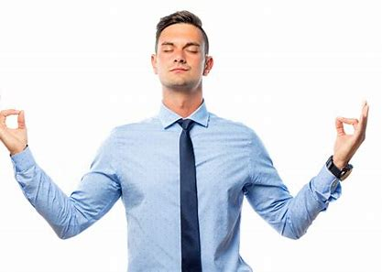
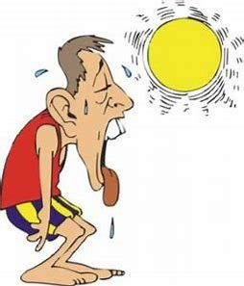
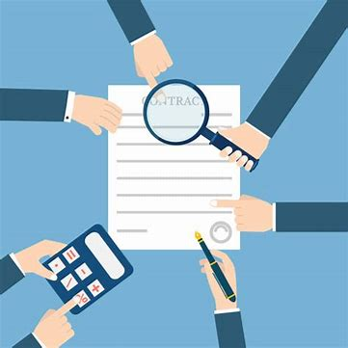
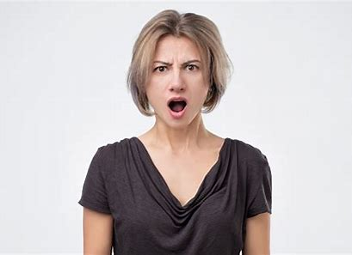
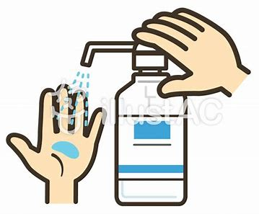
composure enclosure overexposure
disclosure displeasure countermeasure
disclosure displeasure countermeasure

Slide 13
Activity Page:
Spelling
<sure>

Slide 14
Complete sentences.

Slide 15
Parsing & Sentence Walls

Slide 16
The kind policeman had reassured the old couple during his visit.
Subject
policeman
The kind
Verb
had reassured
(transitive)
during his visit
Object
couple
the old

Slide 17
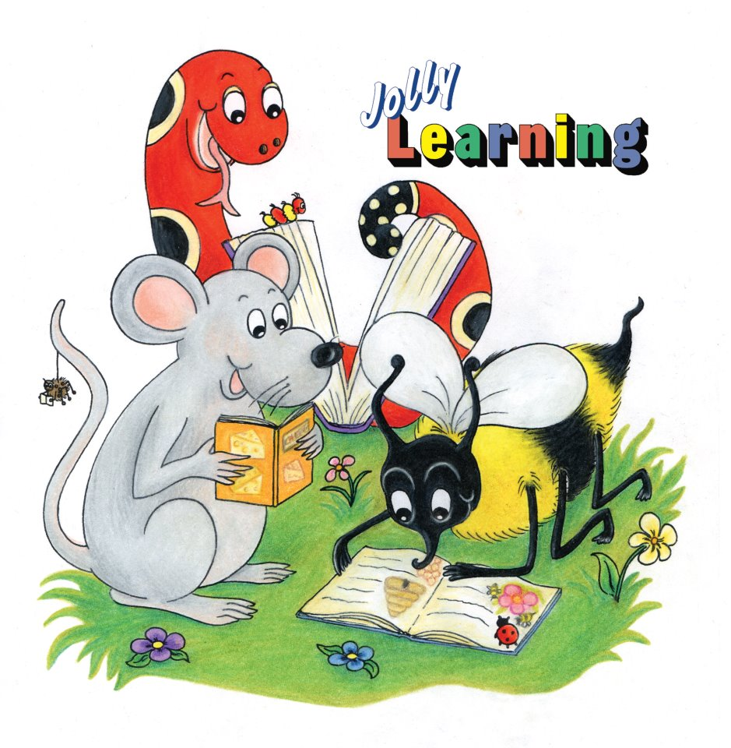
Dictation

Slide 18
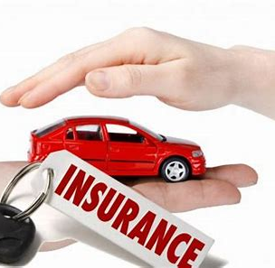

Slide 19
Ensure that you are insured before driving the car.

Slide 21
“I’m sure that can’t be true,” she said with displeasure.

Slide 22
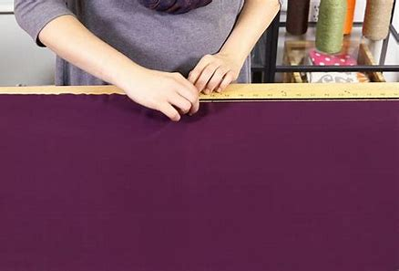

Slide 23
The dressmaker measured the chiffon carefully before she cut it.

Slide 24
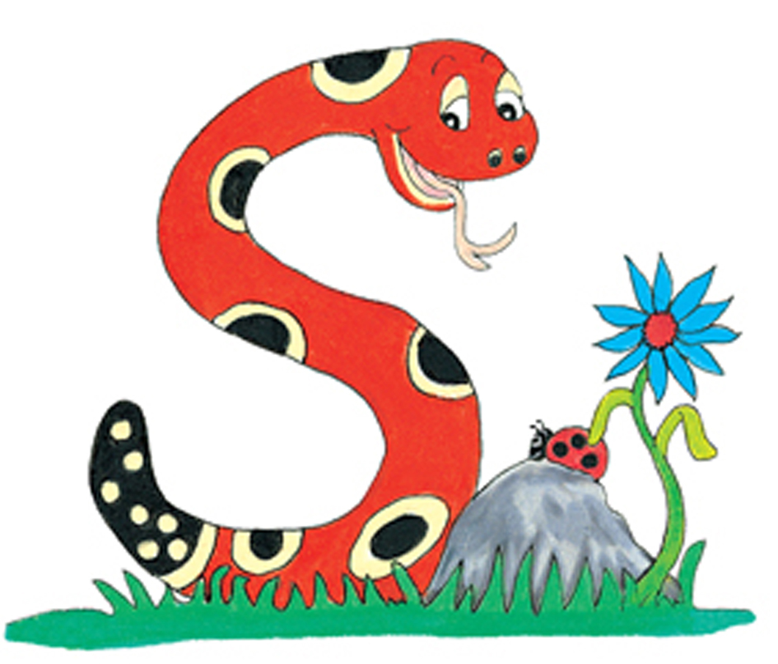
Thank you.
See you
next time!

