Slide 1
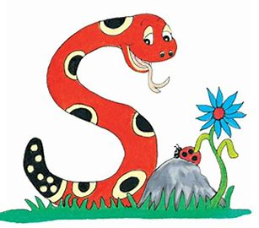
Jolly Grammar
4b-34

Slide 2
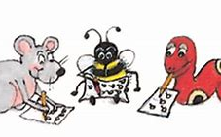
Spelling Test 17

Slide 3
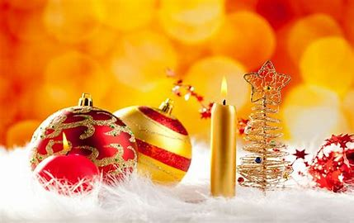
festive

Slide 4
festive
positive

Slide 5
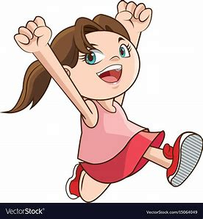
festive
positive
active

Slide 6
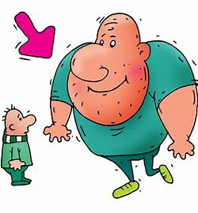
festive
positive
active
massive

Slide 7
festive
positive
active
massive
negative

Slide 8
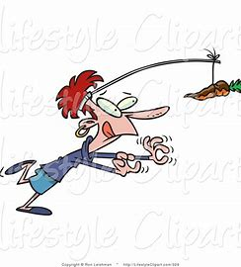
festive
positive
active
massive
negative
motive

Slide 9
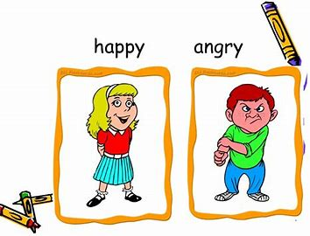
festive
positive
active
massive
negative
motive
7.adjective

Slide 10
festive
positive
active
massive
negative
motive
7.adjective
8.impressive

Slide 11
festive
positive
active
massive
negative
motive
7.adjective
8.impressive
9.explosive

Slide 12
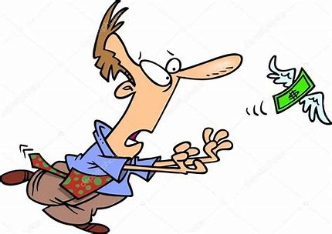
festive
positive
active
massive
negative
motive
7.adjective
8.impressive
9.explosive
10.elusive

Slide 13
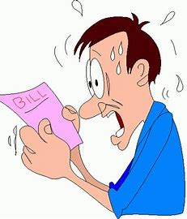
festive
positive
active
massive
negative
motive
7.adjective
8.impressive
9.explosive
10.elusive
11.expensive

Slide 14
festive
positive
active
massive
negative
motive
7.adjective
8.impressive
9.explosive
10.elusive
11.expensive
12.superlative

Slide 15
festive
positive
active
massive
negative
motive
7.adjective
8.impressive
9.explosive
10.elusive
11.expensive
12.superlative
13.constructive

Slide 16
festive
positive
active
massive
negative
motive
7.adjective
8.impressive
9.explosive
10.elusive
11.expensive
12.superlative
13.constructive
14.destructive

Slide 17
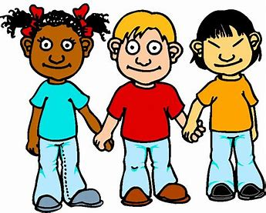
festive
positive
active
massive
negative
motive
7.adjective
8.impressive
9.explosive
10.elusive
11.expensive
12.superlative
13.constructive
14.destructive
15.exclusive

Slide 18
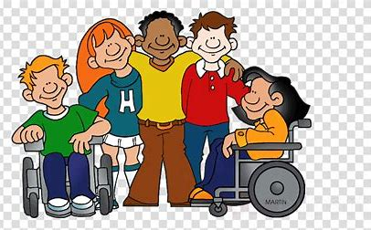
festive
positive
active
massive
negative
motive
7.adjective
8.impressive
9.explosive
10.elusive
11.expensive
12.superlative
13.constructive
14.destructive
15.exclusive
16.inclusive

Slide 19
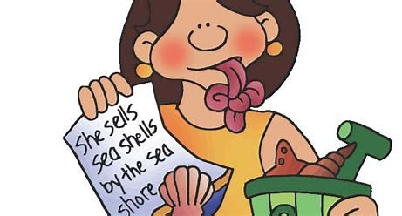
festive
positive
active
massive
negative
motive
7.adjective
8.impressive
9.explosive
10.elusive
11.expensive
12.superlative
13.constructive
14.destructive
15.exclusive
16.inclusive
17.alliterative

Slide 20
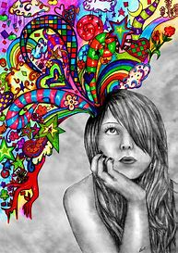
festive
positive
active
massive
negative
motive
7.adjective
8.impressive
9.explosive
10.elusive
11.expensive
12.superlative
13.constructive
14.destructive
15.exclusive
16.inclusive
17.alliterative
18.imaginative

Slide 21
Let’s Revise Possessive
Adjectives

Slide 22
I have
You have
He has
She has
It has
We have
You have
They have
book.

Slide 23
I have
You have
He has
She has
It has
We have
You have
They have
my book.

Slide 24
I have
You have
He has
She has
It has
We have
You have
They have
my book.
your book.

Slide 25
I have
You have
He has
She has
It has
We have
You have
They have
my book.
your book.
his book.

Slide 26
I have
You have
He has
She has
It has
We have
You have
They have
my book.
your book.
his book.
her book.

Slide 27
I have
You have
He has
She has
It has
We have
You have
They have
my book.
your book.
his book.
her book.
its book.

Slide 28
I have
You have
He has
She has
It has
We have
You have
They have
my book.
your book.
his book.
her book.
its book.
our books.

Slide 29
I have
You have
He has
She has
It has
We have
You have
They have
my book.
your book.
his book.
her book.
its book.
our books.
your books.

Slide 30
I have
You have
He has
She has
It has
We have
You have
They have
my book.
your book.
his book.
her book.
its book.
our books.
your books.
their books.

Slide 31
Let’s Revise Contractions

Slide 32
do not
they are
you are
it is

Slide 33
do not
they are
you are
it is
don’t

Slide 34
do not
they are
you are
it is
don’t
they’re

Slide 35
do not
they are
you are
it is
don’t
they’re
you’re

Slide 36
do not
they are
you are
it is
don’t
they’re
you’re
it’s

Slide 37
Let’s Revise Homophones

Slide 38
to
two
too

Slide 39
to
She is going to sing.
two
too

Slide 40
to
She is going to sing.
I am going to the park.
two
too

Slide 41
to
She is going to sing.
I am going to the park.
two
He has two cars.
too

Slide 42
to
She is going to sing.
I am going to the park.
two
He has two cars.
too
You are tall too.

Slide 43
to ＝infinitive, preposition
She is going to sing.
I am going to the park.
two
He has two cars.
too
You are tall too.

Slide 44
to ＝infinitive, preposition
She is going to sing.
I am going to the park.
two ＝２
He has two cars.
too
You are tall too.

Slide 45
to ＝infinitive, preposition
She is going to sing.
I am going to the park.
two ＝２
He has two cars.
too ＝also
You are tall too.

Slide 46
your
you’re

Slide 47
your
I like your bag.
you’re

Slide 48
your
I like your bag.
you’re
You’re so lucky.

Slide 49
your＝possessive adjective
I like your bag.
you’re
You’re so lucky.

Slide 50
your＝possessive adjective
I like your bag.
you’re＝ you are
You’re so lucky.

Slide 51
there
their
they’re

Slide 52
there
The house is over there.
their
they’re

Slide 53
there
The house is over there.
their
I love their cookies.
they’re

Slide 54
there
The house is over there.
their
I love their cookies.
they’re
They’re my parents.

Slide 55
there＝adverb to show position
The house is over there.
their
I love their cookies.
they’re
They’re my parents.

Slide 56
there＝adverb to show position
The house is over there.
their＝possessive adjective
I love their cookies.
they’re
They’re my parents.

Slide 57
there＝adverb to show position
The house is over there.
their＝possessive adjective
I love their cookies.
they’re＝ they are
They’re my parents.

Slide 58
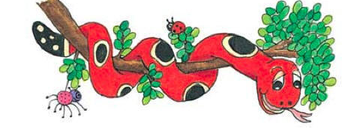
Activity Page:
Homophones(to, too, two)

Slide 59
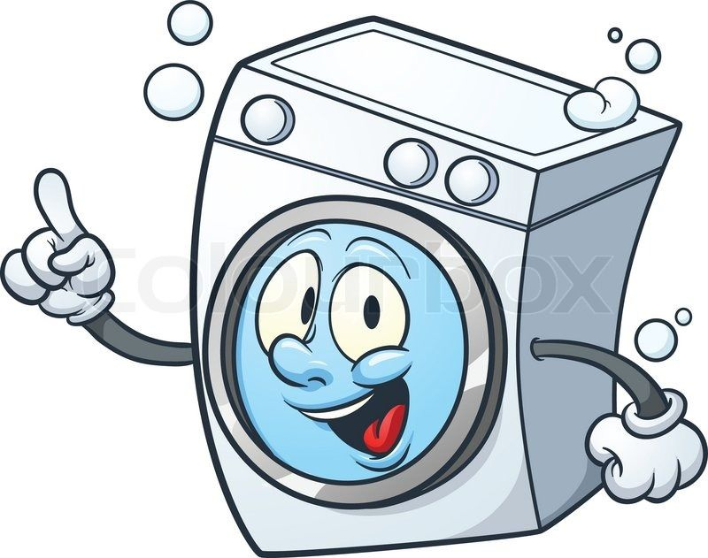
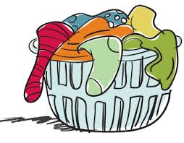
We put our dirty clothes
In the washing machine.

Slide 60
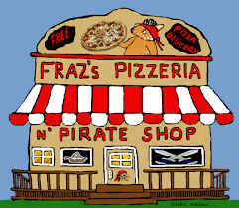
Ask them if they’re going to the new pizzeria tonight.

Slide 61
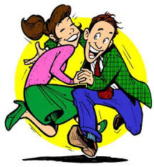
Her parents are already on their way.

Slide 62
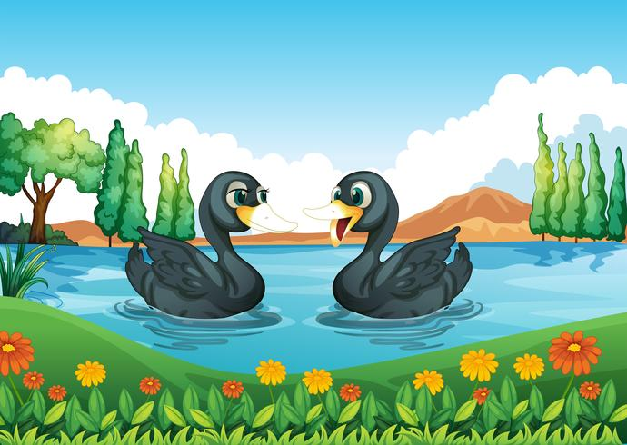
There were two ducks on the pond.

Slide 63
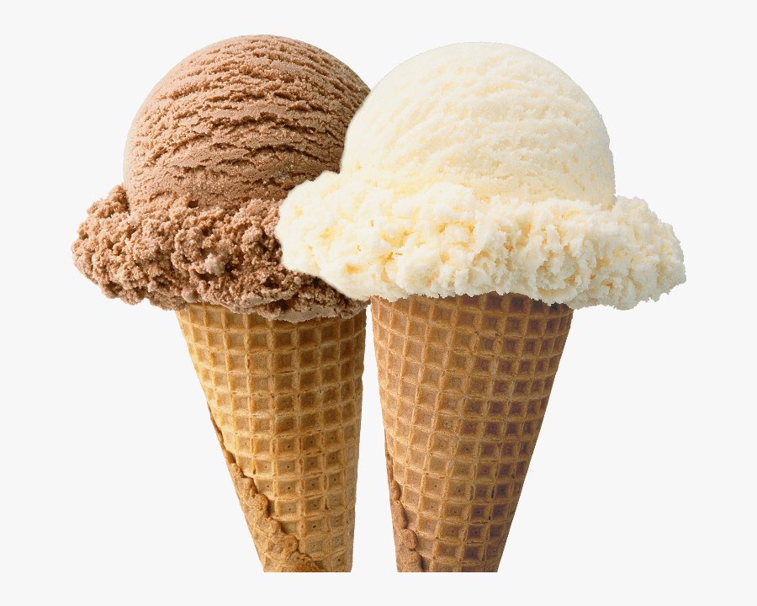
If you’re having vanilla ice cream, I will have chocolate.

Slide 64
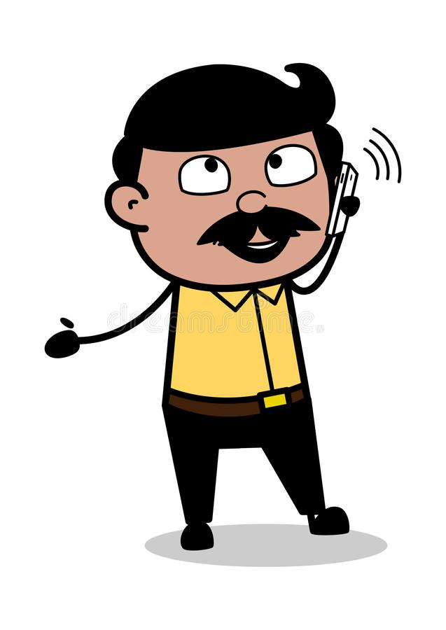
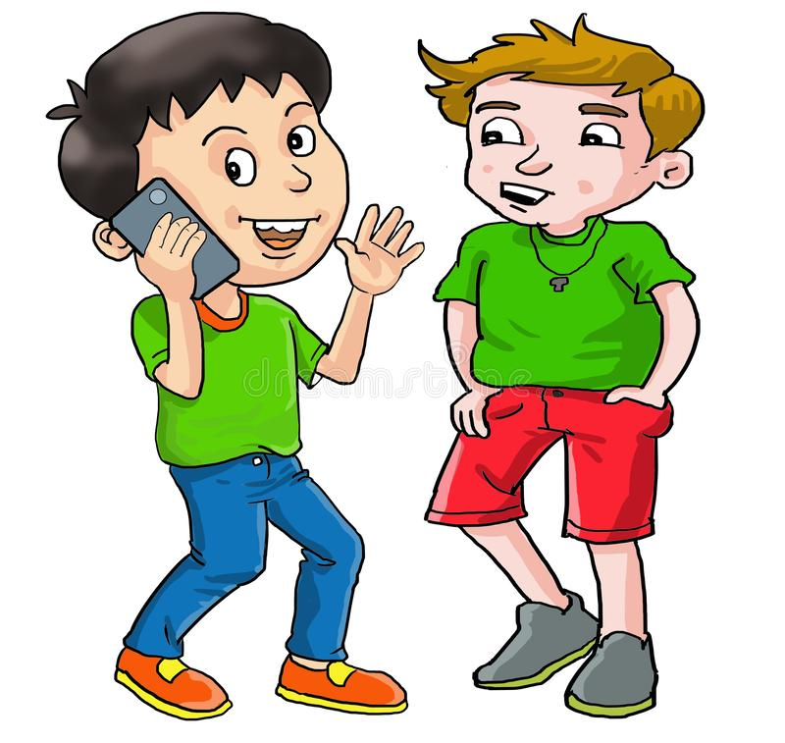
Dad wants to know if we are coming home now.

Slide 65
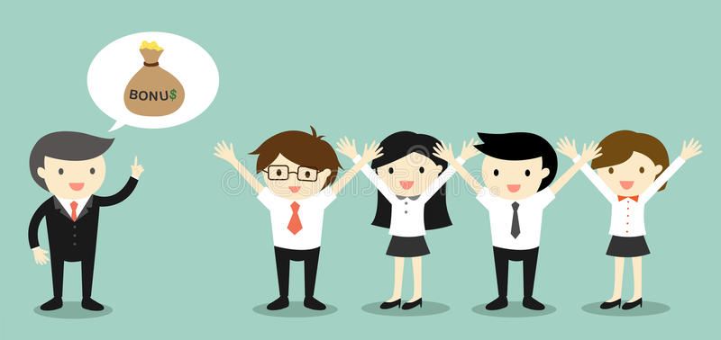
I hope you’re feeling lucky!

Slide 66
Is it your birthday next week?

Slide 67
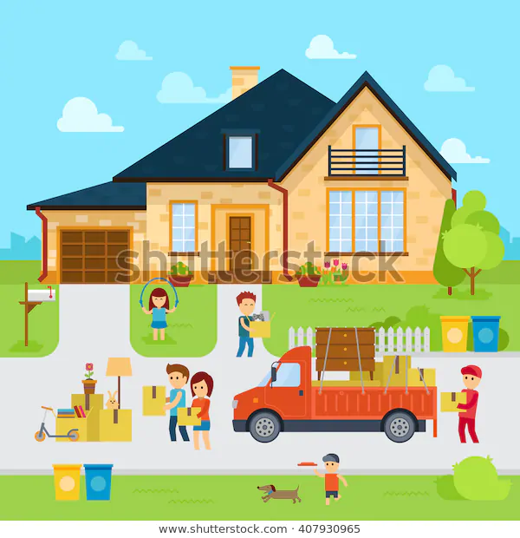
We went to see your new house today.

Slide 68
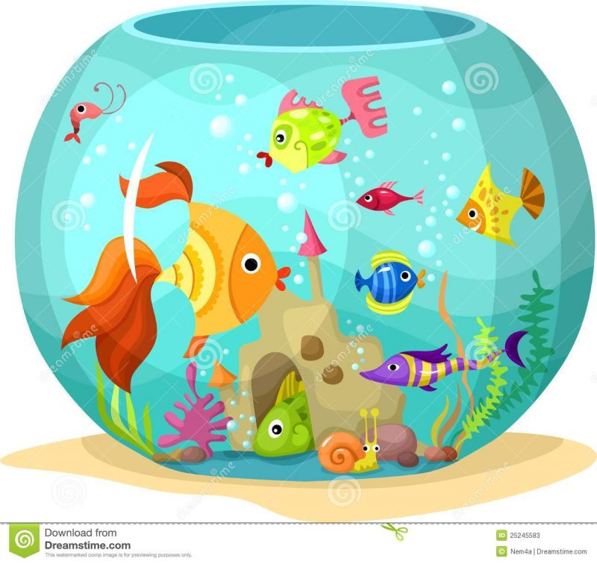
They keep the fish in their aquarium.

Slide 69
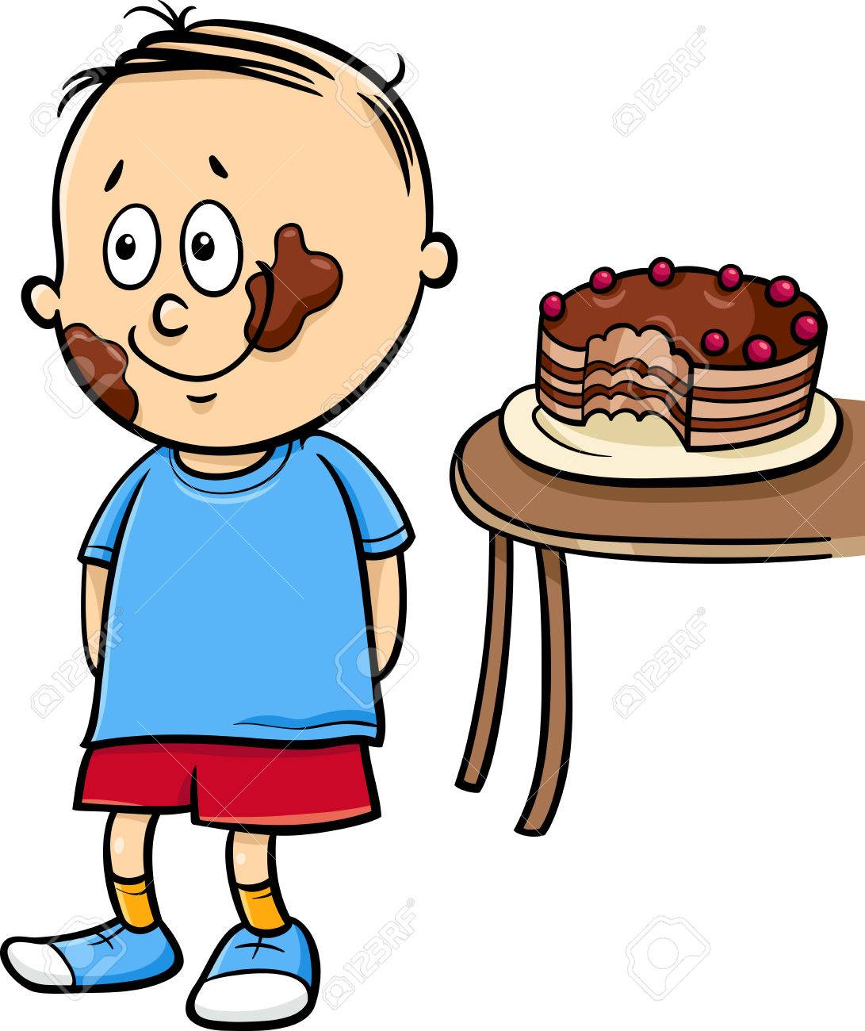
I would like some more cake too, please.

Slide 70
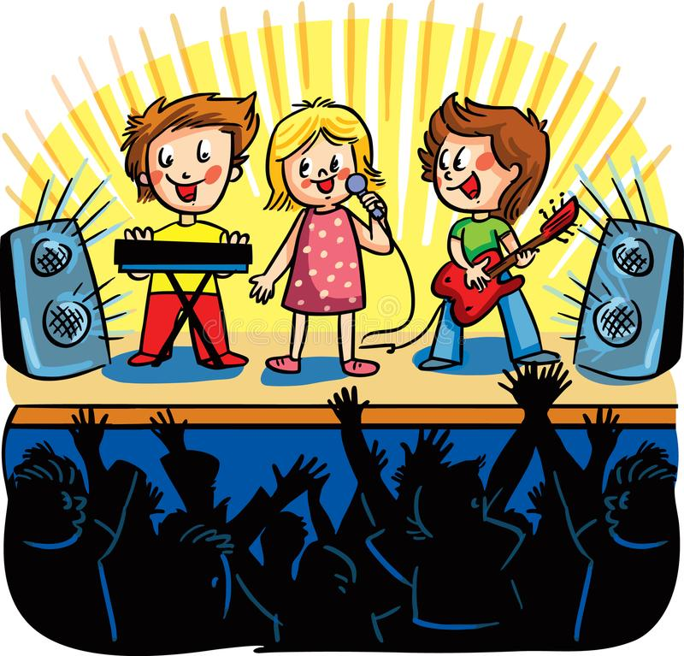
We went to a fabulous concert at our school.

Slide 71
There is a fantastic movie on next week.

Slide 72
This month our class is reading a classic novel.

Slide 73
Thank you.
See you
next time!

