Slide 1
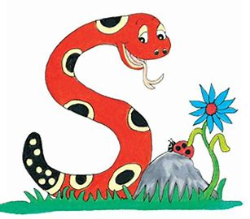
Jolly Grammar
4a-33

Slide 2
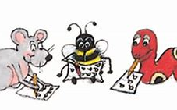
Let’s review comparatives & superlatives

Slide 3
This is a good book.

Slide 4
This is a good book.
This is a better book.
This is the best book.

Slide 5
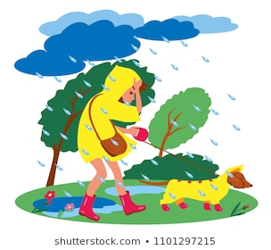
We are expecting bad weather
tomorrow.

Slide 6
We are expecting bad weather
tomorrow.
We are expecting worse weather tomorrow.
We are expecting the worst weather
tomorrow.

Slide 7
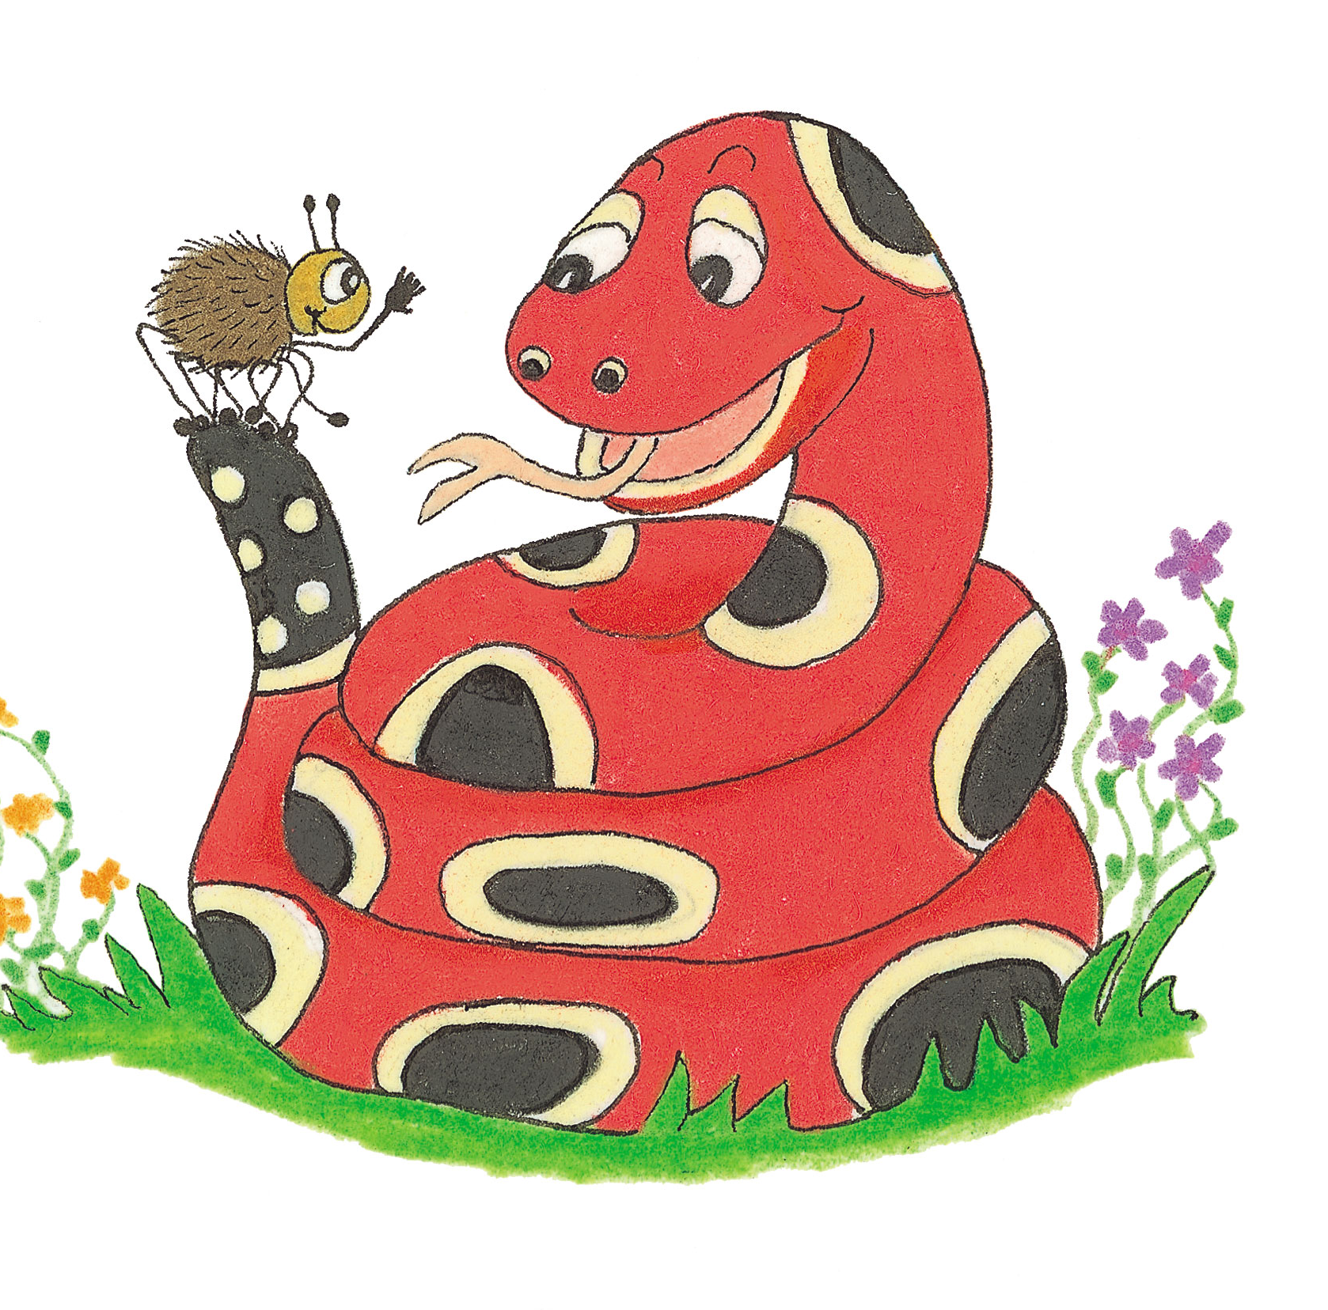
Let’s Revise schwa.

Slide 8
magazine
carrot
success
standard
motor
interrupt

Slide 9
festive
/iv/

Slide 10
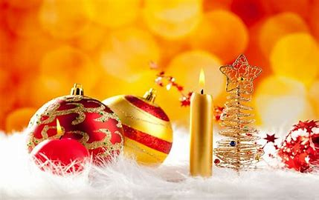
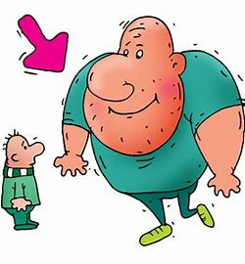
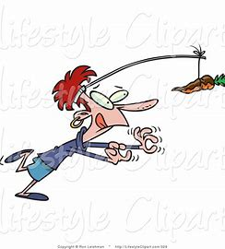
festive positive active
massive negative motive

Slide 11
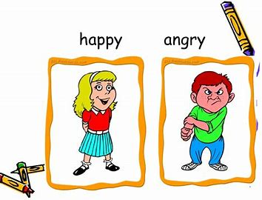
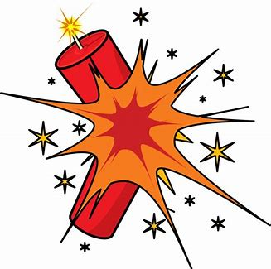
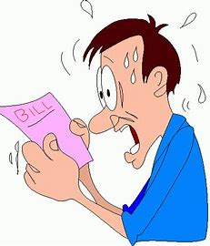
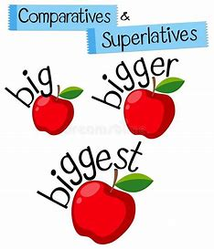
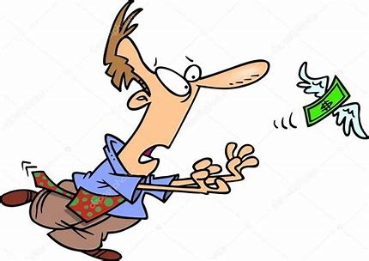
adjective impressive explosive
elusive expensive superlative

Slide 12
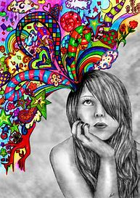
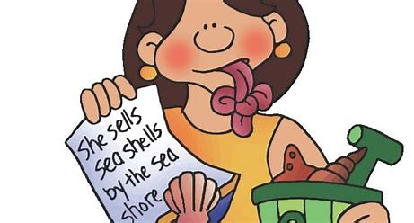
constructive destructive exclusive
inclusive alliterative imaginative

Slide 15
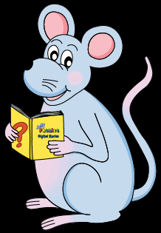
Activity Page
<ive>saying /iv/

Slide 16
Alliteration

Slide 17
Alliteration
Y
R
M

Slide 18
Alliteration
I’m used to yelling at your yellowbellies
Y
R
M

Slide 19
Alliteration
I’m used to yelling at your yellowbellies
The red roses were wrapped in ribbons.
Y
R
M

Slide 20
Alliteration
I’m used to yelling at your yellowbellies
The red roses were wrapped in ribbons.
Most monsters don’t mind making messes.
Y
R
M

Slide 21
Antonyms
massive
active
constructive
negative
impressive
expensive
exclusive
imaginative

Slide 22
Antonyms
massive
active
constructive
negative
positive
impressive
expensive
exclusive
imaginative

Slide 23
Antonyms
massive
small
active
constructive
negative
positive
impressive
expensive
exclusive
imaginative

Slide 24
Antonyms
massive
small
active
constructive
destructive
negative
positive
impressive
expensive
exclusive
imaginative

Slide 25
Antonyms
massive
small
active
passive
constructive
destructive
negative
positive
impressive
expensive
exclusive
imaginative

Slide 26
Antonyms
massive
small
active
passive
constructive
destructive
negative
positive
impressive
expensive
exclusive
inclusive
imaginative

Slide 27
Antonyms
massive
small
active
passive
constructive
destructive
negative
positive
impressive
unimpressive
expensive
exclusive
inclusive
imaginative

Slide 28
Antonyms
massive
small
active
passive
constructive
destructive
negative
positive
impressive
unimpressive
i
expensive
exclusive
inclusive
imaginative
unimaginative

Slide 29
Antonyms
massive
small
active
passive
constructive
destructive
negative
positive
impressive
unimpressive
i
expensive
cheap
exclusive
inclusive
imaginative
unimaginative

Slide 30
parsing

Slide 31
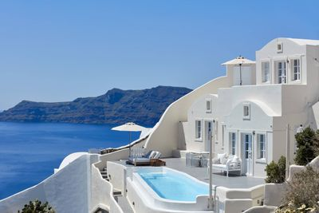
They are building an expensive and exclusive hotel on the Greek island.

Slide 32
They are building an expensive and exclusive hotel on the Greek island.

Slide 33
They are building an expensive and exclusive hotel on the Greek island.

Slide 34
They are building an expensive and exclusive hotel on the Greek island.

Slide 35
They are building an expensive and exclusive hotel on the Greek island.

Slide 36
They are building an expensive and exclusive hotel on the Greek island.

Slide 37
They are building an expensive and exclusive hotel on the Greek island.

Slide 38
They are building an expensive and exclusive hotel on the Greek island.

Slide 39
They are building an expensive and exclusive hotel on the Greek island.

Slide 40
They are building an expensive and exclusive hotel on the Greek island.
Present
Continuous

Slide 41
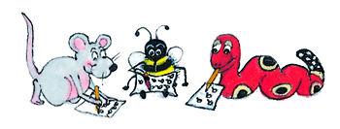
Dictation

Slide 42
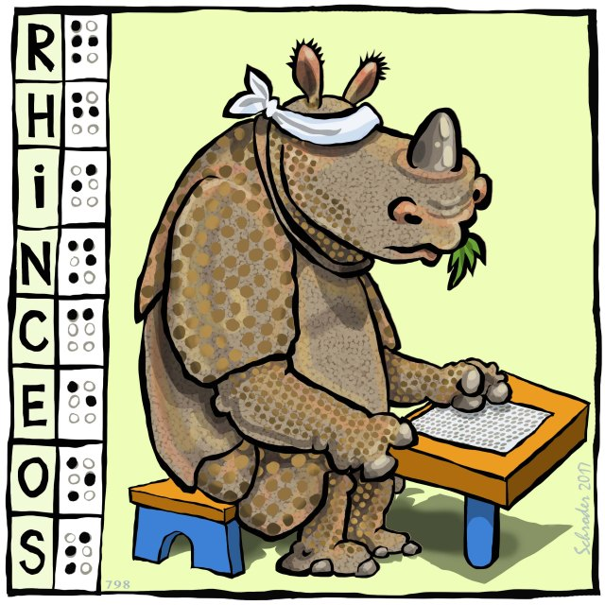

Slide 43
That rhinoceros is truly impressive.

Slide 45
She wore expensive pearl earrings.

Slide 46
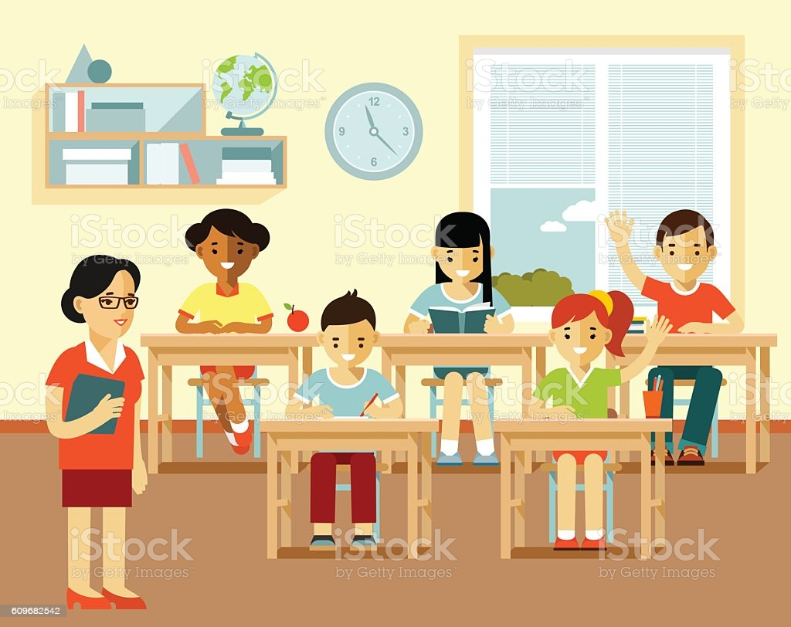

Slide 47
“What is an adjective?” asked the teacher.

Slide 48
Thank you.
See you
next time!

