Slide 1
Jolly Grammar
4a-32

Slide 2
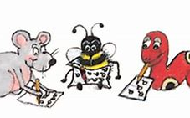
Spelling Test 16

Slide 3
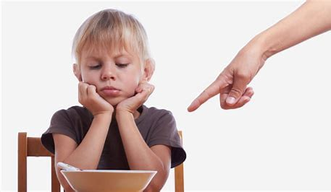
ought

Slide 4
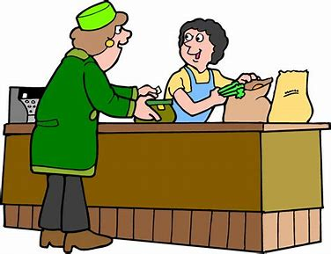
ought
bought

Slide 5
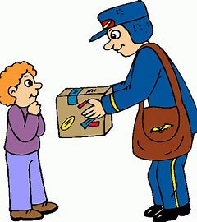
ought
bought
brought

Slide 6
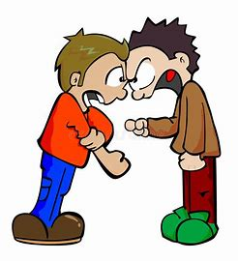
ought
bought
brought
fought

Slide 7
ought
bought
brought
fought
nought

Slide 8
ought
bought
brought
fought
nought
thought

Slide 9
ought
bought
brought
fought
nought
thought
7.ghostly

Slide 10
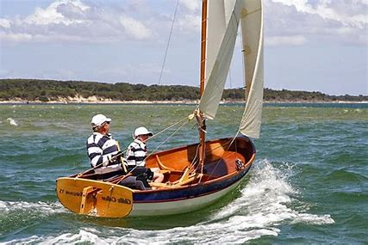
ought
bought
brought
fought
nought
thought
7.ghostly
8.dinghy

Slide 11
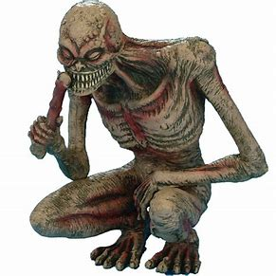
ought
bought
brought
fought
nought
thought
7.ghostly
8.dinghy
9.ghoul

Slide 12
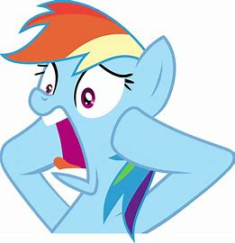
ought
bought
brought
fought
nought
thought
7.ghostly
8.dinghy
9.ghoul
10.aghast

Slide 13
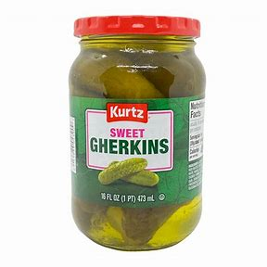
ought
bought
brought
fought
nought
thought
7.ghostly
8.dinghy
9.ghoul
10.aghast
11.gherkin

Slide 14
ought
bought
brought
fought
nought
thought
7.ghostly
8.dinghy
9.ghoul
10.aghast
11.gherkin
12.yoghurt

Slide 15
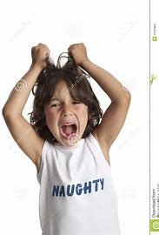
ought
bought
brought
fought
nought
thought
7.ghostly
8.dinghy
9.ghoul
10.aghast
11.gherkin
12.yoghurt
13.naughty

Slide 16
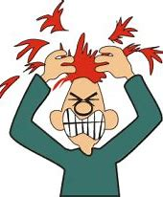
ought
bought
brought
fought
nought
thought
7.ghostly
8.dinghy
9.ghoul
10.aghast
11.gherkin
12.yoghurt
13.naughty
14.fraught

Slide 17
ought
bought
brought
fought
nought
thought
7.ghostly
8.dinghy
9.ghoul
10.aghast
11.gherkin
12.yoghurt
13.naughty
14.fraught
15.caught

Slide 18
ought
bought
brought
fought
nought
thought
7.ghostly
8.dinghy
9.ghoul
10.aghast
11.gherkin
12.yoghurt
13.naughty
14.fraught
15.caught
16.daughter

Slide 19
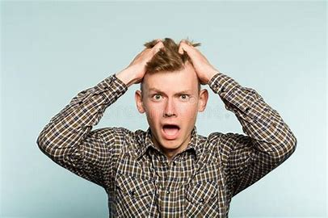
ought
bought
brought
fought
nought
thought
7.ghostly
8.dinghy
9.ghoul
10.aghast
11.gherkin
12.yoghurt
13.naughty
14.fraught
15.caught
16.daughter
17.distraught

Slide 20
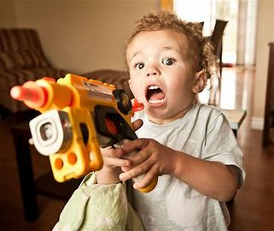
ought
bought
brought
fought
nought
thought
7.ghostly
8.dinghy
9.ghoul
10.aghast
11.gherkin
12.yoghurt
13.naughty
14.fraught
15.caught
16.daughter
17.distraught
18.onslaught

Slide 21
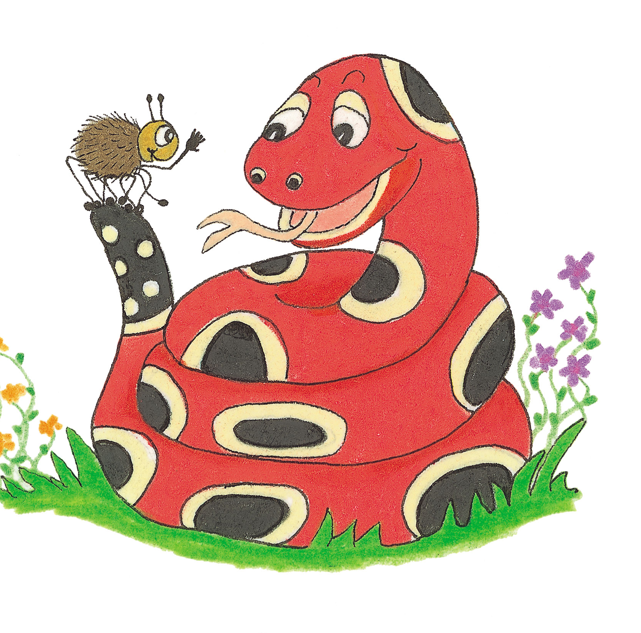
Let’s Revise Comparative
and
Superlative
Adjectives

Slide 22
small

Slide 23
small
Comparative Superlative

Slide 24
small
Comparative Superlative
smaller

Slide 25
small
Comparative Superlative
smaller smallest

Slide 26
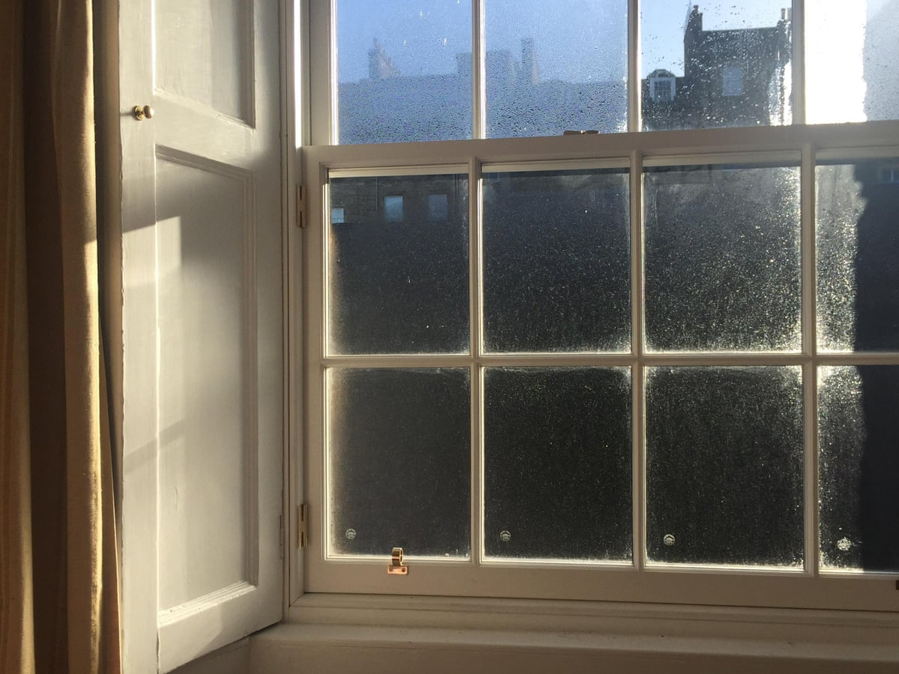
draughty

Slide 27
draughty
Comparative Superlative

Slide 28
draughty
Comparative Superlative
draughtier

Slide 29
draughty
Comparative Superlative
draughtier draughtiest

Slide 30
difficult
Comparative Superlative

Slide 31
difficult
Comparative Superlative
more difficult

Slide 32
difficult
Comparative Superlative
more difficult most difficult

Slide 33
careless
Comparative Superlative

Slide 34
careless
Comparative Superlative
more careless

Slide 35
careless
Comparative Superlative
more careless most careless

Slide 36
good
Comparative Superlative
gooder? goodest?

Slide 37
good
This is a good story.

Slide 38
good
This is a good story.
Comparative Superlative

Slide 39
good
This is a good story.
Comparative Superlative
better
This is a better story.

Slide 40
good
This is a good story.
Comparative Superlative
better best
This is a better story. This is the best story.

Slide 41
bad
This is a bad story.

Slide 42
bad
This is a bad story.
Comparative Superlative

Slide 43
bad
This is a bad story.
Comparative Superlative
worse
This is a worse story.

Slide 44
bad
This is a bad story.
Comparative Superlative
worse worst
This is a worse story. This is the worst story.

Slide 45
Activity Page:
Comparatives and Superlatives 2

Slide 46
It was a good day.

Slide 47
It was a good day.
It was a better day.

Slide 48
It was a good day.
It was a better day.
It was the best day.

Slide 49
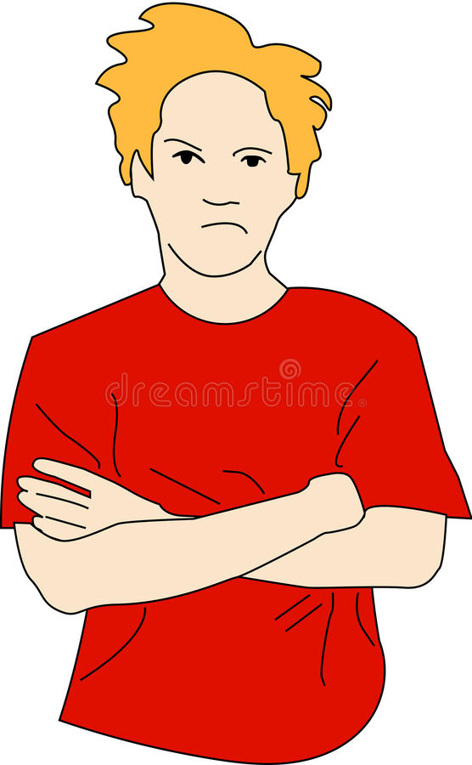
He was in a bad mood.

Slide 50
He was in a bad mood.
He was in a worse mood.
He was in the worst mood.

Slide 51
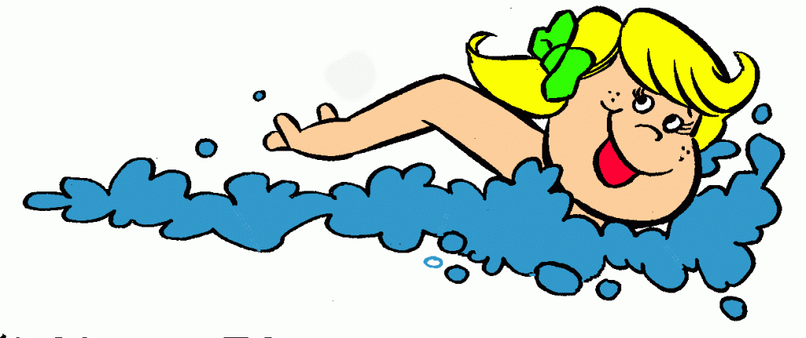
She is a good swimmer.

Slide 52
She is a good swimmer.
She is a better swimmer.
She is the best swimmer.

Slide 53
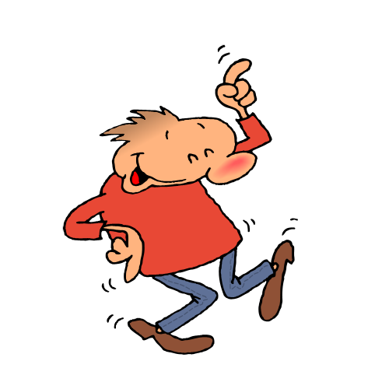
Dad is a bad dancer.

Slide 54
Dad is a bad dancer.
Dad is a worse dancer.
Dad is the worst dancer.

Slide 55
This is a good book.

Slide 56
This is a good book.
This is a better book.
This is the best book.

Slide 57
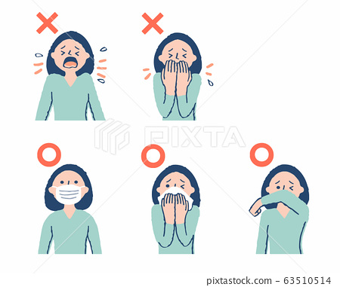
That is a bad example.

Slide 58
That is a bad example.
That is a worse example.
That is the worst example.

Slide 59
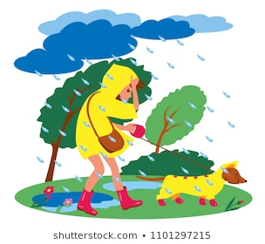
We are expecting bad weather
tomorrow.

Slide 60
We are expecting bad weather
tomorrow.
We are expecting worse weather tomorrow.
We are expecting the worst weather
tomorrow.

Slide 61
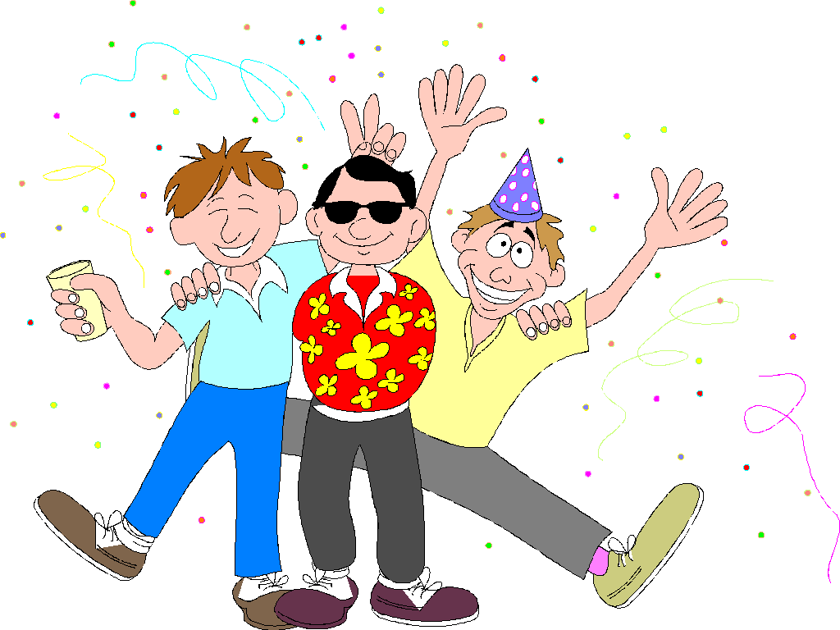
They had a good time at the party.

Slide 62
They had a good time at the party.
They had a better time at the party.
They had the best time at the party.

Slide 63
Thank you.
See you
next time!

