Slide 1
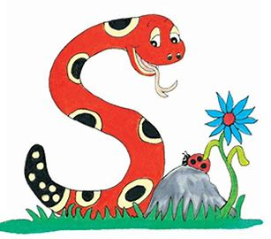
Jolly Grammar
4a-30

Slide 2
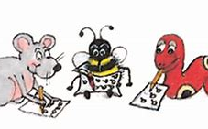
Spelling Test 15

Slide 3
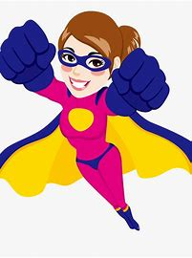
super

Slide 4
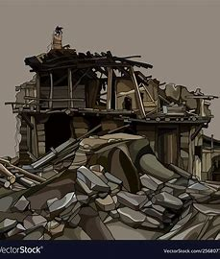
super
ruin

Slide 5
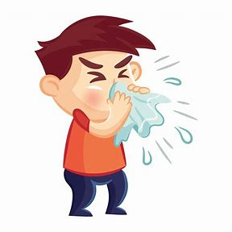
super
ruin
flu

Slide 6
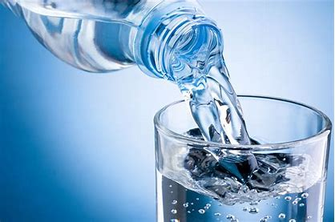
super
ruin
flu
fluid

Slide 7
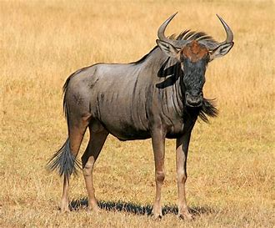
super
ruin
flu
fluid
gnu

Slide 8
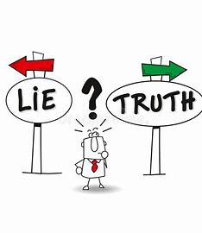
super
ruin
flu
fluid
gnu
truth

Slide 9
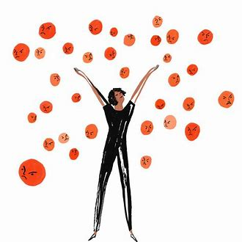
super
ruin
flu
fluid
gnu
truth
7.truly

Slide 10
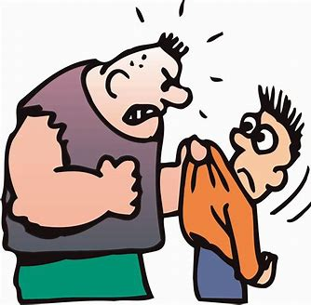
super
ruin
flu
fluid
gnu
truth
7.truly
8.cruel

Slide 11
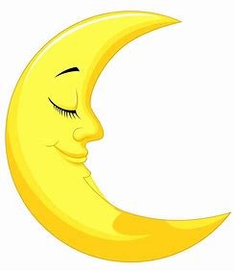
super
ruin
flu
fluid
gnu
truth
7.truly
8.cruel
9.lunar

Slide 12
super
ruin
flu
fluid
gnu
truth
7.truly
8.cruel
9.lunar
10.ruby

Slide 13
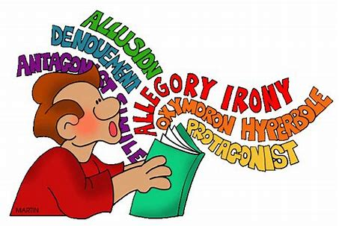
super
ruin
flu
fluid
gnu
truth
7.truly
8.cruel
9.lunar
10.ruby
11.fluent

Slide 14
super
ruin
flu
fluid
gnu
truth
7.truly
8.cruel
9.lunar
10.ruby
11.fluent
12.superb

Slide 15
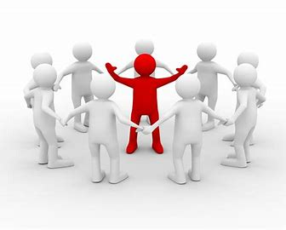
super
ruin
flu
fluid
gnu
truth
7.truly
8.cruel
9.lunar
10.ruby
11.fluent
12.superb
13.crucial

Slide 16
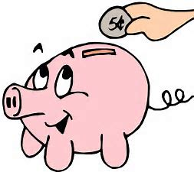
super
ruin
flu
fluid
gnu
truth
7.truly
8.cruel
9.lunar
10.ruby
11.fluent
12.superb
13.crucial
14.frugal

Slide 17
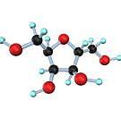
super
ruin
flu
fluid
gnu
truth
7.truly
8.cruel
9.lunar
10.ruby
11.fluent
12.superb
13.crucial
14.frugal
15.glucose

Slide 18
super
ruin
flu
fluid
gnu
truth
7.truly
8.cruel
9.lunar
10.ruby
11.fluent
12.superb
13.crucial
14.frugal
15.glucose
16.superior

Slide 19
super
ruin
flu
fluid
gnu
truth
7.truly
8.cruel
9.lunar
10.ruby
11.fluent
12.superb
13.crucial
14.frugal
15.glucose
16.superior
17.plumage

Slide 20
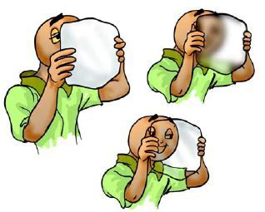
super
ruin
flu
fluid
gnu
truth
7.truly
8.cruel
9.lunar
10.ruby
11.fluent
12.superb
13.crucial
14.frugal
15.glucose
16.superior
17.plumage
18.translucent

Slide 21
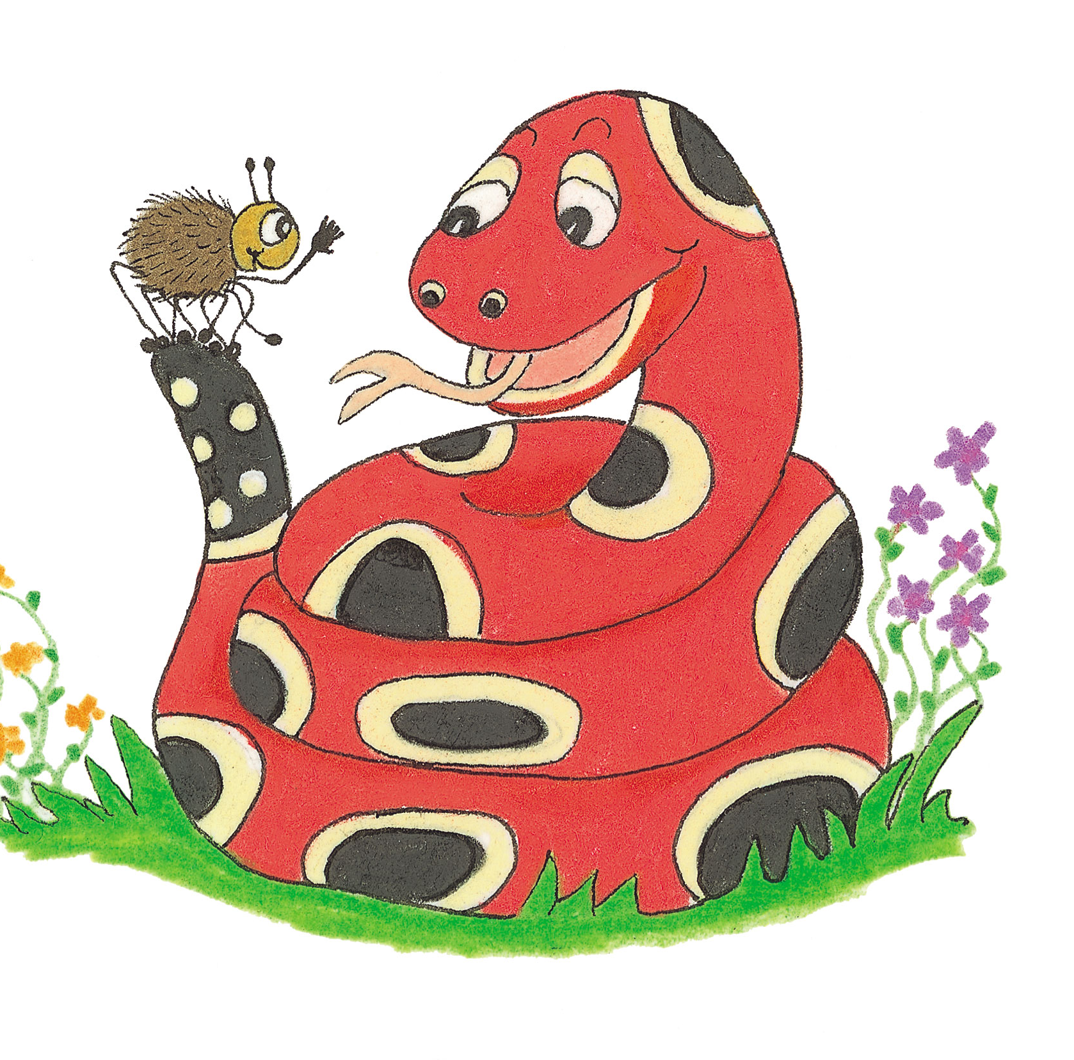
Let’s Revise Subject
Verb
Agreement

Slide 22
The lion chases a man.

Slide 23
The lion chases a man.

Slide 24
The lion chases a man.
subject

Slide 25
The lion chases a man.
subject
object

Slide 26
The lion chases a man.

Slide 27
The lion chases a men.

Slide 28
The lion chases a men.

Slide 29
The lion chases the men.

Slide 30
The lions chases the men.

Slide 31
The lions chases the men.

Slide 32
The lions chase the men.

Slide 33
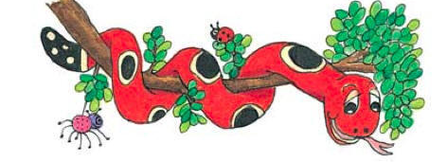
Activity Page:
Plural Subjects and Verbs

Slide 34
I shall buy a new watch next Saturday.

Slide 35
I shall buy a new watch next Saturday.

Slide 36
We shall buy new watches next Saturday.

Slide 37
The hen lays an egg every day.

Slide 38
The hen lays an egg every day.

Slide 39
The hens lay eggs
every day.

Slide 40
She was playing her guitar in the band.

Slide 41
She was playing her guitar in the band.

Slide 42
They were playing their guitars in the band.

Slide 43
The girl flies the kite after school.

Slide 44
The girl flies the kite after school.

Slide 45
The girls fly the kites after school.

Slide 46
The fox chases the goose in the farmyard.

Slide 47
The fox chases the goose in the farmyard.

Slide 48
The foxes chase the geese in the farmyard.

Slide 49
The bird built its nest in the spring.

Slide 50
The bird built its nest in the spring.

Slide 51
The birds built their nests in the spring.

Slide 52
I caught a large fish for supper.

Slide 53
I caught a large fish for supper.

Slide 54
We caught large fish for supper.

Slide 55
Thank you.
See you
next time!

