Slide 1
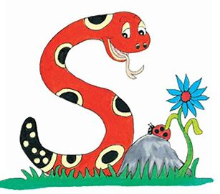
Jolly Grammar
4a-29

Slide 2
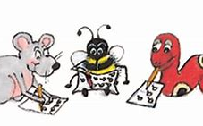
Let’s review Homophones

Slide 3
Look at this book. It’s still in its original cover.

Slide 4
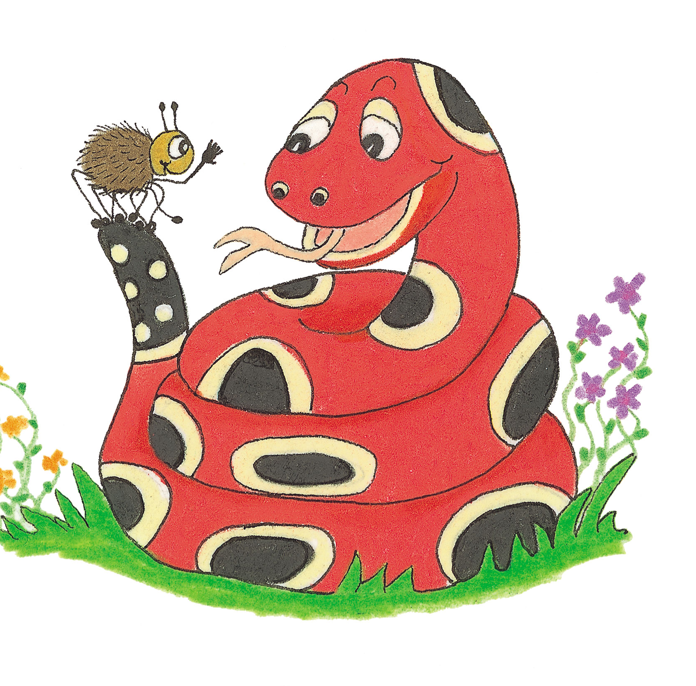
Let’s Revise Schwa

Slide 5
anagram
second
careful
burglar
terror
cavern

Slide 6
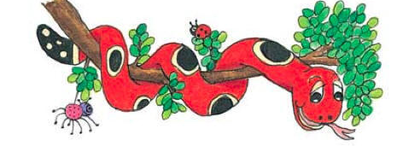
Activity Page:
<u> saying long /oo/

Slide 7
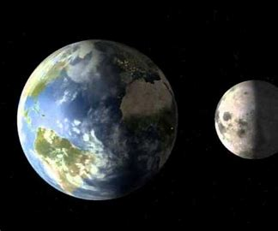
lunar
/oo/

Slide 8
lunar
/oo/
true, flew, rule

Slide 9
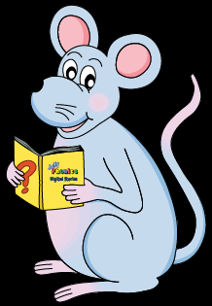
Activity Page
<u>
Saying
/oo/

Slide 10
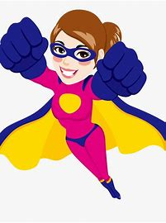
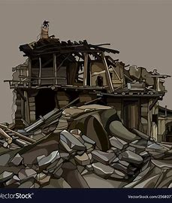
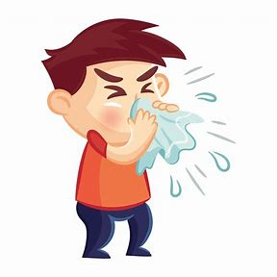
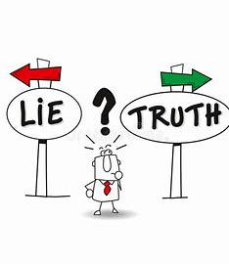
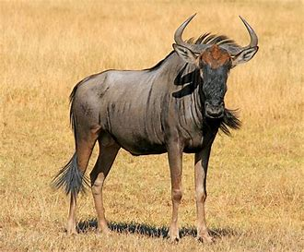
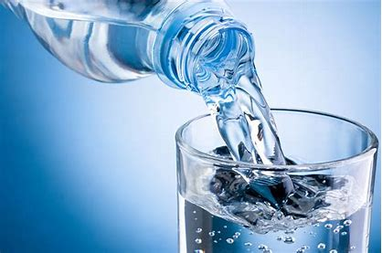
super ruin flu
fluid gnu truth

Slide 11
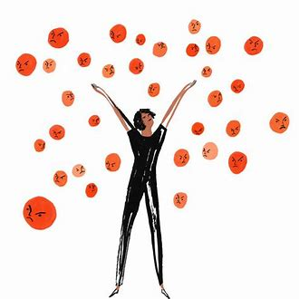
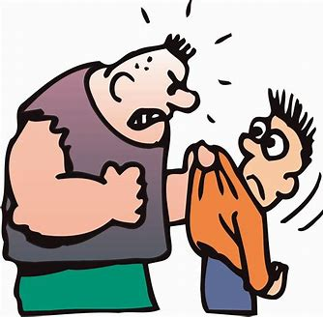
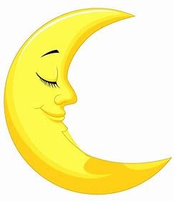
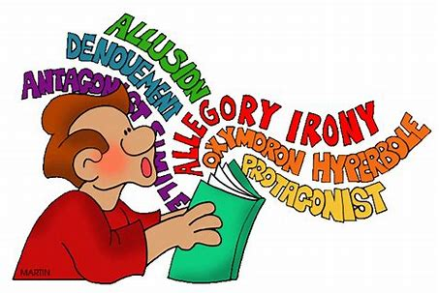
truly cruel lunar
ruby fluent superb

Slide 12
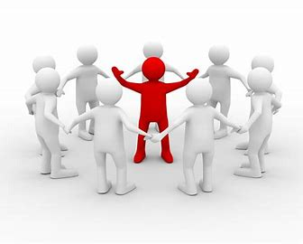
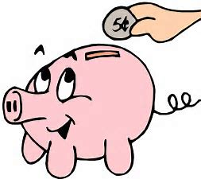
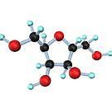
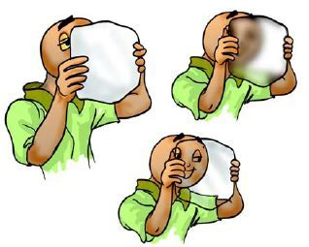
crucial frugal glucose
superior plumage translucent

Slide 15
(very good)
(extremely good)
(deliberately unkind)
(the feathers on a bird)
(a nasty, cold-like illness)
(relating to the moon)
(excellent or better than)
(to spoil or destroy)
(a dark red jewel)
(the opposite of a lie)
(a natural form of sugar)
(letting light pass through)
super
superb
cruel
plumage
flu
lunar
superior
ruin
ruby
truth
glucose
translucent

Slide 16
wolf
earthquake
spy
delay
tooth
six

Slide 17
wolf
earthquake
spy
delay
tooth
six
wolves

Slide 18
wolf
earthquake
spy
delay
tooth
six
wolves
earthquakes

Slide 19
wolf
earthquake
spy
delay
tooth
six
wolves
earthquakes
spies

Slide 20
wolf
earthquake
spy
delay
tooth
six
wolves
earthquakes
spies
delays

Slide 21
wolf
earthquake
spy
delay
tooth
six
wolves
earthquakes
spies
delays
teeth

Slide 22
wolf
earthquake
spy
delay
tooth
six
wolves
earthquakes
spies
delays
teeth
sixes

Slide 23
loaf
pony
cross
fox
worm

Slide 24
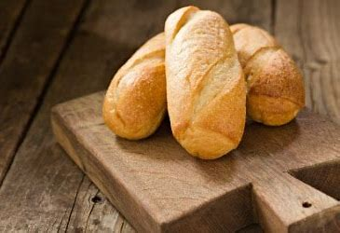
loaf
pony
cross
fox
worm
loaves

Slide 25
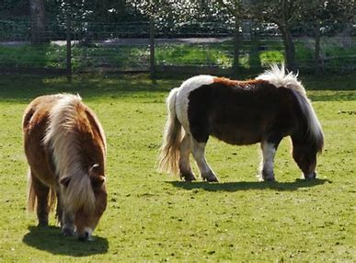
loaf
pony
cross
fox
worm
loaves
ponies

Slide 26
loaf
pony
cross
fox
worm
loaves
ponies
crosses

Slide 27
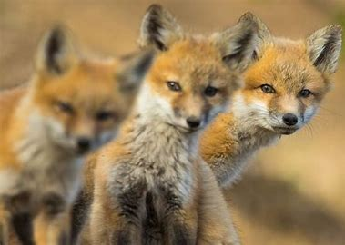
loaf
pony
cross
fox
worm
loaves
ponies
crosses
foxes

Slide 28
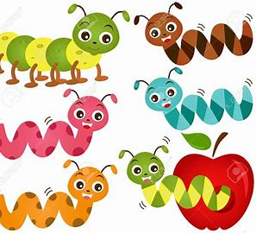
loaf
pony
cross
fox
worm
loaves
ponies
crosses
foxes
worms

Slide 29
parsing

Slide 30
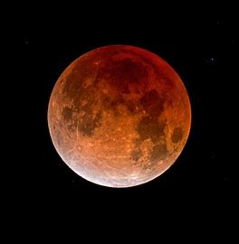
I will be watching the lunar eclipse in July.

Slide 31
I will be watching the lunar eclipse in July.

Slide 32
I will be watching the lunar eclipse in July.

Slide 33
I will be watching the lunar eclipse in July.

Slide 34
I will be watching the lunar eclipse in July.

Slide 35
I will be watching the lunar eclipse in July.

Slide 36
I will be watching the lunar eclipse in July.

Slide 37
I will be watching the lunar eclipse in July.

Slide 38
I will be watching the lunar eclipse in July.
future
continuous

Slide 39
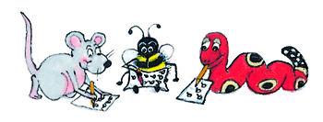
Dictation

Slide 40
Dictation
1.
2.
3.

Slide 41
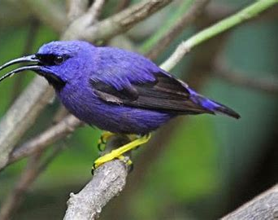

Slide 42
Does the bird have bluish plumage?

Slide 43
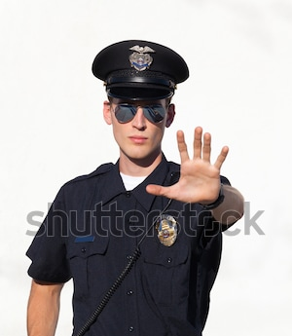

Slide 44
“I want the truth,” said the policeman sternly.

Slide 46
They had heard he was fluent in Spanish.

Slide 47
Thank you.
See you
next time!

