Slide 1
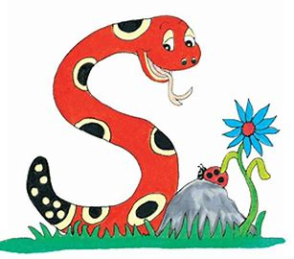
Jolly Grammar
4a-28

Slide 2
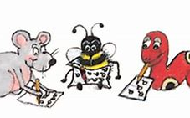
Spelling Test 14

Slide 3
earn

Slide 4
earn
learn

Slide 5
earn
learn
heard

Slide 6
earn
learn
heard
earth

Slide 7
earn
learn
heard
earth
search

Slide 8
earn
learn
heard
earth
search
earnings

Slide 9
earn
learn
heard
earth
search
earnings
7.yearn

Slide 10
earn
learn
heard
earth
search
earnings
7.yearn
8.early

Slide 11
earn
learn
heard
earth
search
earnings
7.yearn
8.early
9.pearl

Slide 12
earn
learn
heard
earth
search
earnings
7.yearn
8.early
9.pearl
10.dearth

Slide 13
earn
learn
heard
earth
search
earnings
7.yearn
8.early
9.pearl
10.dearth
11.hearse

Slide 14
earn
learn
heard
earth
search
earnings
7.yearn
8.early
9.pearl
10.dearth
11.hearse
12.earnest

Slide 15
earn
learn
heard
earth
search
earnings
7.yearn
8.early
9.pearl
10.dearth
11.hearse
12.earnest
13.rehearse

Slide 16
earn
learn
heard
earth
search
earnings
7.yearn
8.early
9.pearl
10.dearth
11.hearse
12.earnest
13.rehearse
14.overheard

Slide 17
earn
learn
heard
earth
search
earnings
7.yearn
8.early
9.pearl
10.dearth
11.hearse
12.earnest
13.rehearse
14.overheard
15.researcher

Slide 18
earn
learn
heard
earth
search
earnings
7.yearn
8.early
9.pearl
10.dearth
11.hearse
12.earnest
13.rehearse
14.overheard
15.researcher
16.searchlight

Slide 19
earn
learn
heard
earth
search
earnings
7.yearn
8.early
9.pearl
10.dearth
11.hearse
12.earnest
13.rehearse
14.overheard
15.researcher
16.searchlight
17.earthworm

Slide 20
earn
learn
heard
earth
search
earnings
7.yearn
8.early
9.pearl
10.dearth
11.hearse
12.earnest
13.rehearse
14.overheard
15.researcher
16.searchlight
17.earthworm
18.earthquake

Slide 21
Here is my book and there is yours.

Slide 22
possessive
adjectives
my
your
his
her
its
our
your
their

Slide 23
possessive
adjectives
my
your
his
her
its
our
your
their
possessive
pronouns
mine
yours
his
hers
its
ours
yours
theirs

Slide 24
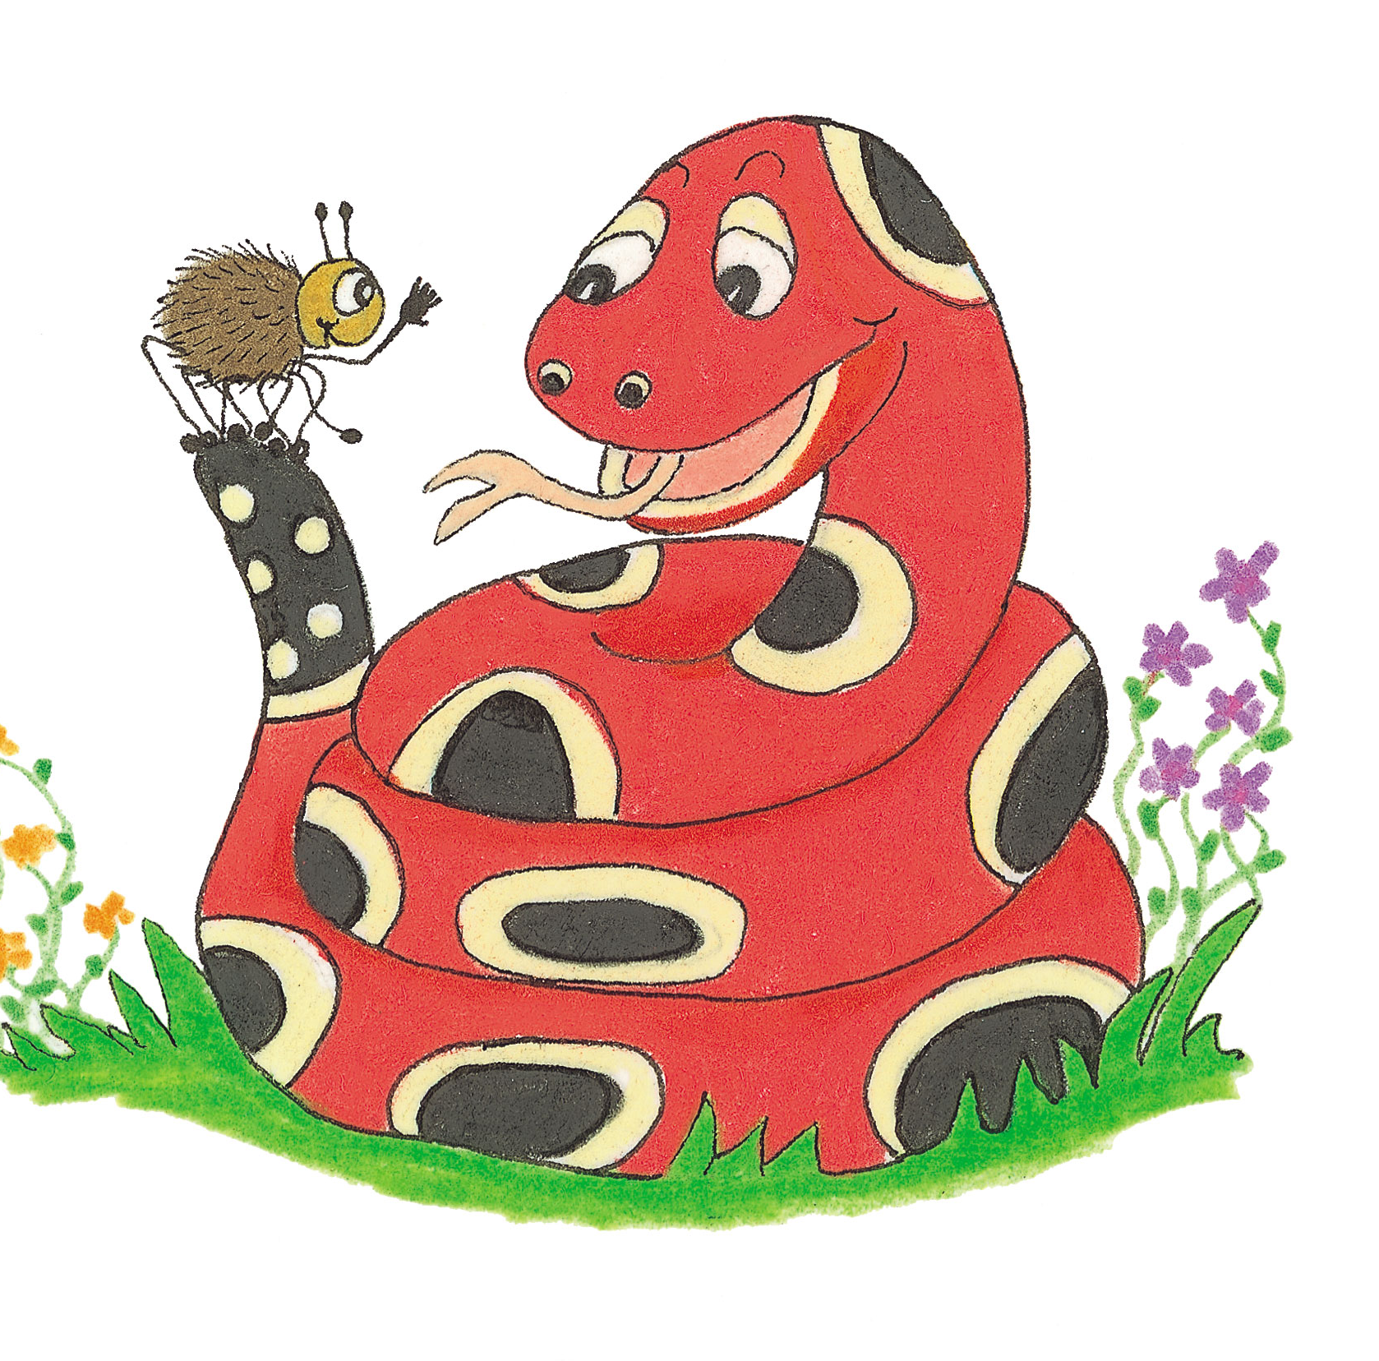
Let’s Revise contractions

Slide 25
I am → I’m
you are → you’re
she is → she’s
he is → he’s
it is → it’s
you are → you’re
we are → we’re
they are → they’re

Slide 26
Let’s Revise homophones

Slide 27
our are

Slide 28
our are
there their they’re

Slide 29
our are
there their they’re
your you’re

Slide 30
our are
there their they’re
your you’re
its it’s

Slide 31
our are
there their they’re
your you’re
its it’s→it is

Slide 32
its or it’s ?
The dog buried bone behind the bush.
a lovely sunny afternoon.

Slide 33
its or it’s ?
The dog buried its bone behind the bush.
It’s a lovely sunny afternoon.

Slide 34
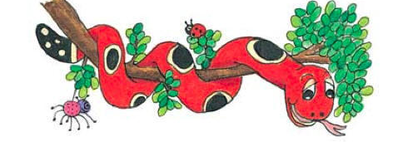
Activity Page:
Homophones (Its and It’s)

Slide 35
“ extremely cold this morning,” remarked Dad.

Slide 36
“It’s extremely cold this morning,” remarked Dad.

Slide 37
The dog barked at ball and wagged tail.

Slide 38
The dog barked at its ball and wagged its tail.

Slide 39
Are you looking for the park? Turn left and
over there.

Slide 40
Are you looking for the park? Turn left and it’s over there.

Slide 41
The mouse ran quickly back to hole.

Slide 42
The mouse ran quickly back to its hole.

Slide 43
Look at that little foal. very young.

Slide 44
Look at that little foal. It’s very young.

Slide 45
“ a great win for the team,” reported Sam.

Slide 46
“It’s a great win for the team,” reported Sam.

Slide 47
Zack looked at the puppy. “ eyes are blue,” he said.

Slide 48
Zack looked at the puppy. “Its eyes are blue,” he said.

Slide 49
I saw a dolphin and
baby at the marina.

Slide 50
I saw a dolphin and its baby at the marina.

Slide 51
The lion roared and showed teeth.

Slide 52
The lion roared and showed its teeth.

Slide 53
“ a wonderful day, today,” signed Reeta.

Slide 54
“It’s a wonderful day, today,” signed Reeta.

Slide 55
Look at this book.
still in original cover.

Slide 56
Look at this book. It’s still in its original cover.

Slide 57
a nice day for birdwatching, so
possible you will see the woodpecker and nest.

Slide 58
It’s a nice day for birdwatching, so it’s possible you will see the woodpecker and its nest.

Slide 59
A mouse went to its house.
“It’s my I-pad,” said Mao.
A bird doesn’t want to show its body.
“It’s there!” said a human.

Slide 60
Thank you.
See you
next time!

