Slide 1
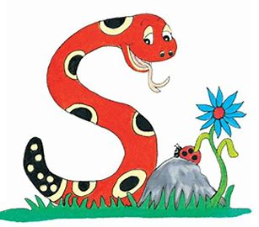
Jolly Grammar
4a-27

Slide 2
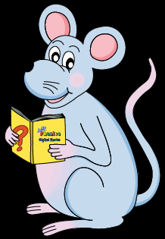
Let’s Review Verb Tenses

Slide 3
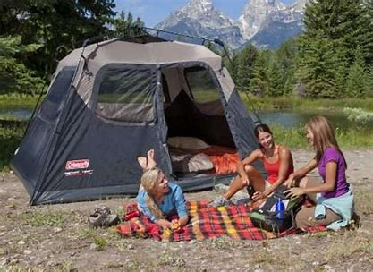
You camp in a tent in August.
↓
Future Continuous

Slide 4
You camp in a tent in August.
↓
You will be camping in a tent in August.
Future Continuous

Slide 5
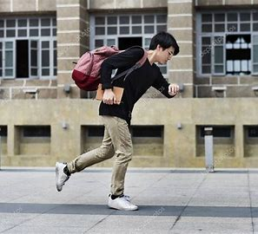
We were late for school this morning.
↓
Simple Present

Slide 6
We were late for school this morning.
↓
We are late for school this morning.
Simple Present

Slide 7
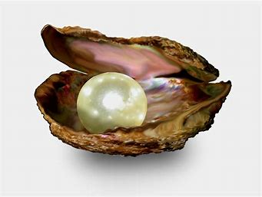

Slide 8
/er/

Slide 9
pearl
/er/

Slide 10
Activity Page
<ear>
Saying
/er/

Slide 11
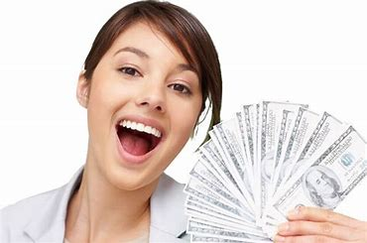
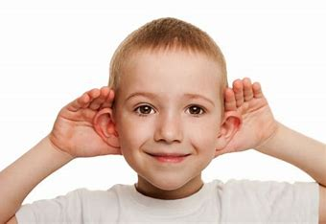
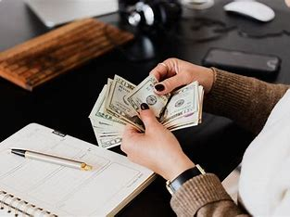
earn learn heard
earth search earnings

Slide 12
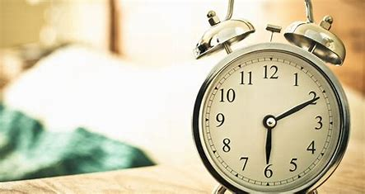
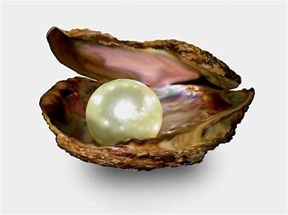
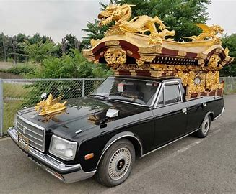
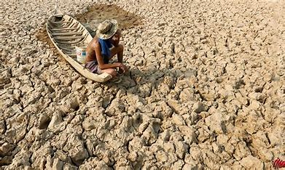
yearn early pearl
dearth hearse earnest

Slide 13
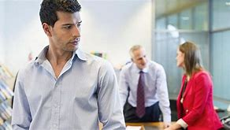
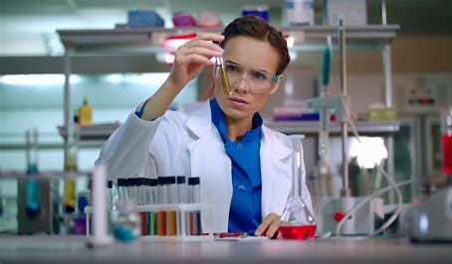
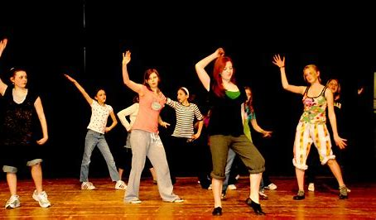
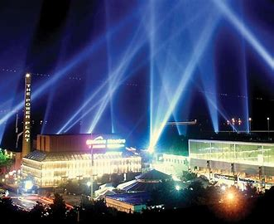
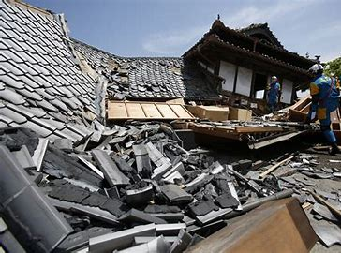
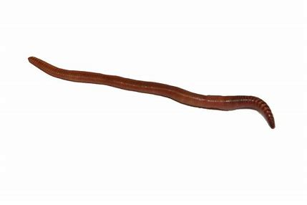
rehearse overheard researcher
searchlight earthworm earthquake

Slide 16
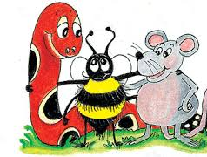
Possessive Nouns

Slide 17
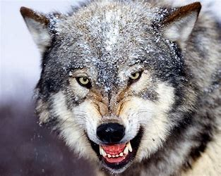
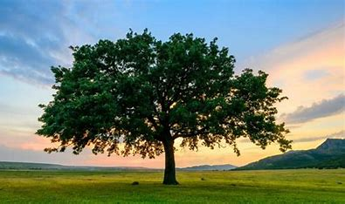
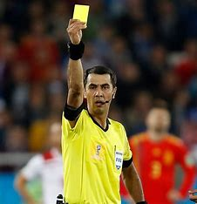
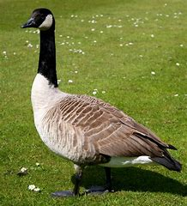
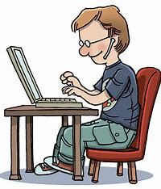
wolf’s goose’s tree’s expert’s referee’s author’s

Slide 18
wolf’s goose’s tree’s expert’s referee’s author’s
the feathers
the book
the branches
the decision
the fur
the opinion

Slide 19
parsing

Slide 20
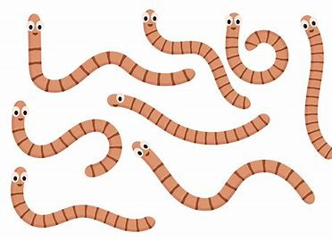
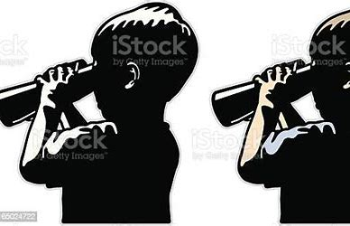
The two boys were searching intently
for earthworms.

Slide 21
The two boys were searching intently
for earthworms.

Slide 22
The two boys were searching intently
for earthworms.

Slide 23
The two boys were searching intently
for earthworms.

Slide 24
The two boys were searching intently
for earthworms.

Slide 25
The two boys were searching intently
for earthworms.

Slide 26
The two boys were searching intently
for earthworms.

Slide 27
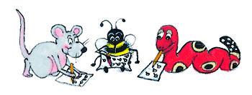
Dictation

Slide 28
Dictation
1.
2.
3.

Slide 29
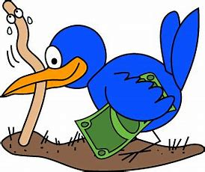

Slide 30
The early bird catches the worm.

Slide 31
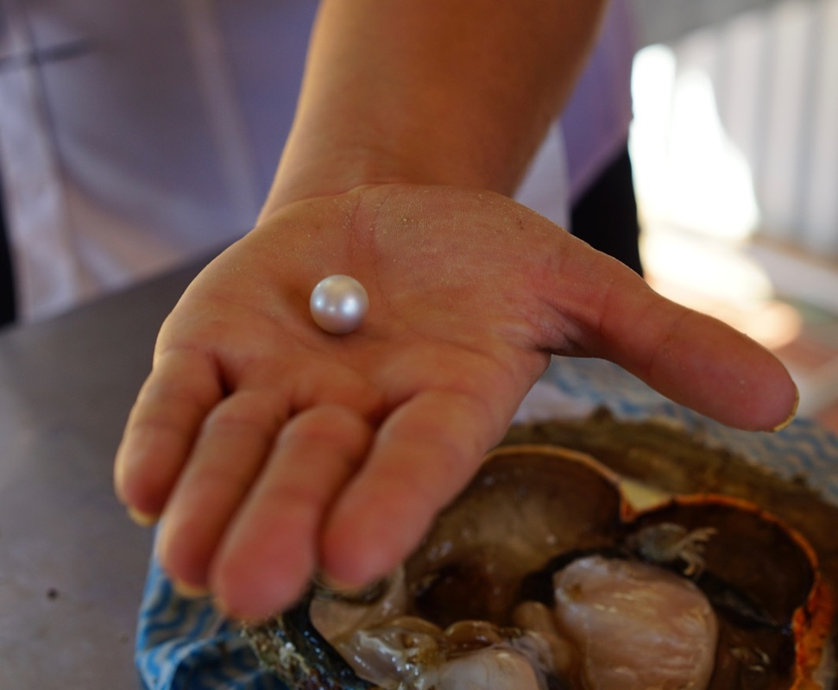

Slide 32
We learned there was a dearth of pearls.

Slide 33
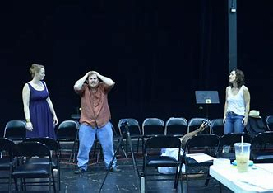

Slide 34
The actors and singers rehearsed the new opera.

Slide 35
Thank you.
See you
next time!

