Slide 1
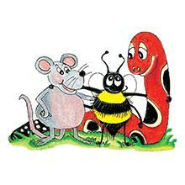
Jolly Grammar 3a-18

Slide 2
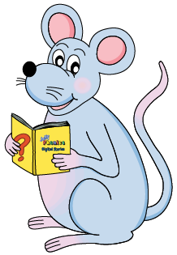
Mini Test 9

Slide 3
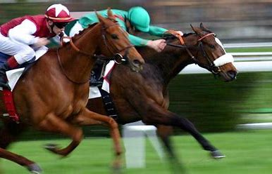
race

Slide 4
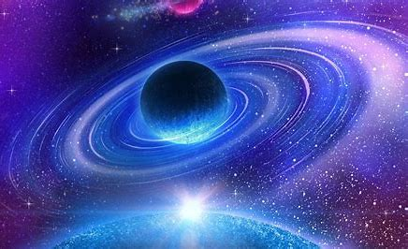
race
space

Slide 5
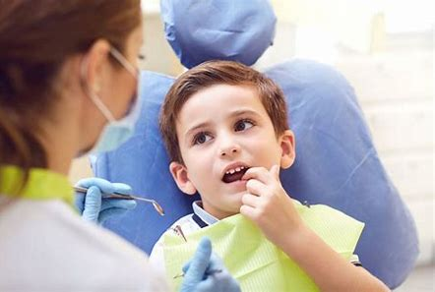
race
space
since

Slide 6
race
space
since
twice

Slide 7
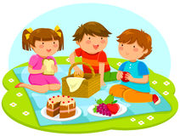
race
space
since
twice
cancel

Slide 8
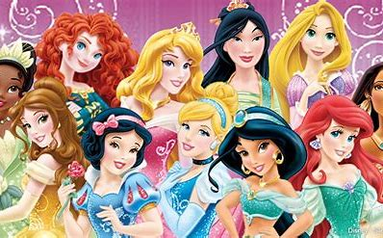
race
space
since
twice
cancel
princess

Slide 9
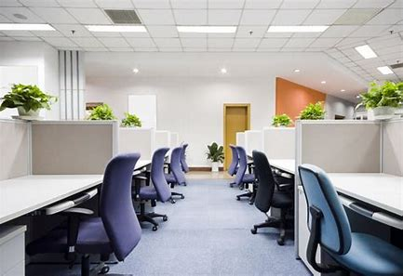
race
space
since
twice
cancel
princess
7. office

Slide 10
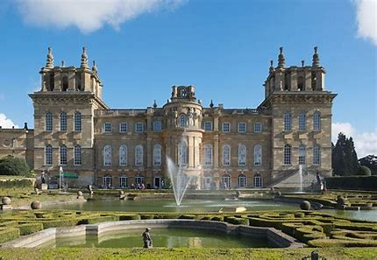
race
space
since
twice
cancel
princess
7. office
8. palace

Slide 11
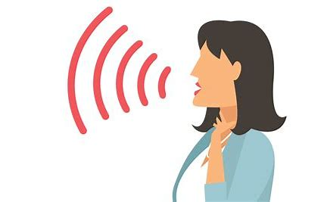
race
space
since
twice
cancel
princess
7. office
8. palace
9. voice

Slide 12
race
space
since
twice
cancel
princess
7. office
8. palace
9. voice
10. silence

Slide 13
race
space
since
twice
cancel
princess
7. office
8. palace
9. voice
10. silence
11. bounce

Slide 14
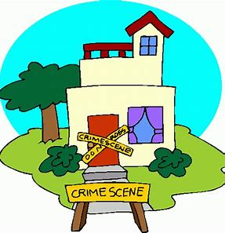
race
space
since
twice
cancel
princess
7. office
8. palace
9. voice
10. silence
11. bounce
12. incident

Slide 15
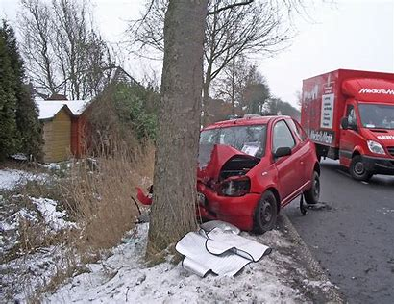
race
space
since
twice
cancel
princess
7. office
8. palace
9. voice
10. silence
11. bounce
12. incident
13. accident

Slide 16
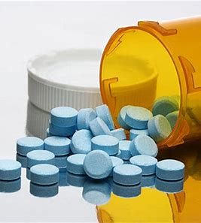
race
space
since
twice
cancel
princess
7. office
8. palace
9. voice
10. silence
11. bounce
12. incident
13. accident
14. medicine

Slide 17
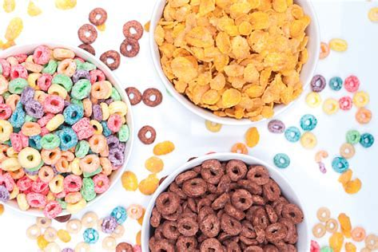
race
space
since
twice
cancel
princess
7. office
8. palace
9. voice
10. silence
11. bounce
12. incident
13. accident
14. medicine
15. cereal

Slide 18
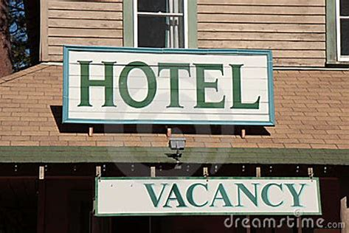
race
space
since
twice
cancel
princess
7. office
8. palace
9. voice
10. silence
11. bounce
12. incident
13. accident
14. medicine
15. cereal
16. vacancy

Slide 19
race
space
since
twice
cancel
princess
7. office
8. palace
9. voice
10. silence
11. bounce
12. incident
13. accident
14. medicine
15. cereal
16. vacancy
17. advance

Slide 20
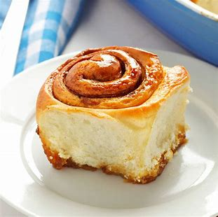
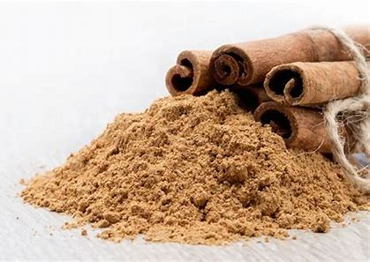
race
space
since
twice
cancel
princess
7. office
8. palace
9. voice
10. silence
11. bounce
12. incident
13. accident
14. medicine
15. cereal
16. vacancy
17. advance
18. cinnamon

Slide 21
Let’s review
Verb to be.

Slide 22
I am
we are
you are
you are
he/she/it is
they are

Slide 23
I was
we
you
you
he/she/it
they

Slide 24
I was
we
you were
you
he/she/it
they

Slide 25
I was
we
you were
you
he/she/it was
they

Slide 26
I was
we were
you were
you
he/she/it was
they

Slide 27
I was
we were
you were
you were
he/she/it was
they

Slide 28
I was
we were
you were
you were
he/she/it was
they were

Slide 29
Past continuous

Slide 30
I walked to school.

Slide 31
I walked to school.
I was walking to school.

Slide 32
I walked to school. Simple past
I was walking to school.

Slide 33
I walked to school. Simple past
I was walking to school.
Past continuous

Slide 34
Activity Page:
The past continuous

Slide 35
She skips in the park.

Slide 36
She skips in the park.
She was skipping in the park.

Slide 37
I milk the cows in the morning.

Slide 38
I milk the cows in the morning.
I was milking the cows in the morning.

Slide 39
We jump over the waves at the beach.

Slide 40
We jump over the waves at the beach.
We were jumping over the waves at the beach.

Slide 41
They rake up the leaves on the lawn.

Slide 42
They rake up the leaves on the lawn.
They were raking the leaves on the lawn.

Slide 43
You help at the swimming club.

Slide 44
You help at the swimming club.
You were helping at the swimming club.

Slide 45
He dusts the ornament.

Slide 46
He dusts the ornament.
He was dusting the ornament.

Slide 47
Join each sentence to the correct tense.
They were playing in the park.
They play in the park.
They are playing in the park.
They played in the park.

Slide 48
Join each sentence to the correct tense.
They were playing in the park.
They play in the park.
They are playing in the park.
They played in the park.
Past continuous

Slide 49
Join each sentence to the correct tense.
They were playing in the park.
They play in the park.
They are playing in the park.
They played in the park.
Past continuous
Simple present

Slide 50
Join each sentence to the correct tense.
They were playing in the park.
They play in the park.
They are playing in the park.
They played in the park.
Past continuous
Simple present
Present continuous

Slide 51
Join each sentence to the correct tense.
They were playing in the park.
They play in the park.
They are playing in the park.
They played in the park.
Past continuous
Simple present
Present continuous
Simple past

Slide 52
Thank you!

