Slide 1
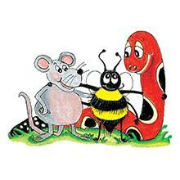
Jolly Grammar 3a-17

Slide 2
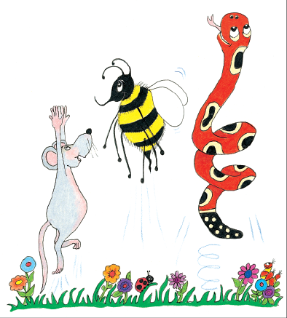
Let’s review
Present continuous.

Slide 3
I draw a picture in my sketchbook.

Slide 4
I draw a picture in my sketchbook.
I am drawing a picture in my sketchbook.

Slide 5
I draw a picture in my sketchbook.
I am drawing a picture in my sketchbook.
They play football in the park.

Slide 6
I draw a picture in my sketchbook.
I am drawing a picture in my sketchbook.
They play football in the park.
They are playing football in the park.

Slide 7
I draw a picture in my sketchbook.
I am drawing a picture in my sketchbook.
They play football in the park.
They are playing football in the park.
The little dog yaps loudly.

Slide 8
I draw a picture in my sketchbook.
I am drawing a picture in my sketchbook.
They play football in the park.
They are playing football in the park.
The little dog yaps loudly.
The little dog is yapping loudly.

Slide 9
I draw a picture in my sketchbook.
I am drawing a picture in my sketchbook.
They play football in the park.
They are playing football in the park.
The little dog yaps loudly.
The little dog is yapping loudly.
We jump on the trampoline.

Slide 10
I draw a picture in my sketchbook.
I am drawing a picture in my sketchbook.
They play football in the park.
They are playing football in the park.
The little dog yaps loudly.
The little dog is yapping loudly.
We jump on the trampoline.
We are jumping on the trampoline.

Slide 11
circus
soft /c/

Slide 12
Spelling List
Soft <c>

Slide 13
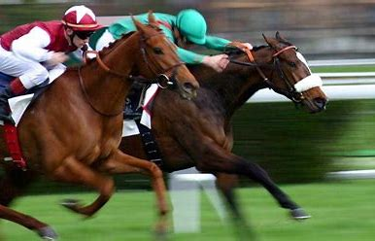
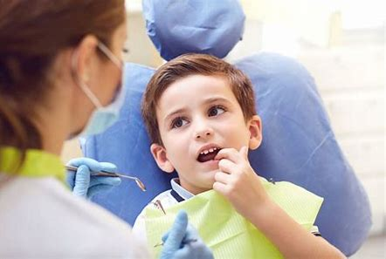
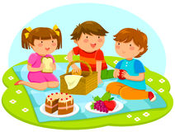
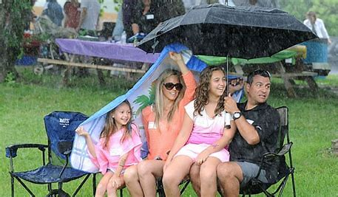
race space since
twice cancel princess

Slide 14
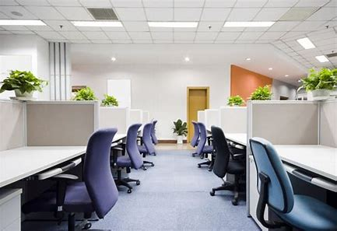
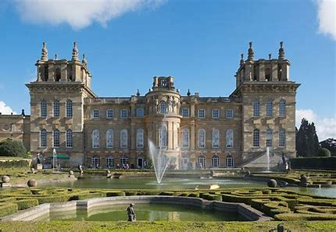
office palace voice
silence bounce incident

Slide 15
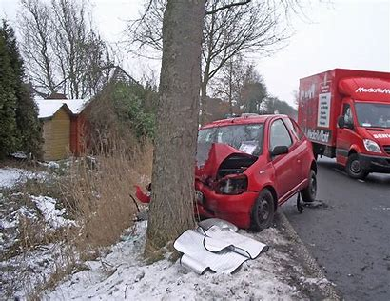
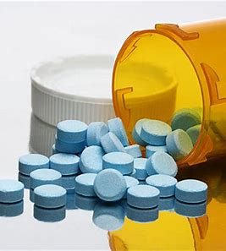
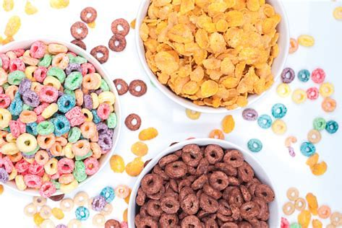
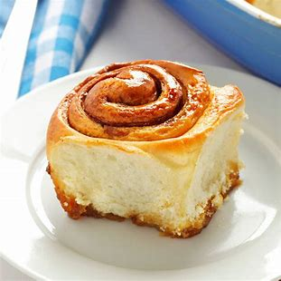
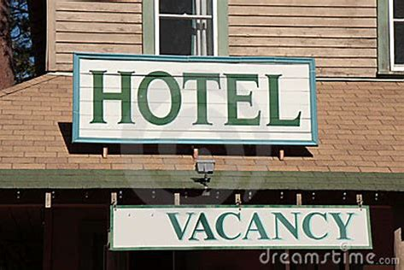
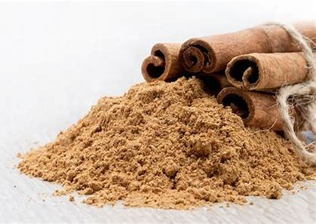
accident medicine cereal
vacancy advance cinnamon

Slide 16
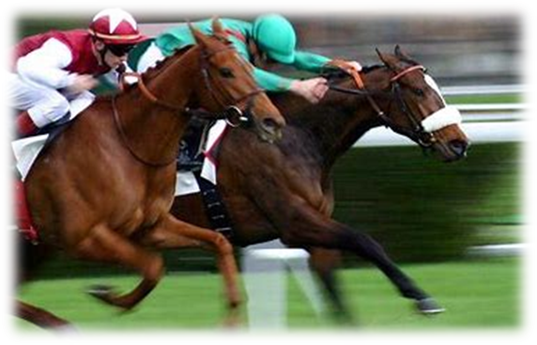
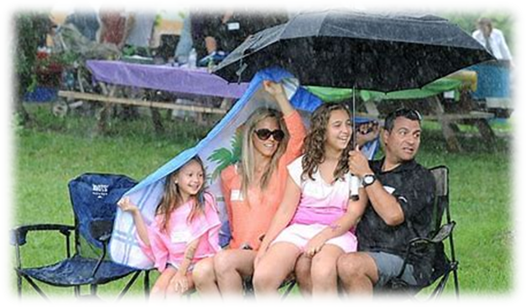
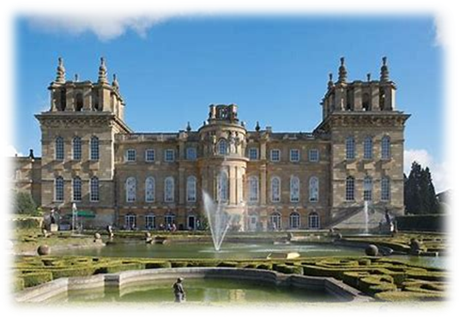
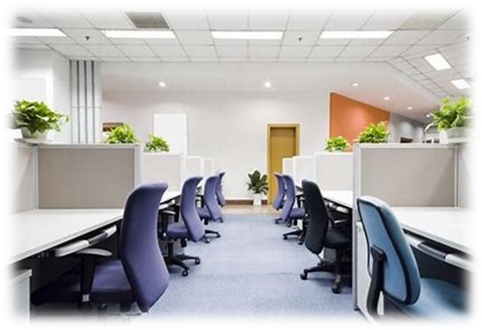
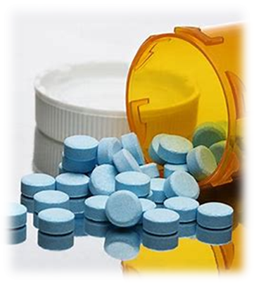
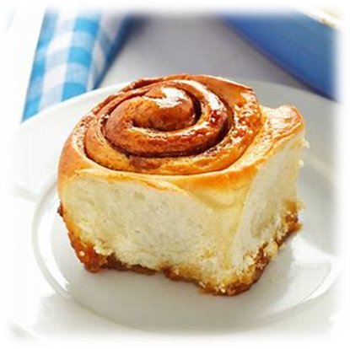
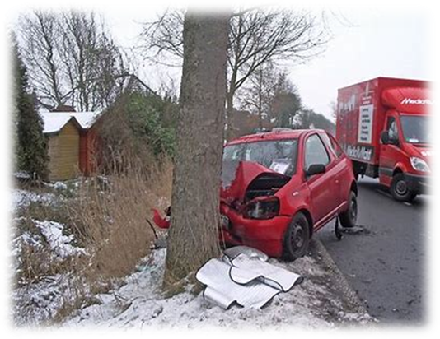
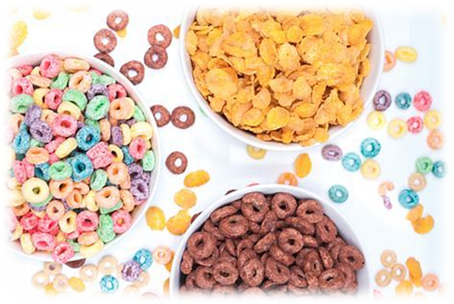
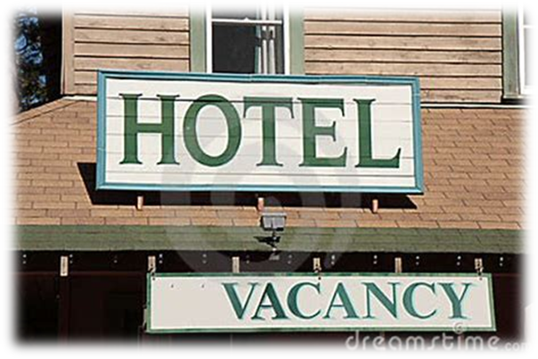
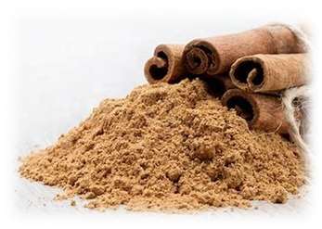

Slide 17
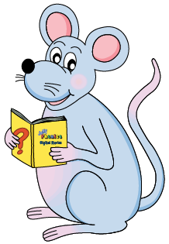
Put the words in the spelling list.

Slide 18
Let’s split these words into syllables.

Slide 19
race
cancel
princess
silence
vacancy

Slide 20
race
cancel
princess
silence
vacancy

Slide 21
race
cancel
princess
silence
vacancy

Slide 22
race
cancel
princess
silence
vacancy

Slide 23
Let’s parse
sentences.

Slide 24
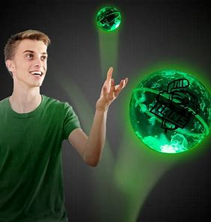
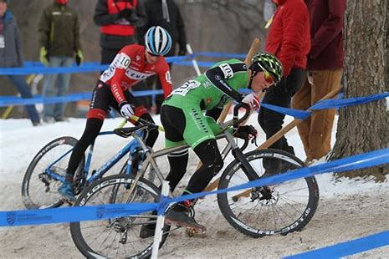
Parse these sentences.
Sam bounced the ball
high into the air.
They cancelled the race
because it was icy.

Slide 25
Parse these sentences.
Sam bounced the ball
high into the air.
They cancelled the race
because it was icy.

Slide 26
Parse these sentences.
Sam bounced the ball
high into the air.
They cancelled the race
because it was icy.

Slide 27
Parse these sentences.
Sam bounced the ball
high into the air.
They cancelled the race
because it was icy.

Slide 28
Parse these sentences.
Sam bounced the ball
high into the air.
They cancelled the race
because it was icy.

Slide 29
Parse these sentences.
Sam bounced the ball
high into the air.
They cancelled the race
because it was icy.

Slide 30
Parse these sentences.
Sam bounced the ball
high into the air.
They cancelled the race
because it was icy.

Slide 31
Parse these sentences.
Sam bounced the ball
high into the air.
They cancelled the race
because it was icy.

Slide 32
Parse these sentences.
Sam bounced the ball
high into the air.
They cancelled the race
because it was icy.

Slide 33
Parse these sentences.
Sam bounced the ball
high into the air.
They cancelled the race
because it was icy.

Slide 34
Parse these sentences.
Sam bounced the ball
high into the air.
They cancelled the race
because it was icy.

Slide 35
Parse these sentences.
Sam bounced the ball
high into the air.
They cancelled the race
because it was icy.

Slide 36
Parse these sentences.
Sam bounced the ball
high into the air.
They cancelled the race
because it was icy.

Slide 37
Parse these sentences.
Sam bounced the ball
high into the air.
They cancelled the race
because it was icy.

Slide 38
Dictation

Slide 39
Dictation
1.
2.
3.

Slide 40
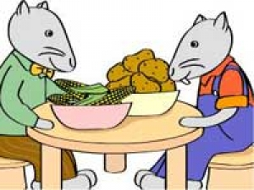

Slide 41
The mice live in a nice place in the city.

Slide 42
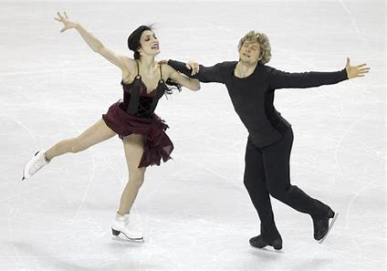

Slide 43
The ice dancers twice did a big circle on the rink.

Slide 45
The policeman had a friendly face.

Slide 46
Thank you!

