Slide 1
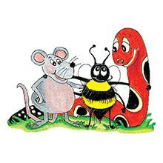
Jolly Grammar 3a-16

Slide 2
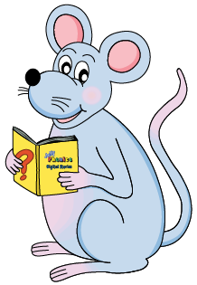
Mini Test 8

Slide 3
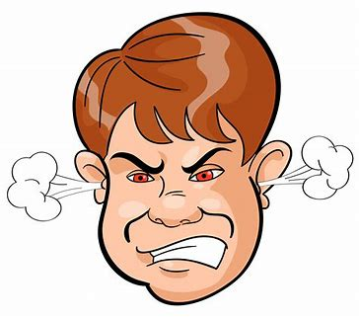
anger

Slide 4
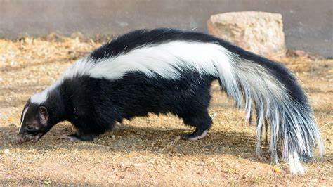
anger
skunk

Slide 5
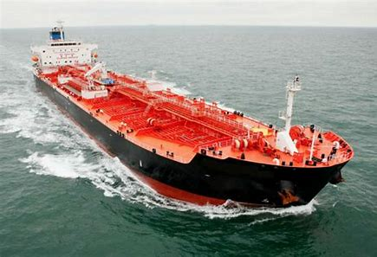
anger
skunk
tanker

Slide 6
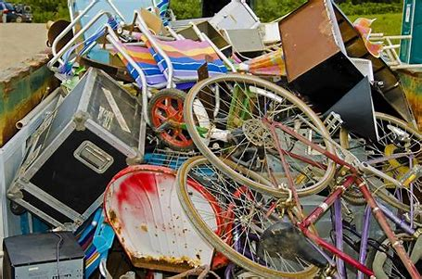
anger
skunk
tanker
junk

Slide 7
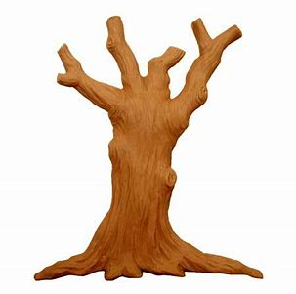
anger
skunk
tanker
junk
trunk

Slide 8
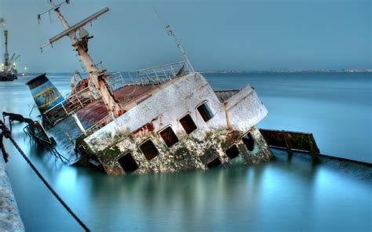
anger
skunk
tanker
junk
trunk
sunken

Slide 9
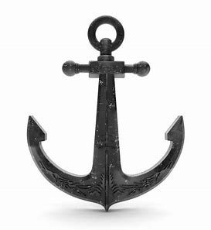
anger
skunk
tanker
junk
trunk
sunken
7. anchor

Slide 10
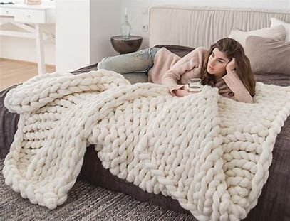
anger
skunk
tanker
junk
trunk
sunken
7. anchor
8. blanket

Slide 11
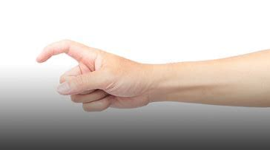
anger
skunk
tanker
junk
trunk
sunken
7. anchor
8. blanket
9. finger

Slide 12
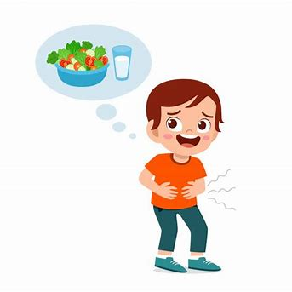
anger
skunk
tanker
junk
trunk
sunken
7. anchor
8. blanket
9. finger
10. hunger

Slide 13
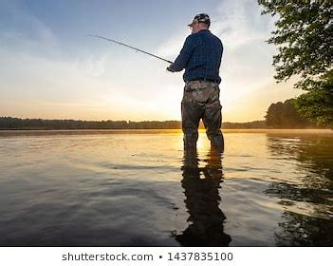
anger
skunk
tanker
junk
trunk
sunken
7. anchor
8. blanket
9. finger
10. hunger
11. angler

Slide 14
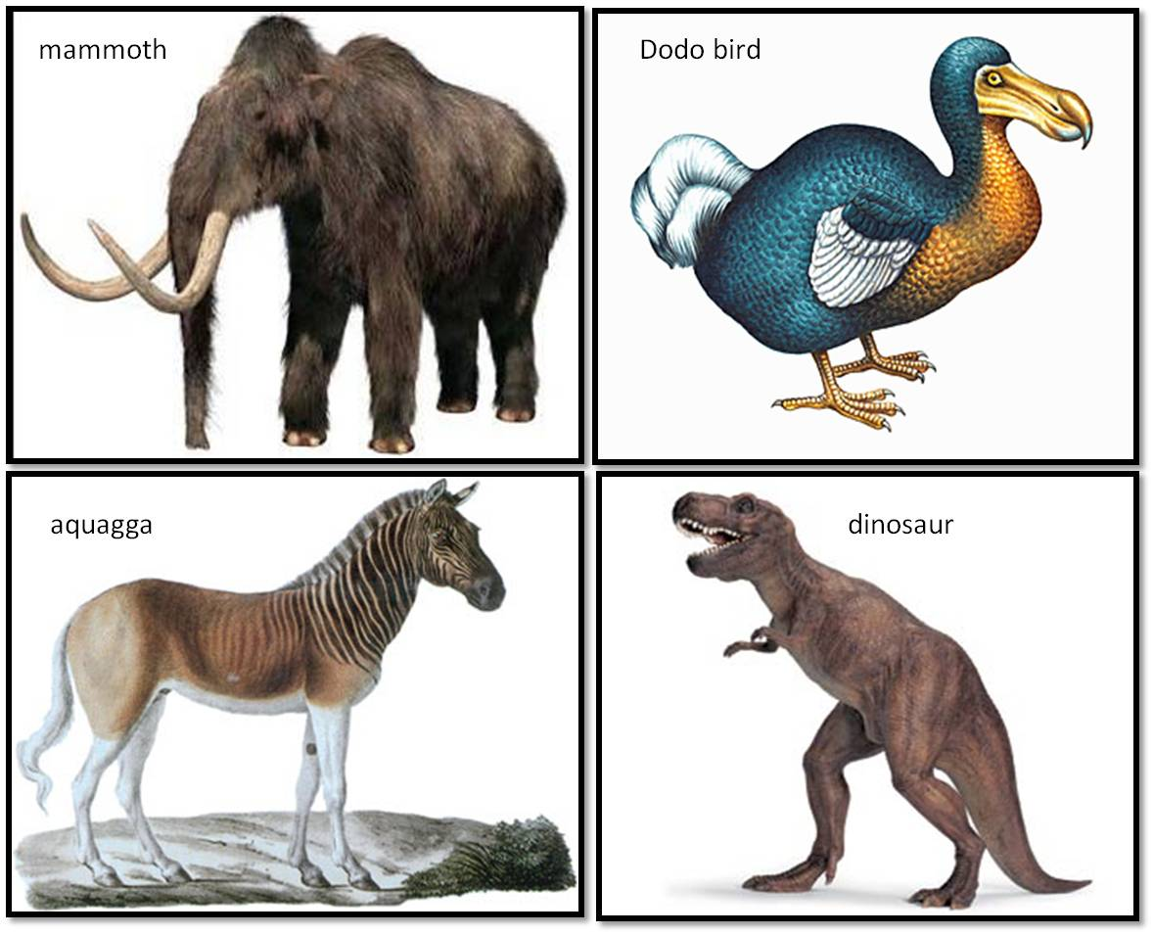
anger
skunk
tanker
junk
trunk
sunken
7. anchor
8. blanket
9. finger
10. hunger
11. angler
12. extinct

Slide 15
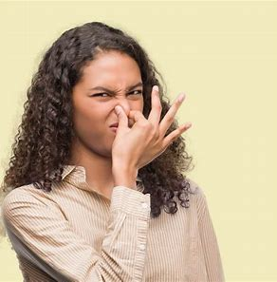
anger
skunk
tanker
junk
trunk
sunken
7. anchor
8. blanket
9. finger
10. hunger
11. angler
12. extinct
13. stinking

Slide 16
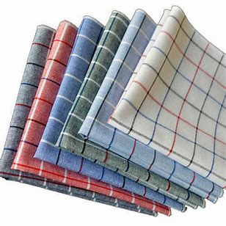
anger
skunk
tanker
junk
trunk
sunken
7. anchor
8. blanket
9. finger
10. hunger
11. angler
12. extinct
13. stinking
14. handkerchief

Slide 17
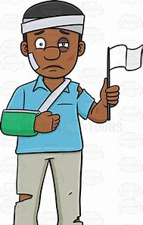
anger
skunk
tanker
junk
trunk
sunken
7. anchor
8. blanket
9. finger
10. hunger
11. angler
12. extinct
13. stinking
14. handkerchief
15. anguish

Slide 18
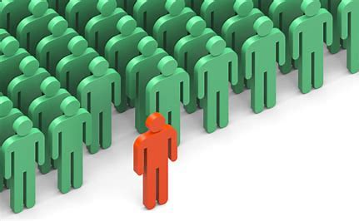
anger
skunk
tanker
junk
trunk
sunken
7. anchor
8. blanket
9. finger
10. hunger
11. angler
12. extinct
13. stinking
14. handkerchief
15. anguish
16. distinctive

Slide 19
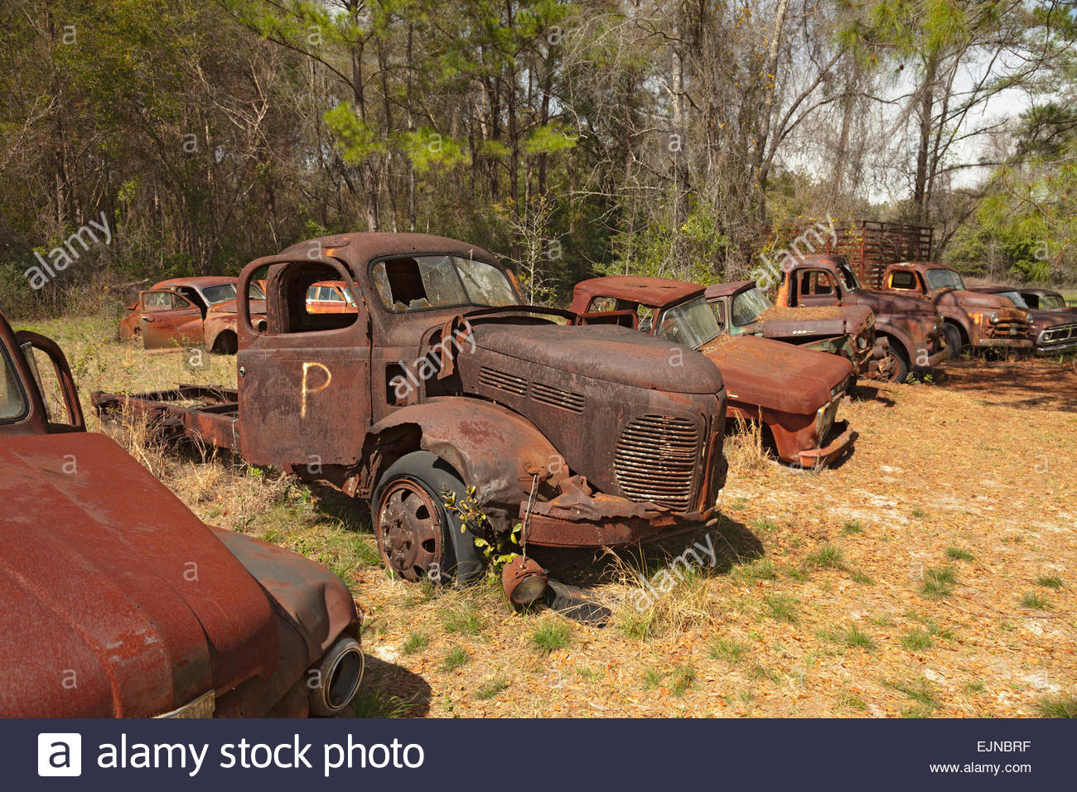
anger
skunk
tanker
junk
trunk
sunken
7. anchor
8. blanket
9. finger
10. hunger
11. angler
12. extinct
13. stinking
14. handkerchief
15. anguish
16. distinctive
17. defunct

Slide 20
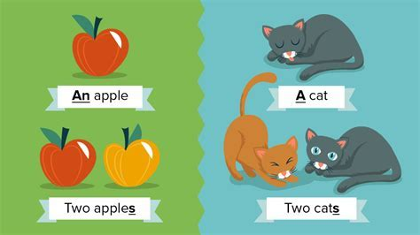
anger
skunk
tanker
junk
trunk
sunken
7. anchor
8. blanket
9. finger
10. hunger
11. angler
12. extinct
13. stinking
14. handkerchief
15. anguish
16. distinctive
17. defunct
18. singular

Slide 21
Let’s review
Verb tenses.

Slide 22
I cooked yesterday.
I cook
everyday.
I shall cook tomorrow.
Simple Tense

Slide 23
Let’s review
Verb to be.

Slide 24
I
we
you
you
he/she/it
they

Slide 25
I am
we
you
you
he/she/it
they

Slide 26
I am
we
you are
you
he/she/it
they

Slide 27
I am
we
you are
you
he/she/it is
they

Slide 28
I am
we are
you are
you
he/she/it is
they

Slide 29
I am
we are
you are
you are
he/she/it is
they

Slide 30
I am
we are
you are
you are
he/she/it is
they are

Slide 31
Activity Page:
Conjugate the verb ‘to be’

Slide 32
I walk to school.
I am walking to school.

Slide 33
I walk to school. Simple present
I am walking to school.

Slide 34
I cooked yesterday.
I cook
everyday.
I shall cook tomorrow.
Simple Tense

Slide 35
I walk to school. Simple present
I am walking to school. Present continuous

Slide 36
Continuous Tense

Slide 37
Activity Page:
The present continuous

Slide 38
I am drawing a picture in my sketchbook.

Slide 39
I am drawing a picture in my sketchbook.
They are playing football in the park.

Slide 40
I am drawing a picture in my sketchbook.
They are playing football in the park.
The little dog is yapping loudly.

Slide 41
I am drawing a picture in my sketchbook.
They are playing football in the park.
The little dog is yapping loudly.
We are jumping on the trampoline.

Slide 42
Thank you!

