Slide 1
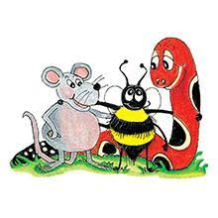
Jolly Grammar 3a-15

Slide 2
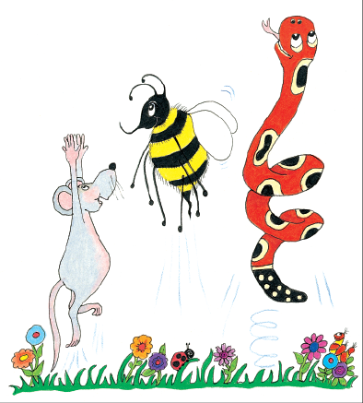
Let’s review
The present participle

Slide 3
fly
grab
remind
measure
juggle
plan
frighten
tie
irritate

Slide 4
flying
grab
remind
measure
juggle
plan
frighten
tie
irritate

Slide 5
flying
grabbing
remind
measure
juggle
plan
frighten
tie
irritate

Slide 6
flying
grabbing
reminding
measure
juggle
plan
frighten
tie
irritate

Slide 7
flying
grabbing
reminding
measureing
juggle
plan
frighten
tie
irritate

Slide 8
flying
grabbing
reminding
measureing
juggleing
plan
frighten
tie
irritate

Slide 9
flying
grabbing
reminding
measureing
juggleing
planning
frighten
tie
irritate

Slide 10
flying
grabbing
reminding
measureing
juggleing
planning
frightening
tie
irritate

Slide 11
flying
grabbing
reminding
measureing
juggleing
planning
frightening
tieying
irritateing

Slide 12
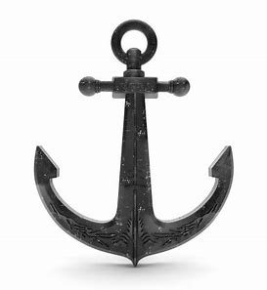
anker
/ng/

Slide 13
Spelling List
<n> spelling of the /ng/ sound

Slide 14
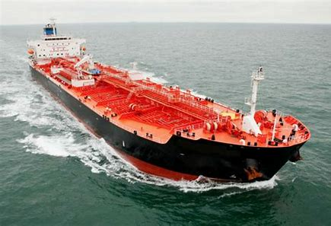
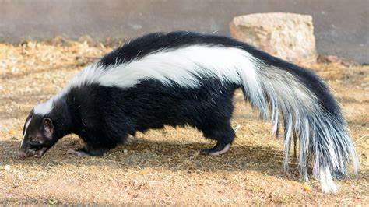
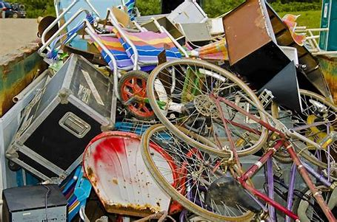
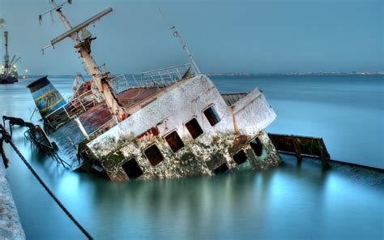
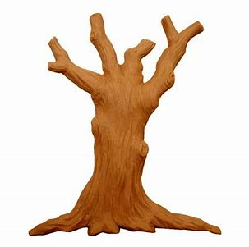
anger skunk tanker
junk trunk sunken

Slide 15
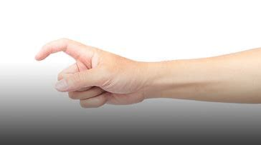
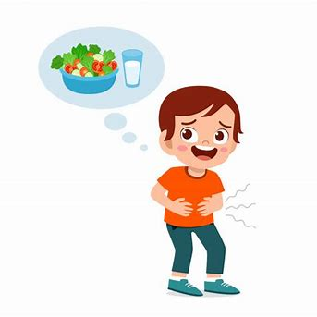
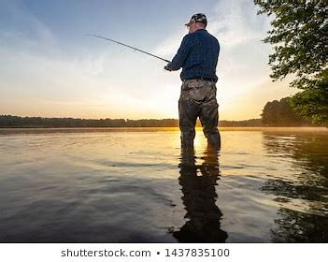
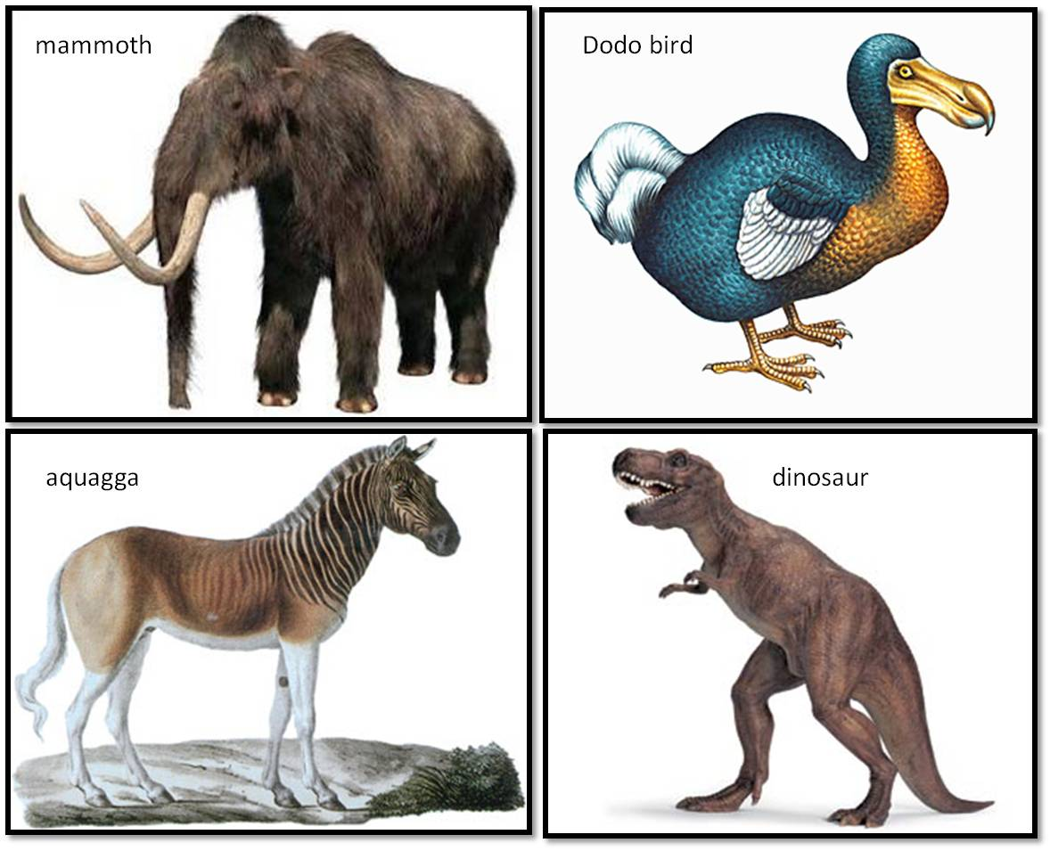
anchor blanket finger
hunger angler extinct

Slide 16
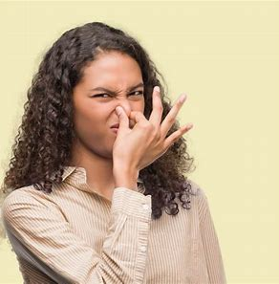
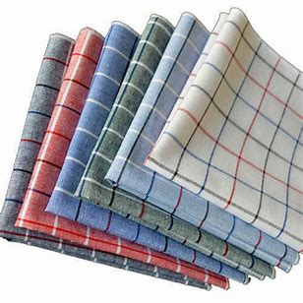
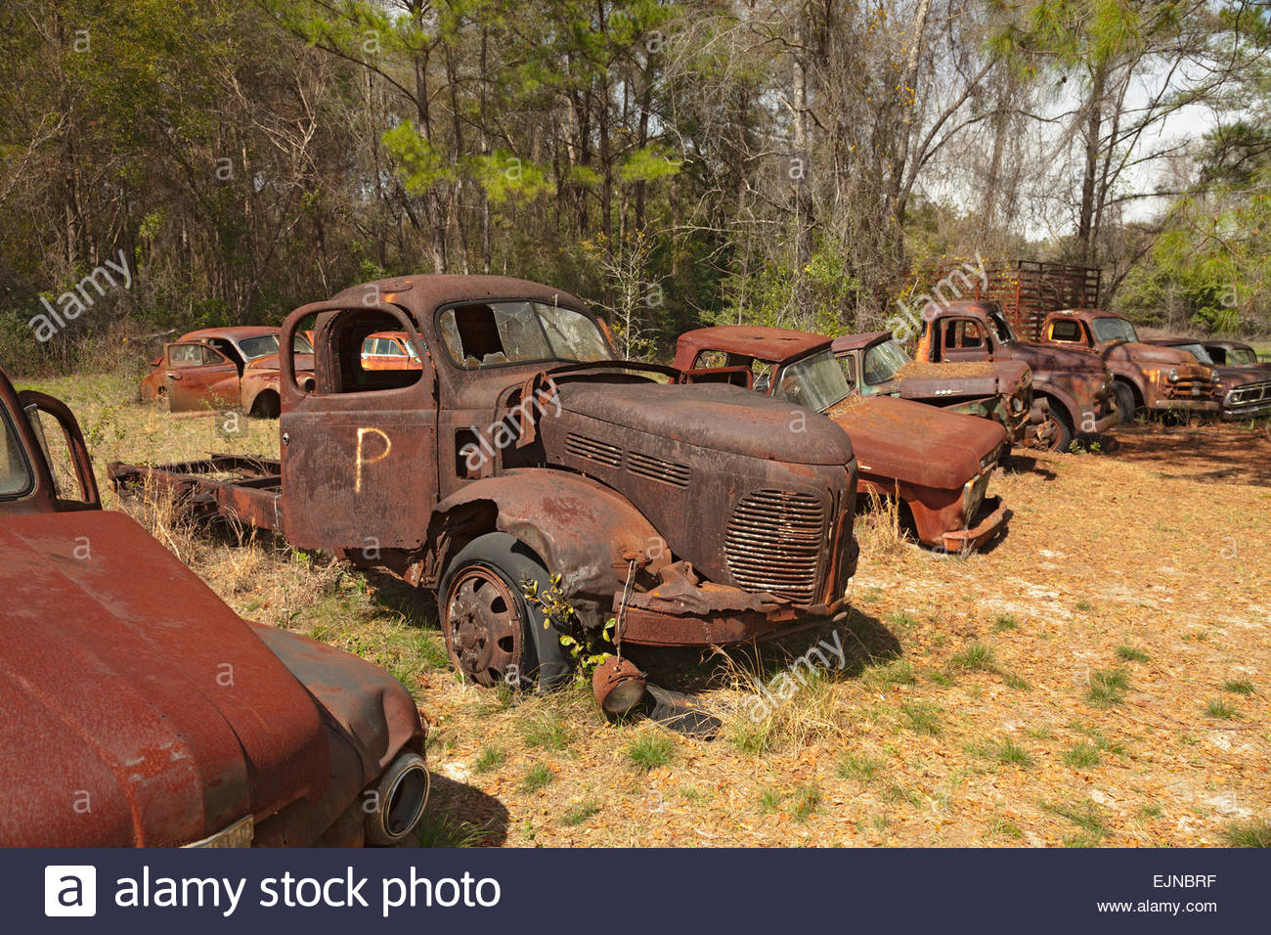
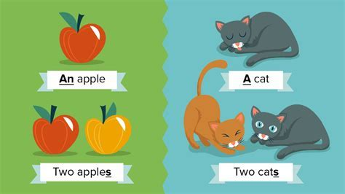
stinking handkerchief anguish
distinctive defunct singular

Slide 17
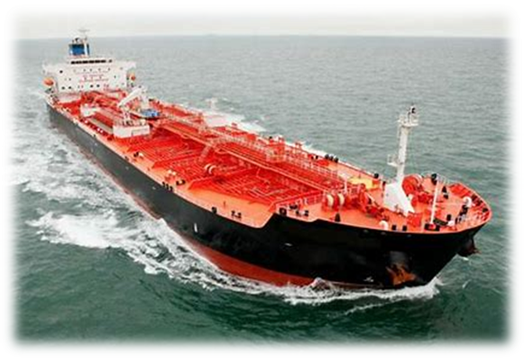
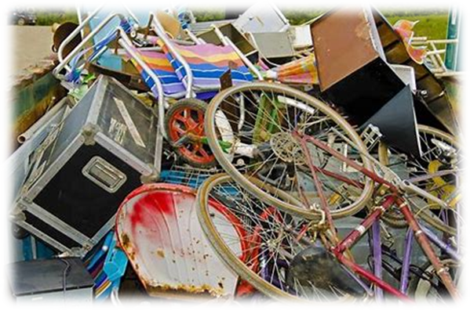
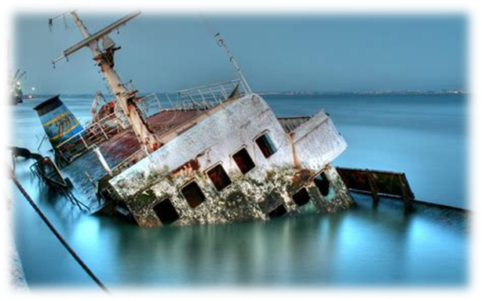
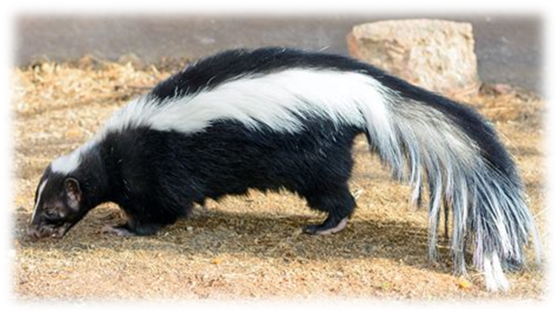
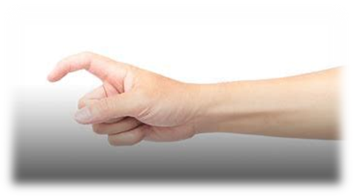
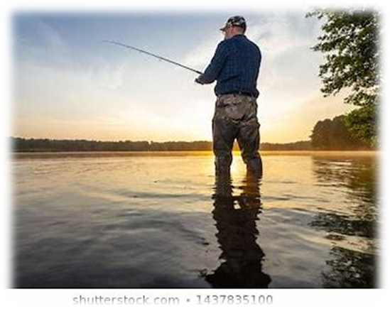
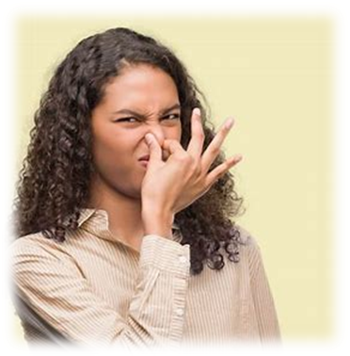
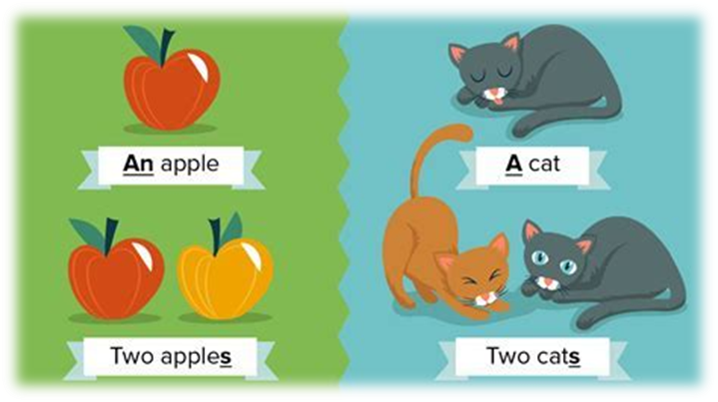
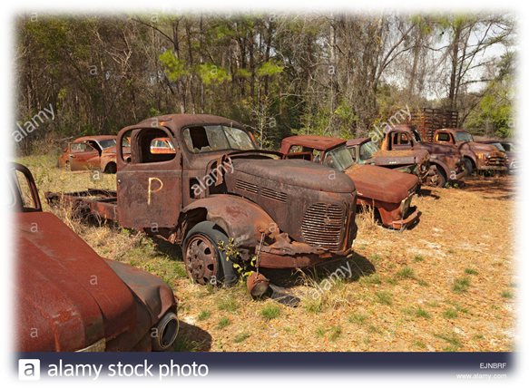

Slide 18
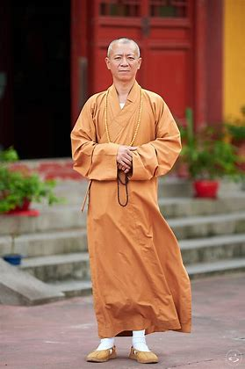
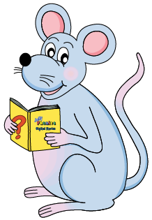
Read the word and draw a picture to illustrate it.

Slide 19
Let’s split these words into syllables.

Slide 20
skunk
blanket
junk
tanker
handkerchief

Slide 21
skunk
blanket
junk
tanker
handkerchief

Slide 22
skunk
blanket
junk
tanker
handkerchief

Slide 23
skunk
blanket
junk
tanker
handkerchief

Slide 24
Let’s parse
sentences.

Slide 25
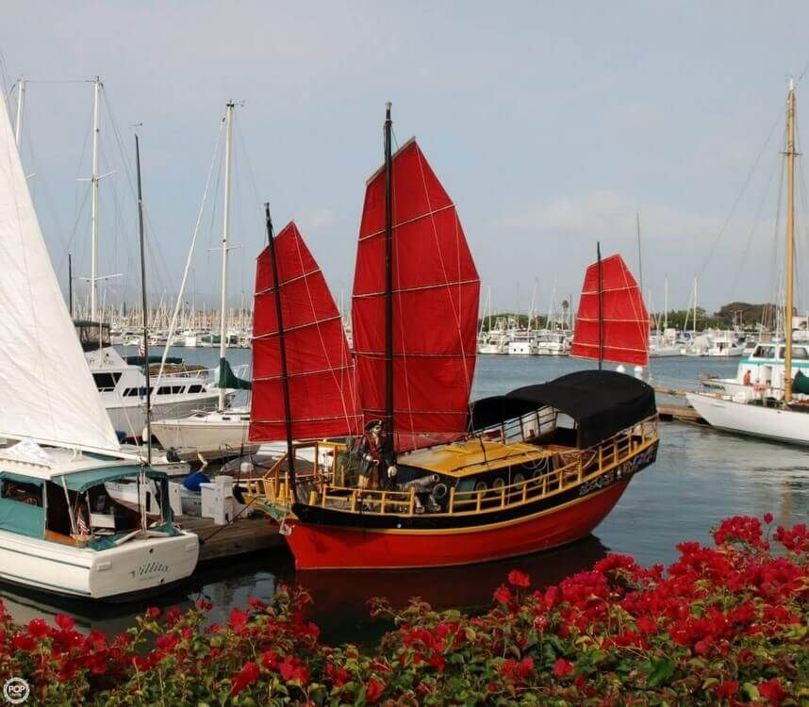
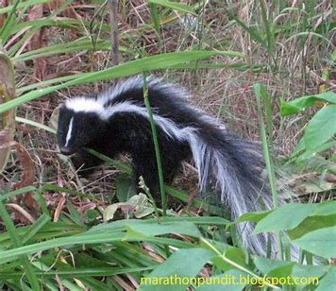
Parse these sentences.
The Chinese junk anchored safely
in the bay.
The black and white skunk
ran quickly into the wood.

Slide 26
Parse these sentences.
The Chinese junk anchored safely
in the bay.
The black and white skunk
ran quickly into the wood.

Slide 27
Parse these sentences.
The Chinese junk anchored safely
in the bay.
The black and white skunk
ran quickly into the wood.

Slide 28
Parse these sentences.
The Chinese junk anchored safely
in the bay.
The black and white skunk
ran quickly into the wood.

Slide 29
Parse these sentences.
The Chinese junk anchored safely
in the bay.
The black and white skunk
ran quickly into the wood.

Slide 30
Parse these sentences.
The Chinese junk anchored safely
in the bay.
The black and white skunk
ran quickly into the wood.

Slide 31
Parse these sentences.
The Chinese junk anchored safely
in the bay.
The black and white skunk
ran quickly into the wood.

Slide 32
Parse these sentences.
The Chinese junk anchored safely
in the bay.
The black and white skunk
ran quickly into the wood.

Slide 33
Parse these sentences.
The Chinese junk anchored safely
in the bay.
The black and white skunk
ran quickly into the wood.

Slide 34
Parse these sentences.
The Chinese junk anchored safely
in the bay.
The black and white skunk
ran quickly into the wood.

Slide 35
Parse these sentences.
The Chinese junk anchored safely
in the bay.
The black and white skunk
ran quickly into the wood.

Slide 36
Parse these sentences.
The Chinese junk anchored safely
in the bay.
The black and white skunk
ran quickly into the wood.

Slide 37
Parse these sentences.
The Chinese junk anchored safely
in the bay.
The black and white skunk
ran quickly into the wood.

Slide 38
Parse these sentences.
The Chinese junk anchored safely
in the bay.
The black and white skunk
ran quickly into the wood.

Slide 39
Parse these sentences.
The Chinese junk anchored safely
in the bay.
The black and white skunk
ran quickly into the wood.

Slide 40
Parse these sentences.
The Chinese junk anchored safely
in the bay.
The black and white skunk
ran quickly into the wood.

Slide 41
Dictation

Slide 42
Dictation
1.
2.
3.

Slide 43
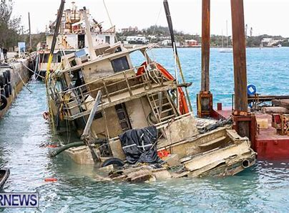

Slide 44
The boat sank in a storm.

Slide 45
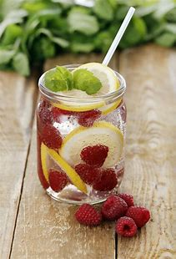

Slide 46
I think I would like a cold drink.

Slide 47
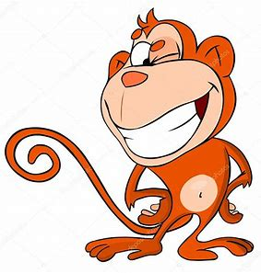
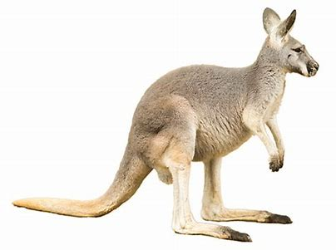

Slide 48
The monkey winked at the kangaroo.

Slide 49
Thank you!

