Slide 1
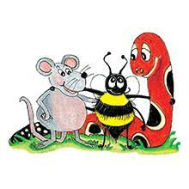
Jolly Grammar 3a-14

Slide 2
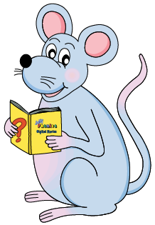
Mini Test 7

Slide 3
gene

Slide 4
gene
these

Slide 5
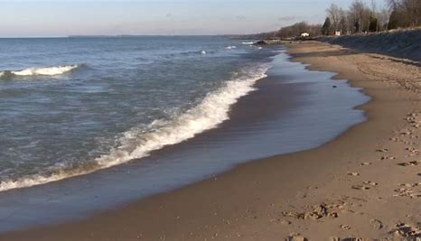
gene
these
recede

Slide 6
gene
these
recede
delete

Slide 7
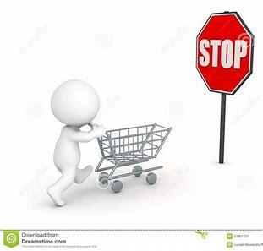
gene
these
recede
delete
impede

Slide 8
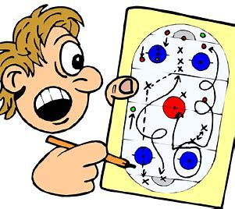
gene
these
recede
delete
impede
scheme

Slide 9
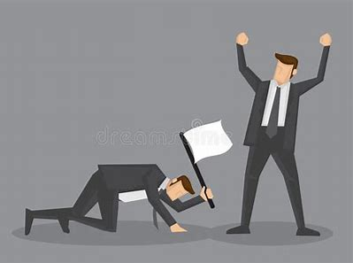
gene
these
recede
delete
impede
scheme
7. concede

Slide 10
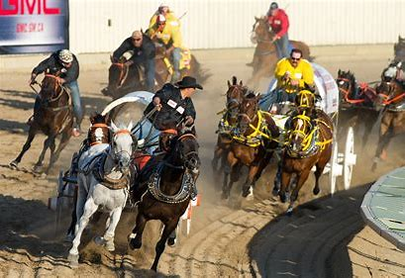
gene
these
recede
delete
impede
scheme
7. concede
8. stampede

Slide 11
gene
these
recede
delete
impede
scheme
7. concede
8. stampede
9. complete

Slide 12
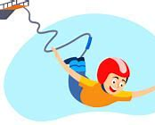
gene
these
recede
delete
impede
scheme
7. concede
8. stampede
9. complete
10. extreme

Slide 13
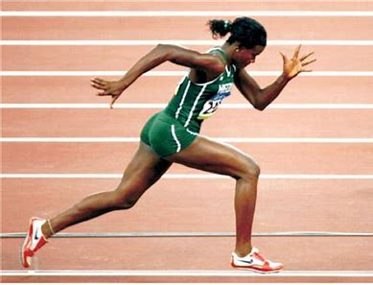
gene
these
recede
delete
impede
scheme
7. concede
8. stampede
9. complete
10. extreme
11. athlete

Slide 14
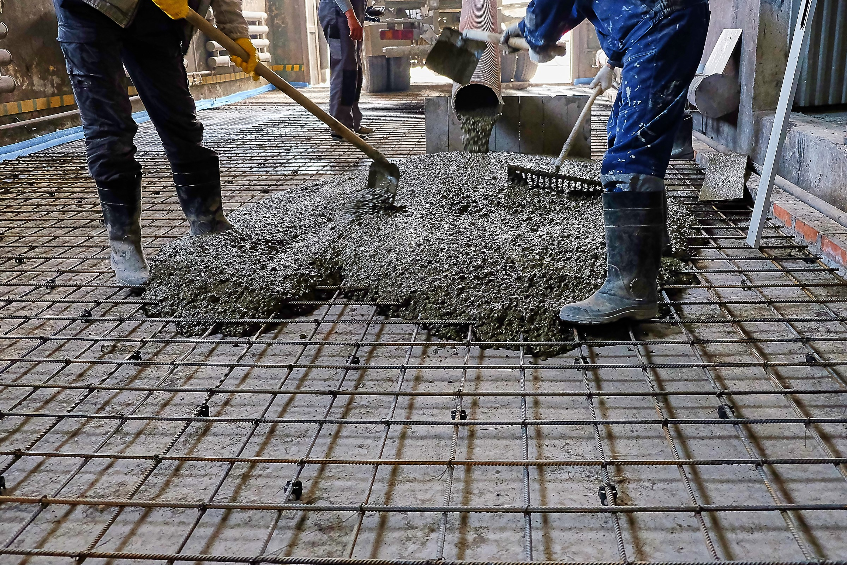
gene
these
recede
delete
impede
scheme
7. concede
8. stampede
9. complete
10. extreme
11. athlete
12. concrete

Slide 15
gene
these
recede
delete
impede
scheme
7. concede
8. stampede
9. complete
10. extreme
11. athlete
12. concrete
13. supreme

Slide 16
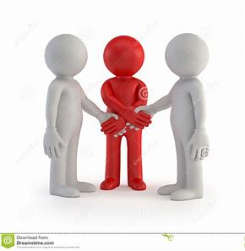
gene
these
recede
delete
impede
scheme
7. concede
8. stampede
9. complete
10. extreme
11. athlete
12. concrete
13. supreme
14. intervene

Slide 17
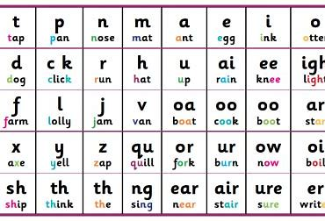
gene
these
recede
delete
impede
scheme
7. concede
8. stampede
9. complete
10. extreme
11. athlete
12. concrete
13. supreme
14. intervene
15. phoneme

Slide 18
gene
these
recede
delete
impede
scheme
7. concede
8. stampede
9. complete
10. extreme
11. athlete
12. concrete
13. supreme
14. intervene
15. phoneme
16. Chinese

Slide 19
gene
these
recede
delete
impede
scheme
7. concede
8. stampede
9. complete
10. extreme
11. athlete
12. concrete
13. supreme
14. intervene
15. phoneme
16. Chinese
17. obsolete

Slide 20
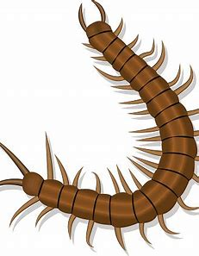
gene
these
recede
delete
impede
scheme
7. concede
8. stampede
9. complete
10. extreme
11. athlete
12. concrete
13. supreme
14. intervene
15. phoneme
16. Chinese
17. obsolete
18. centipede

Slide 21
Let’s review
suffixes.

Slide 22
suffixes

Slide 23
dogs
birds
suffixes

Slide 24
dogs
birds
boxes
suffixes

Slide 25
dogs
birds
boxes
daisies
suffixes

Slide 26
dogs
birds
boxes
daisies
walked
looked
suffixes

Slide 27
dogs
birds
boxes
daisies
walked
looked
walking
suffixes

Slide 28
dogs
birds
boxes
daisies
walked
looked
walking
suffixes
→present participle

Slide 29
Activity Page:
The Present Participle

Slide 30
boil
deliver
inject
perform
sprout

Slide 31
boiling
delivering
injecting
performing
sprouting

Slide 32
boilling
delivering
injecting
performing
sprouting
amuse
describe
serve
exercise
wipe

Slide 33
boiling
delivering
injecting
performing
sprouting
amusing
describing
serving
exercising
wiping

Slide 34
boiling
delivering
injecting
performing
sprouting
amusing
describing
serving
exercising
wiping
admit
shop
grin
knit
stop

Slide 35
boiling
delivering
injecting
performing
sprouting
amusing
describing
serving
exercising
wiping
admitting
shopping
grinning
knitting
stopping

Slide 36
boiling
delivering
injecting
performing
sprouting
amusing
describing
serving
exercising
wiping
admitting
shopping
grinning
knitting
stopping
carry
dry
hurry
stay
tidy

Slide 37
boiling
delivering
injecting
performing
sprouting
amusing
describing
serving
exercising
wiping
admitting
shopping
grinning
knitting
stopping
carrying
drying
hurrying
staying
tidying

Slide 38
boiling
delivering
injecting
performing
sprouting
amusing
describing
serving
exercising
wiping
admitting
shopping
grinning
knitting
stopping
carrying
drying
hurrying
staying
tidying
lie tie

Slide 39
boiling
delivering
injecting
performing
sprouting
amusing
describing
serving
exercising
wiping
admitting
shopping
grinning
knitting
stopping
carrying
drying
hurrying
staying
tidying
lie → lying tie → tying

Slide 40
present participle
boiling
delivering
injecting
performing
sprouting
amusing
describing
serving
exercising
wiping
admitting
shopping
grinning
knitting
stopping
carrying
drying
hurrying
staying
tidying
lie → lying tie → tying

Slide 41
present participle
boiling
delivering
injecting
performing
sprouting
amusing
describing
serving
exercising
wiping
admitting
shopping
grinning
knitting
stopping
carrying
drying
hurrying
staying
tidying
lie → lying tie → tying
flying

Slide 42
present participle
boiling
delivering
injecting
performing
sprouting
amusing
describing
serving
exercising
wiping
admitting
shopping
grinning
knitting
stopping
carrying
drying
hurrying
staying
tidying
lie → lying tie → tying
flying grabbing

Slide 43
present participle
boiling
delivering
injecting
performing
sprouting
amusing
describing
serving
exercising
wiping
admitting
shopping
grinning
knitting
stopping
carrying
drying
hurrying
staying
tidying
lie → lying tie → tying
flying grabbing reminding

Slide 44
present participle
boiling
delivering
injecting
performing
sprouting
amusing
describing
serving
exercising
wiping
admitting
shopping
grinning
knitting
stopping
carrying
drying
hurrying
staying
tidying
lie → lying tie → tying
flying grabbing reminding
measuring

Slide 45
present participle
boiling
delivering
injecting
performing
sprouting
amusing
describing
serving
exercising
wiping
admitting
shopping
grinning
knitting
stopping
carrying
drying
hurrying
staying
tidying
lie → lying tie → tying
flying grabbing reminding
measuring juggling

Slide 46
present participle
boiling
delivering
injecting
performing
sprouting
amusing
describing
serving
exercising
wiping
admitting
shopping
grinning
knitting
stopping
carrying
drying
hurrying
staying
tidying
lie → lying tie → tying
flying grabbing reminding
measuring juggling planning

Slide 47
present participle
boiling
delivering
injecting
performing
sprouting
amusing
describing
serving
exercising
wiping
admitting
shopping
grinning
knitting
stopping
carrying
drying
hurrying
staying
tidying
lie → lying tie → tying
flying grabbing reminding
measuring juggling planning
frightening

Slide 48
present participle
boiling
delivering
injecting
performing
sprouting
amusing
describing
serving
exercising
wiping
admitting
shopping
grinning
knitting
stopping
carrying
drying
hurrying
staying
tidying
lie → lying tie → tying
flying grabbing reminding
measuring juggling planning
frightening tying

Slide 49
present participle
boiling
delivering
injecting
performing
sprouting
amusing
describing
serving
exercising
wiping
admitting
shopping
grinning
knitting
stopping
carrying
drying
hurrying
staying
tidying
lie → lying tie → tying
flying grabbing reminding
measuring juggling planning
frightening tying irritating

Slide 50
Thank you!

