Slide 1
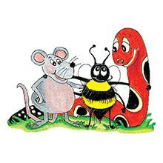
Jolly Grammar 3a-13

Slide 2
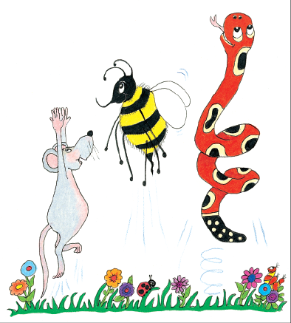
Let’s review
syllables.

Slide 3
green house
ran
un kind
wish ing
thank ful
dis ag ree

Slide 4
green house
ran
un kind
wish ing
thank ful
dis ag ree

Slide 5
green house
ran
un kind
wish ing
thank ful
dis ag ree

Slide 6
green house
ran
un kind
wish ing
thank ful
dis ag ree

Slide 7
green house
ran
un kind
wish ing
thank ful
dis ag ree

Slide 8
green house
ran
un kind
wish ing
thank ful
dis a gree

Slide 9
Spelling ＜e-e＞

Slide 10
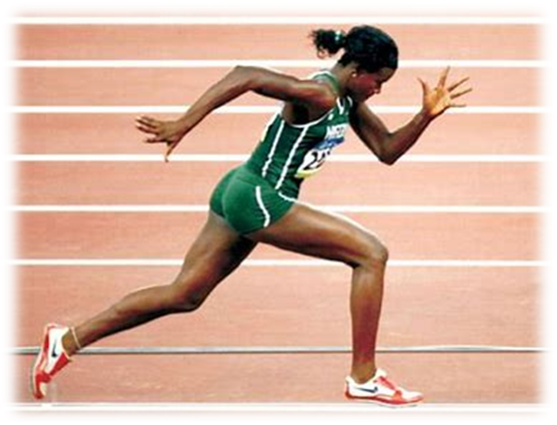
athlete
/ee/

Slide 11
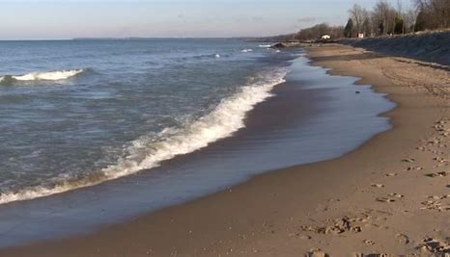
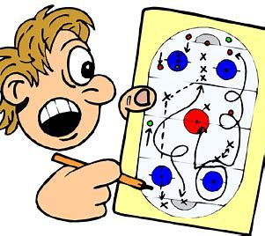
gene these recede
delete impede scheme

Slide 12
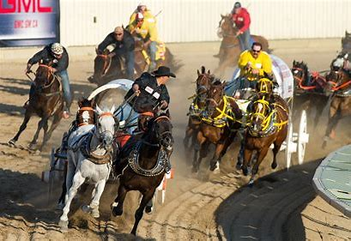
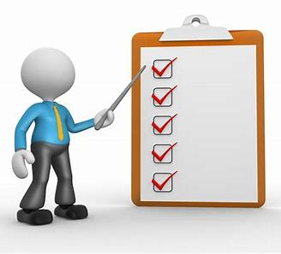
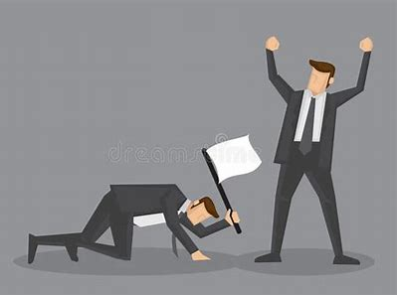
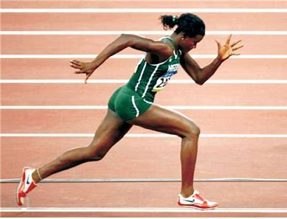
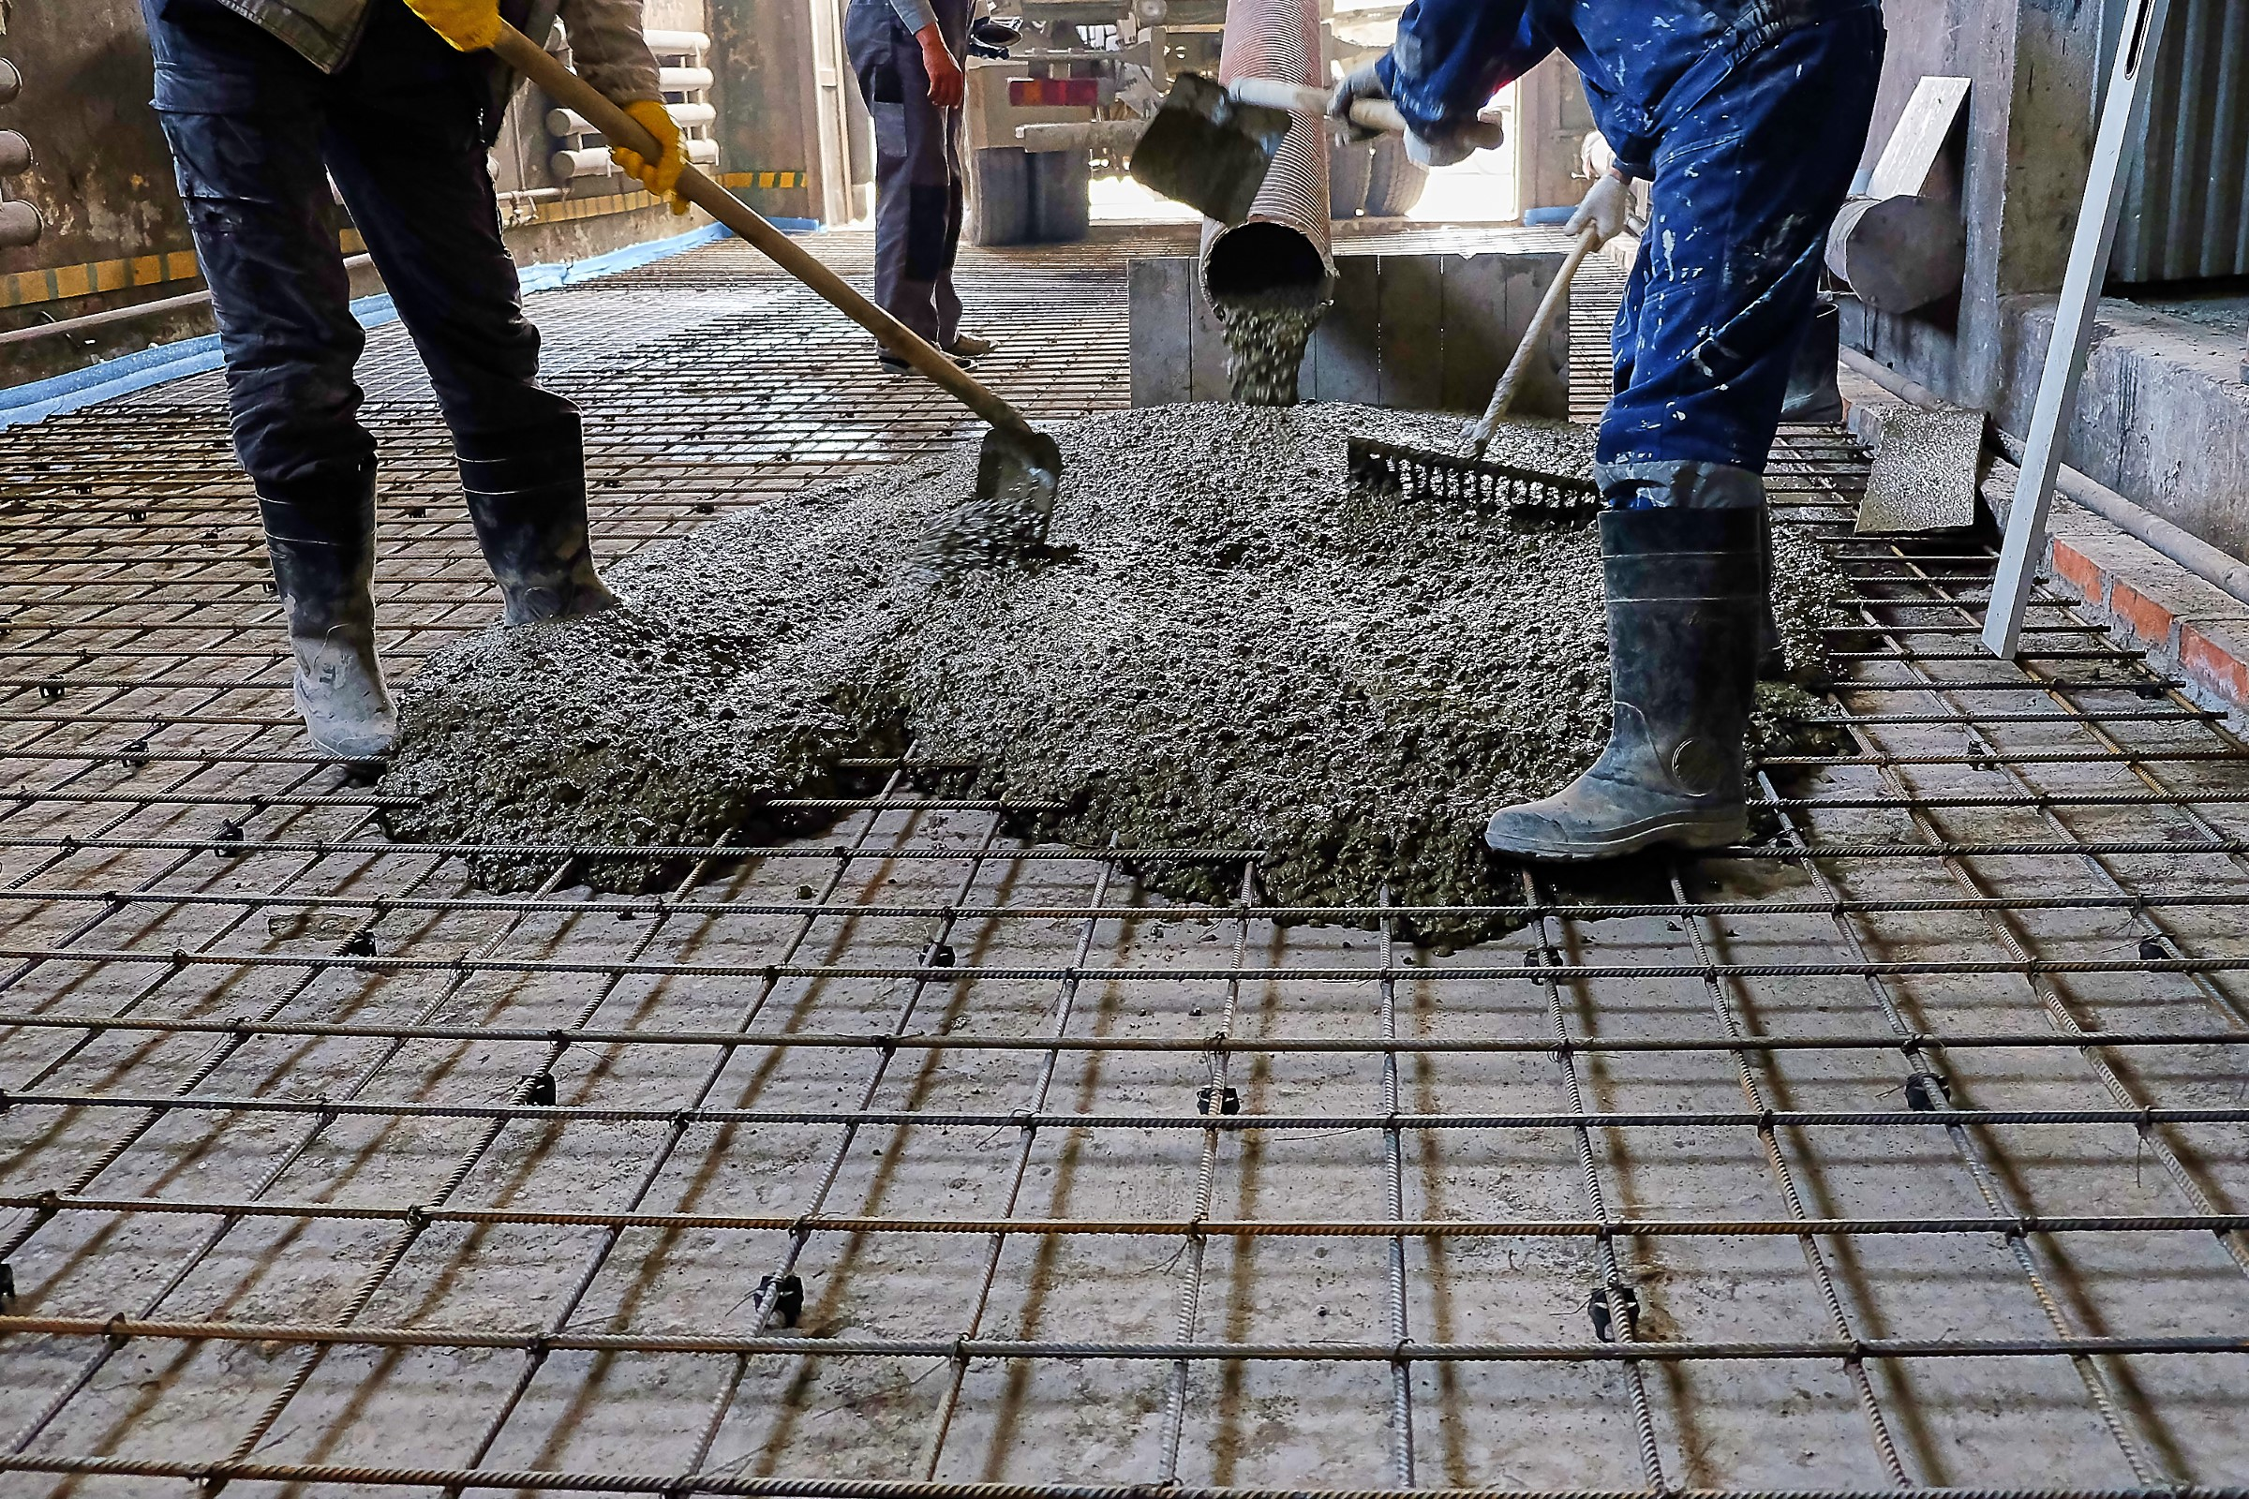
concede stampede complete
extreme athlete concrete

Slide 13
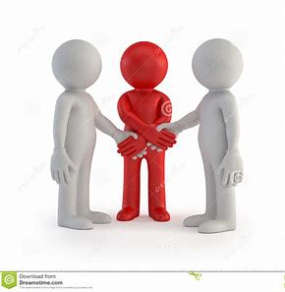
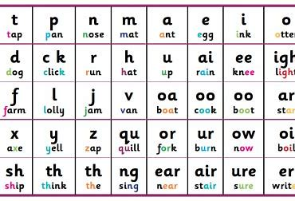
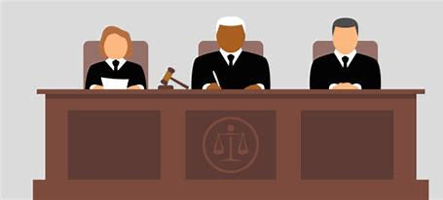
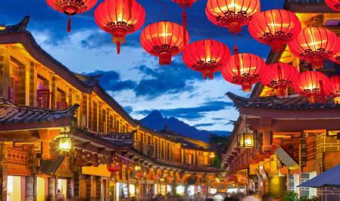
supreme intervene phoneme
Chinese obsolete centipede

Slide 14
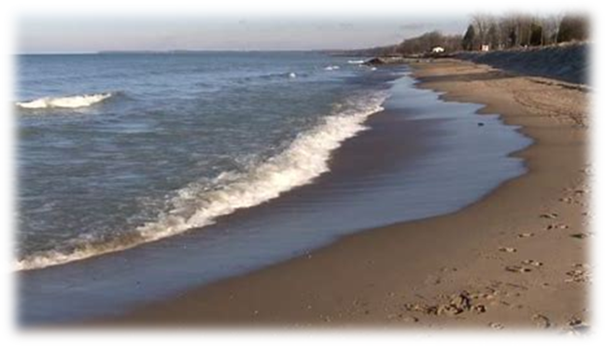
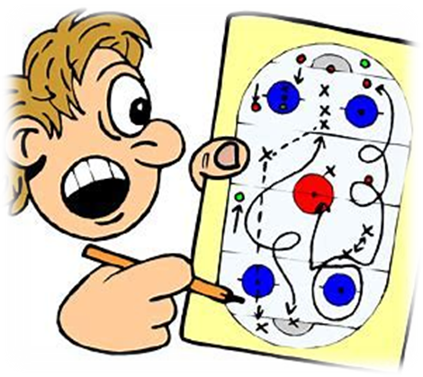
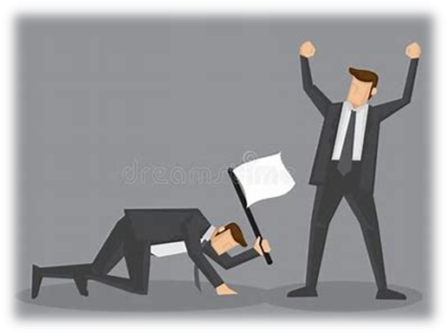
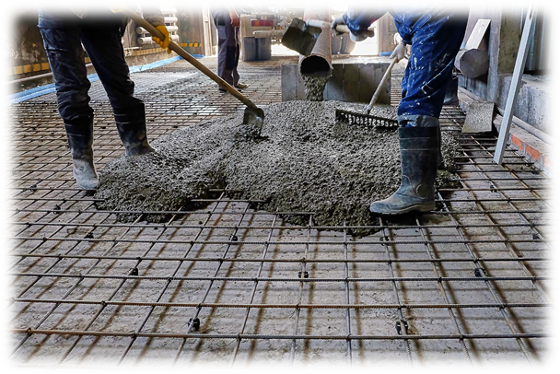
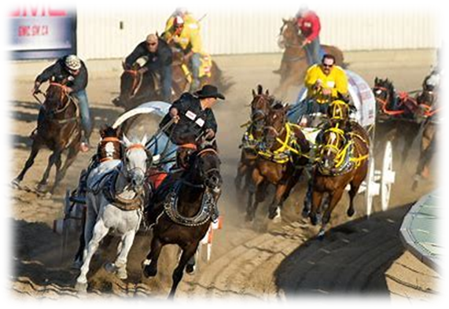
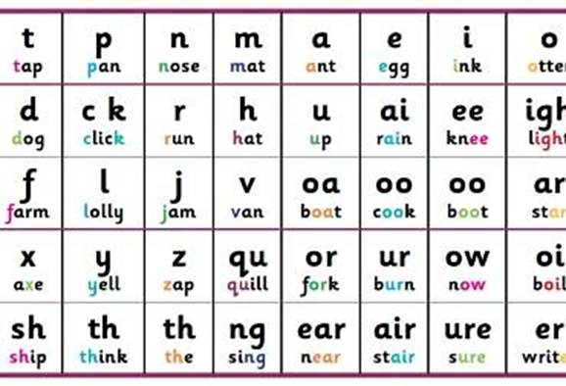
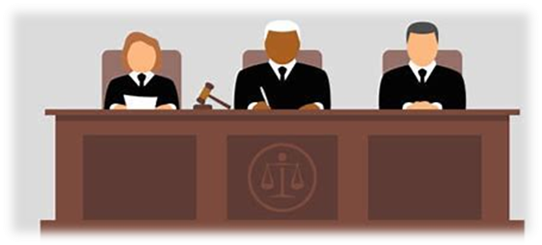

Slide 15
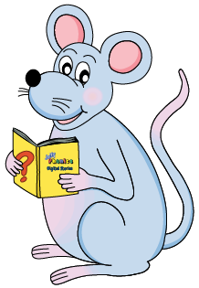
Find the words from the spelling list.

Slide 16
Let’s split these words into syllables.

Slide 17
concrete
these
athlete
extreme
intervene

Slide 18
concrete
these
athlete
extreme
intervene

Slide 19
concrete
these
athlete
extreme
intervene

Slide 20
concrete
these
athlete
extreme
intervene

Slide 21
concrete
these
athlete
extreme
intervene

Slide 22
Let’s parse
sentences.

Slide 23
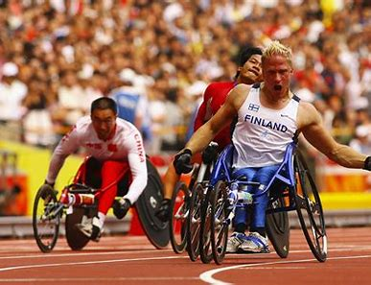
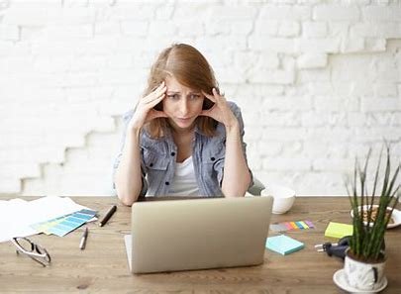
Parse these sentences.
The athletes will compete in the morning.
I accidentally deleted my work
on the computer.

Slide 24
Parse these sentences.
The athletes will compete in the morning.
I accidentally deleted my work
on the computer.

Slide 25
Parse these sentences.
The athletes will compete in the morning.
I accidentally deleted my work
on the computer.

Slide 26
Parse these sentences.
The athletes will compete in the morning.
I accidentally deleted my work
on the computer.

Slide 27
Parse these sentences.
The athletes will compete in the morning.
I accidentally deleted my work
on the computer.

Slide 28
Parse these sentences.
The athletes will compete in the morning.
I accidentally deleted my work
on the computer.

Slide 29
Parse these sentences.
The athletes will compete in the morning.
I accidentally deleted my work
on the computer.

Slide 30
Parse these sentences.
The athletes will compete in the morning.
I accidentally deleted my work
on the computer.

Slide 31
Parse these sentences.
The athletes will compete in the morning.
I accidentally deleted my work
on the computer.

Slide 32
Parse these sentences.
The athletes will compete in the morning.
I accidentally deleted my work
on the computer.

Slide 33
Parse these sentences.
The athletes will compete in the morning.
I accidentally deleted my work
on the computer.

Slide 34
Parse these sentences.
The athletes will compete in the morning.
I accidentally deleted my work
on the computer.

Slide 35
Dictation

Slide 36
Dictation
1.
2.
3.

Slide 37
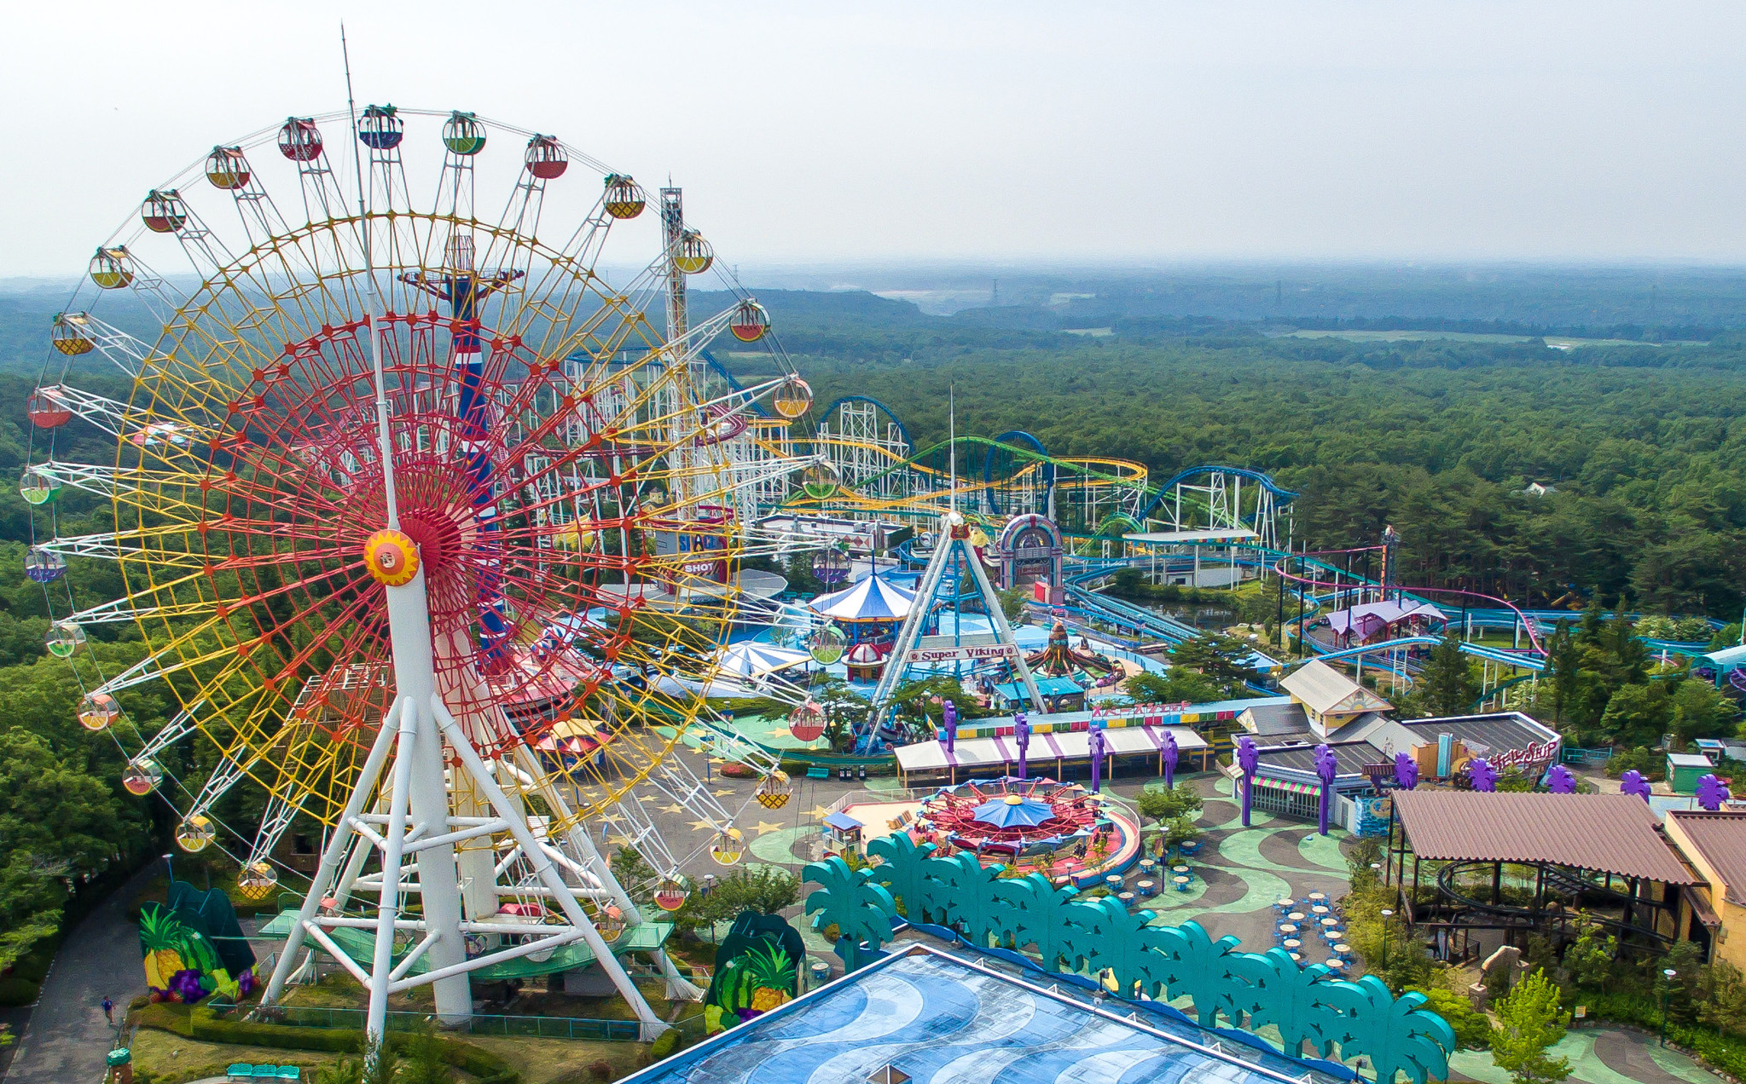
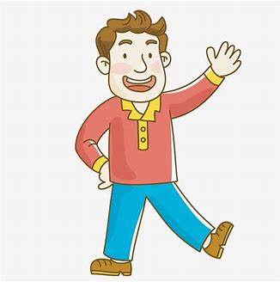

Slide 38
We went to the theme park with Uncle Tom.

Slide 39
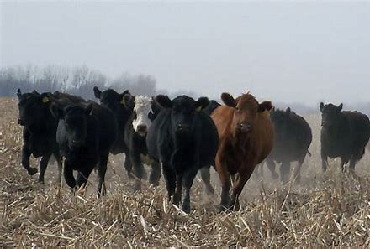
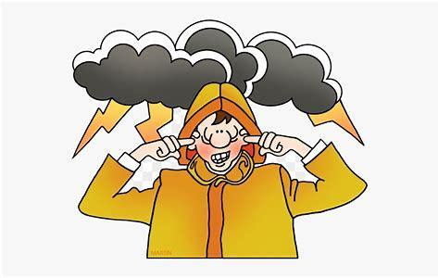

Slide 40
There was a loud clap of thunder which made the cows stampede.

Slide 41
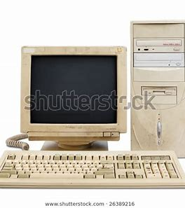

Slide 42
The computer was so old it was obsolete.

Slide 43
Thank you!

