Slide 1
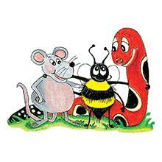
Jolly Grammar 3a-35

Slide 2
Let’s review
syllables.

Slide 3
enjoyable
lovable
huggable
reliable
usable

Slide 4
Spelling List
Spelling
The <-less> Suffix

Slide 5
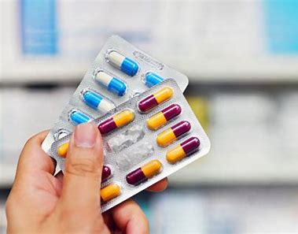
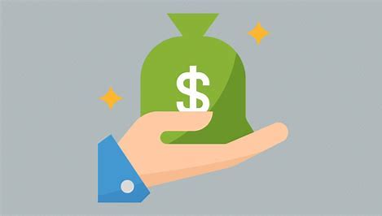
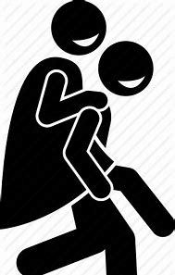
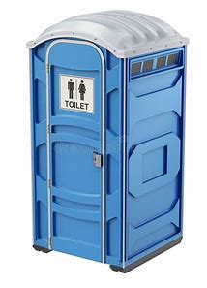
avoidable profitable available
portable adaptable dependable

Slide 6
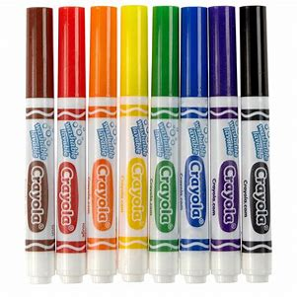
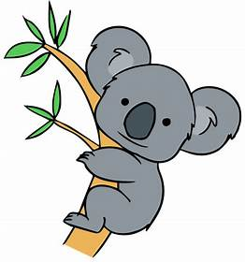
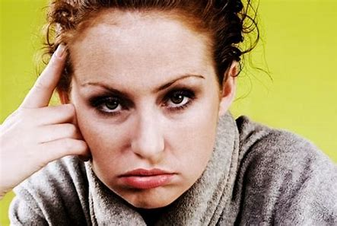
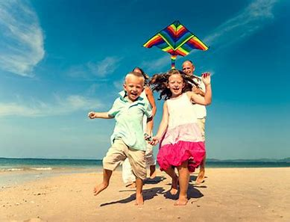
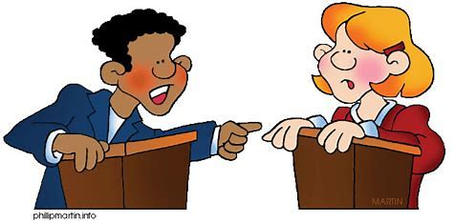
breakable usable lovable
irritable enjoyable debatable

Slide 7
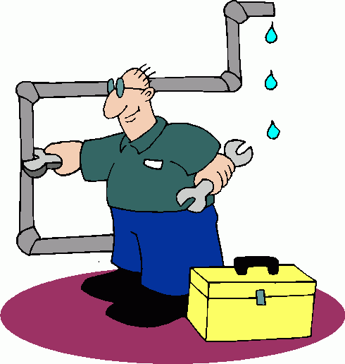
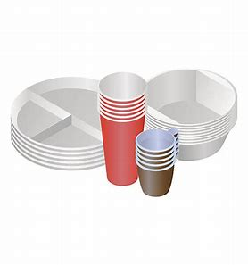
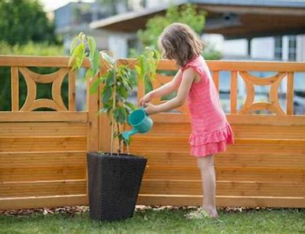
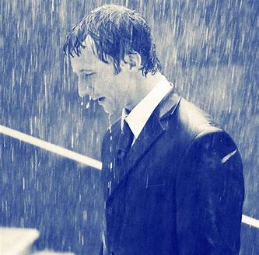
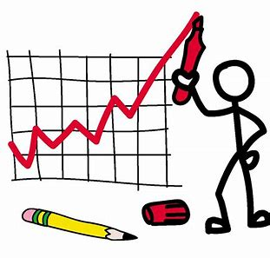
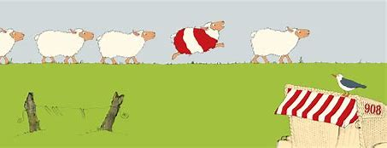
changeable disposable desirable
miserable variable noticeable

Slide 8
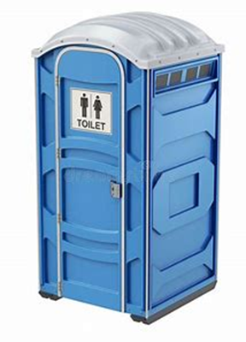
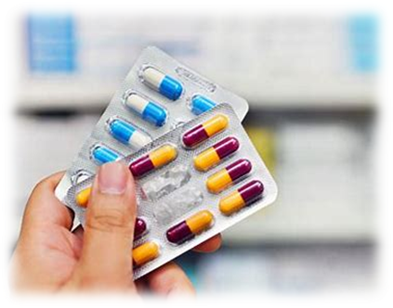
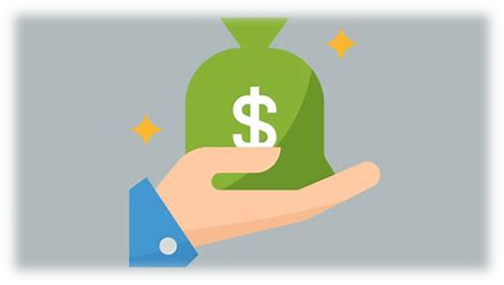
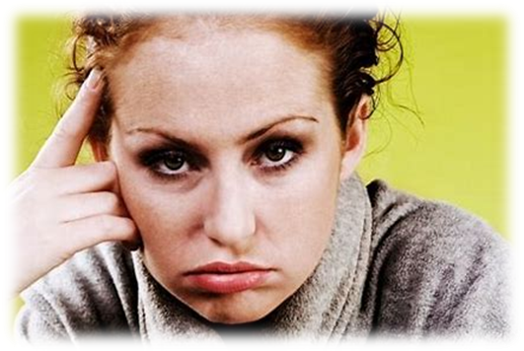
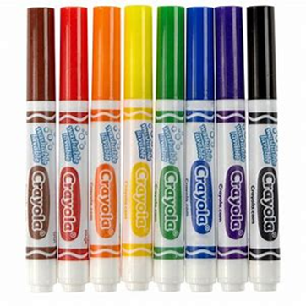
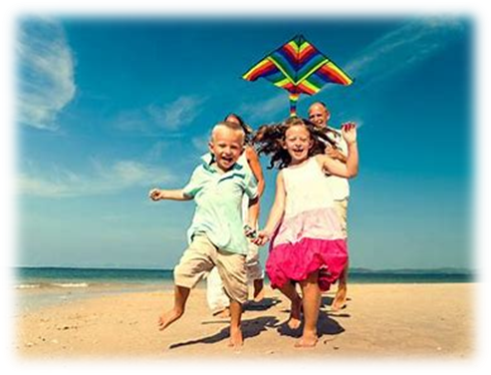
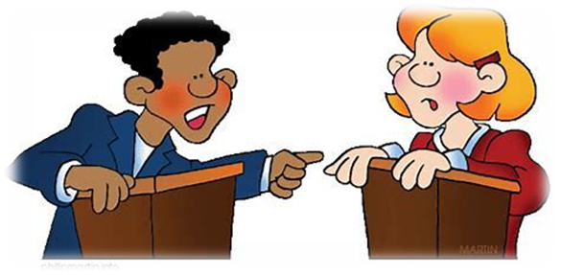
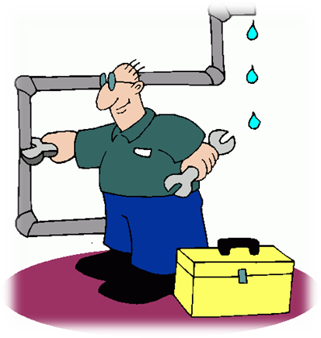
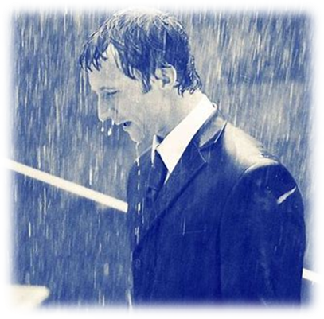
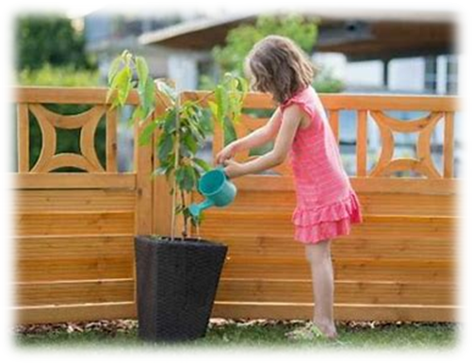
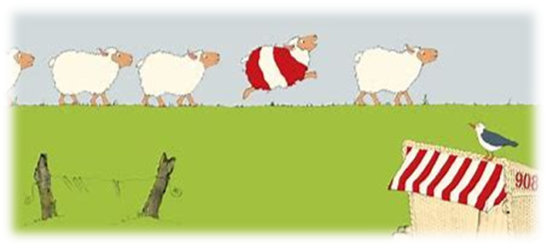

Slide 9
Activity page
The <-able> Suffix

Slide 10
Activity page
The <-able> Suffix
‘capable or worthy of being’

Slide 11
breakable

Slide 12
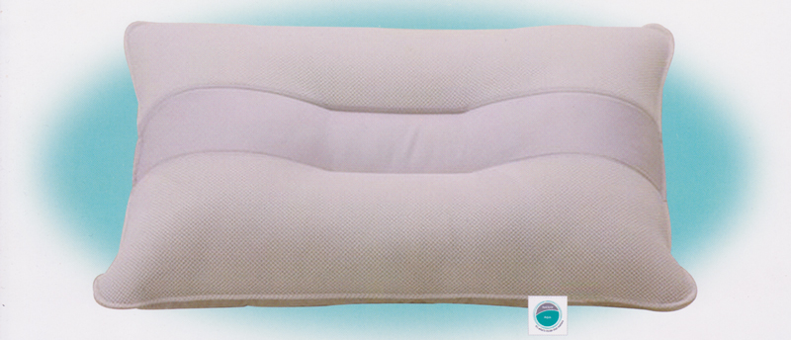
breakable
washable

Slide 13
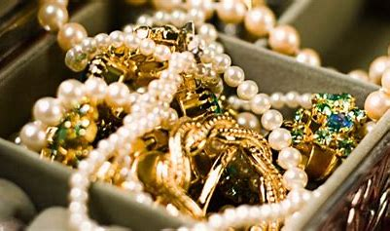
breakable
washable
valuable

Slide 14
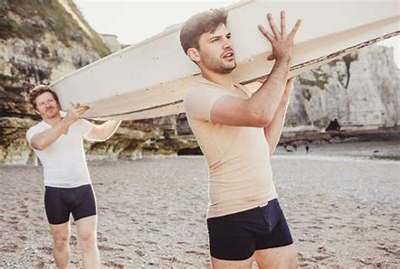
breakable
washable
valuable
sizable

Slide 15
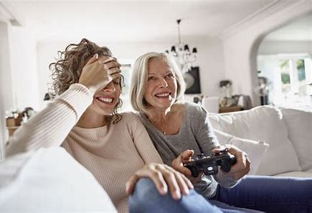
breakable
washable
valuable
sizable
enjoyable

Slide 16
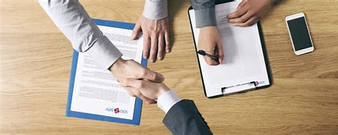
breakable
washable
valuable
sizable
enjoyable
reliable

Slide 17
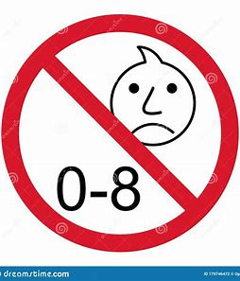
breakable
washable
valuable
sizable
enjoyable
reliable
suitable

Slide 18
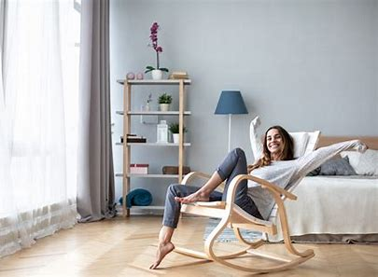
breakable
washable
valuable
sizable
enjoyable
reliable
suitable
comfortable

Slide 19
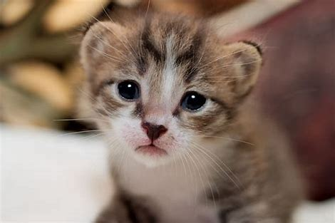
breakable
washable
valuable
sizable
enjoyable
reliable
suitable
comfortable
adorable

Slide 20
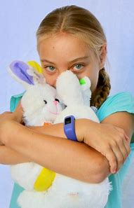
breakable
washable
valuable
sizable
enjoyable
reliable
suitable
comfortable
adorable
huggable

Slide 21
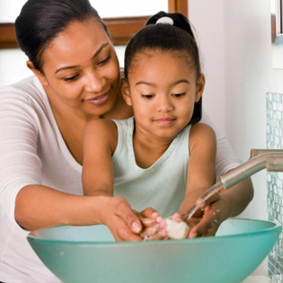
breakable
washable
valuable
sizable
enjoyable
reliable
suitable
comfortable
adorable
huggable
desirable

Slide 22
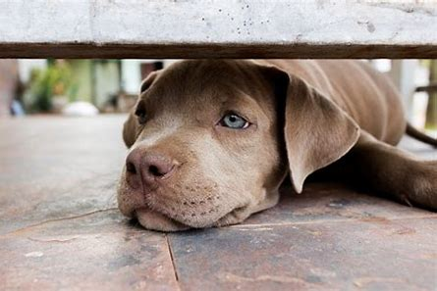
breakable
washable
valuable
sizable
enjoyable
reliable
suitable
comfortable
adorable
huggable
desirable
pitiable

Slide 23
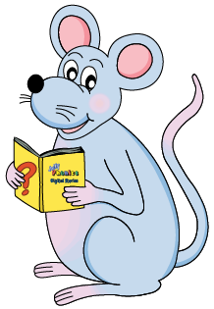
Let’s parse
sentences.

Slide 24
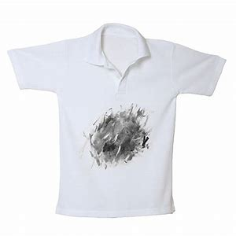
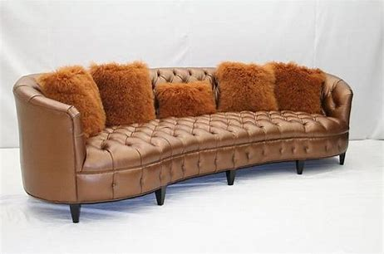
Parse these sentences.
The dirty shirt is washable.
The sofa was old but comfortable.

Slide 25
Parse these sentences.
The dirty shirt is washable.
The sofa was old but comfortable.

Slide 26
Parse these sentences.
The dirty shirt is washable.
The sofa was old but comfortable.

Slide 27
Parse these sentences.
The dirty shirt is washable.
The sofa was old but comfortable.

Slide 28
Parse these sentences.
The dirty shirt is washable.
The sofa was old but comfortable.

Slide 29
Parse these sentences.
The dirty shirt is washable.
The sofa was old but comfortable.

Slide 30
Parse these sentences.
The dirty shirt is washable.
The sofa was old but comfortable.

Slide 31
Parse these sentences.
The dirty shirt is washable.
The sofa was old but comfortable.

Slide 32
Parse these sentences.
The dirty shirt is washable.
The sofa was old but comfortable.

Slide 33
Parse these sentences.
The dirty shirt is washable.
The sofa was old but comfortable.

Slide 34
Dictation

Slide 35
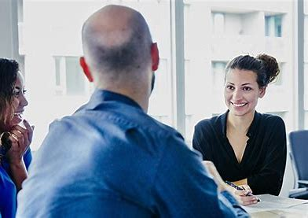
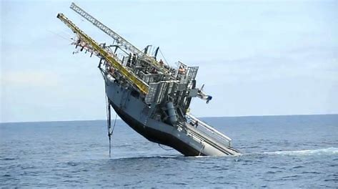

Slide 36
They claimed the ship was unsinkable.

Slide 37
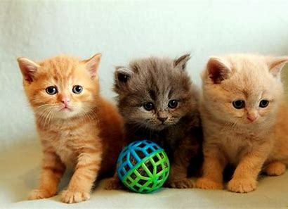

Slide 38
“The kittens were all adorable,” said May.

Slide 39
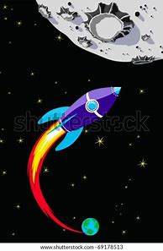

Slide 40
It was improbable the boy’s rocket would reach the moon.

Slide 41
See you next time!

