Slide 1
Jolly Grammar 3a-34

Slide 2
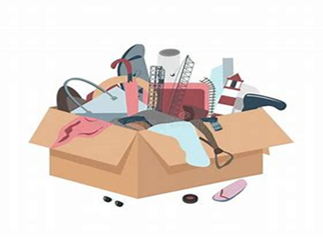
useless

Slide 3
useless
helpless

Slide 4
useless
helpless
endless

Slide 5
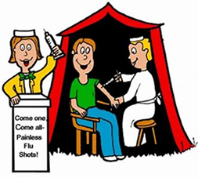
useless
helpless
endless
painless

Slide 6
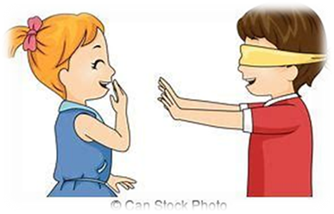
useless
helpless
endless
painless
aimless

Slide 7
useless
helpless
endless
painless
aimless
flawless

Slide 8
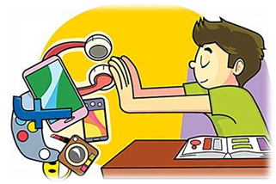
useless
helpless
endless
painless
aimless
flawless
7. worthless

Slide 9
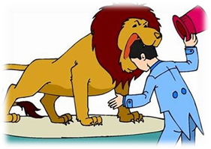
useless
helpless
endless
painless
aimless
flawless
7. worthless
8. fearless

Slide 10
useless
helpless
endless
painless
aimless
flawless
7. worthless
8. fearless
9. timeless

Slide 11
useless
helpless
endless
painless
aimless
flawless
7. worthless
8. fearless
9. timeless
10. harmless

Slide 12
useless
helpless
endless
painless
aimless
flawless
7. worthless
8. fearless
9. timeless
10. harmless
11. speechless

Slide 13
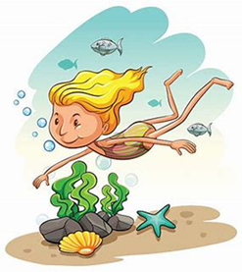
useless
helpless
endless
painless
aimless
flawless
7. worthless
8. fearless
9. timeless
10. harmless
11. speechless
12. bottomless

Slide 14
useless
helpless
endless
painless
aimless
flawless
7. worthless
8. fearless
9. timeless
10. harmless
11. speechless
12. bottomless
13. priceless

Slide 15
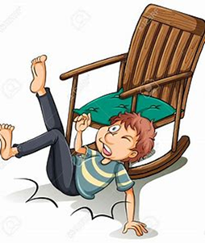
useless
helpless
endless
painless
aimless
flawless
7. worthless
8. fearless
9. timeless
10. harmless
11. speechless
12. bottomless
13. priceless
14. careless

Slide 16
useless
helpless
endless
painless
aimless
flawless
7. worthless
8. fearless
9. timeless
10. harmless
11. speechless
12. bottomless
13. priceless
14. careless
15. pitiless

Slide 17
useless
helpless
endless
painless
aimless
flawless
7. worthless
8. fearless
9. timeless
10. harmless
11. speechless
12. bottomless
13. priceless
14. careless
15. pitiless
16. breathless

Slide 18
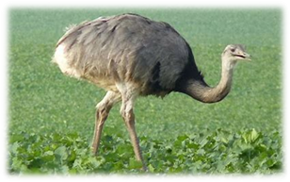
useless
helpless
endless
painless
aimless
flawless
7. worthless
8. fearless
9. timeless
10. harmless
11. speechless
12. bottomless
13. priceless
14. careless
15. pitiless
16. breathless
17. flightless

Slide 19
useless
helpless
endless
painless
aimless
flawless
7. worthless
8. fearless
9. timeless
10. harmless
11. speechless
12. bottomless
13. priceless
14. careless
15. pitiless
16. breathless
17. flightless
18. weightless

Slide 20
Let’s Review Tenses.

Slide 21
 | Past | Present | Future
Simple
Continuous

Slide 22
 | Past | Present | Future
Simple |  | I cook dinner.
Continuous

Slide 23
 | Past | Present | Future
Simple | I cooked dinner. | I cook dinner.
Continuous

Slide 24
 | Past | Present | Future
Simple | I cooked dinner. | I cook dinner. | I will/shall cook dinner.
Continuous

Slide 25
 | Past | Present | Future
Simple | I cooked dinner. | I cook dinner. | I will/shall cook dinner.
Continuous |  | I am cooking dinner.

Slide 26
 | Past | Present | Future
Simple | I cooked dinner. | I cook dinner. | I will/shall cook dinner.
Continuous | I was cooking dinner. | I am cooking dinner.

Slide 27
 | Past | Present | Future
Simple | I cooked dinner. | I cook dinner. | I will/shall cook dinner.
Continuous | I was cooking dinner. | I am cooking dinner. | I will/shall be cooking dinner.

Slide 28
Activity Page:
The Future Continuous

Slide 29
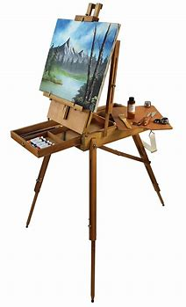
I paint a picture.
I
You
He / She / It
We
You
They

Slide 30
I paint a picture.
I shall be painting a picture.
You
He / She / It
We
You
They

Slide 31
I paint a picture.
I shall be painting a picture.
You will be painting a picture.
He / She / It
We
You
They

Slide 32
I paint a picture.
I shall be painting a picture.
You will be painting a picture.
He / She / It will be painting a picture.
We
You
They

Slide 33
I paint a picture.
I shall be painting a picture.
You will be painting a picture.
He / She / It will be painting a picture.
We shall be painting a picture.
You
They

Slide 34
I paint a picture.
I shall be painting a picture.
You will be painting a picture.
He / She / It will be painting a picture.
We shall be painting a picture.
You will be painting a picture.
They

Slide 35
I paint a picture.
I shall be painting a picture.
You will be painting a picture.
He / She / It will be painting a picture.
We shall be painting a picture.
You will be painting a picture.
They will be painting a picture.

Slide 36
I shall be grinning if I win.
He will be competing in the hoping race.
You will be dancing in the summer show.
She will be walking a long way on her trip.
They will be composing a song for the concert.
You will be digging the vegetable patch.
We shall be joining the other class today.

Slide 37
I shall be grinning if I win.
He will be competing in the hopping race.
You will be dancing in the summer show.
She will be walking a long way on her trip.
They will be composing a song for the concert.
You will be digging the vegetable patch.
We shall be joining the other class today.

Slide 38
I shall be grinning if I win.
He will be competing in the hoping race.
You will be dancing in the summer show.
She will be walking a long way on her trip.
They will be composing a song for the concert.
You will be digging the vegetable patch.
We shall be joining the other class today.

Slide 39
I shall be grinning if I win.
He will be competing in the hoping race.
You will be dancing in the summer show.
She will be walking a long way on her trip.
They will be composing a song for the concert.
You will be digging the vegetable patch.
We shall be joining the other class today.

Slide 40
I shall be grinning if I win.
He will be competing in the hoping race.
You will be dancing in the summer show.
She will be walking a long way on her trip.
They will be composing a song for the concert.
You will be digging the vegetable patch.
We shall be joining the other class today.

Slide 41
I shall be grinning if I win.
He will be competing in the hoping race.
You will be dancing in the summer show.
She will be walking a long way on her trip.
They will be composing a song for the concert.
You will be digging the vegetable patch.
We shall be joining the other class today.

Slide 42
I shall be grinning if I win.
He will be competing in the hoping race.
You will be dancing in the summer show.
She will be walking a long way on her trip.
They will be composing a song for the concert.
You will be digging the vegetable patch.
We shall be joining the other class today.

Slide 43
They were playing cards.
I shall play cards.
He plays cards.
You will be playing cards.
We played cards.
She is playing cards.
Simple past
Simple present
Simple future
Past continuous
Present continuous
Future continuous

Slide 44
They were playing cards.
I shall play cards.
He plays cards.
You will be playing cards.
We played cards.
She is playing cards.
Simple past
Simple present
Simple future
Past continuous
Present continuous
Future continuous

Slide 45
They were playing cards.
I shall play cards.
He plays cards.
You will be playing cards.
We played cards.
She is playing cards.
Simple past
Simple present
Simple future
Past continuous
Present continuous
Future continuous

Slide 46
They were playing cards.
I shall play cards.
He plays cards.
You will be playing cards.
We played cards.
She is playing cards.
Simple past
Simple present
Simple future
Past continuous
Present continuous
Future continuous

Slide 47
They were playing cards.
I shall play cards.
He plays cards.
You will be playing cards.
We played cards.
She is playing cards.
Simple past
Simple present
Simple future
Past continuous
Present continuous
Future continuous

Slide 48
They were playing cards.
I shall play cards.
He plays cards.
You will be playing cards.
We played cards.
She is playing cards.
Simple past
Simple present
Simple future
Past continuous
Present continuous
Future continuous

Slide 49
They were playing cards.
I shall play cards.
He plays cards.
You will be playing cards.
We played cards.
She is playing cards.
Simple past
Simple present
Simple future
Past continuous
Present continuous
Future continuous

Slide 50
See you next time!

