Slide 1
Jolly Grammar 3a-33

Slide 2
Let’s review
Some sounds.

Slide 3
office
stage
witch
sledge
beetle
quote
quill
busy
cheese
ooze

Slide 4
Let’s review
Suffixes.

Slide 5
walk
walk
look
hop

Slide 6
walked
walk
look
hop

Slide 7
walked
walking
look
hop

Slide 8
walked
walking
looked
hop

Slide 9
walked
walking
looked
hopping

Slide 10
walked
walking
looked
hopping
use
pain
fear
price

Slide 11
walked
walking
looked
hopping
useless
pain
fear
price

Slide 12
walked
walking
looked
hopping
useless
painless
fear
price

Slide 13
walked
walking
looked
hopping
useless
painless
fearless
price

Slide 14
walked
walking
looked
hopping
useless
painless
fearless
priceless

Slide 15
Spelling List
Spelling
The <-less> Suffix

Slide 16
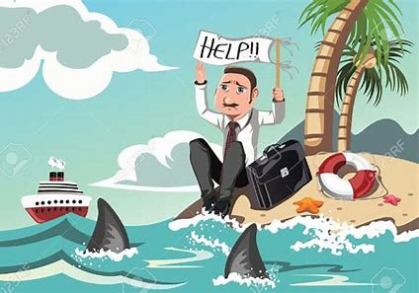
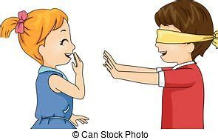
useless helpless endless
painless aimless flawless

Slide 17
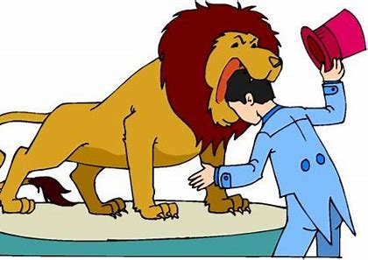
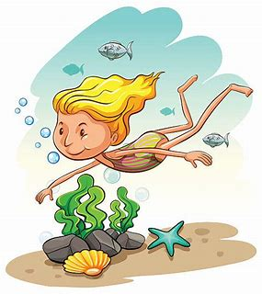
worthless fearless timeless
harmless speechless bottomless

Slide 18
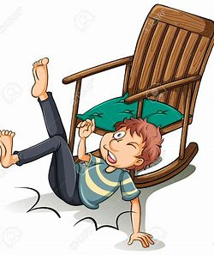
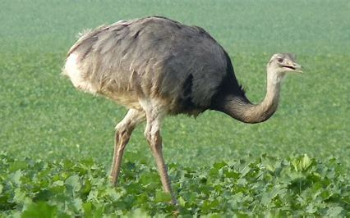
priceless careless pitiless
breathless flightless weightless

Slide 19
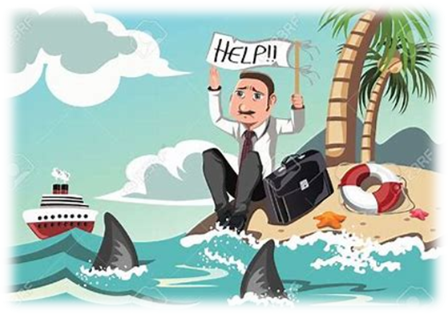
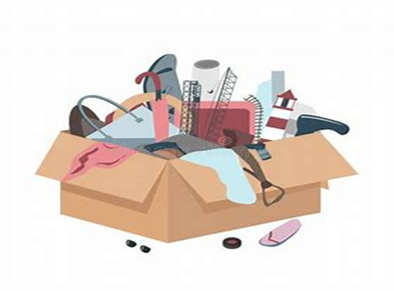
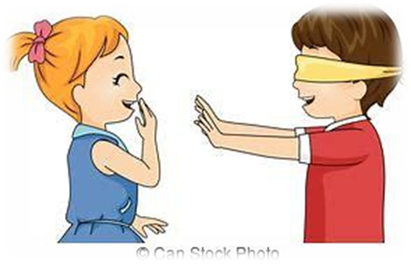
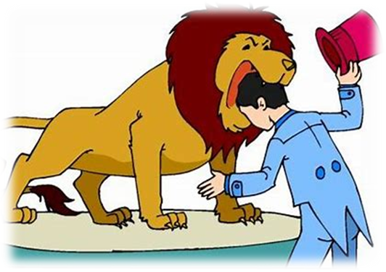
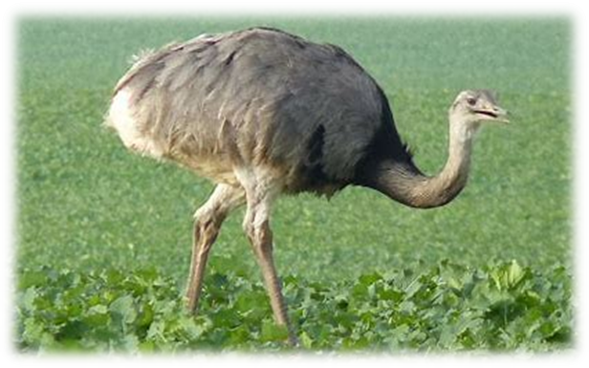

Slide 20
Let’s review
syllables.

Slide 21
sleeveless
priceless
cloudless
speechless
effortless

Slide 22
Let’s parse
sentences.

Slide 23
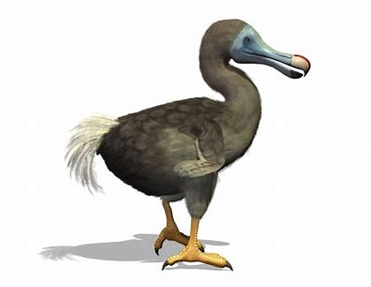
Parse these sentences.
The dull story seemed endless.
The extinct dodo was a flightless bird.

Slide 24
Parse these sentences.
The dull story seemed endless.
The extinct dodo was a flightless bird.

Slide 25
Parse these sentences.
The dull story seemed endless.
The extinct dodo was a flightless bird.

Slide 26
Parse these sentences.
The dull story seemed endless.
The extinct dodo was a flightless bird.

Slide 27
Parse these sentences.
The dull story seemed endless.
The extinct dodo was a flightless bird.

Slide 28
Parse these sentences.
The dull story seemed endless.
The extinct dodo was a flightless bird.

Slide 29
Parse these sentences.
The dull story seemed endless.
The extinct dodo was a flightless bird.

Slide 30
Parse these sentences.
The dull story seemed endless.
The extinct dodo was a flightless bird.

Slide 31
Parse these sentences.
The dull story seemed endless.
The extinct dodo was a flightless bird.

Slide 32
Parse these sentences.
The dull story seemed endless.
The extinct dodo was a flightless bird.

Slide 33
Dictation

Slide 34
Dictation
1.
2.
3.

Slide 35
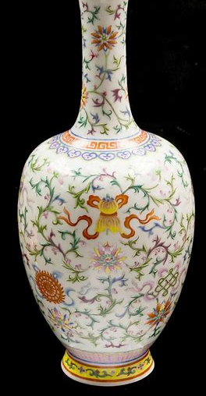

Slide 36
That Chinese vase was priceless.

Slide 37
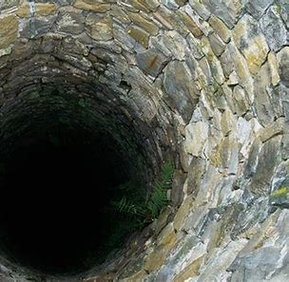

Slide 38
The well seemed to be bottomless.

Slide 39
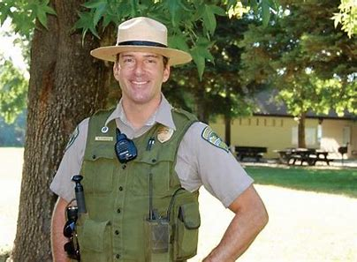
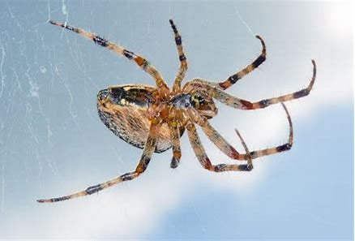

Slide 40
“That spider is harmless,” said the park ranger.

Slide 41
Homework
Put the words from the spelling list into alphabetical order. (page 36).

