Slide 1
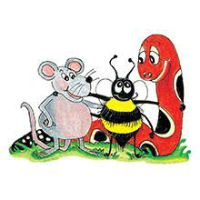
Jolly Grammar 3a-32

Slide 2
Spelling Test
16

Slide 3
ooze

Slide 4
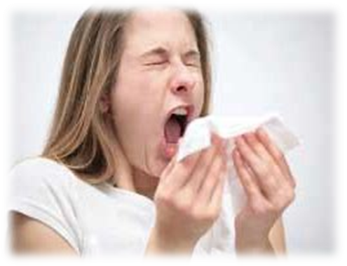
ooze
sneeze

Slide 5
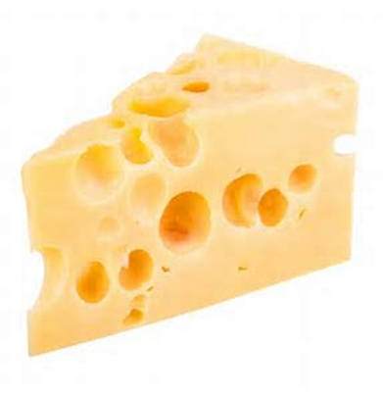
ooze
sneeze
cheese

Slide 6
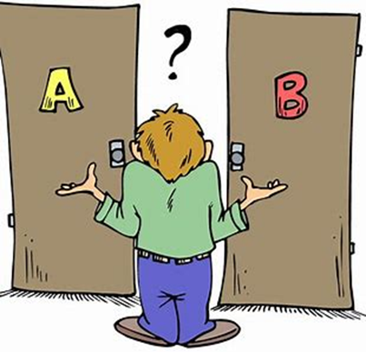
ooze
sneeze
cheese
choose

Slide 7
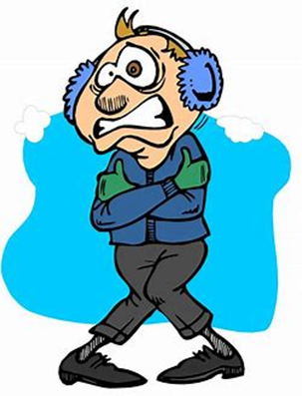
ooze
sneeze
cheese
choose
freeze

Slide 8
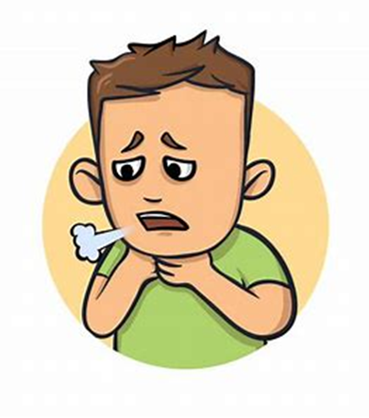
ooze
sneeze
cheese
choose
freeze
wheeze

Slide 9
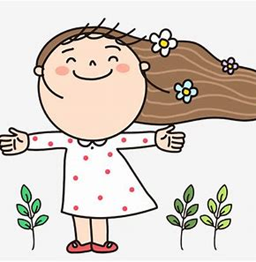
ooze
sneeze
cheese
choose
freeze
wheeze
7. breeze

Slide 10
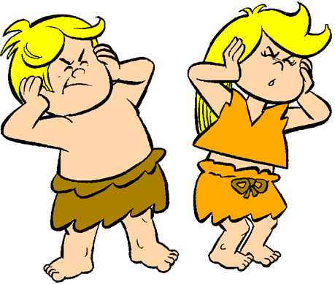
ooze
sneeze
cheese
choose
freeze
wheeze
7. breeze
8. noise

Slide 11
ooze
sneeze
cheese
choose
freeze
wheeze
7. breeze
8. noise
9. browse

Slide 12
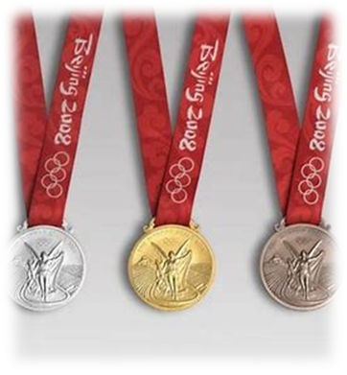
ooze
sneeze
cheese
choose
freeze
wheeze
7. breeze
8. noise
9. browse
10. bronze

Slide 13
ooze
sneeze
cheese
choose
freeze
wheeze
7. breeze
8. noise
9. browse
10. bronze
11. pause

Slide 14
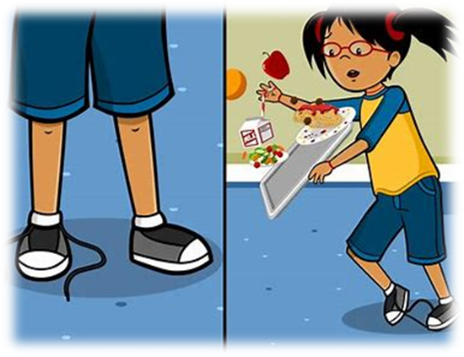
ooze
sneeze
cheese
choose
freeze
wheeze
7. breeze
8. noise
9. browse
10. bronze
11. pause
12. cause

Slide 15
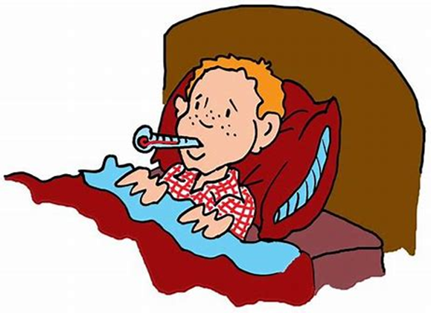
ooze
sneeze
cheese
choose
freeze
wheeze
7. breeze
8. noise
9. browse
10. bronze
11. pause
12. cause
13. disease

Slide 16
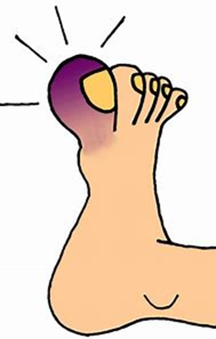
ooze
sneeze
cheese
choose
freeze
wheeze
7. breeze
8. noise
9. browse
10. bronze
11. pause
12. cause
13. disease
14. bruise

Slide 17
ooze
sneeze
cheese
choose
freeze
wheeze
7. breeze
8. noise
9. browse
10. bronze
11. pause
12. cause
13. disease
14. bruise
15. applause

Slide 18
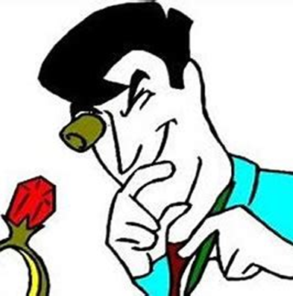
ooze
sneeze
cheese
choose
freeze
wheeze
7. breeze
8. noise
9. browse
10. bronze
11. pause
12. cause
13. disease
14. bruise
15. applause
16. appraise

Slide 19
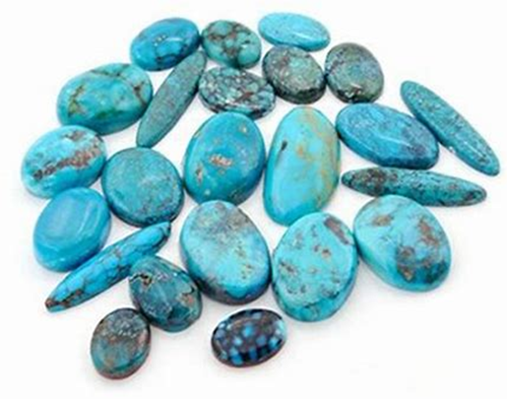
ooze
sneeze
cheese
choose
freeze
wheeze
7. breeze
8. noise
9. browse
10. bronze
11. pause
12. cause
13. disease
14. bruise
15. applause
16. appraise
17. turquoise

Slide 20
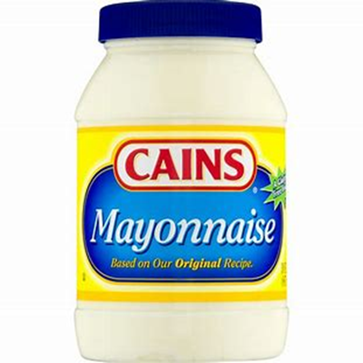
ooze
sneeze
cheese
choose
freeze
wheeze
7. breeze
8. noise
9. browse
10. bronze
11. pause
12. cause
13. disease
14. bruise
15. applause
16. appraise
17. turquoise
18. mayonnaise

Slide 21
Let’s review speech marks.

Slide 22
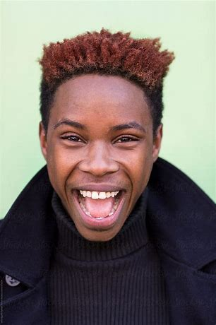
“The fireworks are brilliant,” said Bill.
shouted
cried
exclaimed
whispered
groaned

Slide 23
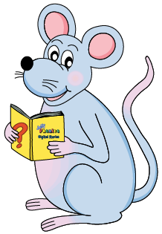
Activity Page:
Speech Marks

Slide 24
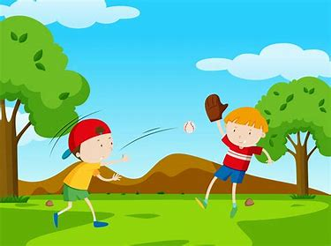
Jack
Ok, let’s play.
Let’s play baseball.
Triet
Once upon a time, there were two boys at Katsuyama park. It was a windy day. They went to the grass field.
“Let’s play baseball,” Jack said.
“Ok, let’ s play,” Triet replied.
Jack threw the ball and the ball almost hit Triet in the face. They stopped playing baseball and started playing soccer. After that they went home and baked cookies. Some cookies burnt. Jack’s dog and Jack ate cookies together.

Slide 25
See you
next time!

