Slide 1
Jolly Grammar 3a-31

Slide 2
Let’s review
Speech marks.

Slide 3
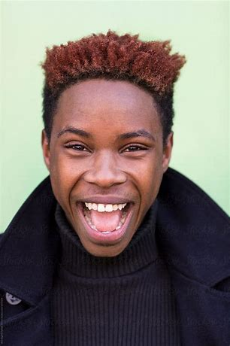
“The fireworks are brilliant,” said Bill.
shouted
cried
exclaimed
whispered
groaned

Slide 4
Let’s revise some spelling patterns.

Slide 5
cancel
germ
hutch
judge
eagle
equal
trunk
anchor
easy
measles

Slide 6
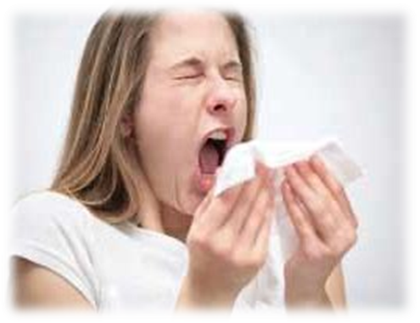
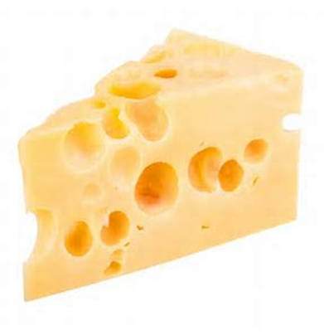
sneeze
/z/
cheese
/z/

Slide 7
Spelling List
Spelling <s> of the /z/ sound

Slide 8
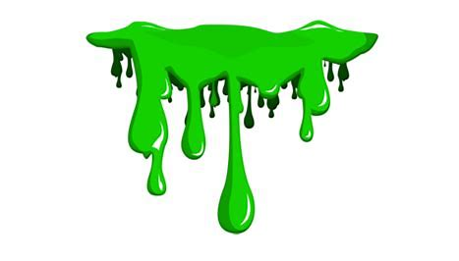
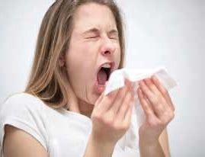
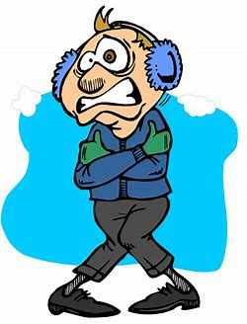
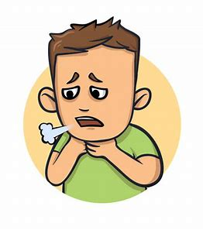
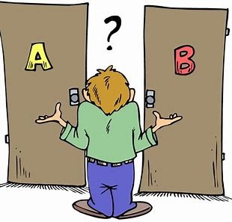
ooze sneeze cheese
choose freeze wheeze

Slide 9
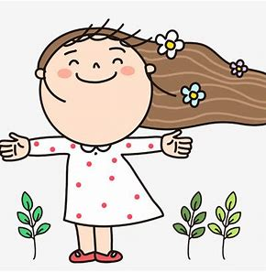
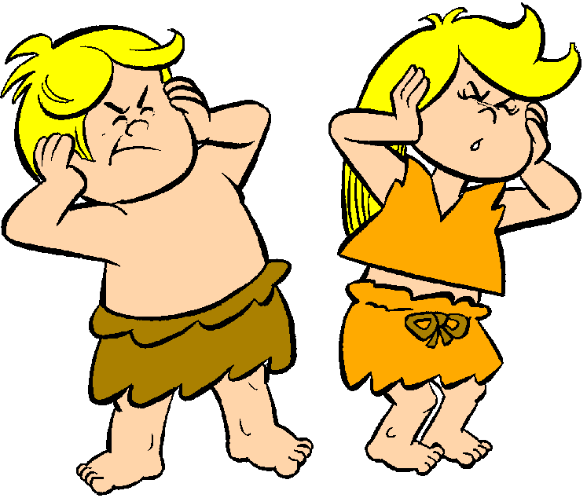
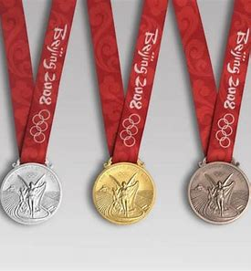
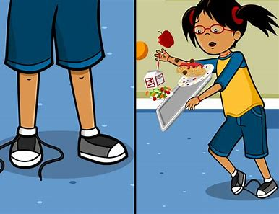
breeze noise browse
bronze pause cause

Slide 10
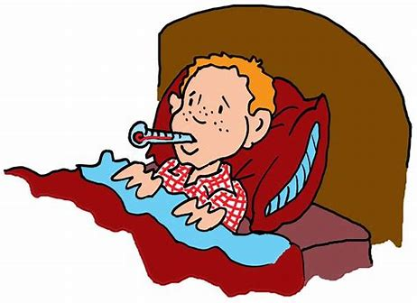
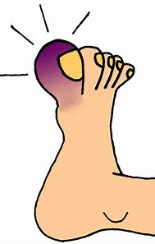
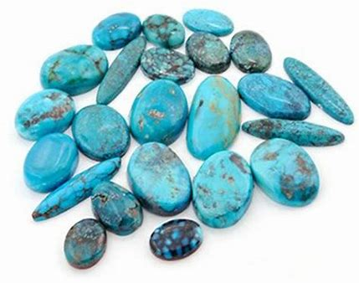
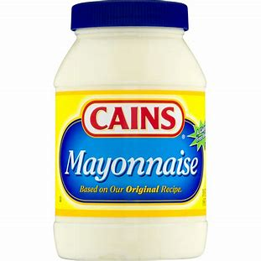
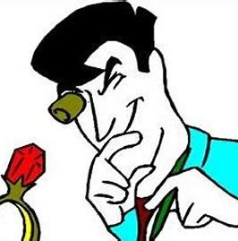
disease bruise applause
appraise turquoise mayonnaise

Slide 11
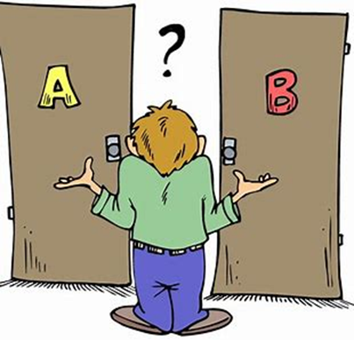
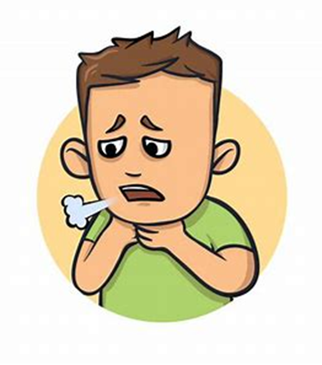
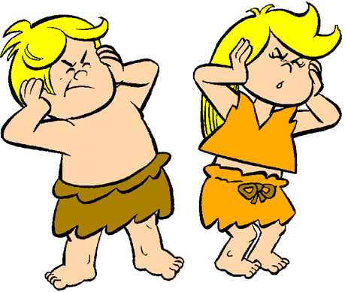
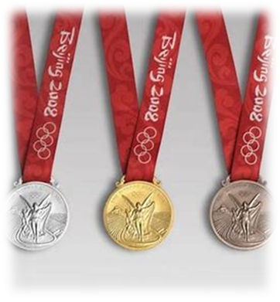
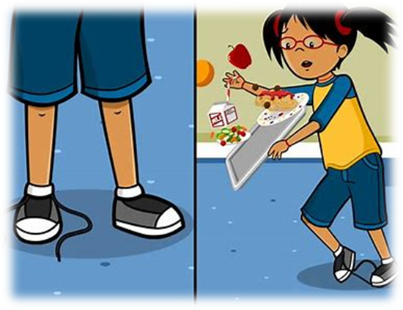

Slide 12
Split the words into syllables.

Slide 13
wheeze
appraise
turquoise
please
mayonnaise

Slide 14
Let’s parse
sentences.

Slide 15
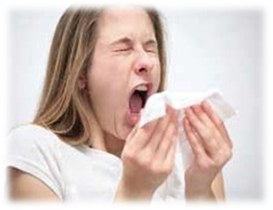
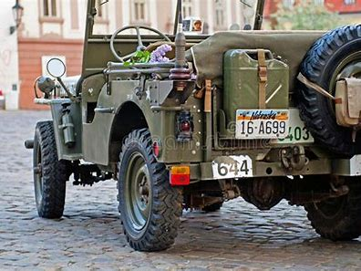
Parse these sentences.
I sneeze and wheeze in the winter.
The old American jeep reversed noisily outside our house.

Slide 16
Parse these sentences.
I sneeze and wheeze in the winter.
The old American jeep reversed noisily outside our house.

Slide 17
Parse these sentences.
I sneeze and wheeze in the winter.
The old American jeep reversed noisily outside our house.

Slide 18
Parse these sentences.
I sneeze and wheeze in the winter.
The old American jeep reversed noisily outside our house.

Slide 19
Parse these sentences.
I sneeze and wheeze in the winter.
The old American jeep reversed noisily outside our house.

Slide 20
Parse these sentences.
I sneeze and wheeze in the winter.
The old American jeep reversed noisily outside our house.

Slide 21
Parse these sentences.
I sneeze and wheeze in the winter.
The old American jeep reversed noisily outside our house.

Slide 22
Parse these sentences.
I sneeze and wheeze in the winter.
The old American jeep reversed noisily outside our house.

Slide 23
Parse these sentences.
I sneeze and wheeze in the winter.
The old American jeep reversed noisily outside our house.

Slide 24
Parse these sentences.
I sneeze and wheeze in the winter.
The old American jeep reversed noisily outside our house.

Slide 25
Parse these sentences.
I sneeze and wheeze in the winter.
The old American jeep reversed noisily outside our house.

Slide 26
Parse these sentences.
I sneeze and wheeze in the winter.
The old American jeep reversed noisily outside our house.

Slide 27
Parse these sentences.
I sneeze and wheeze in the winter.
The old American jeep reversed noisily outside our house.

Slide 28
Parse these sentences.
I sneeze and wheeze in the winter.
The old American jeep reversed noisily outside our house.

Slide 29
Parse these sentences.
I sneeze and wheeze in the winter.
The old American jeep reversed noisily outside our house.

Slide 30
Dictation

Slide 31
Dictation
1.
2.
3.

Slide 32
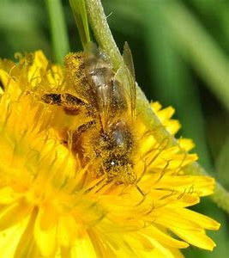
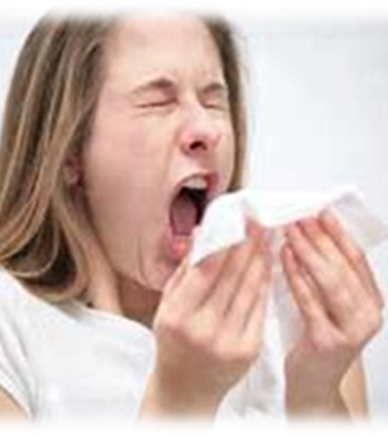

Slide 33
“Pollen makes me wheeze and sneeze,” said Anna .

Slide 34
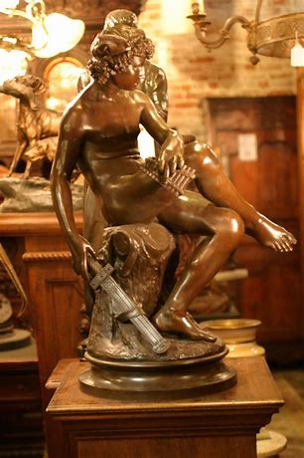
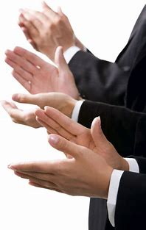

Slide 35
The new bronze statue caused much applause.

Slide 36
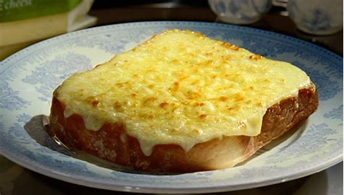

Slide 37
Can I have cheese on toast please?

Slide 38
Homework
Put the words from the spelling list into alphabetical order. (page 32).

