Slide 1
Jolly Grammar 3a-30

Slide 2
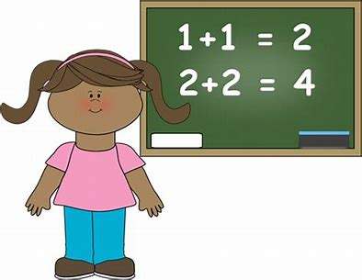
easy

Slide 3
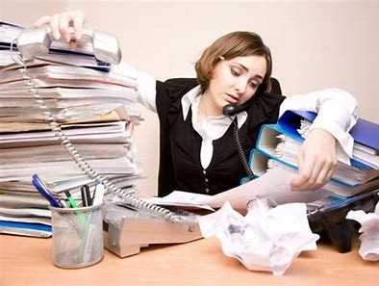
easy
busy

Slide 4
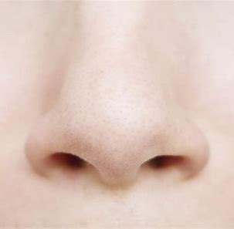
easy
busy
nose

Slide 5
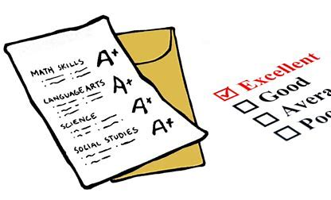
easy
busy
nose
result

Slide 6
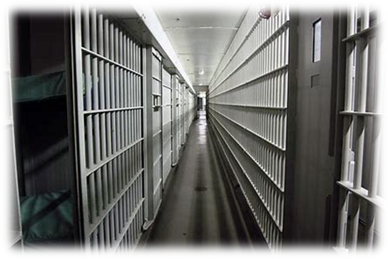
easy
busy
nose
result
prison

Slide 7
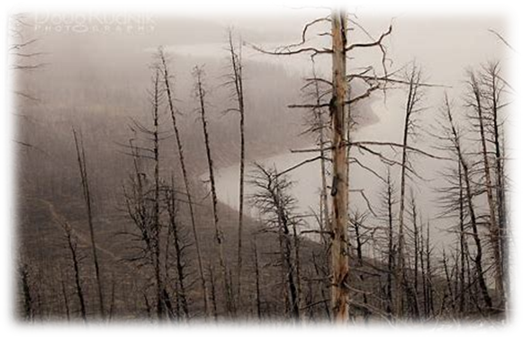
easy
busy
nose
result
prison
dismal

Slide 8
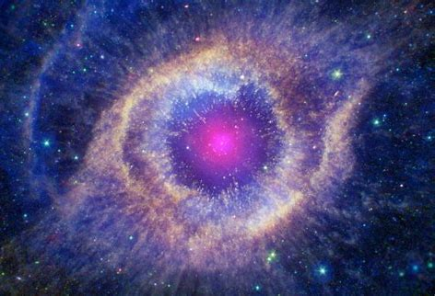
easy
busy
nose
result
prison
dismal
7. cosmic

Slide 9
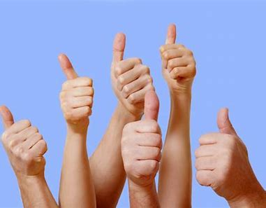
easy
busy
nose
result
prison
dismal
7. cosmic
8. positive

Slide 10
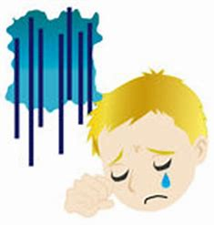
easy
busy
nose
result
prison
dismal
7. cosmic
8. positive
9. misery

Slide 11
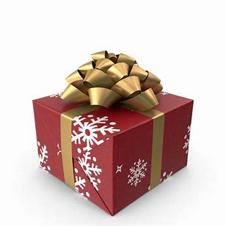
easy
busy
nose
result
prison
dismal
7. cosmic
8. positive
9. misery
10. present

Slide 12
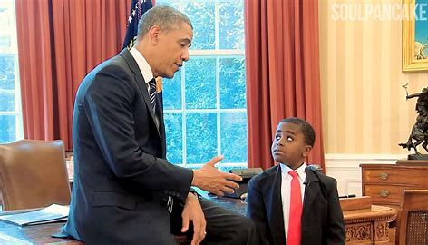
easy
busy
nose
result
prison
dismal
7. cosmic
8. positive
9. misery
10. present
11. president

Slide 13
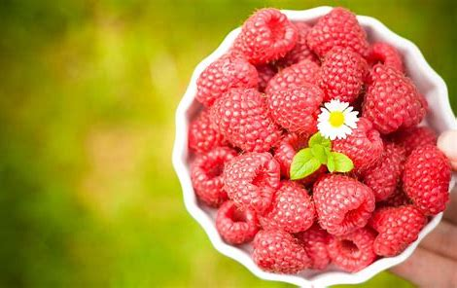
easy
busy
nose
result
prison
dismal
7. cosmic
8. positive
9. misery
10. present
11. president
12. raspberry

Slide 14
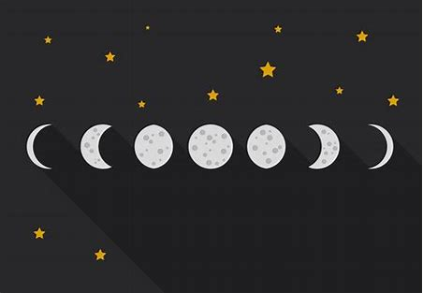
easy
busy
nose
result
prison
dismal
7. cosmic
8. positive
9. misery
10. present
11. president
12. raspberry
13. phase

Slide 15
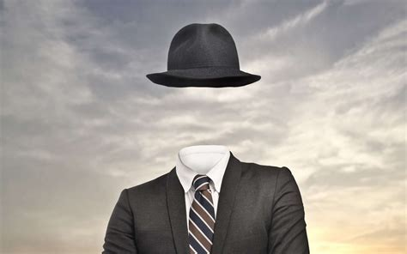
easy
busy
nose
result
prison
dismal
7. cosmic
8. positive
9. misery
10. present
11. president
12. raspberry
13. phase
14. invisible

Slide 16
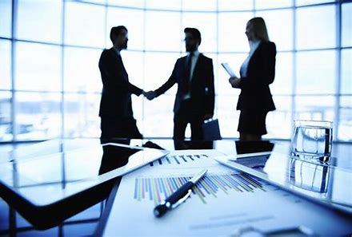
easy
busy
nose
result
prison
dismal
7. cosmic
8. positive
9. misery
10. present
11. president
12. raspberry
13. phase
14. invisible
15. business

Slide 17
easy
busy
nose
result
prison
dismal
7. cosmic
8. positive
9. misery
10. present
11. president
12. raspberry
13. phase
14. invisible
15. business
16. inquisitive

Slide 18
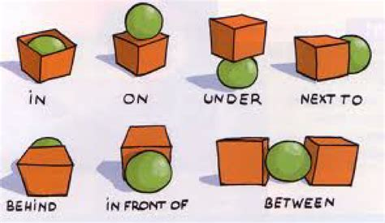
easy
busy
nose
result
prison
dismal
7. cosmic
8. positive
9. misery
10. present
11. president
12. raspberry
13. phase
14. invisible
15. business
16. inquisitive
17. preposition

Slide 19
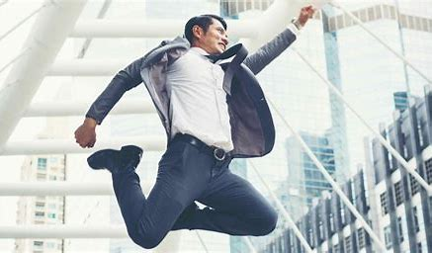
easy
busy
nose
result
prison
dismal
7. cosmic
8. positive
9. misery
10. present
11. president
12. raspberry
13. phase
14. invisible
15. business
16. inquisitive
17. preposition
18. enthusiastic

Slide 20
Activity Page:
Speech Marks

Slide 21
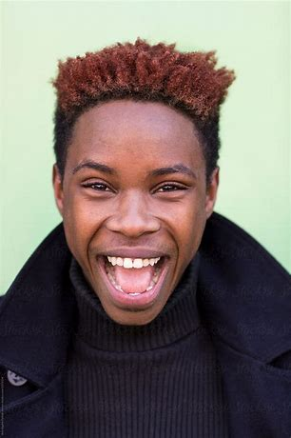
The fireworks are brilliant said Bill

Slide 22
The fireworks are brilliant said Bill.

Slide 23
“The fireworks are brilliant,” said Bill.

Slide 24
“The fireworks are brilliant,” said Bill.
shouted
cried
exclaimed
whispered
groaned

Slide 25
“I feel sick,” said Sam.
“I don’t want to go,” shouted Lily.
“I’ve fallen over and hurt my knee,” cried Megan.
“The roller coaster was very scary,” groaned Seth.
“I’m going to my granny’s for supper tomorrow,”
exclaimed Anna.

Slide 26
Extension Activity

