Slide 1
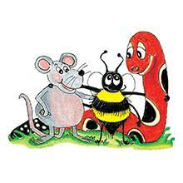
Jolly Grammar 3a-29

Slide 2
Let’s review
Soft<c>
soft<g>
etc…

Slide 3
twice
page
fetch
bridge
simple
puzzle
quiver
question
junk
defunct

Slide 4
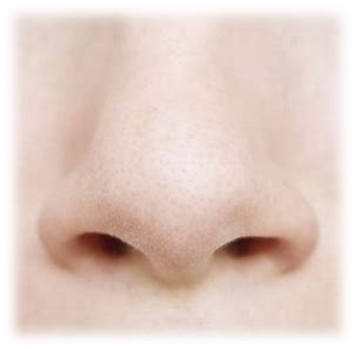
nose
/z/

Slide 5
nose
/z/
goes
does
is
rose
as

Slide 6
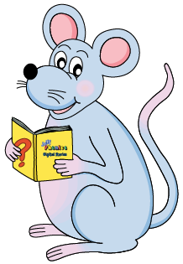
Activity Page:
The <s> Spelling
of the /z/ Sound

Slide 7
Spelling List
Spelling <s> of the /z/ sound

Slide 8
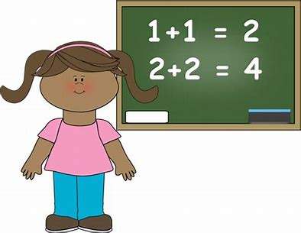
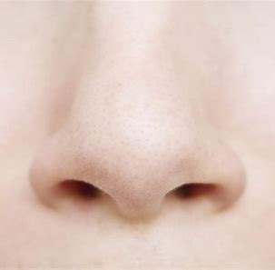
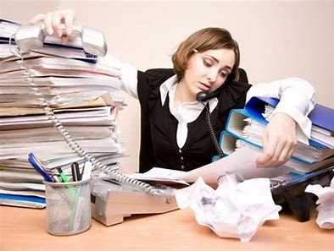
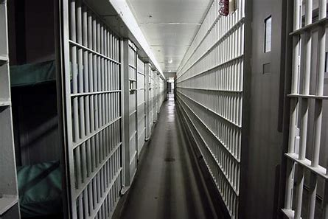
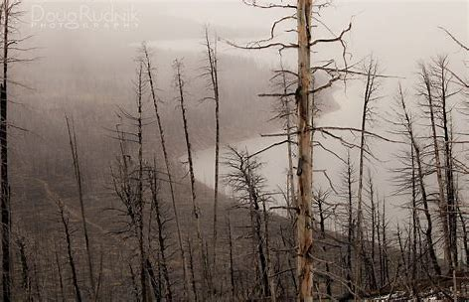
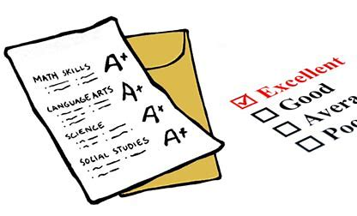
easy busy nose
result prison dismal

Slide 9
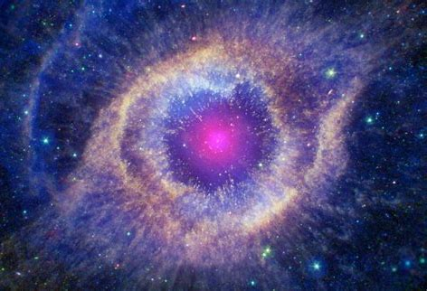
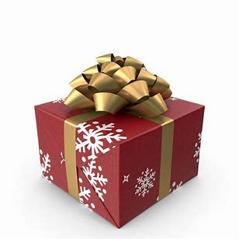
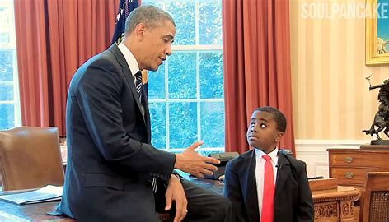
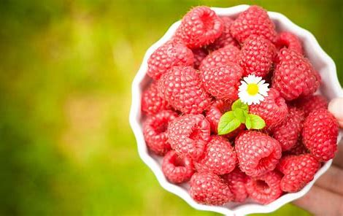
cosmic positive misery
present president raspberry

Slide 10
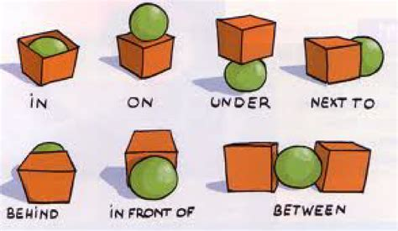
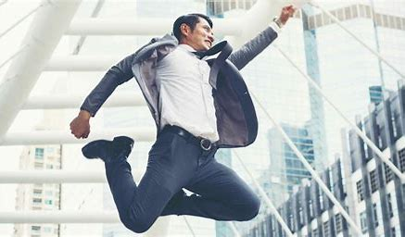
phase invisible business
inquisitive preposition enthusiastic

Slide 11
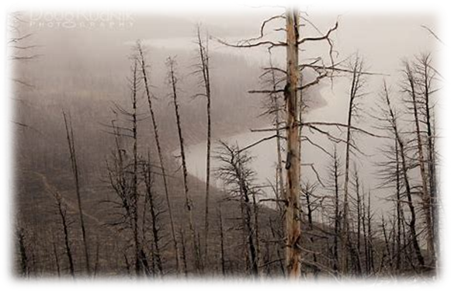
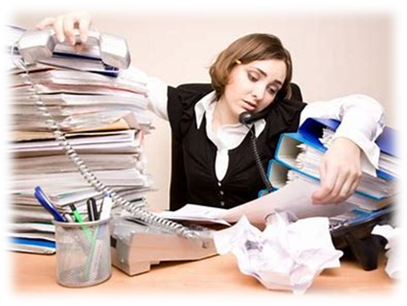
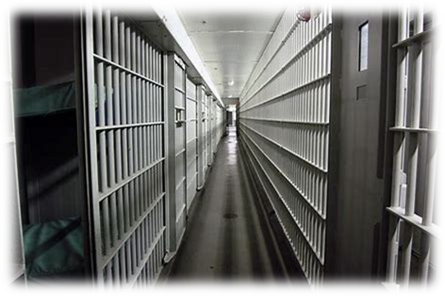
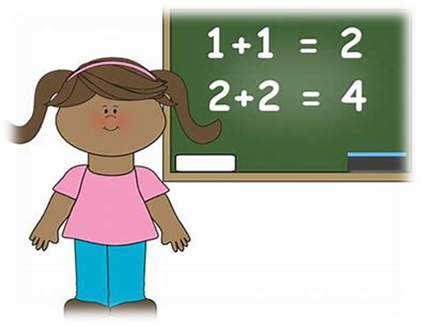
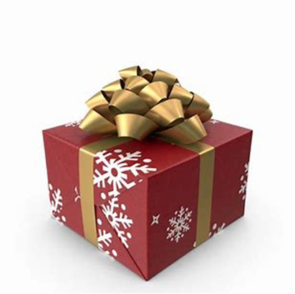
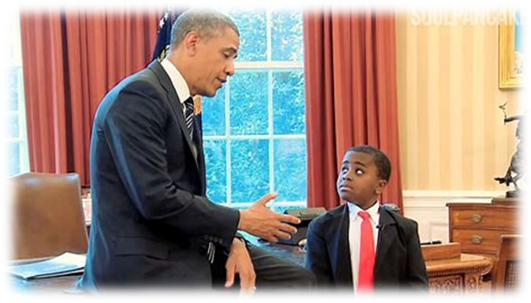
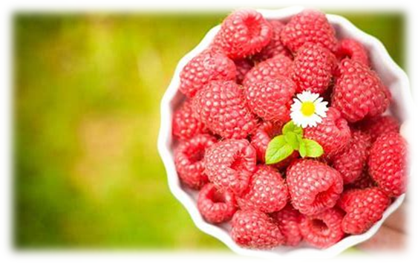
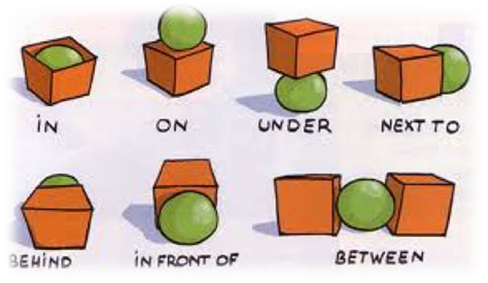

Slide 12
Let’s review
syllables.

Slide 13
dismal
nose
clumsy
drowsy
raspberry

Slide 14
Let’s parse
sentences.

Slide 15
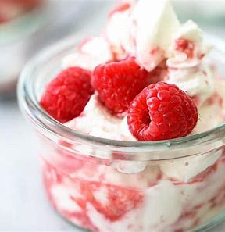
Parse these sentences.
I carefully cut the paper with my sharp scissors.
He quickly ate the English raspberries and cream for dessert.

Slide 16
Parse these sentences.
I carefully cut the paper with my sharp scissors.
He quickly ate the English raspberries and cream for dessert.

Slide 17
Parse these sentences.
I carefully cut the paper with my sharp scissors.
He quickly ate the English raspberries and cream for dessert.

Slide 18
Parse these sentences.
I carefully cut the paper with my sharp scissors.
He quickly ate the English raspberries and cream for dessert.

Slide 19
Parse these sentences.
I carefully cut the paper with my sharp scissors.
He quickly ate the English raspberries and cream for dessert.

Slide 20
Parse these sentences.
I carefully cut the paper with my sharp scissors.
He quickly ate the English raspberries and cream for dessert.

Slide 21
Parse these sentences.
I carefully cut the paper with my sharp scissors.
He quickly ate the English raspberries and cream for dessert.

Slide 22
Parse these sentences.
I carefully cut the paper with my sharp scissors.
He quickly ate the English raspberries and cream for dessert.

Slide 23
Parse these sentences.
I carefully cut the paper with my sharp scissors.
He quickly ate the English raspberries and cream for dessert.

Slide 24
Parse these sentences.
I carefully cut the paper with my sharp scissors.
He quickly ate the English raspberries and cream for dessert.

Slide 25
Parse these sentences.
I carefully cut the paper with my sharp scissors.
He quickly ate the English raspberries and cream for dessert.

Slide 26
Parse these sentences.
I carefully cut the paper with my sharp scissors.
He quickly ate the English raspberries and cream for dessert.

Slide 27
Parse these sentences.
I carefully cut the paper with my sharp scissors.
He quickly ate the English raspberries and cream for dessert.

Slide 28
Parse these sentences.
I carefully cut the paper with my sharp scissors.
He quickly ate the English raspberries and cream for dessert.

Slide 29
Parse these sentences.
I carefully cut the paper with my sharp scissors.
He quickly ate the English raspberries and cream for dessert.

Slide 30
Parse these sentences.
I carefully cut the paper with my sharp scissors.
He quickly ate the English raspberries and cream for dessert.

Slide 31
Parse these sentences.
I carefully cut the paper with my sharp scissors.
He quickly ate the English raspberries and cream for dessert.

Slide 32
Parse these sentences.
I carefully cut the paper with my sharp scissors.
He quickly ate the English raspberries and cream for dessert.

Slide 33
Dictation

Slide 34
Dictation
1.
2.
3.

Slide 35
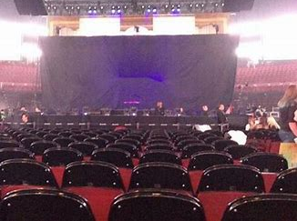

Slide 36
We reserved some seats for two concerts.

Slide 37
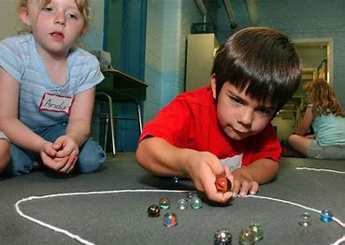

Slide 38
We played marbles indoors as it was raining.

Slide 39
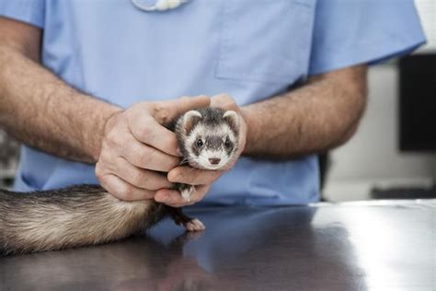
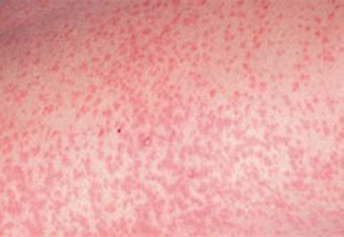

Slide 40
The weasel had measles.

Slide 41
See you next week.

