Slide 1
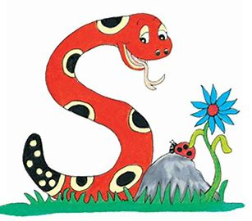
Jolly Grammar
4a-26

Slide 2
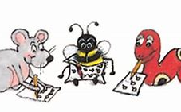
Spelling Test 13

Slide 3
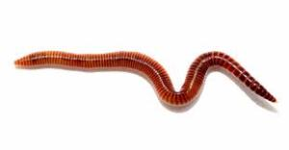
worm

Slide 4
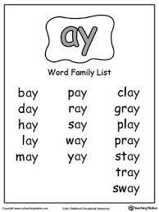
worm
word

Slide 5
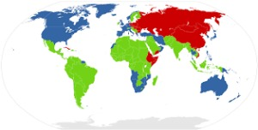
worm
word
world

Slide 6
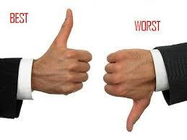
worm
word
world
worst

Slide 7
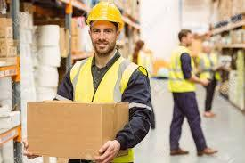
worm
word
world
worst
worker

Slide 8
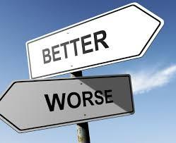
worm
word
world
worst
worker
worse

Slide 9
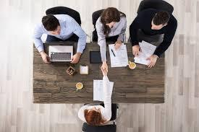
worm
word
world
worst
worker
worse
7.workable

Slide 10
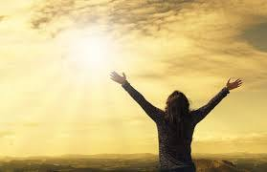
worm
word
world
worst
worker
worse
7.workable
8.worthy

Slide 11
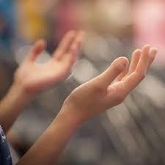
worm
word
world
worst
worker
worse
7.workable
8.worthy
9.worship

Slide 12
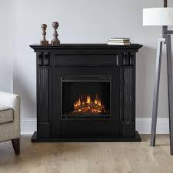
worm
word
world
worst
worker
worse
7.workable
8.worthy
9.worship
10.fireworks

Slide 13
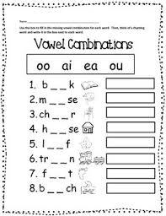
worm
word
world
worst
worker
worse
7.workable
8.worthy
9.worship
10.fireworks
11.worksheet

Slide 14
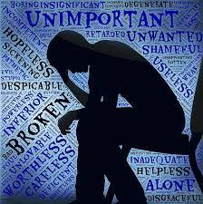
worm
word
world
worst
worker
worse
7.workable
8.worthy
9.worship
10.fireworks
11.worksheet
12.worthless

Slide 15
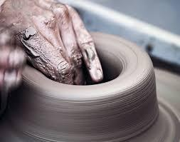
worm
word
world
worst
worker
worse
7.workable
8.worthy
9.worship
10.fireworks
11.worksheet
12.worthless
13.workmanship

Slide 16
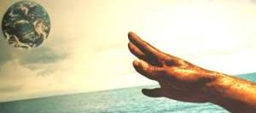
worm
word
world
worst
worker
worse
7.workable
8.worthy
9.worship
10.fireworks
11.worksheet
12.worthless
13.workmanship
14.worldliness

Slide 17
worm
word
world
worst
worker
worse
7.workable
8.worthy
9.worship
10.fireworks
11.worksheet
12.worthless
13.workmanship
14.worldliness
15.workforce

Slide 18
worm
word
world
worst
worker
worse
7.workable
8.worthy
9.worship
10.fireworks
11.worksheet
12.worthless
13.workmanship
14.worldliness
15.workforce
16.worldwide

Slide 19
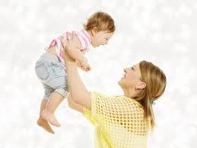
worm
word
world
worst
worker
worse
7.workable
8.worthy
9.worship
10.fireworks
11.worksheet
12.worthless
13.workmanship
14.worldliness
15.workforce
16.worldwide
17.worthwhile

Slide 20
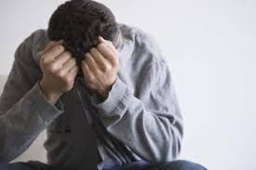
worm
word
world
worst
worker
worse
7.workable
8.worthy
9.worship
10.fireworks
11.worksheet
12.worthless
13.workmanship
14.worldliness
15.workforce
16.worldwide
17.worthwhile
18.worthlessness

Slide 21
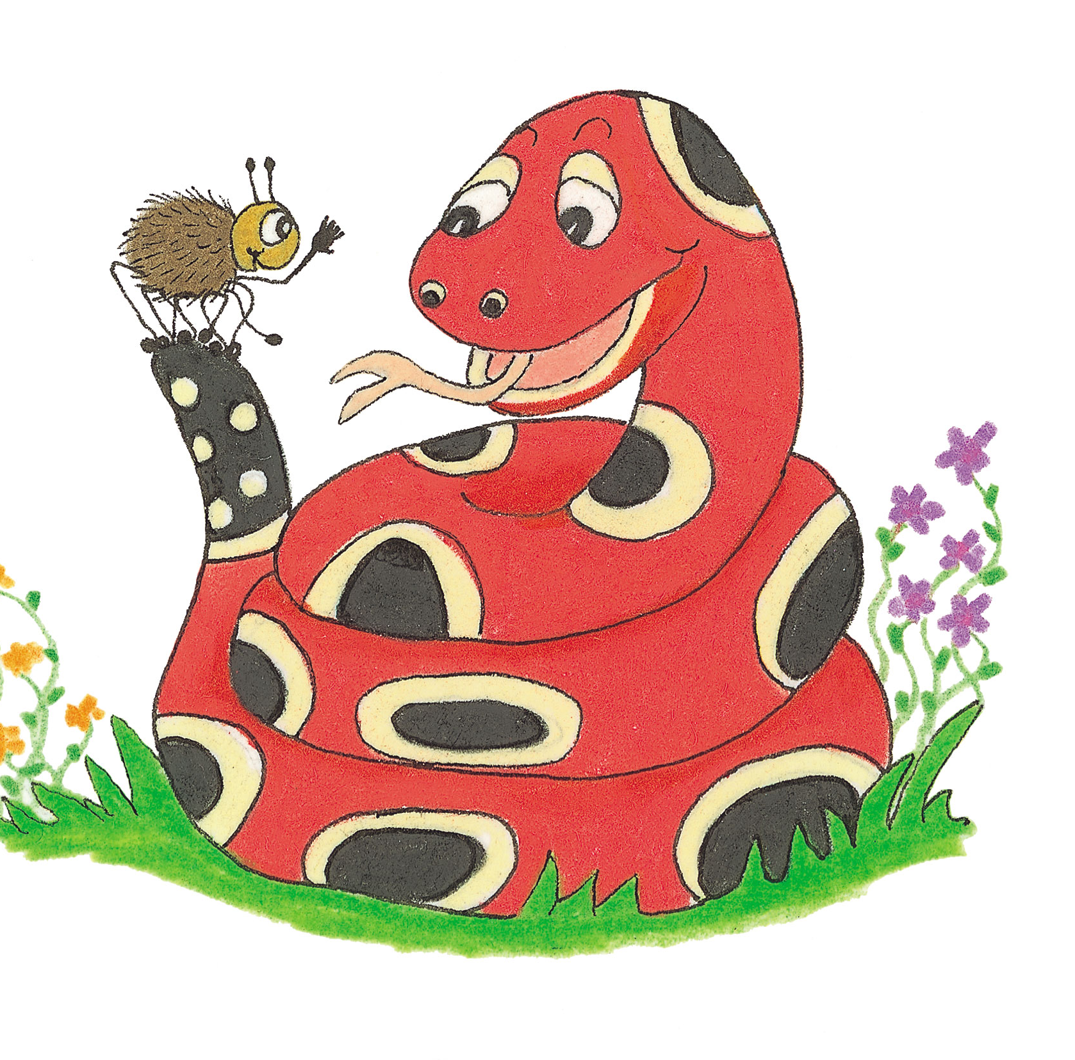
Let’s Revise Verbs

Slide 23
Let’s Revise Verb Tenses

Slide 24
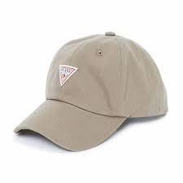
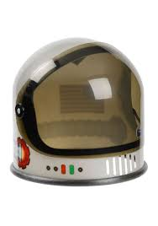
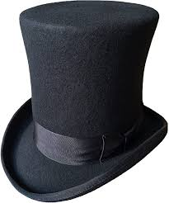
 |  | I look

Slide 25
 | Past | Present | Future
 |  | I look

Slide 26
 | Past | Present | Future
Simple Tense |  | I look

Slide 27
 | Past | Present | Future
Simple Tense | I looked | I look

Slide 28
 | Past | Present | Future
Simple Tense | I looked | I look | I shall/will look

Slide 29
 | Past | Present | Future
Simple Tense | I looked | I look | I shall/will look
Continuous Tense

Slide 30
 | Past | Present | Future
Simple Tense | I looked | I look | I shall/will look
Continuous Tense |  | I am looking

Slide 31
 | Past | Present | Future
Simple Tense | I looked | I look | I shall/will look
Continuous Tense | I was looking | I am looking

Slide 32
 | Past | Present | Future
Simple Tense | I looked | I look | I shall/will look
Continuous Tense | I was looking | I am looking | I shall/will be looking

Slide 33
Activity Page:
Changing Verb Tenses 1

Slide 34
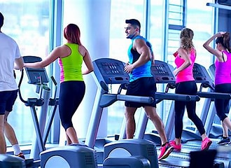
They exercise every day at the gym.
↓
Simple Future

Slide 35
They exercise every day at the gym.
↓
They will exercise every day at the gym.
Simple Future

Slide 36
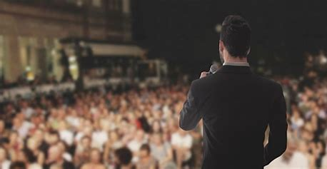
He introduces the next performer.
↓
Simple Past

Slide 37
He introduces the next performer.
↓
He introduced the next performer.
Simple Past

Slide 38
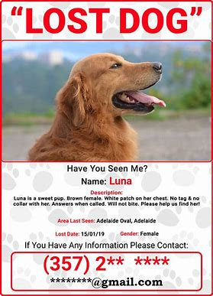
We search for the missing dog.
↓
Past Continuous

Slide 39
We search for the missing dog.
↓
We were searching for
the missing dog.
Past Continuous

Slide 40
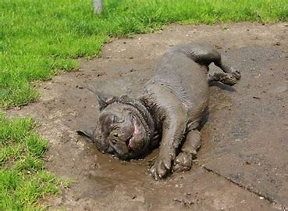
The dog rolls around in the mud.
↓
Present Continuous

Slide 41
The dog rolls around in the mud.
↓
The dog is rolling around
in the mud.
Present Continuous

Slide 42
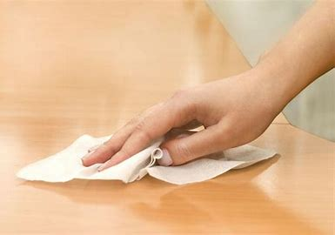
Alex wipes the table after dinner.
↓
Future Continuous

Slide 43
Alex wipes the table after dinner.
↓
Alex will be wiping the table
after dinner.
Future Continuous

Slide 44
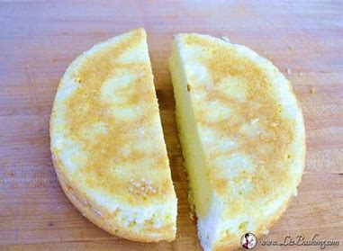
You cut the cake into two halves.
↓
Simple Future

Slide 45
You cut the cake into two halves.
↓
You will cut the cake into two halves.
Simple Future

Slide 46
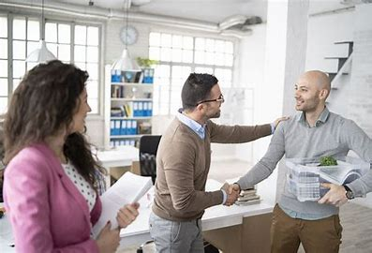
I start my new job next week.
↓
Future Continuous

Slide 47
I start my new job next week.
↓
I will be starting my new job next week.
Future Continuous

Slide 48
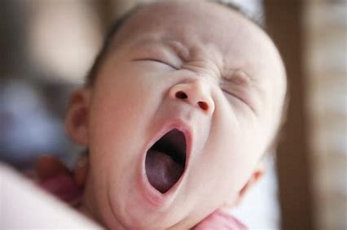
The baby yawns sleepily.
↓
Present Continuous

Slide 49
The baby yawns sleepily.
↓
The baby is yawning sleepily.
Present Continuous

Slide 50
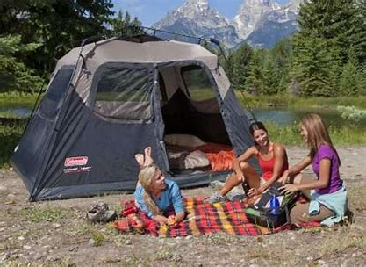
You camp in a tent in August.
↓
Future Continuous

Slide 51
You camp in a tent in August.
↓
You will be camping in a tent in August.
Future Continuous

Slide 52
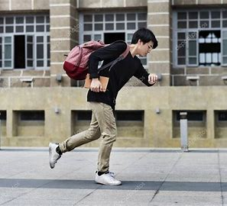
We were late for school this morning.
↓
Simple Present

Slide 53
We were late for school this morning.
↓
We are late for school this morning.
Simple Present

Slide 54
Thank you.
See you
next time!

