Slide 1
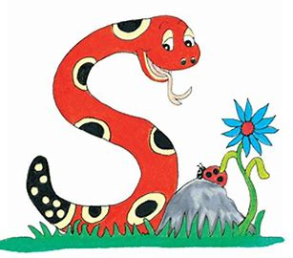
Jolly Grammar
4a-25

Slide 2
Let’s Review Comparatives and Superlatives

Slide 3
It was a difficult climb up the mountain.

Slide 4
It was a difficult climb up the mountain.

Slide 5
It was a difficult climb up the mountain.
It was a more(less) difficult climb
up the mountain.
It was the most(least) difficult climb
up the mountain.

Slide 6
worm
/er/

Slide 7
Activity Page
<or>
Saying
/er/

Slide 8
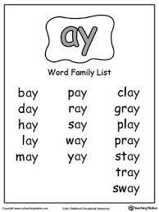
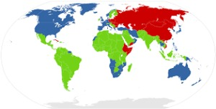
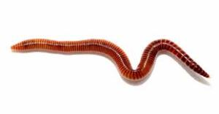
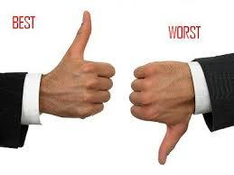
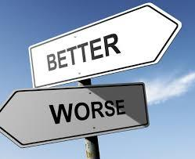
worm word world
worst worker worse

Slide 9
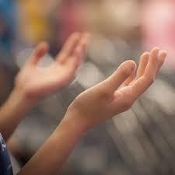
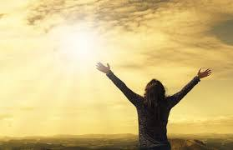
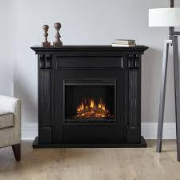
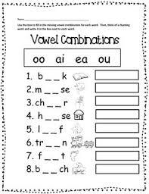
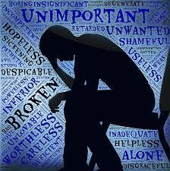
workable worthy worship
fireworks worksheet worthless

Slide 10
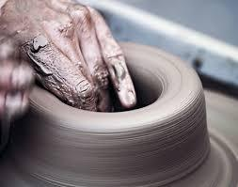
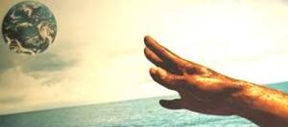
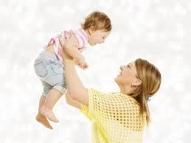
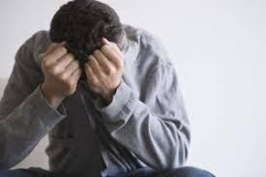
workmanship worldliness workforce
worldwide worthwhile worthlessness

Slide 13
adjective | -er/more/less comparative | -est/most/least superlative
worthy
worthwhile
interesting

Slide 14
adjective | -er/more/less comparative | -est/most/least superlative
worthy | worthier
worthwhile
interesting

Slide 15
adjective | -er/more/less comparative | -est/most/least superlative
worthy | worthier | worthiest
worthwhile
interesting

Slide 16
adjective | -er/more/less comparative | -est/most/least superlative
worthy | worthier | worthiest
worthwhile | more/less worthwhile
interesting

Slide 17
adjective | -er/more/less comparative | -est/most/least superlative
worthy | worthier | worthiest
worthwhile | more/less worthwhile | most/least worthwhile
interesting

Slide 18
adjective | -er/more/less comparative | -est/most/least superlative
worthy | worthier | worthiest
worthwhile | more/less worthwhile | most/least worthwhile
interesting | more/less interesting

Slide 19
adjective | -er/more/less comparative | -est/most/least superlative
worthy | worthier | worthiest
worthwhile | more/less worthwhile | most/least worthwhile
interesting | more/less interesting | most/least interesting

Slide 20
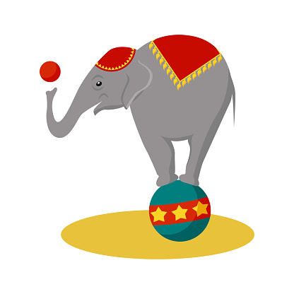
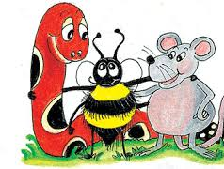
Compound Words

Slide 21
world
work
word
out
search
wide

Slide 22
world
work
word
out
search
wide

Slide 23
parsing

Slide 24
He will be the worst worker
in the world.

Slide 25
He will be the worst worker
in the world.

Slide 26
He will be the worst worker
in the world.

Slide 27
He will be the worst worker
in the world.

Slide 28
He will be the worst worker
in the world.

Slide 29
He will be the worst worker
in the world.

Slide 30
He will be the worst worker
in the world.

Slide 31
He will be the worst worker
in the world.
Simple Future

Slide 32
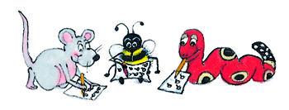
Dictation

Slide 33
Dictation
1.
2.
3.

Slide 34
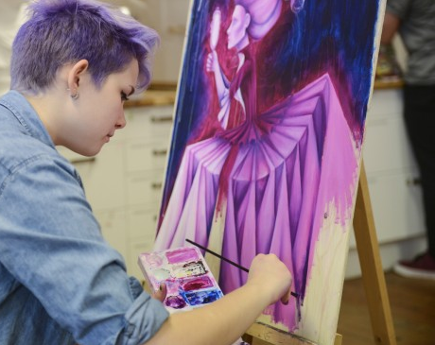

Slide 35
The workmanship of the artist is spectacular.

Slide 37
Worms are found in most parts of the world.

Slide 38
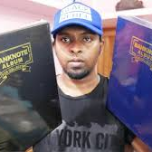

Slide 39
“Are these albums worth much?” asked the collector.

Slide 40
Thank you.
See you
next time!

