Slide 1
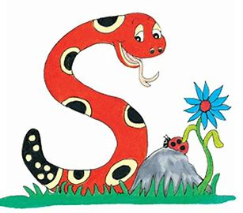
Jolly Grammar
4a-24

Slide 2
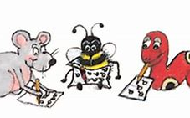
Spelling Test 12

Slide 3
pattern

Slide 4
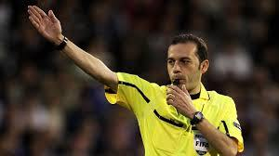
pattern
referee

Slide 5
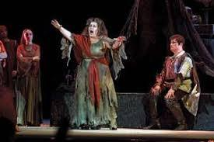
pattern
referee
opera

Slide 6
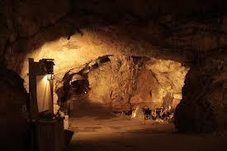
pattern
referee
opera
cavern

Slide 7
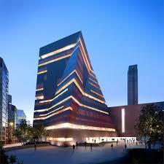
pattern
referee
opera
cavern
modern

Slide 8
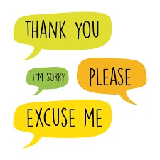
pattern
referee
opera
cavern
modern
manners

Slide 9
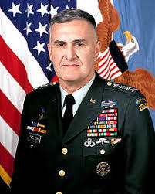
pattern
referee
opera
cavern
modern
manners
7.general

Slide 10
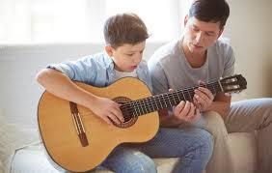
pattern
referee
opera
cavern
modern
manners
7.general
8.interest

Slide 11
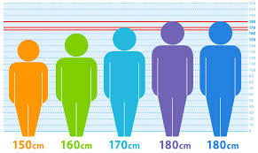
pattern
referee
opera
cavern
modern
manners
7.general
8.interest
9.average

Slide 12
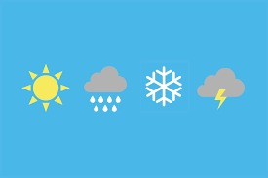
pattern
referee
opera
cavern
modern
manners
7.general
8.interest
9.average
10.weather

Slide 13
pattern
referee
opera
cavern
modern
manners
7.general
8.interest
9.average
10.weather
11.different

Slide 14
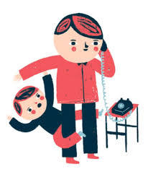
pattern
referee
opera
cavern
modern
manners
7.general
8.interest
9.average
10.weather
11.different
12.interrupt

Slide 15
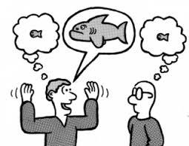
pattern
referee
opera
cavern
modern
manners
7.general
8.interest
9.average
10.weather
11.different
12.interrupt
13.exaggerate

Slide 16
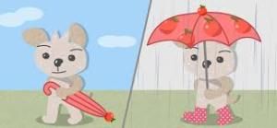
pattern
referee
opera
cavern
modern
manners
7.general
8.interest
9.average
10.weather
11.different
12.interrupt
13.exaggerate
14.whether

Slide 17
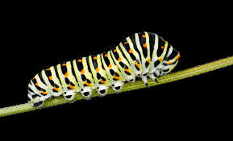
pattern
referee
opera
cavern
modern
manners
7.general
8.interest
9.average
10.weather
11.different
12.interrupt
13.exaggerate
14.whether
15.caterpillar

Slide 18
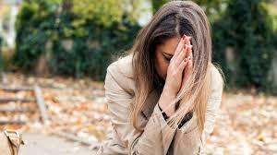
pattern
referee
opera
cavern
modern
manners
7.general
8.interest
9.average
10.weather
11.different
12.interrupt
13.exaggerate
14.whether
15.caterpillar
16.desperate

Slide 19
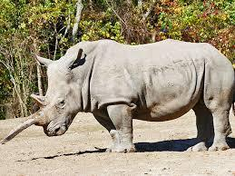
pattern
referee
opera
cavern
modern
manners
7.general
8.interest
9.average
10.weather
11.different
12.interrupt
13.exaggerate
14.whether
15.caterpillar
16.desperate
17.rhynoceros

Slide 20
pattern
referee
opera
cavern
modern
manners
7.general
8.interest
9.average
10.weather
11.different
12.interrupt
13.exaggerate
14.whether
15.caterpillar
16.desperate
17.rhynoceros
18.temperature

Slide 21
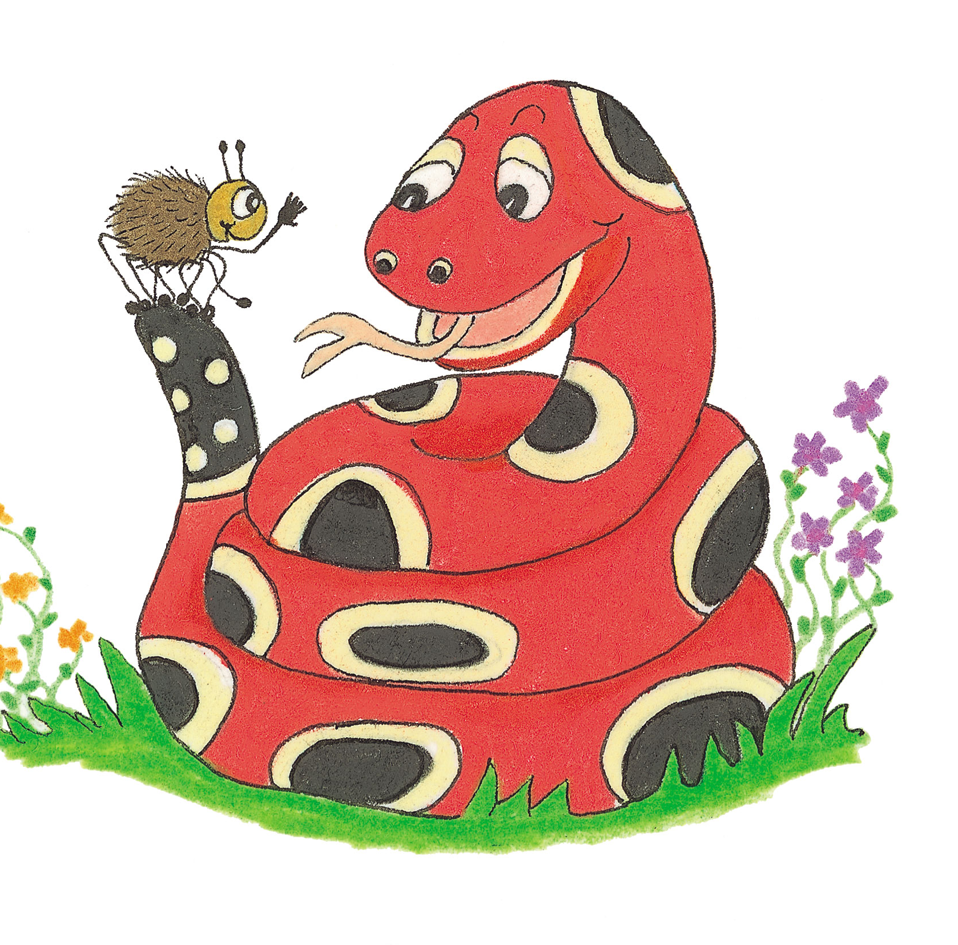
Let’s Revise Adjectives

Slide 22
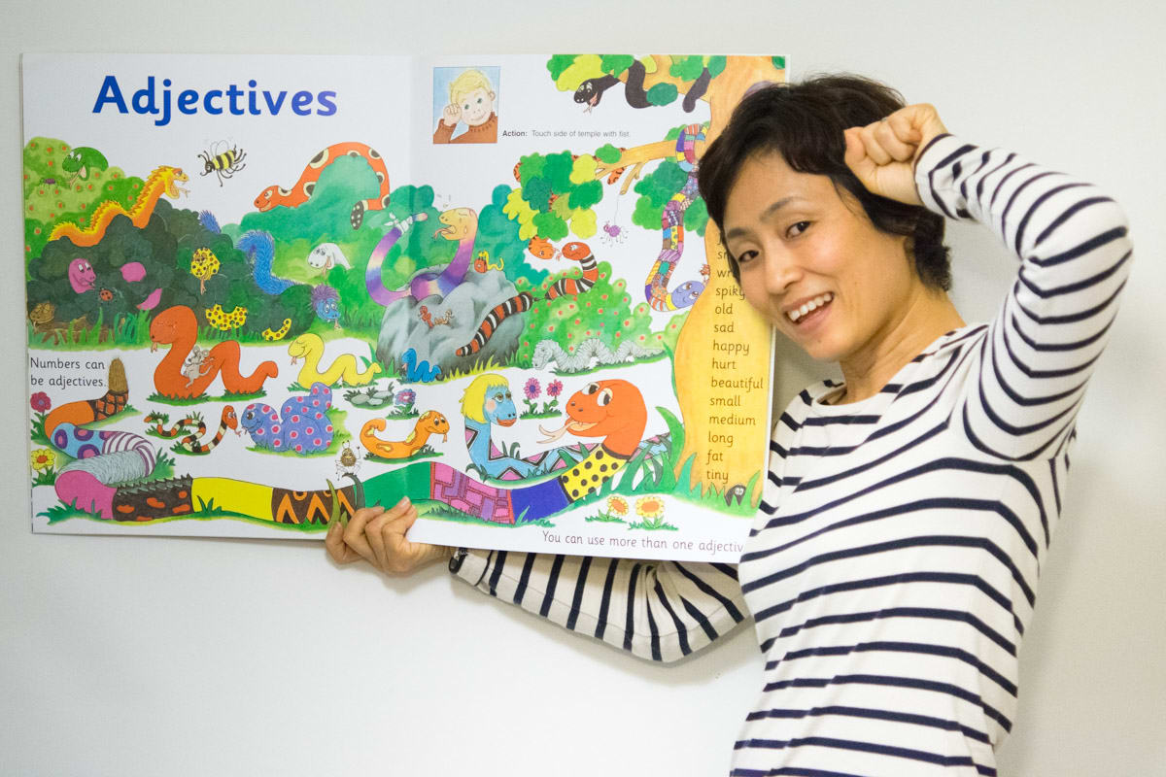

Slide 23
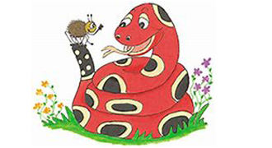
Adjective
Comparative
Superlative

Slide 24
Adjective
hot
close
short
happy
grey
Comparative
Superlative

Slide 25
Adjective
hot
close
short
happy
grey
Comparative
hotter
Superlative
hottest

Slide 26
Adjective
hot
close
short
happy
grey
Comparative
hotter
closer
Superlative
hottest
closest

Slide 27
Adjective
hot
close
short
happy
grey
Comparative
hotter
closer
shorter
Superlative
hottest
closest
shortest

Slide 28
Adjective
hot
close
short
happy
grey
Comparative
hotter
closer
shorter
happier
Superlative
hottest
closest
shortest
happiest

Slide 29
Adjective
hot
close
short
happy
grey
Comparative
hotter
closer
shorter
happier
greyer
Superlative
hottest
closest
shortest
happiest
greyest

Slide 30
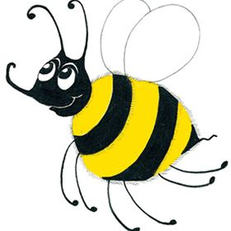
He is an intelligent boy.

Slide 31
He is an intelligent boy.
Comparative?
Superlative?

Slide 32
He is an intelligent boy.
Comparative?
×intelligenter??
Superlative?

Slide 33
He is an intelligent boy.
Comparative?
×intelligenter??
Superlative?
×intelligentest??

Slide 34
He is an intelligent boy.
Comparative?
more intelligent
Superlative?

Slide 35
He is an intelligent boy.
Comparative?
more intelligent
Superlative?
most intelligent

Slide 36
He is an intelligent boy.
Opposite?

Slide 37
He is an intelligent boy.
Comparative?
less intelligent

Slide 38
He is an intelligent boy.
Comparative?
less intelligent
Superlative?
least intelligent

Slide 39
It was an expensive ring.

Slide 40
He was a beautiful horse.

Slide 41
She was a helpful friend.

Slide 42
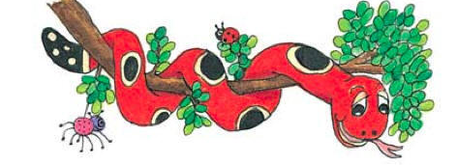
Activity Page:
Comparatives and
Superlatives

Slide 43
Zack and Meg had a successful day.

Slide 44
Zack and Meg had a successful day.
Zack and Meg had
a more(less) successful day.
Zack and Meg had
the most(least) successful day.

Slide 45
It was a difficult climb up the mountain.

Slide 46
It was a difficult climb up the mountain.
It was a more(less) difficult climb
up the mountain.
It was the most(least) difficult climb
up the mountain.

Slide 47
The first expert had an interesting idea.

Slide 48
The first expert had an interesting idea.
The first expert had
a more(less) interesting idea.
The first expert had
the most(least) interesting idea.

Slide 49
It is a dangerous route.

Slide 50
It is a dangerous route.
It is a more(less) dangerous route.
It is the most(least) dangerous route.

Slide 51
The detective found an important clue.

Slide 52
The detective found an important clue.
The detective found
a more(less) important clue.
The detective found
the most(least) important clue.

Slide 53
Adjectives | <-er> / <-est> | more / most
safe | ✔

Slide 54
Adjectives | <-er> / <-est> | more / most
safe | ✔
famous
careful
lazy
delicious

Slide 55
Adjectives | <-er> / <-est> | more / most
safe | ✔
famous |  | ✔
careful
lazy
delicious

Slide 56
Adjectives | <-er> / <-est> | more / most
safe | ✔
famous |  | ✔
careful |  | ✔
lazy
delicious

Slide 57
Adjectives | <-er> / <-est> | more / most
safe | ✔
famous |  | ✔
careful |  | ✔
lazy | ✔
delicious

Slide 58
Adjectives | <-er> / <-est> | more / most
safe | ✔
famous |  | ✔
careful |  | ✔
lazy | ✔
delicious |  | ✔

Slide 59
Adjectives | <-er> / <-est> | more / most
short
big
silly
brilliant
thin

Slide 60
Adjectives | <-er> / <-est> | more / most
short | ✔
big
silly
brilliant
thin

Slide 61
Adjectives | <-er> / <-est> | more / most
short | ✔
big | ✔
silly
brilliant
thin

Slide 62
Adjectives | <-er> / <-est> | more / most
short | ✔
big | ✔
silly | ✔
brilliant
thin

Slide 63
Adjectives | <-er> / <-est> | more / most
short | ✔
big | ✔
silly | ✔
brilliant |  | ✔
thin

Slide 64
Adjectives | <-er> / <-est> | more / most
short | ✔
big | ✔
silly | ✔
brilliant |  | ✔
thin | ✔

Slide 65
Thank you.
See you
next time!

