Slide 1
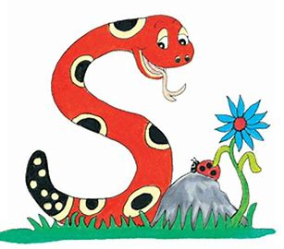
Jolly Grammar
4a-23

Slide 2
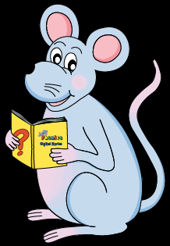
Present Participles
used as Adjectives

Slide 3
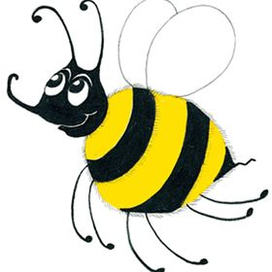
spelling test
spelling list
spelling book
spelling lesson
spelling sheet

Slide 4
How many syllables are there?
pattern

Slide 5
How many syllables are there?
pattern

Slide 6
Which syllable is stressed?
pattern

Slide 7
Which syllable is stressed?
pattern
stressed
unstressed

Slide 8
Which syllable is stressed?
pattern
< >
stressed
unstressed

Slide 9
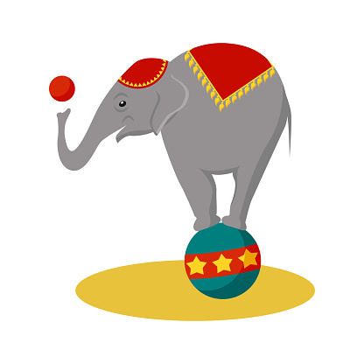
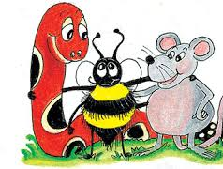
Activity Page: Schwa <er>

Slide 10
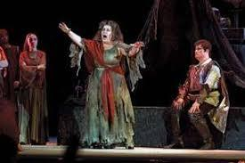
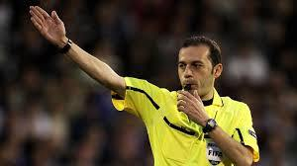
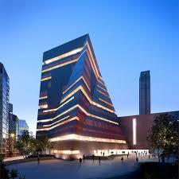
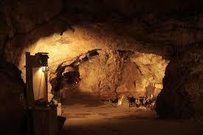
pattern referee opera
cavern modern manners

Slide 11
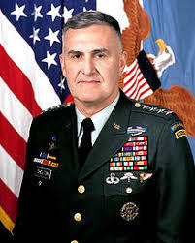
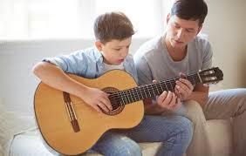
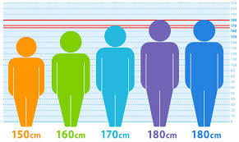
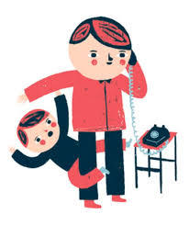
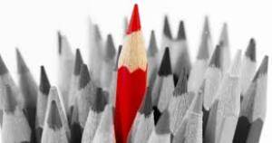
general interest average
weather different interrupt

Slide 12
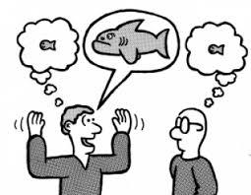
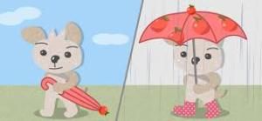
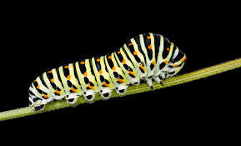
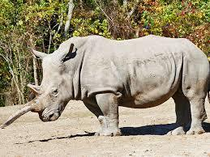
exaggerate whether caterpillar
desperate rhinoceros temperature

Slide 15
Unscramble the letters

Slide 16
referee whether pattern
caterpillar modern manners
weather general interrupt
different average interest
exaggerate cavern desperate
rhinoceros opera temperature

Slide 17
Write a different sentence

Slide 18
That is Leo’s hat!
“No way!” Mao said.
He loves only ice cream!
What did you say?
I bought potatoes, onions, carrots and eggplants.

Slide 19
Punctuation

Slide 20
“It is Anna’s turn to sing,” announced Miss Beach.
Grandma exclaimed, “That was beautiful!”
“Whose turn is it next?” enquired Seth.

Slide 21
parsing

Slide 22
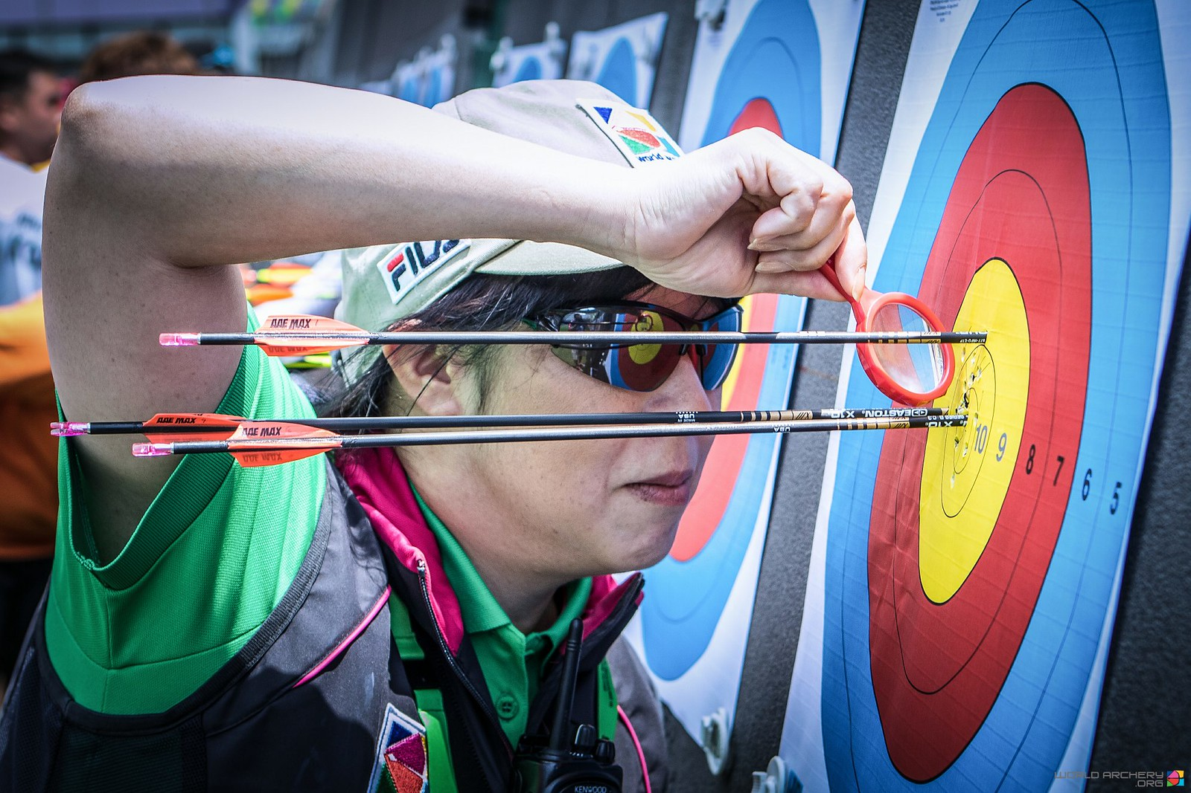
An expert archer will referee the archery competition.

Slide 23
An expert archer will referee the archery competition.

Slide 24
An expert archer will referee the archery competition.

Slide 25
An expert archer will referee the archery competition.

Slide 26
An expert archer will referee the archery competition.

Slide 27
An expert archer will referee the archery competition.

Slide 28
An expert archer will referee
the archery competition.→Simple Future

Slide 29
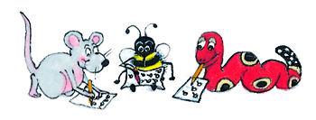
Dictation

Slide 30
Dictation
1.
2.
3.

Slide 31
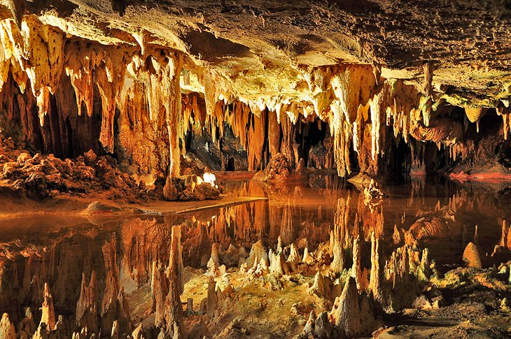

Slide 32
The author has a particular interest in caverns.

Slide 33
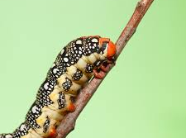
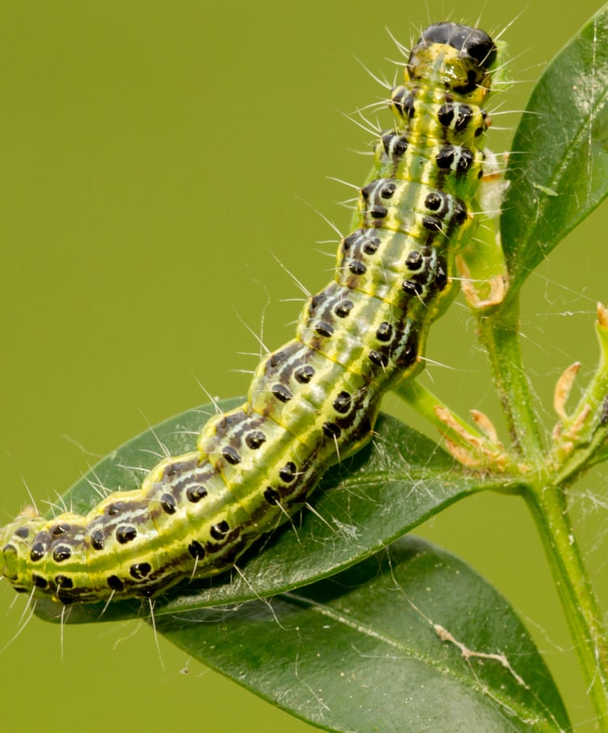

Slide 34
The two caterpillars had different patterns.

Slide 36
Be careful not to interrupt the lesson.

Slide 37
Thank you.
See you
next time!

