Slide 1
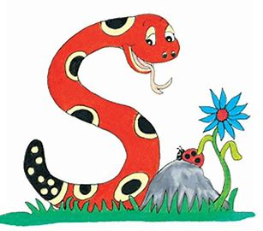
Jolly Grammar
4a-22

Slide 2
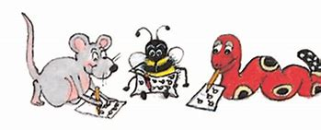
Spelling Test 11

Slide 3
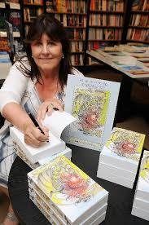
author

Slide 4
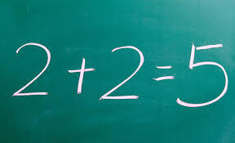
author
error

Slide 5
author
error
doctor

Slide 6
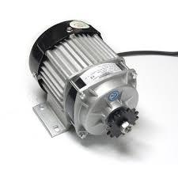
author
error
doctor
motor

Slide 7
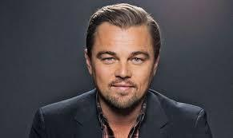
author
error
doctor
motor
actor

Slide 8
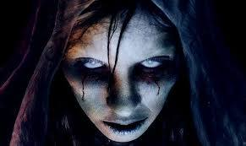
author
error
doctor
motor
actor
terror

Slide 9
author
error
doctor
motor
actor
terror
7.comfort

Slide 10
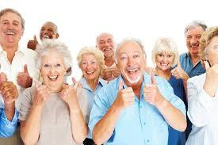
author
error
doctor
motor
actor
terror
7.comfort
8.senior

Slide 11
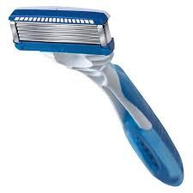
author
error
doctor
motor
actor
terror
7.comfort
8.senior
9.razor

Slide 12
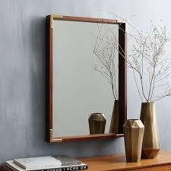
author
error
doctor
motor
actor
terror
7.comfort
8.senior
9.razor
10.mirror

Slide 13
author
error
doctor
motor
actor
terror
7.comfort
8.senior
9.razor
10.mirror
11.memory

Slide 14
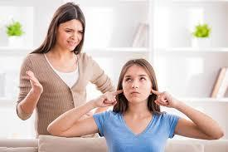
author
error
doctor
motor
actor
terror
7.comfort
8.senior
9.razor
10.mirror
11.memory
12.stubborn

Slide 15
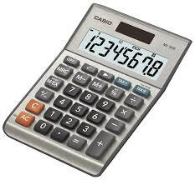
author
error
doctor
motor
actor
terror
7.comfort
8.senior
9.razor
10.mirror
11.memory
12.stubborn
13.calculator

Slide 16
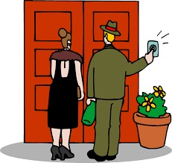
author
error
doctor
motor
actor
terror
7.comfort
8.senior
9.razor
10.mirror
11.memory
12.stubborn
13.calculator
14.visitor

Slide 17
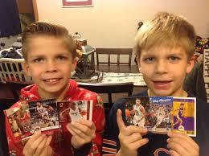
author
error
doctor
motor
actor
terror
7.comfort
8.senior
9.razor
10.mirror
11.memory
12.stubborn
13.calculator
14.visitor
15.collector

Slide 18
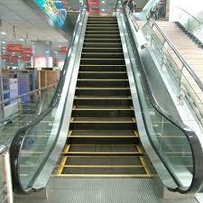
author
error
doctor
motor
actor
terror
7.comfort
8.senior
9.razor
10.mirror
11.memory
12.stubborn
13.calculator
14.visitor
15.collector
16.escalator

Slide 19
author
error
doctor
motor
actor
terror
7.comfort
8.senior
9.razor
10.mirror
11.memory
12.stubborn
13.calculator
14.visitor
15.collector
16.escalator
17.decoration

Slide 20
author
error
doctor
motor
actor
terror
7.comfort
8.senior
9.razor
10.mirror
11.memory
12.stubborn
13.calculator
14.visitor
15.collector
16.escalator
17.decoration
18.oppoturnity

Slide 21
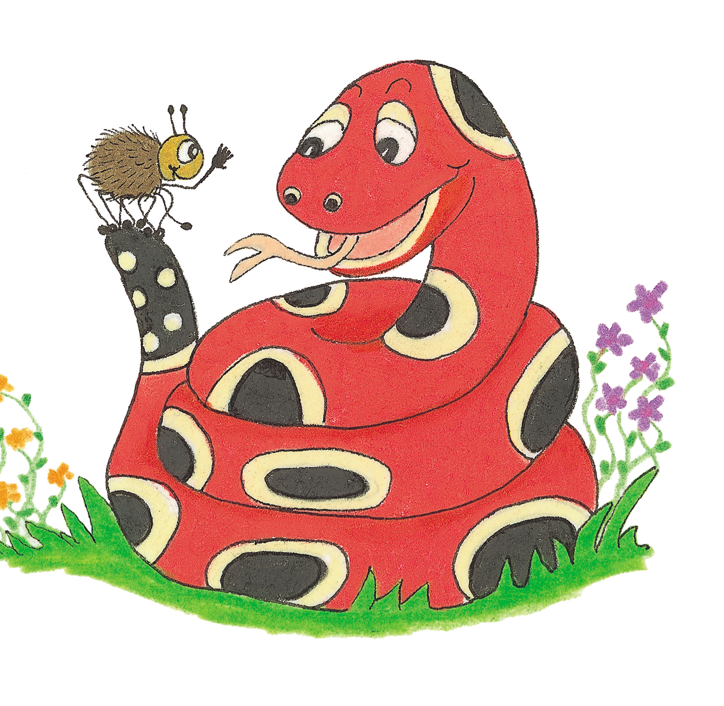
Let’s Revise Suffixes

Slide 22
She runs.
It flies.
She played music.
He was walking.

Slide 23
She runs.
It flies.
She played music.
He was walking.

Slide 24
He was walking.

Slide 25
He was walking.
(past) continuous

Slide 26
He was walking.
(past) continuous
The winding road

Slide 27
He was walking.
(past) continuous
The winding road
adjective

Slide 28
He was walking.
(past) continuous
The winding road
adjective
Dancing is fun.

Slide 29
He was walking.
(past) continuous
The winding road
adjective
Dancing is fun.
noun

Slide 30
The galloping horse raced across the field.

Slide 31
The galloping horse raced across the field.
Find the verb

Slide 32
The galloping horse raced across the field.

Slide 33
The galloping horse raced across the field.

Slide 34
spell

Slide 35
spelling

Slide 36
spelling test
spelling list
spelling book
spelling lesson
spelling sheet

Slide 37
spelling test
spelling list
spelling book
spelling lesson
spelling sheet

Slide 38
Present Participles
used as Adjectives
verb ＋ ing ＝ present participle

Slide 39
Present Participles
used as Adjectives
verb ＋ ing ＝ present participle
a barking dog

Slide 40
Activity Page:
Present Participles
Used as Adjectives

Slide 41
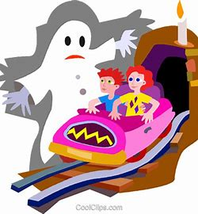
The screaming boy
ran out of the ghost train.

Slide 42
The screaming boy
ran out of the ghost train.

Slide 43
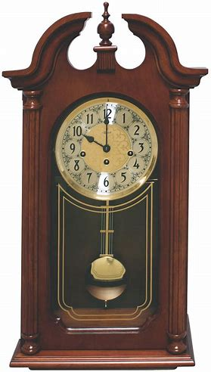
At night, the chiming
clock sounds very loud.

Slide 44
At night, the chiming
clock sounds very loud.

Slide 45
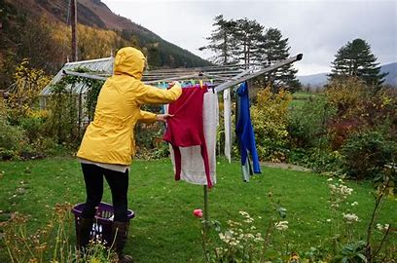
The drying clothes got
wet again in the rain.

Slide 46
The drying clothes got
wet again in the rain.

Slide 47
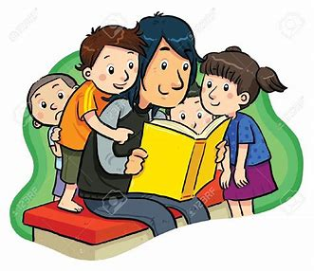
The storyteller knows
many amusing tales.

Slide 48
The storyteller knows
many amusing tales.

Slide 49
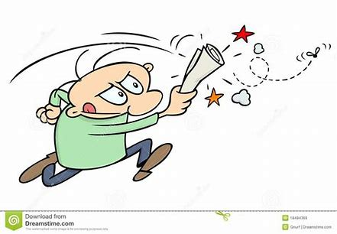
The irritating fly buzzed
around the room.

Slide 50
The irritating fly buzzed
around the room.

Slide 51
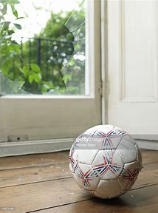
The bouncing ball went
through the open window.

Slide 52
The bouncing ball went
through the open window.

Slide 53
a collapsing

Slide 54
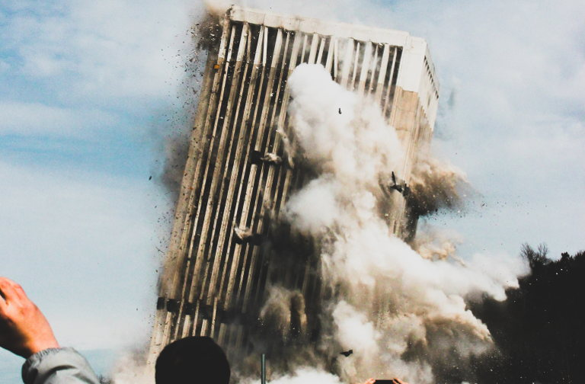
a collapsing building

Slide 55
a terrifying

Slide 56
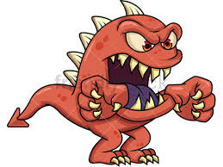
a terrifying monster

Slide 57
a sparkling

Slide 58
a sparkling stars

Slide 59
an interesting

Slide 60
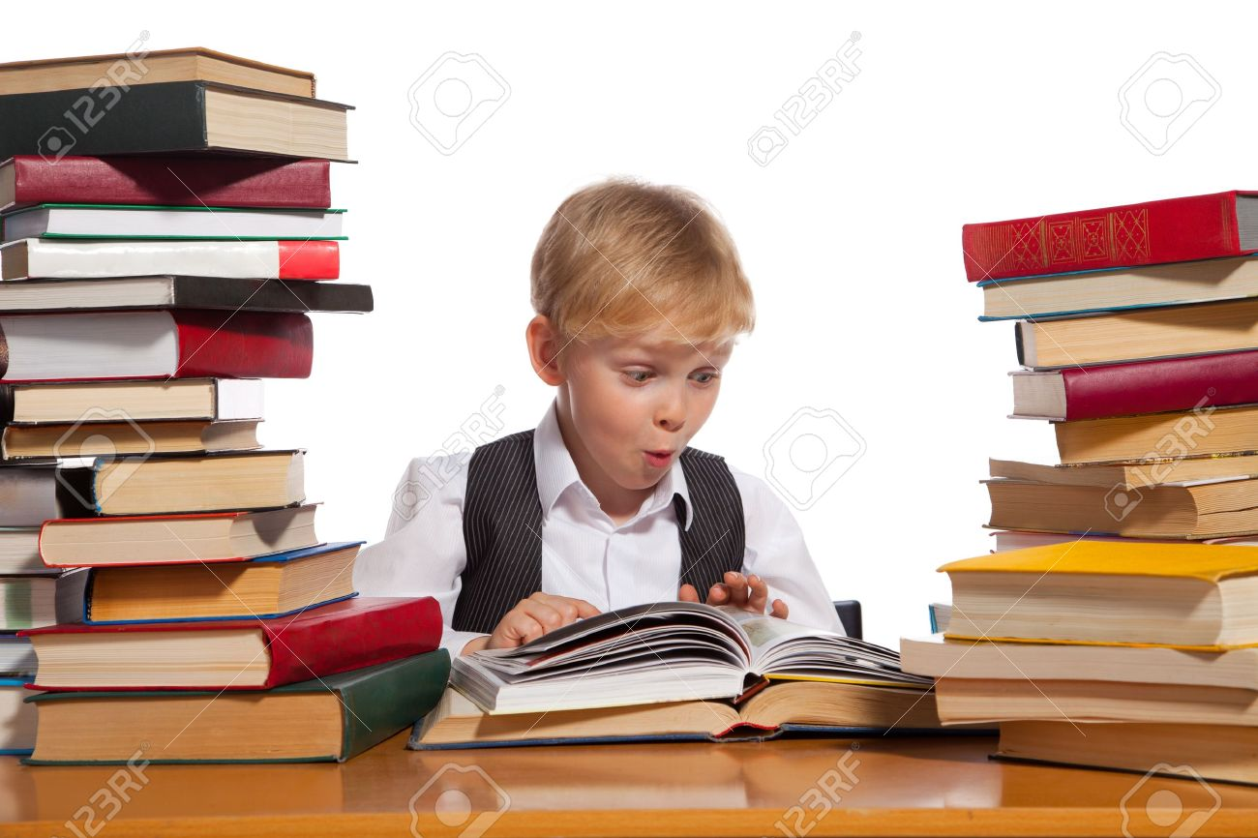
an interesting book

Slide 61
the racing

Slide 62
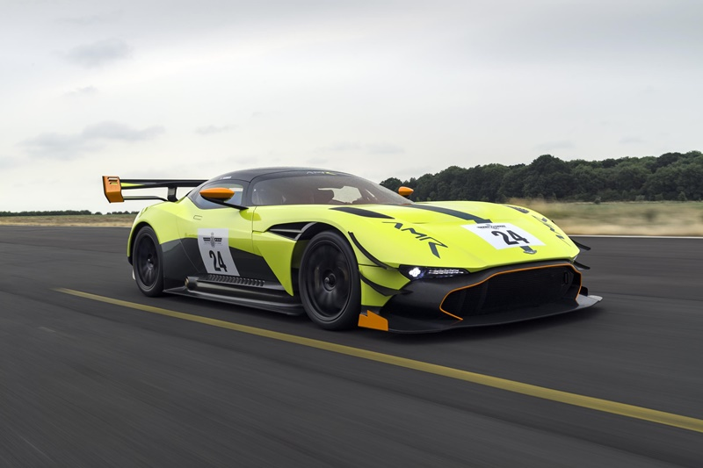
the racing car

Slide 63
a cheering

Slide 64
a cheering crowd

Slide 65
the boiling

Slide 66
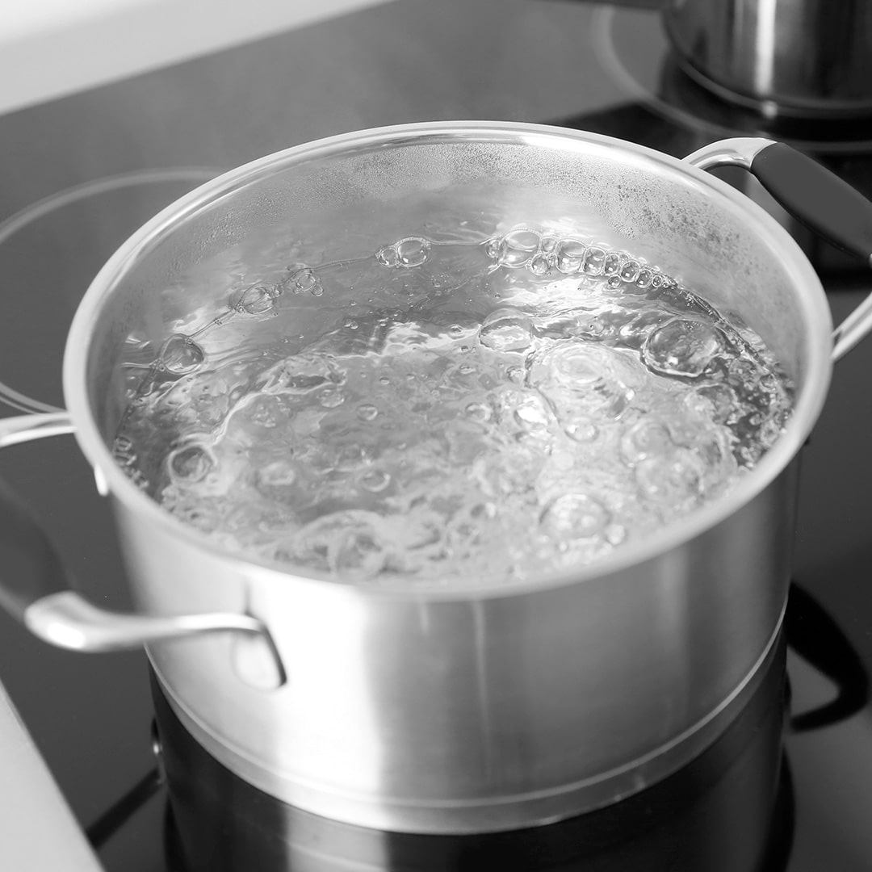
the boiling water

Slide 67
the melting

Slide 68
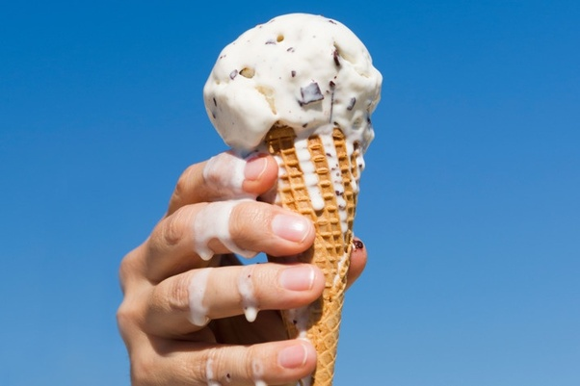
the melting ice cream

Slide 69
I saw a melting ice cream at the mall.
I found a collapsing town.
I found boiling water in the kitchen.
I saw racing caterpillars on a leaf.
I saw sparking stones in mountains.
I found a terrifying mosquito in India.
I found an interesting dictionary.
I found an interesting planet in space.
I eat a melting ice cream.

Slide 70
Thank you.
See you
next time!

