Slide 1
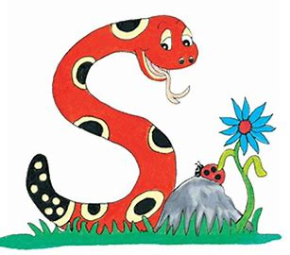
Jolly Grammar
4a-20

Slide 2
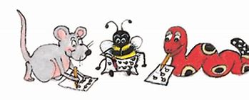
Spelling Test 10

Slide 3
grammar

Slide 4
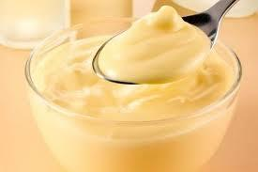
grammar
custard

Slide 5
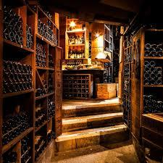
grammar
custard
cellar

Slide 6
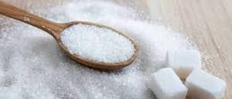
grammar
custard
cellar
sugar

Slide 7
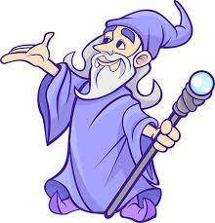
grammar
custard
cellar
sugar
wizard

Slide 8
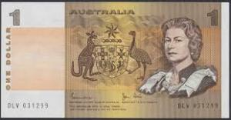
grammar
custard
cellar
sugar
wizard
dollar

Slide 9
grammar
custard
cellar
sugar
wizard
dollar
7.popular

Slide 10
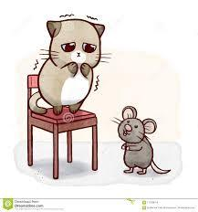
grammar
custard
cellar
sugar
wizard
dollar
7.popular
8.coward

Slide 11
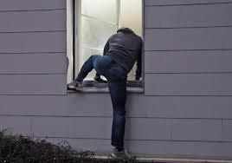
grammar
custard
cellar
sugar
wizard
dollar
7.popular
8.coward
9.burglar

Slide 12
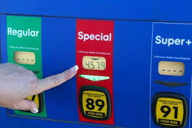
grammar
custard
cellar
sugar
wizard
dollar
7.popular
8.coward
9.burglar
10.regular

Slide 13
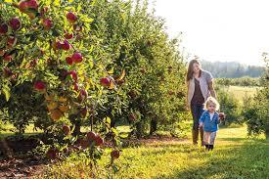
grammar
custard
cellar
sugar
wizard
dollar
7.popular
8.coward
9.burglar
10.regular
11.orchard

Slide 14
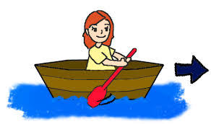
grammar
custard
cellar
sugar
wizard
dollar
7.popular
8.coward
9.burglar
10.regular
11.orchard
12.forward

Slide 15
grammar
custard
cellar
sugar
wizard
dollar
7.popular
8.coward
9.burglar
10.regular
11.orchard
12.forward
13.standard

Slide 16
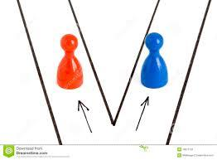
grammar
custard
cellar
sugar
wizard
dollar
7.popular
8.coward
9.burglar
10.regular
11.orchard
12.forward
13.standard
14.separate

Slide 17
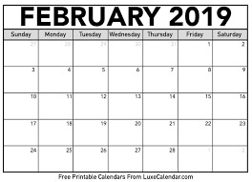
grammar
custard
cellar
sugar
wizard
dollar
7.popular
8.coward
9.burglar
10.regular
11.orchard
12.forward
13.standard
14.separate
15.calendar

Slide 18
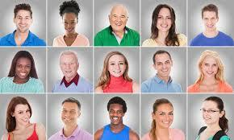
grammar
custard
cellar
sugar
wizard
dollar
7.popular
8.coward
9.burglar
10.regular
11.orchard
12.forward
13.standard
14.separate
15.calendar
16.familiar

Slide 19
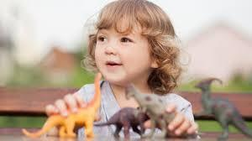
grammar
custard
cellar
sugar
wizard
dollar
7.popular
8.coward
9.burglar
10.regular
11.orchard
12.forward
13.standard
14.separate
15.calendar
16.familiar
17.particular

Slide 20
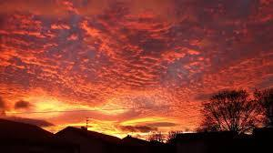
grammar
custard
cellar
sugar
wizard
dollar
7.popular
8.coward
9.burglar
10.regular
11.orchard
12.forward
13.standard
14.separate
15.calendar
16.familiar
17.particular
18.spectacular

Slide 21
Let’s Revise Punctuations

Slide 22
I love you.

Slide 23
I love you.
full stop

Slide 24
Do you love me?

Slide 25
Do you love me?
question mark

Slide 26
Stop it!

Slide 27
Stop it!
exclamation mark

Slide 28
I like apples, oranges,
peaches and strawberries.

Slide 29
I like apples, oranges,
peaches and strawberries.
commas

Slide 30
He said, “wait for me”.

Slide 31
He said, “wait for me”.
speech marks

Slide 32
It’s so hot today.

Slide 33
It’s so hot today.
apostrophe

Slide 34
Punctuation is important!

Slide 35
apostrophe
This is Yuto’s pencil.

Slide 36
apostrophe
This is Yuto’s pencil.
This is Reina’s eraser.

Slide 37
apostrophe
This is Yuto’s pencil.
This is Reina’s eraser.
This is Masayasu’s bag.

Slide 38
apostrophe
This is Yuto’s pencil.
This is Reina’s eraser.
This is Masayasu’s bag.
→ possessive nouns

Slide 39
I ate some of my cake.

Slide 40
I ate some of my cake.

Slide 41
I ate some of my cake.
possessive adjective

Slide 42
I ate some of my cake.

Slide 43
I ate some of Anna’s cake.

Slide 44
I ate some of Anna’s cake.
possessive noun
acting as an adjective

Slide 45
I ate some of Anna’s birthday cake.

Slide 46
I ate some of Anna’s birthday cake.

Slide 47
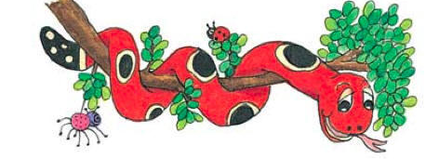
Activity Page: Possessive Nouns

Slide 48
The tail of a peacock is magnificent.
Find and underline nouns

Slide 49
The tail of a peacock is magnificent.
Rewrite it with a possessive noun

Slide 50
The tail of a peacock is magnificent.
Rewrite it with a possessive noun
A peacock’s tail is magnificent.

Slide 51
Everyone applauded the model’s outfit.

Slide 52
Everyone applauded the model’s outfit.
A genius’s ideas are usually brilliant.

Slide 53
Everyone applauded the model’s outfit.
A genius’s ideas are usually brilliant.
The crowd’s cheers were very loud.

Slide 54
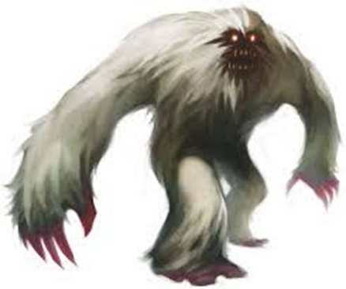
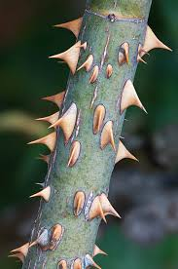
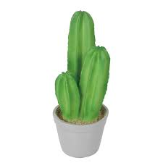
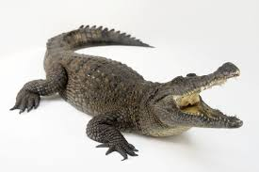

Slide 55
The cactus’s prickles were very sharp.

Slide 56
The cactus’s prickles were very sharp.
The pirate’s ship was huge and menacing.

Slide 57
The cactus’s prickles were very sharp.
The pirate’s ship was huge and menacing.
A crocodile’s teeth are large and strong.

Slide 58
The cactus’s prickles were very sharp.
The pirate’s ship was huge and menacing.
A crocodile’s teeth are large and strong.
They found traces of the abominable snowman’s footprints.

Slide 59
They came to collect me in Dad’s car.

Slide 60
They came to collect me in Dad’s car.

Slide 61
king’s army

Slide 62
king’s army
Meg’s house

Slide 63
king’s army
Meg’s house
horse’s mane

Slide 64
king’s army
Meg’s house
horse’s mane
van’s engine

Slide 65
king’s army
Meg’s house
horse’s mane
van’s engine
Seth’s party

Slide 66
Thank you.
See you
next time!

