Slide 1
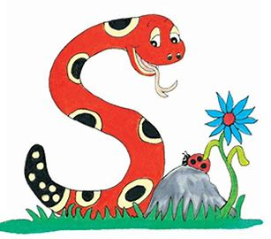
Jolly Grammar
4a-18

Slide 2
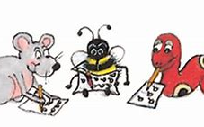
Spelling Test 9

Slide 3
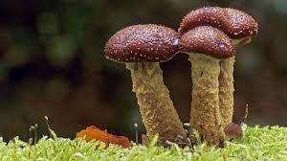
fungus

Slide 4
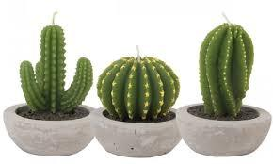
fungus
cactus

Slide 5
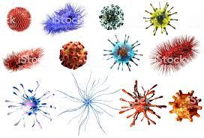
fungus
cactus
virus

Slide 6
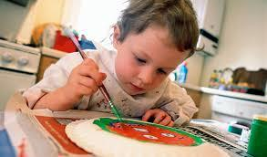
fungus
cactus
virus
focus

Slide 7
fungus
cactus
virus
focus
minus

Slide 8
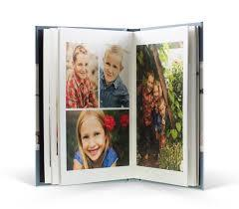
fungus
cactus
virus
focus
minus
album

Slide 9
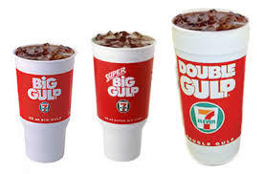
fungus
cactus
virus
focus
minus
album
7.medium

Slide 10
fungus
cactus
virus
focus
minus
album
7.medium
8.careful

Slide 11
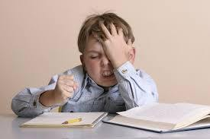
fungus
cactus
virus
focus
minus
album
7.medium
8.careful
9.difficult

Slide 12
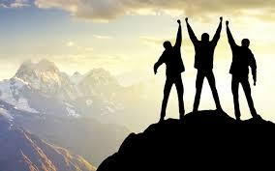
fungus
cactus
virus
focus
minus
album
7.medium
8.careful
9.difficult
10.success

Slide 13
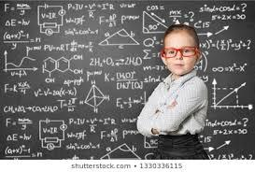
fungus
cactus
virus
focus
minus
album
7.medium
8.careful
9.difficult
10.success
11.genius

Slide 14
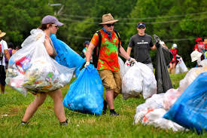
fungus
cactus
virus
focus
minus
album
7.medium
8.careful
9.difficult
10.success
11.genius
12.volunteer

Slide 15
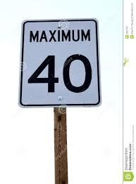
fungus
cactus
virus
focus
minus
album
7.medium
8.careful
9.difficult
10.success
11.genius
12.volunteer
13.maximum

Slide 16
fungus
cactus
virus
focus
minus
album
7.medium
8.careful
9.difficult
10.success
11.genius
12.volunteer
13.maximum
14.minimum

Slide 17
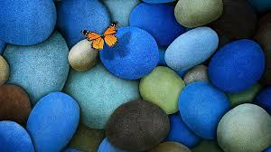
fungus
cactus
virus
focus
minus
album
7.medium
8.careful
9.difficult
10.success
11.genius
12.volunteer
13.maximum
14.minimum
15.beautiful

Slide 18
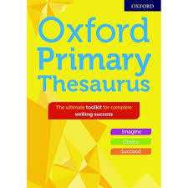
fungus
cactus
virus
focus
minus
album
7.medium
8.careful
9.difficult
10.success
11.genius
12.volunteer
13.maximum
14.minimum
15.beautiful
16.thesaurus

Slide 19
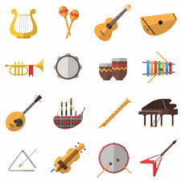
fungus
cactus
virus
focus
minus
album
7.medium
8.careful
9.difficult
10.success
11.genius
12.volunteer
13.maximum
14.minimum
15.beautiful
16.thesaurus
17.instrument

Slide 20
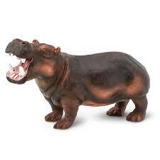
fungus
cactus
virus
focus
minus
album
7.medium
8.careful
9.difficult
10.success
11.genius
12.volunteer
13.maximum
14.minimum
15.beautiful
16.thesaurus
17.instrument
18.hippopotamus

Slide 21
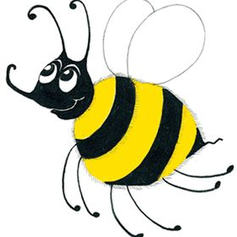
Let’s Revise Nouns

Slide 22
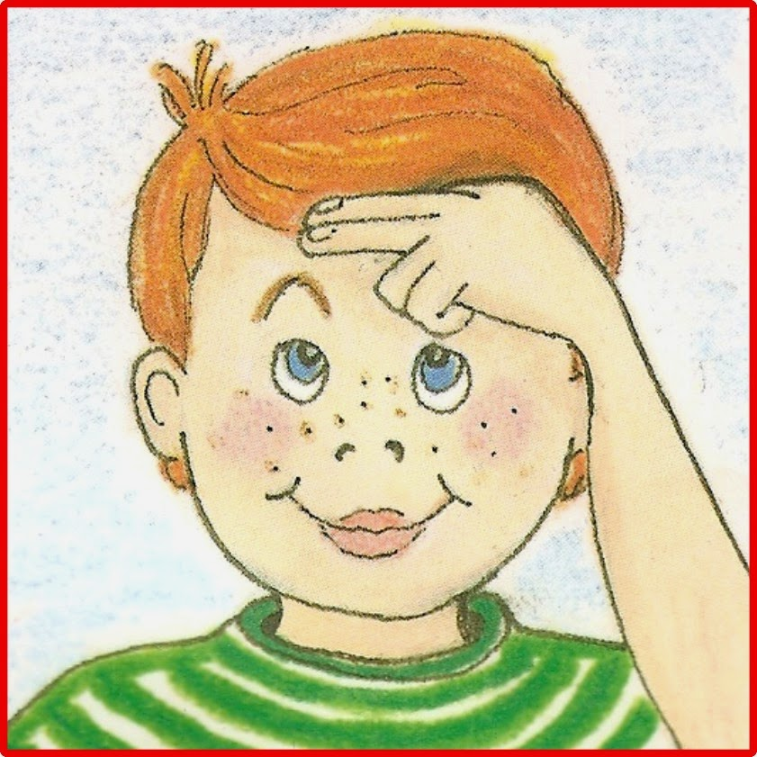
Nouns
Proper Nouns
Common Nouns

Slide 23
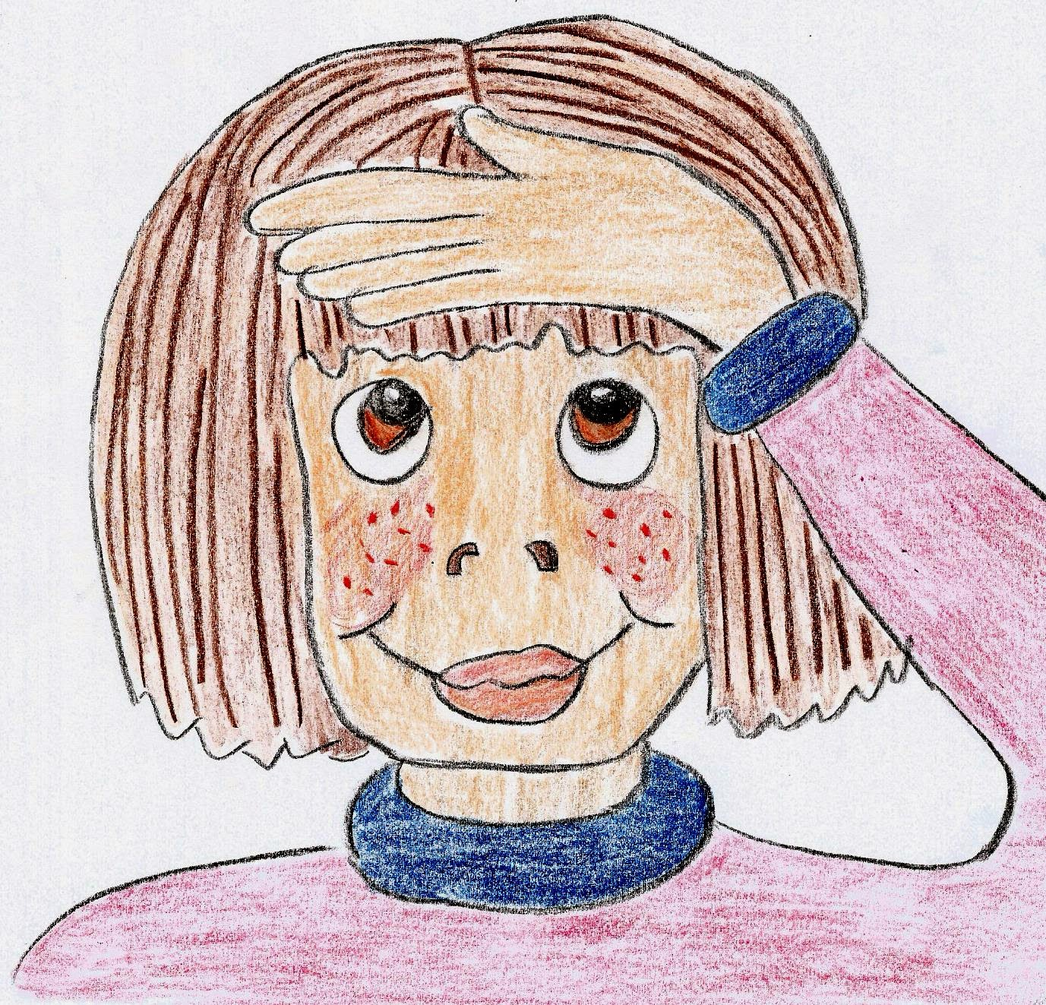
Nouns
Proper Nouns
Common Nouns
Monday
Jane
Tokyo
egg
classes
rain

Slide 24
Proper Noun? or Common Noun?
On Monday, Jane and Zack saw
a bird sitting on an egg in the nest.

Slide 25
Common Nouns
①concrete: photo, drum, flowers, ice
②collective: a class of children
a herd of cows
③abstract: love, trouble, friendship

Slide 26
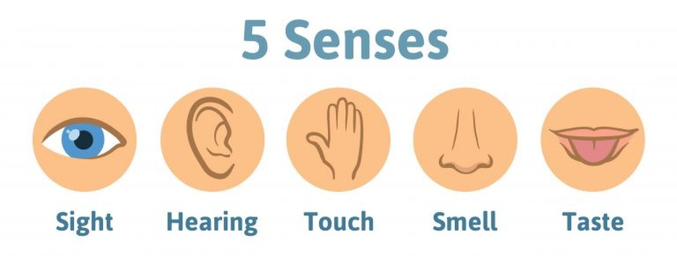
Concrete Nouns
tree
floor
chair
shoe
bed
bell
telephone
radio
bird
frog
silk
water
wool
ice
sand
smoke
perfume
rose
coffee
paint
sugar
vinegar
milk
mint
salt

Slide 27
Concrete Nouns

Slide 28
Common Nouns
①concrete: photo, drum, flowers, ice
②collective: a class of children
a herd of cows
③abstract: love, trouble, friendship

Slide 29
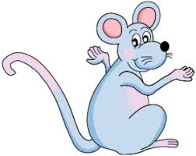
What is ‘abstract’?

Slide 30
What is ‘abstract’?
It exists in thought or as an idea, but is not a physical thing.

Slide 31
the boy’s dog
the boy’s love for his dog

Slide 32
the boy’s dog
the boy’s love for his dog
concrete noun

Slide 33
the boy’s dog
the boy’s love for his dog
concrete noun
abstract noun

Slide 34
abstract nouns

Slide 35
abstract nouns
The names for ideas, feelings, actions, qualities and events

Slide 36
abstract nouns
Example:
happiness sadness anger
amazement anxiety delight
envy excitement fear
hope surprise worry
beauty kindness bravery
confidence fairness intelligence
weakness peace war
freedom taste knowledge
romance hate government
ideas time adventure
weather

Slide 38
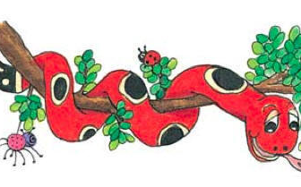
Activity Page: Abstract Nouns

Slide 39
“What is the time?” asked Bee.
The pain in his leg was getting worse.
We play on the beach when the tide is out.
It was a shock when the lion escaped at the zoo.
The children had and adventure on the island.

Slide 40
“What is the time?” asked Bee.
The pain in his leg was getting worse.
We play on the beach when the tide is out.
It was a shock when the lion escaped at the zoo.
The children had and adventure on the island.

Slide 41
“What is the time?” asked Bee.
The pain in his leg was getting worse.
We play on the beach when the tide is out.
It was a shock when the lion escaped at the zoo.
The children had and adventure on the island.

Slide 42
“What is the time?” asked Bee.
The pain in his leg was getting worse.
We play on the beach when the tide is out.
It was a shock when the lion escaped at the zoo.
The children had and adventure on the island.

Slide 43
“What is the time?” asked Bee.
The pain in his leg was getting worse.
We play on the beach when the tide is out.
It was a shock when the lion escaped at the zoo.
The children had an adventure on the island.

Slide 44
“What is the time?” asked Bee.
The pain in his leg was getting worse.
We play on the beach when the tide is out.
It was a shock when the lion escaped at the zoo.
The children had an adventure on the island.

Slide 45
Proper Nouns | Concrete Nouns | Abstract Nouns
 |  | idea

Slide 46
Proper Nouns | Concrete Nouns | Abstract Nouns
Carlos |  | idea
Africa
London
Wednesday
October
Canada

Slide 47
Proper Nouns | Concrete Nouns | Abstract Nouns
Carlos | table | idea
Africa | flute
London | carrot
Wednesday | rabbit
October | shoes
Canada | train

Slide 48
Proper Nouns | Concrete Nouns | Abstract Nouns
Carlos | table | idea
Africa | flute | knowledge
London | carrot | intelligence
Wednesday | rabbit | fear
October | shoes | hope
Canada | train | sadness

Slide 49
Thank you.
See you
next time!

