Slide 1
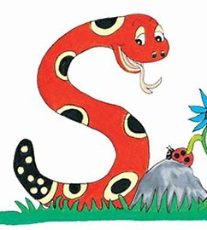
Jolly Grammar
4a-16

Slide 2
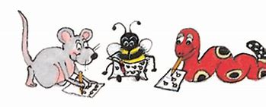
Spelling Test 8

Slide 3
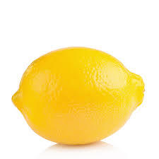
lemon

Slide 4
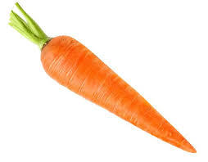
lemon
carrot

Slide 5
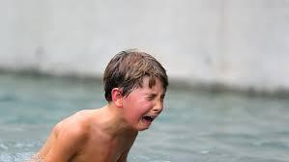
lemon
carrot
agony

Slide 6
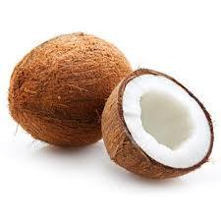
lemon
carrot
agony
coconut

Slide 7
lemon
carrot
agony
coconut
second

Slide 8
lemon
carrot
agony
coconut
second
purpose

Slide 9
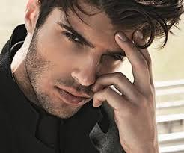
lemon
carrot
agony
coconut
second
purpose
7.handsome

Slide 10
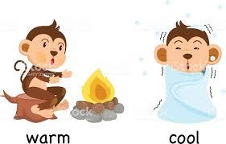
lemon
carrot
agony
coconut
second
purpose
7.handsome
8.opposite

Slide 11
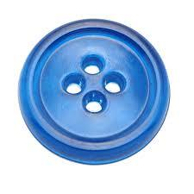
lemon
carrot
agony
coconut
second
purpose
7.handsome
8.opposite
9.button

Slide 12
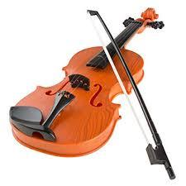
lemon
carrot
agony
coconut
second
purpose
7.handsome
8.opposite
9.button
10.violin

Slide 13
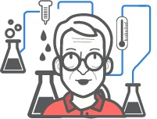
lemon
carrot
agony
coconut
second
purpose
7.handsome
8.opposite
9.button
10.violin
11.method

Slide 14
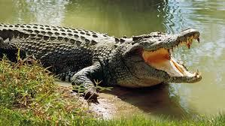
lemon
carrot
agony
coconut
second
purpose
7.handsome
8.opposite
9.button
10.violin
11.method
12.crocodile

Slide 15
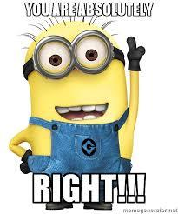
lemon
carrot
agony
coconut
second
purpose
7.handsome
8.opposite
9.button
10.violin
11.method
12.crocodile
13.absolutely

Slide 16
lemon
carrot
agony
coconut
second
purpose
7.handsome
8.opposite
9.button
10.violin
11.method
12.crocodile
13.absolutely
14.apostrophe

Slide 17
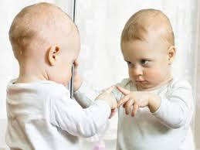
lemon
carrot
agony
coconut
second
purpose
7.handsome
8.opposite
9.button
10.violin
11.method
12.crocodile
13.absolutely
14.apostrophe
15.recognise

Slide 18
lemon
carrot
agony
coconut
second
purpose
7.handsome
8.opposite
9.button
10.violin
11.method
12.crocodile
13.absolutely
14.apostrophe
15.recognise
16.apology

Slide 19
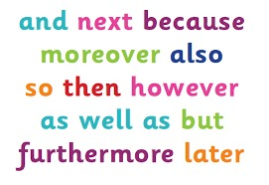
lemon
carrot
agony
coconut
second
purpose
7.handsome
8.opposite
9.button
10.violin
11.method
12.crocodile
13.absolutely
14.apostrophe
15.recognise
16.apology
17.conjunction

Slide 20
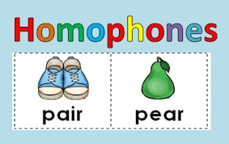
lemon
carrot
agony
coconut
second
purpose
7.handsome
8.opposite
9.button
10.violin
11.method
12.crocodile
13.absolutely
14.apostrophe
15.recognise
16.apology
17.conjunction
18.homophone
.

Slide 21
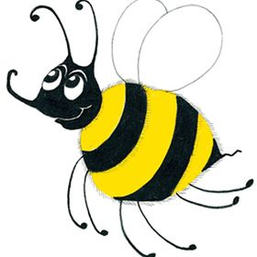
Let’s Revise Nouns

Slide 22
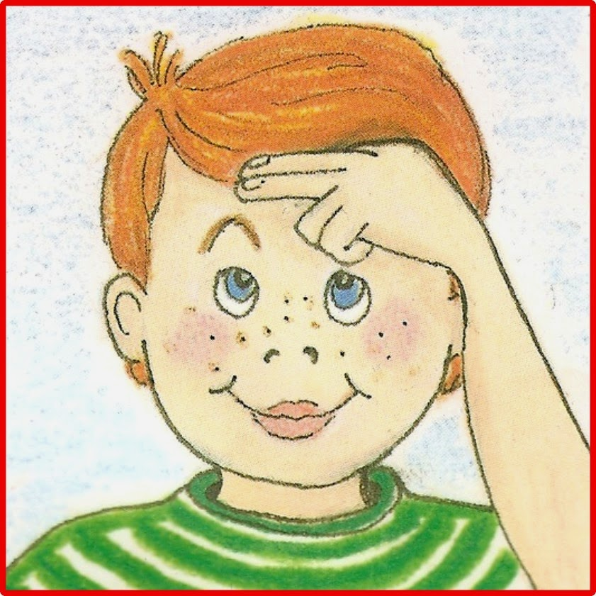
Nouns
Proper Nouns
Common Nouns

Slide 23
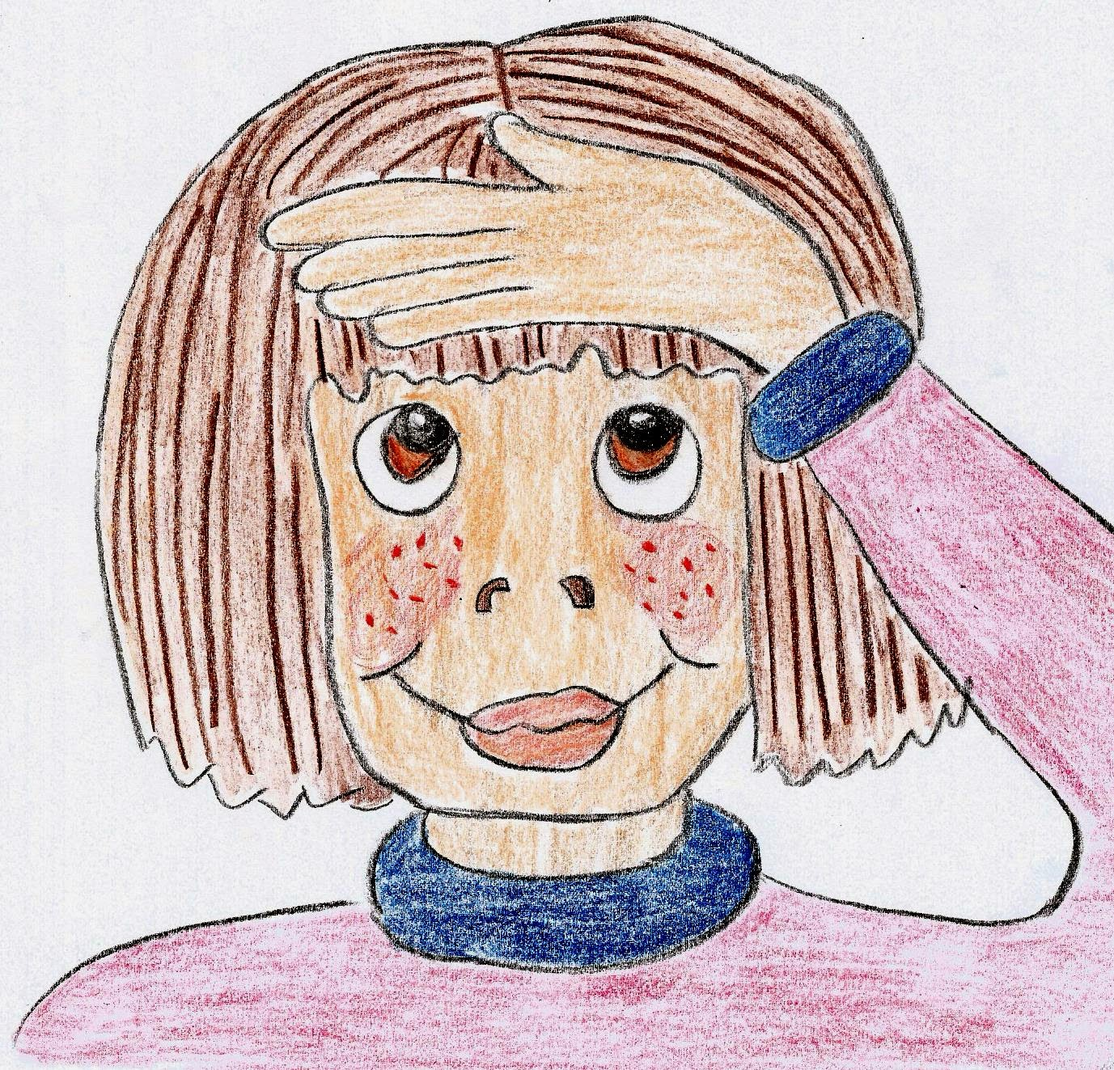
Nouns
Proper Nouns
Common Nouns
Monday
Jane
Tokyo
egg
classes
rain

Slide 24
Proper Noun?
Or
Common Noun?

Slide 25
Proper Noun? or Common Noun?
On Monday, Jane and Zack saw
a bird sitting on an egg in the nest.

Slide 26
Nouns
Proper Nouns
Common Nouns
Monday
Jane
Tokyo
egg
classes
rain

Slide 27
Common Nouns
①concrete: photo, drum, flowers, ice
②collective: a class of children
a herd of cows
③abstract: love, trouble, friendship

Slide 28
Common Nouns
①concrete: photo, drum, flowers, ice
②collective: a class of children
a herd of cows
③abstract: love, trouble, friendship

Slide 29
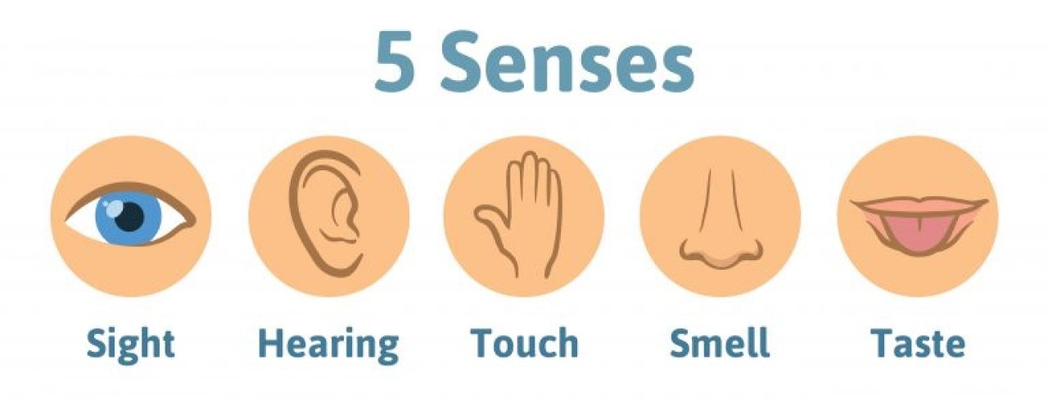
Concrete Nouns

Slide 30
Concrete Nouns
tree
floor
chair
shoe
bed

Slide 31
Concrete Nouns
tree
floor
chair
shoe
bed
bell
telephone
radio
bird
frog

Slide 32
Concrete Nouns
tree
floor
chair
shoe
bed
bell
telephone
radio
bird
frog
silk
water
wool
ice
sand

Slide 33
Concrete Nouns
tree
floor
chair
shoe
bed
bell
telephone
radio
bird
frog
silk
water
wool
ice
sand
smoke
perfume
rose
coffee
paint

Slide 34
Concrete Nouns
tree
floor
chair
shoe
bed
bell
telephone
radio
bird
frog
silk
water
wool
ice
sand
smoke
perfume
rose
coffee
paint
sugar
vinegar
milk
mint
salt

Slide 35
Concrete Nouns

Slide 36
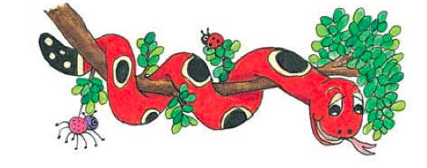
Activity Page: Concrete Nouns

Slide 37
Thank you.
See you
next time!

