Slide 1
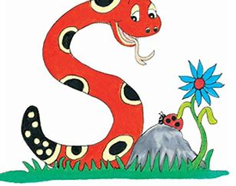
Jolly Grammar
4a-13

Slide 2
Let’s revise Plural Nouns in sentences

Slide 3
The policeman chased a thief.
“Come and play,” said the boy.
I had a sandwich at lunchtime.
She picked a strawberry in the garden.

Slide 4
The policeman chased a thief.
thieves
“Come and play,” said the boy.
I had a sandwich at lunchtime.
She picked a strawberry in the garden.

Slide 5
The policeman chased a thief.
thieves
“Come and play,” said the boy.
boys
I had a sandwich at lunchtime.
She picked a strawberry in the garden.

Slide 6
The policeman chased a thief.
thieves
“Come and play,” said the boy.
boys
I had a sandwich at lunchtime.
sandwiches
She picked a strawberry in the garden.

Slide 7
The policeman chased a thief.
thieves
“Come and play,” said the boy.
boys
I had a sandwich at lunchtime.
sandwiches
She picked a strawberry in the garden.
strawberries

Slide 8
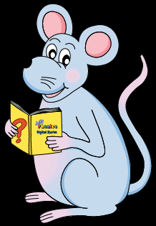
Schwa <a>

Slide 9
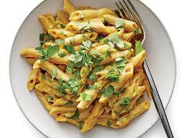
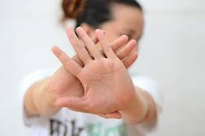
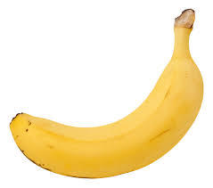
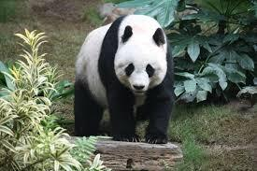
pasta avoid banana
panda comma hexagon

Slide 10
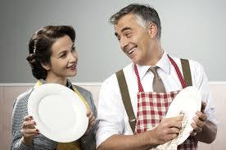
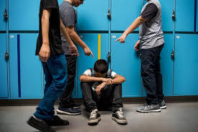
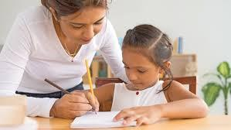
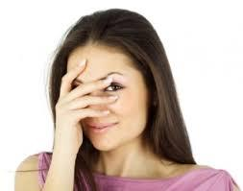
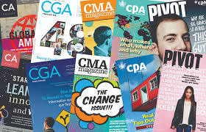
anagram husband harass
private magazine embarrass

Slide 11
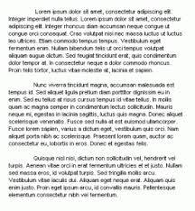
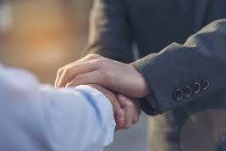
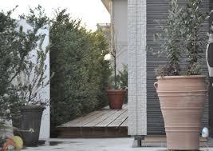
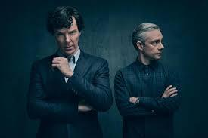
exclamation paragraph guarantee
entrance abominable announcement

Slide 13
syllables

Slide 14
hex/a/gon
pan/da
har/ass
mag/a/zine
a/bom/i/na/ble
par/a/graph
ba/na/na
pas/ta
pri/vate
em/bar/rass
en/trance
guar/an/tee
com/ma
a/void
hus/band
an/a/gram
ex/cla/ma/tion
an/nounce/ment

Slide 15
anagrams

Slide 16
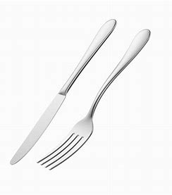
pasta

Slide 17
pasta anchovy

Slide 18
pasta anchovy loaves

Slide 19
pasta anchovy loaves cheese

Slide 20
pasta anchovy loaves cheese
banana

Slide 21
pasta anchovy loaves cheese
banana steak

Slide 22
pasta anchovy loaves cheese
banana steak potato

Slide 23
pasta anchovy loaves cheese
banana steak potato cucumber

Slide 24
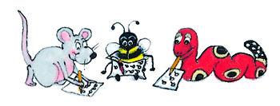
Complete the sentences

Slide 25
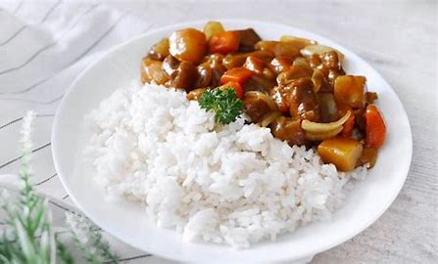
My favorite foods are

Slide 26
My favorite foods are
pizza, salad, meatballs,
udon noodles and curry.

Slide 27
My favorite foods are
soy sauce, French fries, fried chicken and spaghetti.

Slide 28
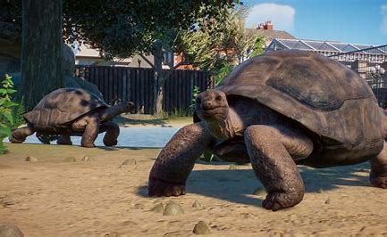
At the zoo I saw

Slide 29
At the zoo I saw
elephants, goats, tortoises,
zebras, monkeys and donkeys.

Slide 30
Parsing

Slide 31
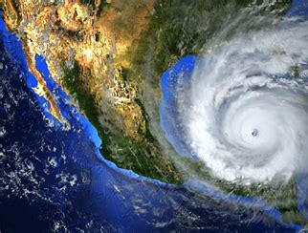
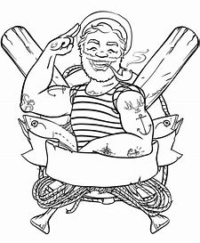
The abominable pirate successfully avoided the hurricane.

Slide 32
The abominable pirate successfully avoided the hurricane.

Slide 33
The abominable pirate successfully avoided the hurricane.

Slide 34
The abominable pirate successfully avoided the hurricane.

Slide 35
The abominable pirate successfully avoided the hurricane.

Slide 36
The abominable pirate successfully avoided the hurricane.

Slide 37
Dictation

Slide 38
Dictation
1.
2.
3.

Slide 39
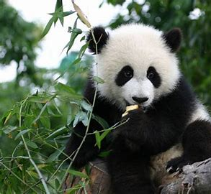

Slide 40
A panda is a black and white animal.

Slide 41
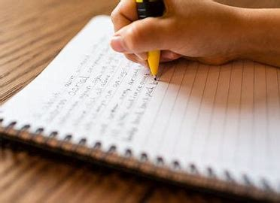

Slide 42
I am writing a paragraph about the magazine.

Slide 44
A hexagon is a shape with six sides.

Slide 45
Thank you!

