Slide 1
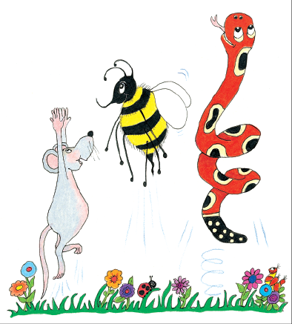
Jolly Grammar
4a-10

Slide 2
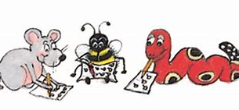
Spelling Test 5

Slide 3
twelve

Slide 4
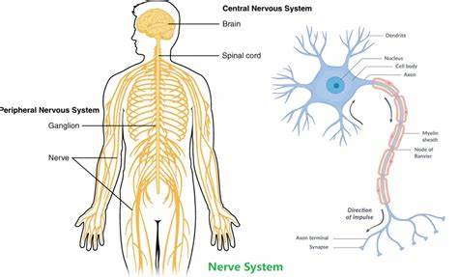
twelve
nerve

Slide 5
twelve
nerve
solve

Slide 6
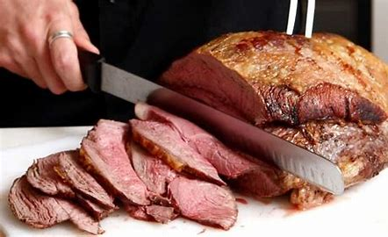
twelve
nerve
solve
calve

Slide 7
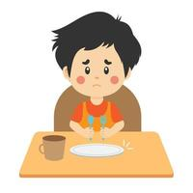
twelve
nerve
solve
calve
starve

Slide 8
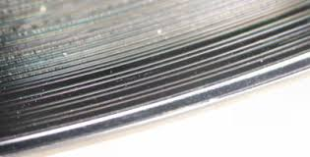
twelve
nerve
solve
calve
starve
groove

Slide 9
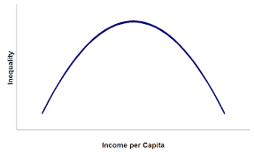
twelve
nerve
solve
calve
starve
groove
7.curve

Slide 10
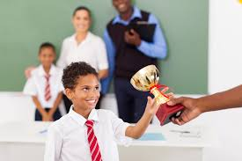
twelve
nerve
solve
calve
starve
groove
7.curve
8.diserve

Slide 11
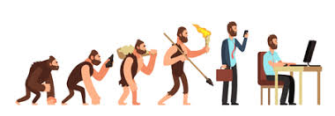
twelve
nerve
solve
calve
starve
groove
7.curve
8.diserve
9.evolve

Slide 12
twelve
nerve
solve
calve
starve
groove
7.curve
8.diserve
9.evolve
10.invove

Slide 13
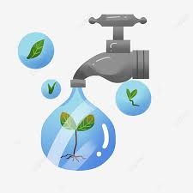
twelve
nerve
solve
calve
starve
groove
7.curve
8.diserve
9.evolve
10.invove
11.conserve

Slide 14
twelve
nerve
solve
calve
starve
groove
7.curve
8.diserve
9.evolve
10.invove
11.conserve
12.mauve

Slide 15
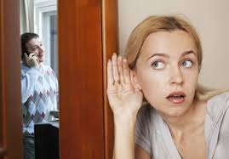
twelve
nerve
solve
calve
starve
groove
7.curve
8.diserve
9.evolve
10.invove
11.conserve
12.mauve
13.eavesdrop

Slide 16
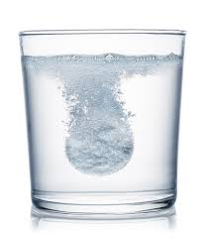
twelve
nerve
solve
calve
starve
groove
7.curve
8.diserve
9.evolve
10.invove
11.conserve
12.mauve
13.eavesdrop
14.dissolve

Slide 17
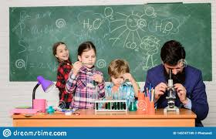
twelve
nerve
solve
calve
starve
groove
7.curve
8.diserve
9.evolve
10.invove
11.conserve
12.mauve
13.eavesdrop
14.dissolve
15.observe

Slide 18
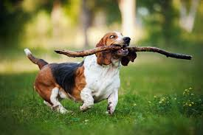
twelve
nerve
solve
calve
starve
groove
7.curve
8.diserve
9.evolve
10.invove
11.conserve
12.mauve
13.eavesdrop
14.dissolve
15.observe
16.retrieve

Slide 19
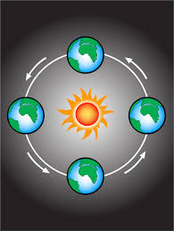
twelve
nerve
solve
calve
starve
groove
7.curve
8.diserve
9.evolve
10.invove
11.conserve
12.mauve
13.eavesdrop
14.dissolve
15.observe
16.retrieve
17.revolve

Slide 20
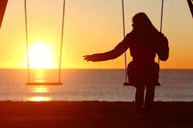
twelve
nerve
solve
calve
starve
groove
7.curve
8.diserve
9.evolve
10.invove
11.conserve
12.mauve
13.eavesdrop
14.dissolve
15.observe
16.retrieve
17.revolve
18.bereavement

Slide 21
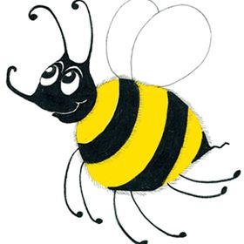
Let’s revise thesauruses.

Slide 22
The aquarium has a big fish.

Slide 23
Let’s work on activity page.

