Slide 1
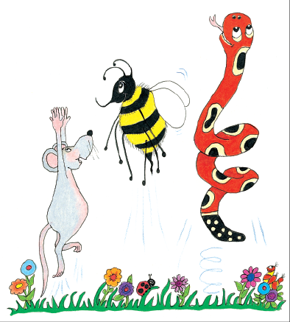
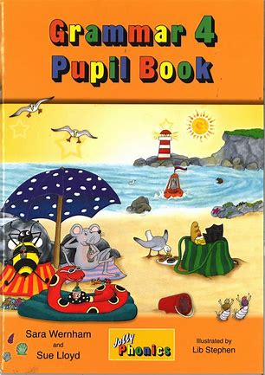
Jolly Grammar
4a-9

Slide 2
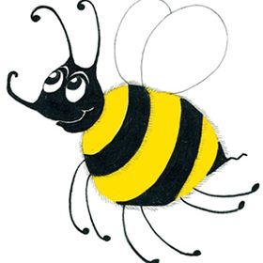
Spelling
<ve>
saying /v/

Slide 3
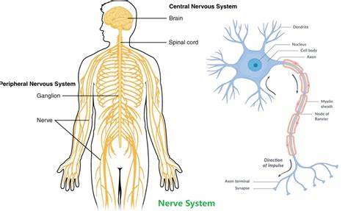
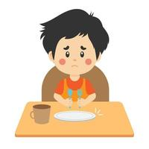
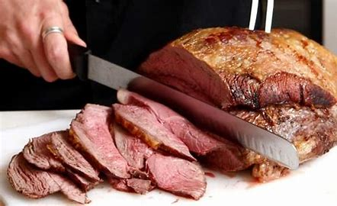
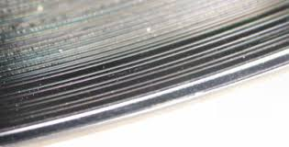
twelve nerve solve
carve starve groove

Slide 4
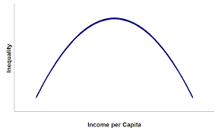
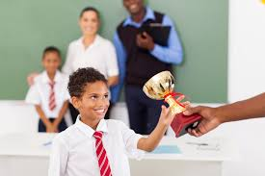
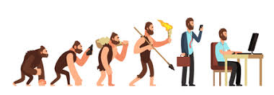
curve deserve evolve
involve conserve mauve

Slide 5
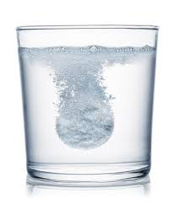
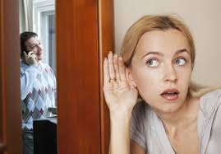
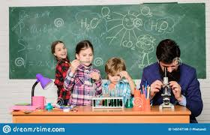
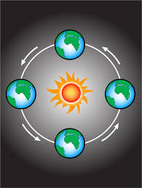
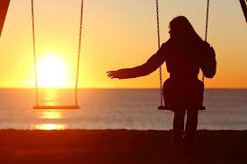
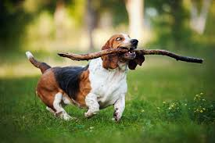
eavesdrop dissolve observe
retrieve revolve bereavement

Slide 8
Which words from the spelling list complete the sentences?

Slide 9
Add the correct punctuation.

Slide 10
parsing

Slide 11
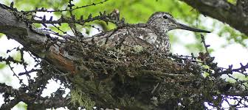
The rare bird was nesting quietly in the conservation area.

Slide 12
The rare bird was nesting quietly in the conservation area.

Slide 13
The rare bird was nesting quietly in the conservation area.

Slide 14
The rare bird was nesting quietly in the conservation area.

Slide 15
The rare bird was nesting quietly in the conservation area.

Slide 16
The rare bird was nesting quietly in the conservation area.

Slide 17
The rare bird was nesting quietly in the conservation area.

Slide 18
The rare bird was nesting quietly in the conservation area.

Slide 19
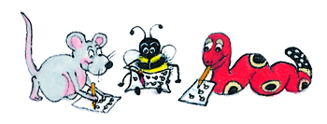
Dictation

Slide 20
Dictation
1.
2.
3.

Slide 21
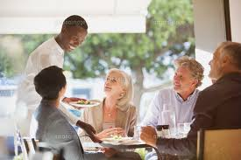

Slide 22
The waiter is serving twelve people.

Slide 24
The chef carves the joint of beef.

Slide 25
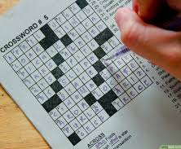

Slide 26
They solved the clues for the crossword.

