Slide 1
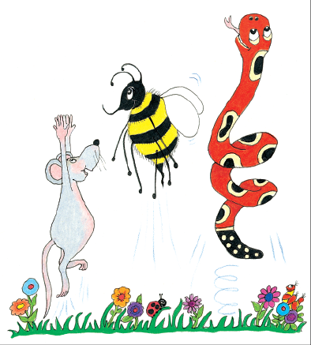
Jolly Grammar
4a-8

Slide 2
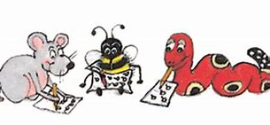
Spelling Test 4

Slide 3
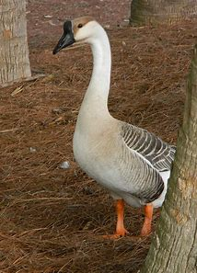
goose

Slide 4
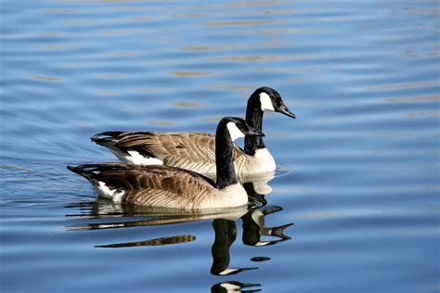
goose
geese

Slide 5
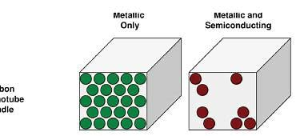
goose
geese
sparse

Slide 6
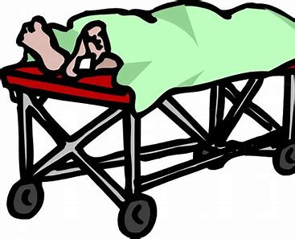
goose
geese
sparse
corpse

Slide 7
goose
geese
sparse
corpse
dense

Slide 8
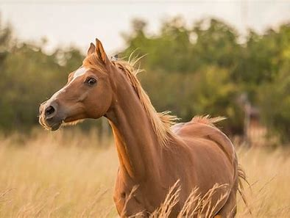
goose
geese
sparse
corpse
dense
horse

Slide 9
goose
geese
sparse
corpse
dense
horse
7.increase

Slide 10
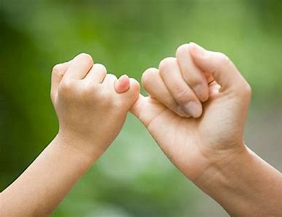
goose
geese
sparse
corpse
dense
horse
7.increase
8.promise

Slide 11
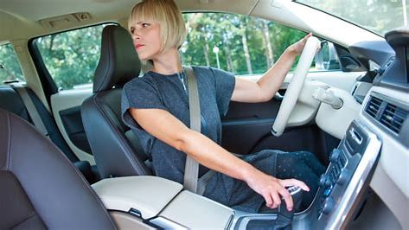
goose
geese
sparse
corpse
dense
horse
7.increase
8.promise
9.reverse

Slide 12
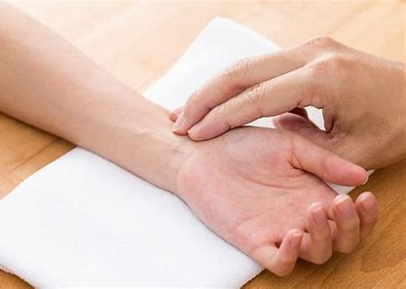
goose
geese
sparse
corpse
dense
horse
7.increase
8.promise
9.reverse
10.pulse

Slide 13
goose
geese
sparse
corpse
dense
horse
7.increase
8.promise
9.reverse
10.pulse
11.cease

Slide 14
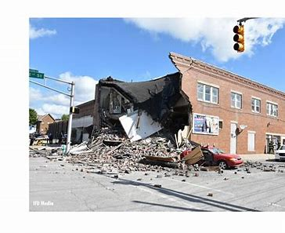
goose
geese
sparse
corpse
dense
horse
7.increase
8.promise
9.reverse
10.pulse
11.cease
12.collapse

Slide 15
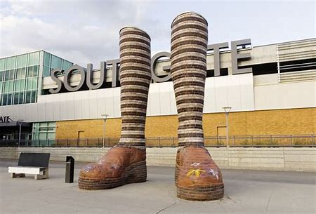
goose
geese
sparse
corpse
dense
horse
7.increase
8.promise
9.reverse
10.pulse
11.cease
12.collapse
13.immense

Slide 16
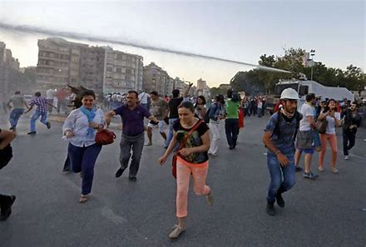
goose
geese
sparse
corpse
dense
horse
7.increase
8.promise
9.reverse
10.pulse
11.cease
12.collapse
13.immense
14.disperse

Slide 17
goose
geese
sparse
corpse
dense
horse
7.increase
8.promise
9.reverse
10.pulse
11.cease
12.collapse
13.immense
14.disperse
15.converse

Slide 18
goose
geese
sparse
corpse
dense
horse
7.increase
8.promise
9.reverse
10.pulse
11.cease
12.collapse
13.immense
14.disperse
15.converse
16.suspense

Slide 19
goose
geese
sparse
corpse
dense
horse
7.increase
8.promise
9.reverse
10.pulse
11.cease
12.collapse
13.immense
14.disperse
15.converse
16.suspense
17.nonsense

Slide 20
goose
geese
sparse
corpse
dense
horse
7.increase
8.promise
9.reverse
10.pulse
11.cease
12.collapse
13.immense
14.disperse
15.converse
16.suspense
17.nonsense
18.lighthouse

Slide 21
Let’s revise possessive adjectives.

Slide 22
my
your
his/her/its
our
your
their
book

Slide 23
Let’s revise contractions.

Slide 24
my
your
his/her/its
our
your
their
book
I am
You are
He/she/it is
We are
You are
They are

Slide 25
my
your
his/her/its
our
your
their
book
I am
You are
He/she/it is
We are
You are
They are
I’m
You’re
He’s
We’re
You’re
They’re

Slide 26
my
your
his/her/its
our
your
their
book
I am
You are
He/she/it is
We are
You are
They are
I’m
You’re
He’s
We’re
You’re
They’re

Slide 27
my
your
his/her/its
our
your
their
book
I am
You are
He/she/it is
We are
You are
They are
I’m
You’re
He’s
We’re
You’re
They’re

Slide 28
my
your
his/her/its
our
your
their
book
I am
You are
He/she/it is
We are
You are
They are
I’m
You’re
He’s
We’re
You’re
They’re
there

Slide 29
my
your
his/her/its
our
your
their
book
I am
You are
He/she/it is
We are
You are
They are
I’m
You’re
He’s
We’re
You’re
They’re

Slide 30
Let’s work
in pairs.

Slide 31
This is our house.
Their house is nearby.
There is our house.
The house is over there.
Where is your hat?
You’re coming to the party, aren’t you?
We lost our way in the fog.
They’re my parents.
Look over there.
You’re not so short.

