Slide 1
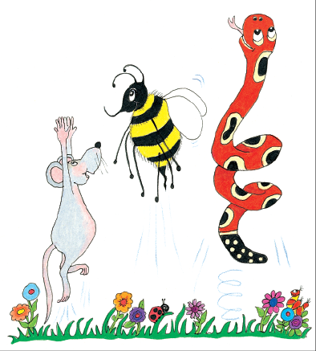
Jolly Grammar
4a-7

Slide 2
Review
The snake eats eggs.

Slide 3
Review
The snake eats eggs.

Slide 4
Review
S
The snake eats eggs.

Slide 5
Review
S
The snake eats eggs.
O

Slide 6
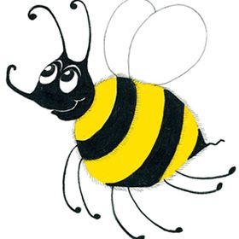
Spelling
<se>
saying /s/

Slide 7
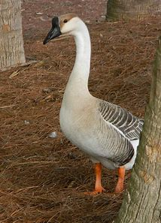
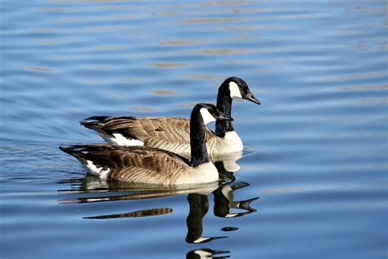
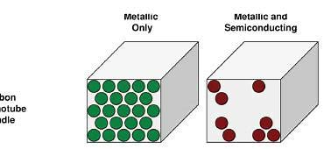
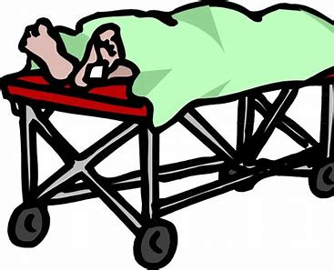
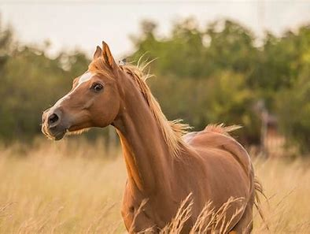
goose geese sparse
corpse dense horse

Slide 8
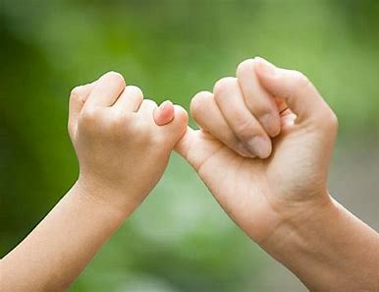
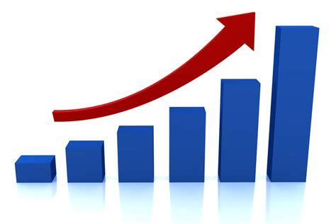
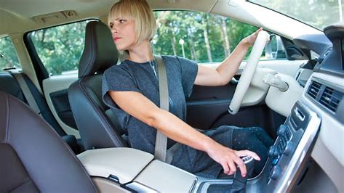
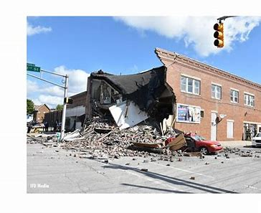
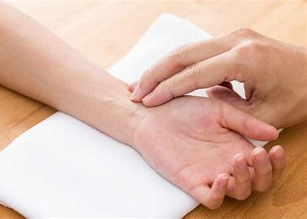
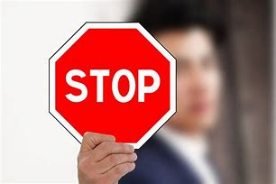
increase promise reverse
pulse cease collapse

Slide 9
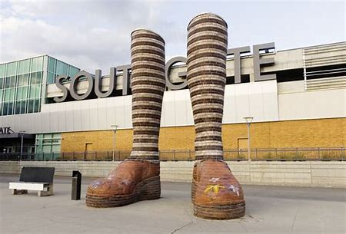
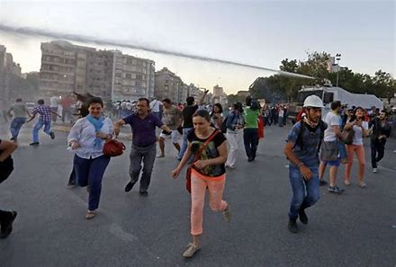
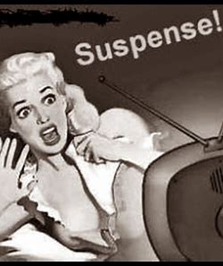
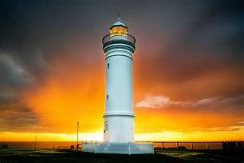
immense disperse converse
suspense nonsense lighthouse

Slide 11
Synonyms

Slide 12
converse
fun

Slide 13
parsing

Slide 14
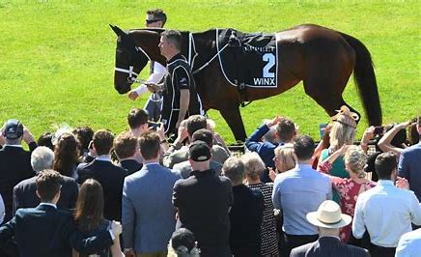
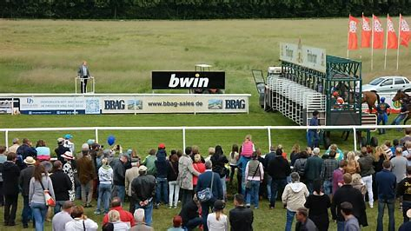
The dense crowd will be dispersing after the horse race.

Slide 15
The dense crowd will be dispersing after the horse race.

Slide 16
The dense crowd will be dispersing after the horse race.

Slide 17
The dense crowd will be dispersing after the horse race.

Slide 18
The dense crowd will be dispersing after the horse race.

Slide 19
The dense crowd will be dispersing after the horse race.

Slide 20
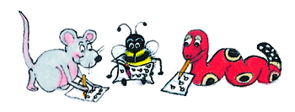
Dictation

Slide 21
Dictation
1.
2.
3.

Slide 22
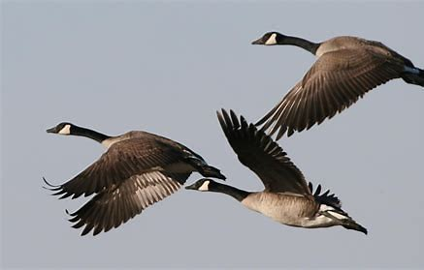

Slide 23
The geese were flying north.

Slide 24
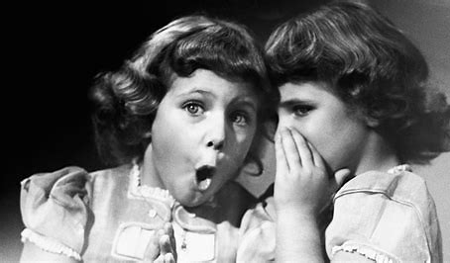

Slide 25
“The lighthouse looks immense,”
whispered Sue.

Slide 26
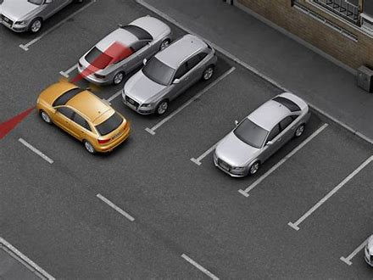

Slide 27
Can you reverse the car into the parking space?

